Slide 1
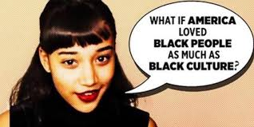
Cultural Appropriation
Anique Frazier

Slide 2
Bio
Hello, my name is Anique Frazier and I am a junior at Francis Marion University. I am apart of this website to ask the question Do you feel that Cultural Appropriation is happening more towards Black Cultural than any other cultural trends? The reason I ask this question is that I see a lot of trends from the 1990s coming back and mostly see a lot of it comes from the trends that are adopted from black culture.

Slide 3
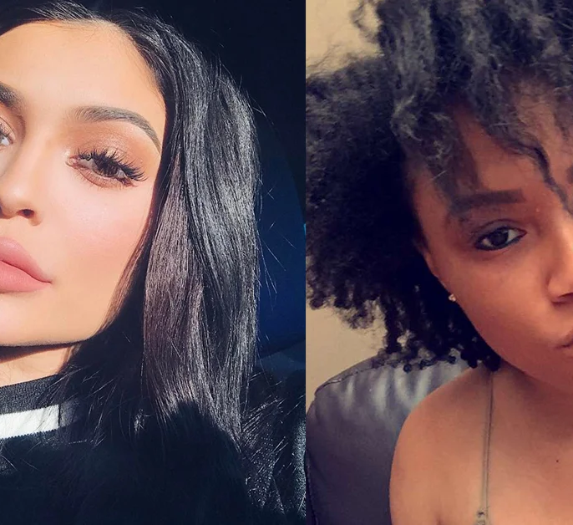
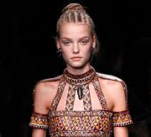
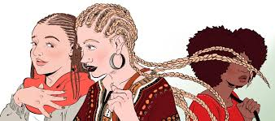
Trends that are being copied
In social media, people see a lot of pictures, videos, and trends, were celebrities are adapting more towards black cultural trends such as braided hairstyles, body transformation, and fashion. There are some black people that thinks that is this a mockery of black culture, because it gives a kind of empowerment to African-Americans.

Slide 4
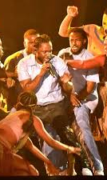
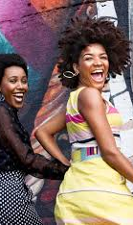
What makes Black cultural Trending?
In many ways Black cultural trends allow people to express themselves, show creativity, and gives awareness to issues that are being wrongly accused as wild lifestyle.

Slide 5
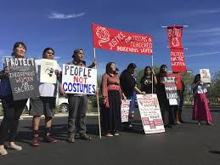
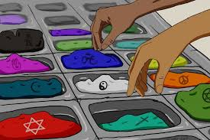
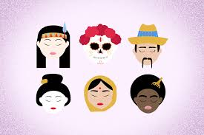
What is being done now?
To be honest everyone is going to try to take a trend from any culture and try to make it their own, but to go about it the right way is to ask for consent to using that cultural trend. It may see bazaar to “ask permission” for another race to make a trend out of another race’s culture. However no matter who is making the cultural appropriation any better.

