Slide 1
Blackfishing
Brandi Britt

Slide 2
About me
My name is Brandi Britt. I am a junior at Francis Marion University.
I major in psychology and I minor in sociology.

Slide 3
What is blackfishing?
To easily explain, blackfishing is when a non-black person is usually accused of trying or “pretending” to be black.
They do this in ways of certain hairstyles, makeup, extreme tanning, etc.

Slide 4
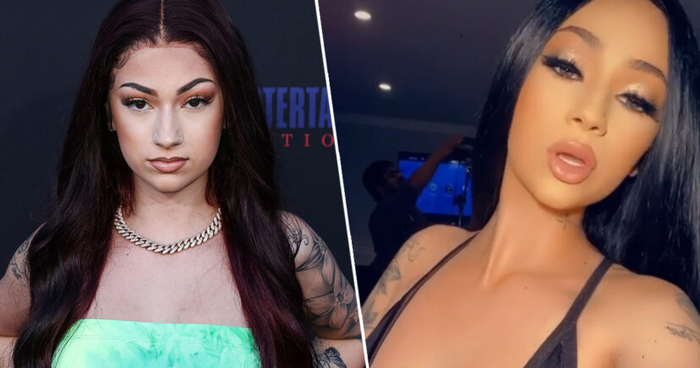
Example of blackfishing
Pictured on the side is Danielle Bregoli.
She is white. When she posted this picture on Instagram, people immediately knew something was different about her. The color of her skin was much darker and people were also saying she was blackfishing.

Slide 5
WHY BLACKFISHING IS WRONG
Blackfishing is wrong because it is just simply disrespectful. I personally think people should just be who they are and not try to be someone else.
People of color find it offensive because it’s not the person’s true selves and they find it disrespectful, which even though I am not a person of color, I can fully understand that.

