Slide 1
Lets Become Unified
Tyler Howell

Slide 2
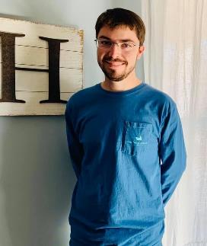
Introduction
My name is Tyler Howell and I’m a senior a Francis Marion. My major is biology with a collateral in chemistry and psychology. While being involved in the racial discovery class it has opened my eyes to how much racism is still apparent in the world today.

Slide 3
How to become unified
We can best gain experiences from seeing what has happened in the past to learn and grow.
The best way to learn is to read books and watch movies on real events, since there is some form of common ground in this area.
Here are some good books and movies to gain experiences and are extremely enjoyable.

Slide 4
Devil in the Grove
Devil in the Grove is a book written about Thurgood Marshall a African American lawyer.
Thurgood Marshall experiences some of the worst racism that this country has ever seen and was able to fight against it and win for a majority of his cases. He was able to fight against Jim Crow laws and provide a better life for blacks.
Though there are more improvements that need to be made to further advance what Thurgood Marshall has done to become a better society.

Slide 5
Hidden Figures
Hidden Figures is an inspirational book and movie that everyone should see or read.
It is completely true and depicts what racism was like in the 1960’s.
The movie also shows some of the gains that were made during this time.
We all need to strive and be better in order to stop racism.

Slide 6
Bridge to Brilliance
Racism doesn’t only affect adults it also hinders children.
Bridge to Brilliance is an exceptional book that demonstrates how racism can be a detriment to children and their learning.
We should all try to immolate Nadia Lopez and the positive influence she makes in communities and how she helps minorities because of racism.

Slide 7
Lets make a difference
We should all strive to be better individuals in order to unify us all and to be more as one.
We as a people should not judge someone for their appearance but instead should evaluate their character.
The next time someone is offensive lets try to tell them how insensitive it is to the individual and ask if they would like for that to happen to them.

