Slide 1
Do Black People Have Issues With Cops ?
Final Project By: Jazmine Salley

Slide 2
Black people never have unfair encounters with law enforcement.
True Or False ?
False!

Slide 3
Racial Profiling
the use of race or ethnicity as grounds for suspecting someone of having committed an offense.
Many people of color have to deal with things that fall under this subject.
Most of the time, this happens with black males.

Slide 4
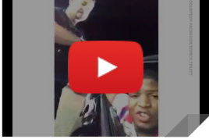
Watch this video
https://youtu.be/uh1L24-GVFc
This guy was stopped for no reason. The officer asked the guy to turn off the car. They guy did not want accused of having a gun and refused to shut off the car. The officer lied about the young man having a gun. The guy was snatched out of his car

Slide 5
Black people get the same amount and quality of health care.
True or False ??
FALSE!

Slide 6
Racial Disparities
Racial disparity refers to a difference that may or may not be related to discrimination.
Criminal justice experts distinguish between legal and extralegal factors to explain racial disparities in criminal justice.
Legal factors include seriousness of the offense and prior criminal record.
Ex: someone with a record of criminal activities may not receive the same treatment as someone without, especially if they are black.

Slide 7
Here is a quick definition for the next question.
Microaggression
a statement, action, or incident regarded as an instance of indirect, subtle, or unintentional discrimination against members of a marginalized group such as a racial or ethnic minority:

Slide 8
Microagressions are no big deal and do not hurt peoples’ feelings.
True or False?
False !

Slide 9
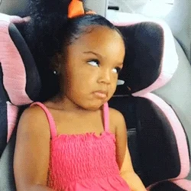
Examples
Your hair looks nice for a black girl.
You talk like a white girl.
You like watermelon?
You should know this.
You like kool-aid?
You like chicken?
#mood

Slide 10
The “ghetto/hood” was created by real estate and residents of neighborhoods.
True Or False ??
TRUEEE!

Slide 11
Redlining
Systematic denial of services to those of specific races seeking residency in certain neighborhoods or communities
This creates a community of whites and a community of blacks
Many people who have experienced this do not know that this response has a name. So, many more people have experienced this that recorded.

Slide 12
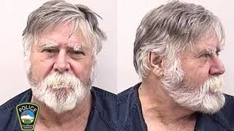
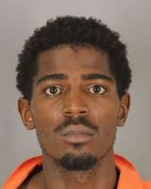
Who robbed the bank ?
The Answer is the male on the left .

Slide 13
The previous slide was to show that anyone is capable of crime.
Both of these men were incarcerated.
Only 1 robbed the bank.
Most would pick the black guy.

Slide 14
Last and Final Notes
Black People are not treated equally. Anyone who thinks that they are, are part of the problem.
Many races think that blacks are not worthy.
Corrupt cops should not have a job in ANY other county.
"We declare our right on this earth...to be a human being, to be respected as a human being, to be given the rights of a human being in this society, on this earth, in this day, which we intend to bring into existence by any means necessary.”
- Malcom X
I do not have rights to the photos and videos used in this PowerPoint.

