Slide 1
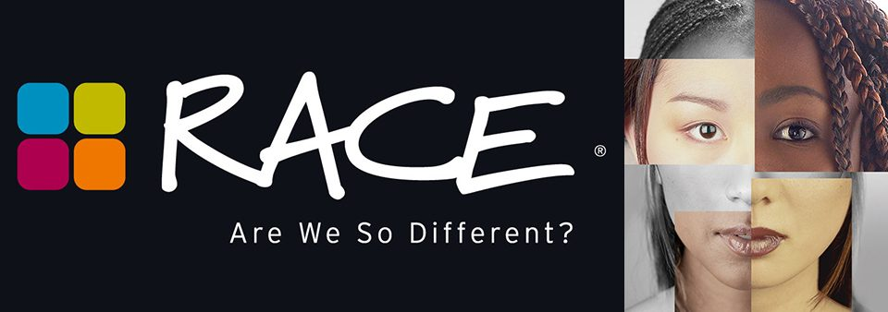

Slide 2
Hi, My name is Destiny Robinson. I am a 22 year old senior at Francis Marion University. My part of the web site is about getting others opinion on whether or not they think we have a race problem in our country. I have asked a couple of students and professors at Francis Marion what they thought about racial bias in our area. I believe by asking these questions change can be made on our campus as well as our community.

Slide 3
Do you think there is a race problem in the world? Why or Why not?
21 year old Caucasian female – Yes, I do think there is a race problem. People say they aren’t racists, but they don’t realize some things they say are racist.
50 year old African American male- I don’t think there is a race problem perse, but there will always be people with prejudices ways.
30 year old Caucasian female- Yes, and it’s a problem we created as humans.
23 year old African American female- Yes, its all around us everyday.

Slide 4
How do you think we as a college campus/community can change that?
23 year old African American female- Talking more about it. Not staying quiet about racial profiling and race issues in the world.
22 year old Caucasian female- We could listen to both side, and work together to close the gap.
40 year old African American male- have encouraging programs that teach about diversity.
22 Year old Caucasian female- we could listen to both sides, and work together to close the gap.

Slide 5
Do you see yourself as being bias towards people of the opposite or same race as you?
59 year old Caucasian male –yes, we all have bias ways that we are unaware of.
23 year old African American female-no
40 year old Caucasian female-no
21 year old African American female- I am bias towards people of the opposite race.

Slide 6
Do you believe in stereotypes? If so, what stereotypes do you see in the world or on campus?
47 year old Caucasian female- no, I do not believe in stereotypes.
25 year old African American male- yes, stereotypes of all races.
19 year old Caucasian male- yes, certain people are treated differently because of their race.
50 year old African American male- no, I do not believe in stereotyping others, but good or bad stereotyping does exist.

Slide 7
Do you think there is a such thing as white privilege/black privilege? Explain why or why not?
25 year old African American male- yes, there is white privilege, look at the job world.
47 year old Caucasian female- I think that white privilege is a “thing” and it has been around for a long time.
23 year old African American female- I do not think there is, but the public makes it seem like it is .
25 year old Caucasian female- yes, I think that I as a white person have been given more opportunities, but I believe that you are what you make yourself. Your circumstances should not define you, but they will if you allow it.

Slide 9
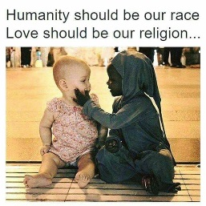
This class has taught me that…..
Being bias is something we all have to over come.
Just because someone voted for a certain person , does not make them racist.
You have to teach others how to treat you.
You must always get to know someone before you form an opinion about them.
Talking about racial issues is the only way to get
through them.
Standing up for what you believe in does not make
you a racist person.

Slide 10
