Slide 1
Sampling Distributions
Psychology 302
William P. Wattles, Ph.D.

Slide 2
I got the job!!! I am the new Human Resource Recruitment Specialist for …I would be involved in all branches. BEST PART... most of my job has to do with job analysis and performance, retention and turnover trends! (ALL STATISTICS and Behavior analysis) I will always apply what I learned at Francis Marion …Thank you so much for your continued support.

Slide 3
American Size Survey

Slide 4
American Size Survey

Slide 5
Statistical Inference
We use information from a sample to infer something about a wider population.
American Size Survey Measured 10,000 people

Slide 6
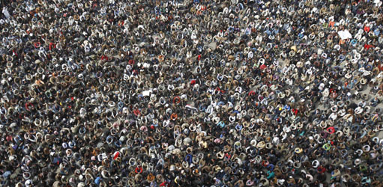
Population
Sample

Slide 7
Probability
The probability of any outcome is the proportion of times it would occur in a long series of repetitions.
The relative frequency of an event in the population equals the probability of the event.

Slide 8
Relative
Considered in comparison with something else: the relative quiet of the suburbs.
Dependent on or interconnected with something else; not absolute.

Slide 9
Relative Frequency ?
(.33)

Slide 10
Relative Frequency ?
(.20)

Slide 11
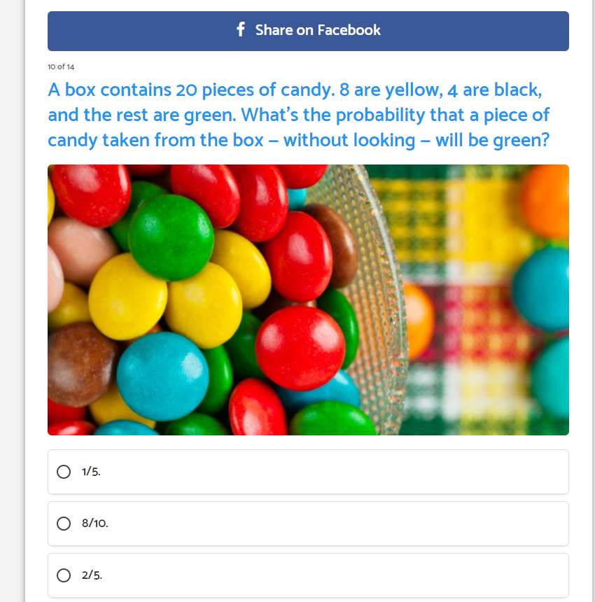

Slide 12
8/20= 40% =2/5

Slide 13
Probability Distribution
The probability distribution of a random variable tells us the possible values of the variable and the probability associated with each value.

Slide 14
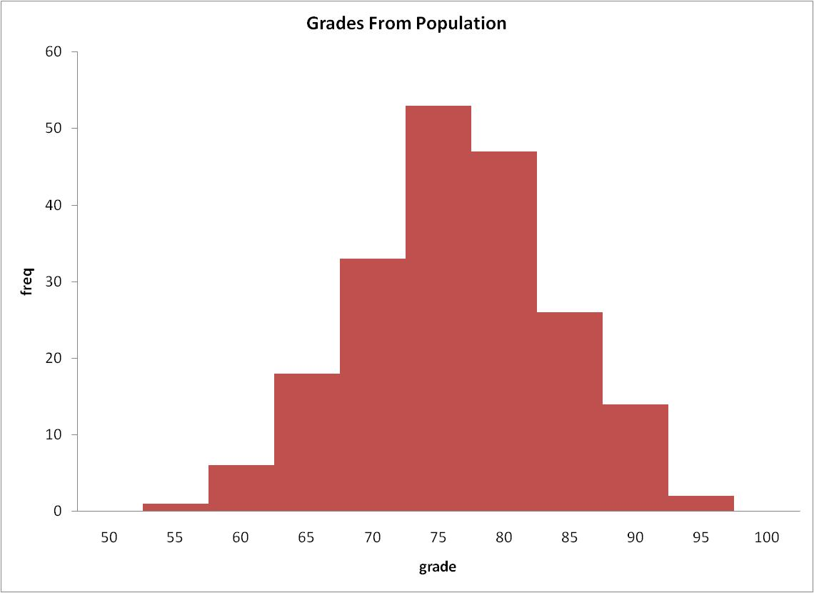
Raw Score Frequency Distribution.

Slide 15

Raw Score Probability Distribution.

Slide 16
Frequency distribution versus probability distribution
Given the formula for probability it is clear that the curves will be the same.
The relative frequency of scores in the population equals the probability of those scores.
Y axis is probability rather than frequency.

Slide 17
The Normal curve
When the data are normal we can use table A to determine the probability of an event.

Slide 18
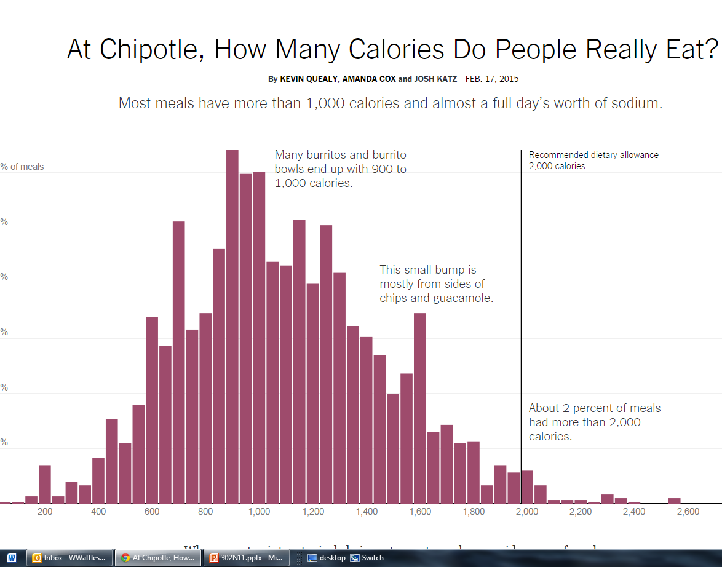
Example of normally distributed data

Slide 19
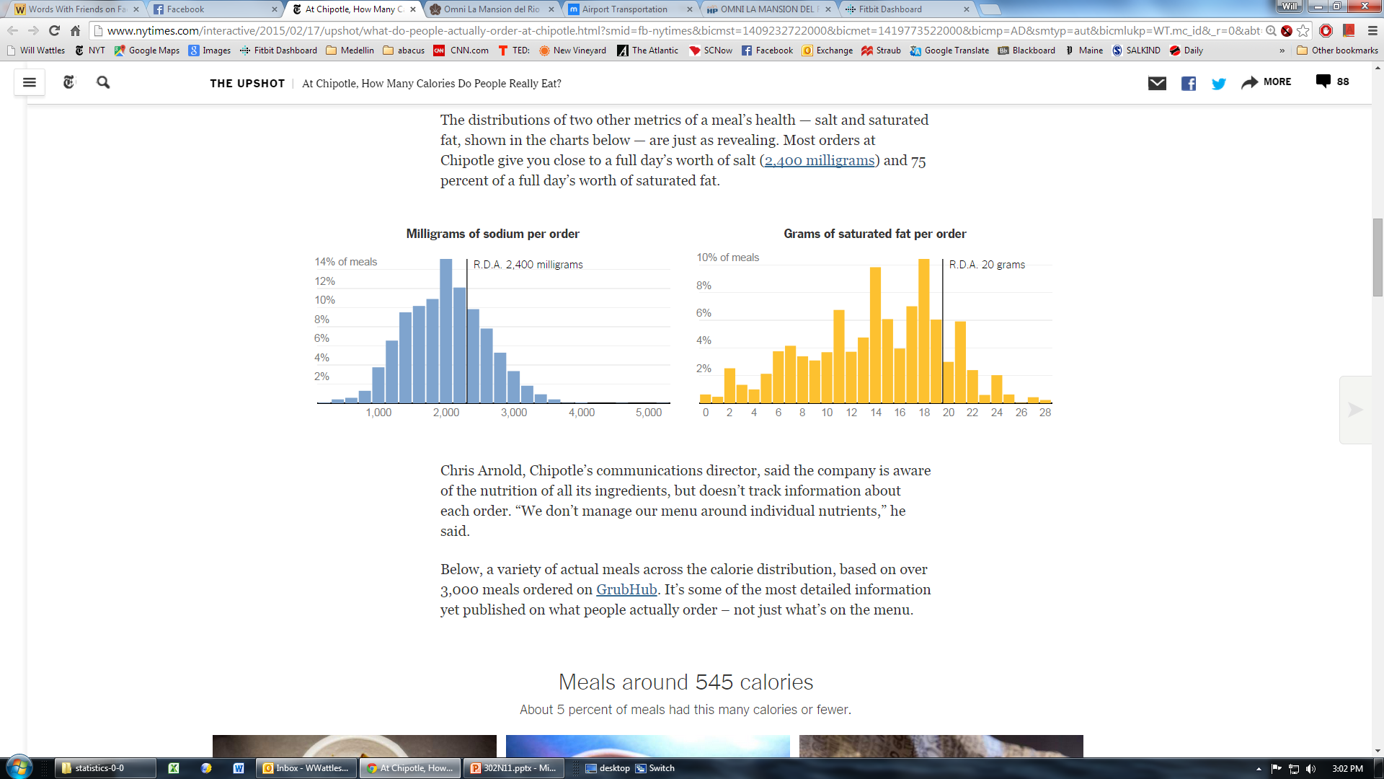

Slide 20
Using the standard normal curve to describe samples
Instead of using a frequency distribution of raw scores we will obtain a frequency distribution of sample statistics
Called a sampling distribution

Slide 21
Sampling Distribution

Slide 22
Sampling Variability
The basic fact that different random samples will choose different subjects and no doubt produce a different value for the statistic.

Slide 23
Sampling Distribution exercise
http://onlinestatbook.com/stat_sim/sampling_dist/index.html

Slide 24


Slide 25
Sampling Distribution
The values that the statistic can take and the relative frequency of each.

Slide 26
Sampling Variability
Random phenomenon-individual outcomes are uncertain but regularly distributed.
Probability of an outcome is the proportion of times the outcome would occur in a long series of repetitions.

Slide 27
A sampling distribution of the means
provides us with a theoretical probability distribution that describes the probability of obtaining any sample mean when we randomly select a sample of a particular N from a particular raw score population.

Slide 28
A sampling distribution of the means
is the distribution of all possible values of random sample means when an infinite number of samples of the same size are selected from one raw score population.

Slide 29
Sampling distributions.
Y axis still measures frequency
X axis now measures values the statistic (I.e., the sample mean) can take rather than values of the individual raw score.

Slide 30
Sampling distributions.
The variability will be much less. It is easier to get one extreme score than to get a bunch of extreme scores
Sampling distributions exist for many types of sample statistics

Slide 31
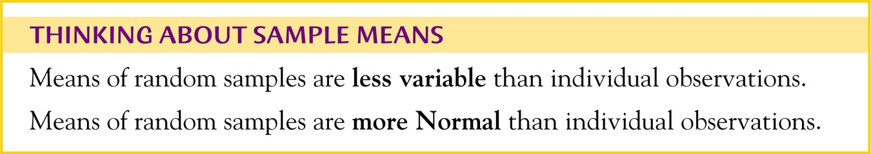

Slide 32
Raw Score Probability Distribution.

Slide 33
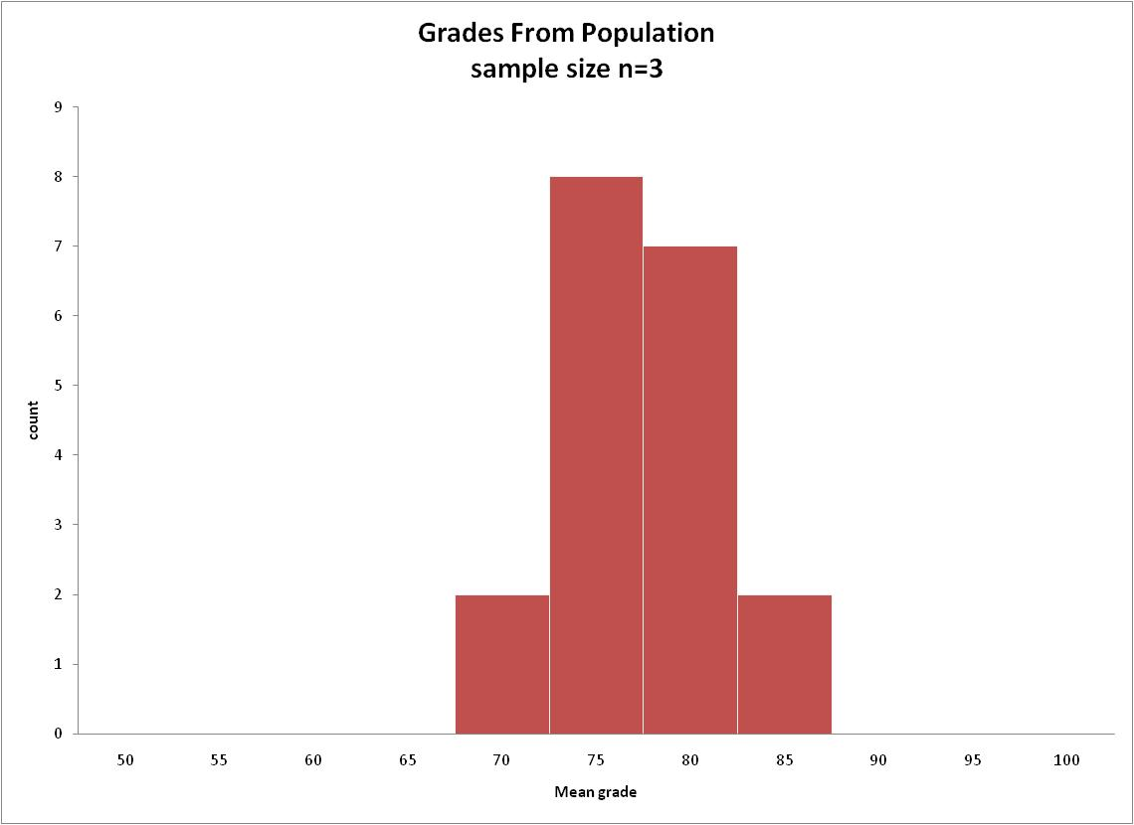
Sampling Distribution
frequency

Slide 34
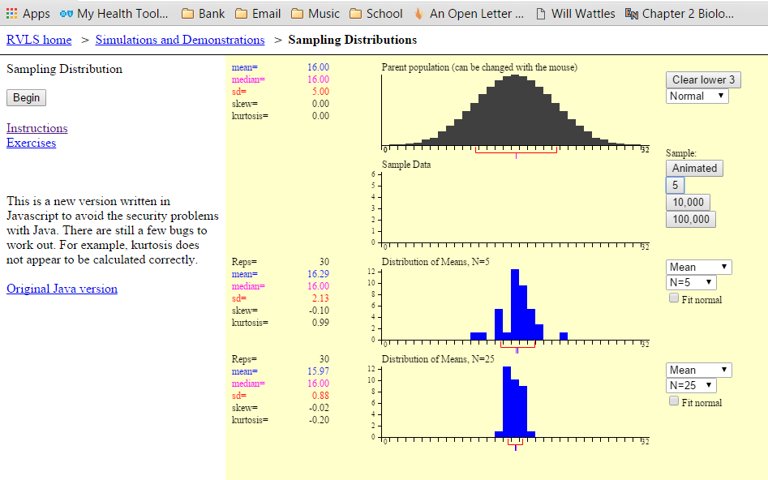

Slide 35
Characteristics of a sampling distribution
All the samples contain raw scores from the same population
All the samples are randomly selected
All the samples have the same size N.
The sampling distribution represents all possible values of the sample statistic

Slide 36
Standard Error of the Mean
The standard error of the mean is a standard deviation calculated just like any other standard deviation.
Has a different name because it refers to means not scores
Is related to the standard deviation of the raw scores.

Slide 37

Standard Error

Slide 38
SEM
The standard error of the mean (SEM) tells how well we have measured the mean. It is a measure of how far your sample mean is likely to be from the true population mean. It is expressed in the same units as the data.

Slide 39
The standard deviation versus the standard error
• The SD quantifies scatter — how much the values vary from one another.
• The SEM quantifies how precisely you know the true mean of the population. It takes into account both the value of the SD and the sample size.
•Both SD and SEM are in the same units – raw score units.
• The SEM, by definition, is always smaller than the SD.

Slide 40
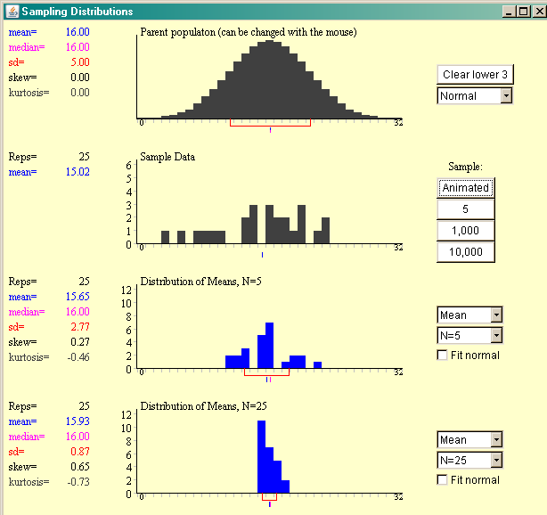
Law of Large Numbers
As sample size increases, the mean of the sample gets closer to the mean of the population.

Slide 41
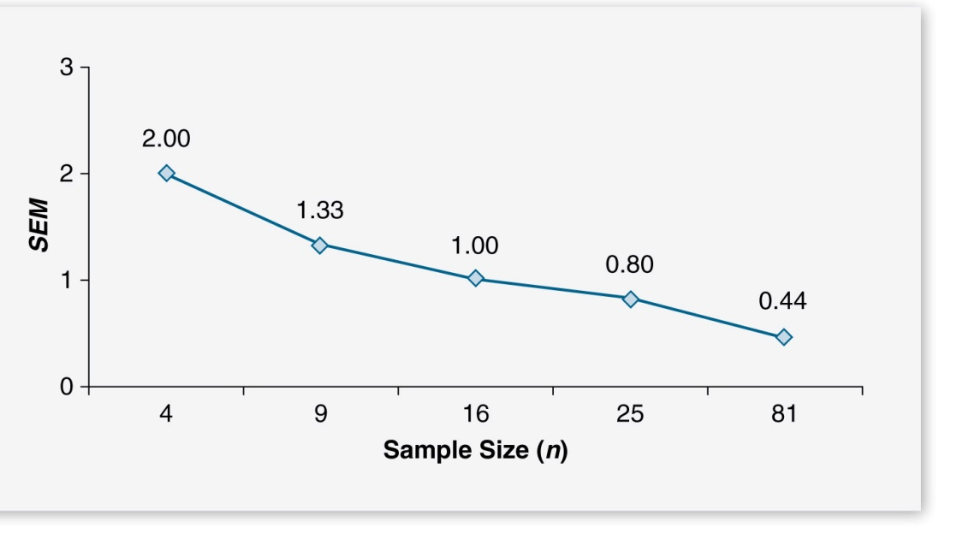
Law of Large Numbers
As the sample size increases the standard error of the mean (SEM) decreases.

Slide 42
Sample Means
Used for measurement data.
Less variable than individual observations
More normal than individual observations.

Slide 43
Central Limit Theorem:
the sampling distribution of means will:
  form an approximately normal distribution.
  have a mean that equals the mean of the raw scores.
  have a standard deviation mathematically related to the standard deviation of the raw scores.

Slide 44
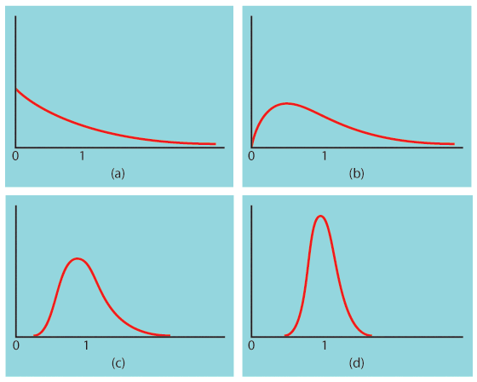
The central limit theorem
Population with strongly skewed distribution
Sampling distribution of for n = 2 observations
Sampling distribution of for n = 10 observations
Sampling distribution of
for n = 25
observations

Slide 45
How large a sample size?
  A sample size of 25 is generally enough to obtain a normal sampling distribution from a strong skewness or even mild outliers.
  A sample size of 40 will typically be good enough to overcome extreme skewness and outliers.

Slide 46
Standard Error of the Mean
The standard error of the mean is a standard deviation calculated just like any other standard deviation.
Has a different name because it refers to means not scores
Is related to the standard deviation of the raw scores.

Slide 47
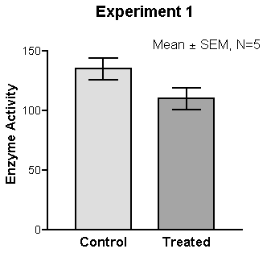

Slide 48
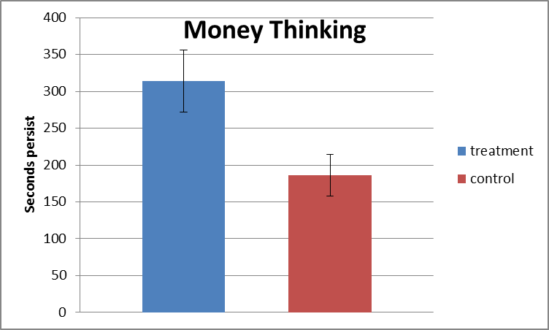
Standard error of the mean tells you how accurate your estimate of the mean is likely to be.

Slide 49

Standard Score

Slide 50
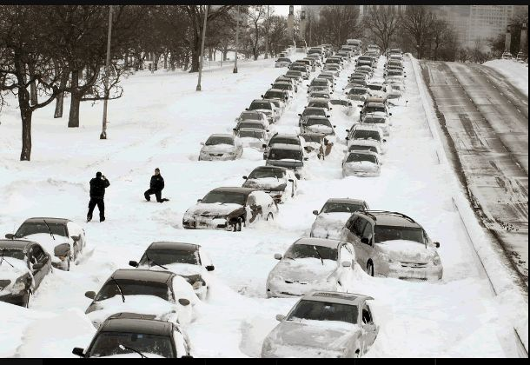
The End

Slide 51

Notes:
2:55 to part on moneyball and intuition

Slide 52
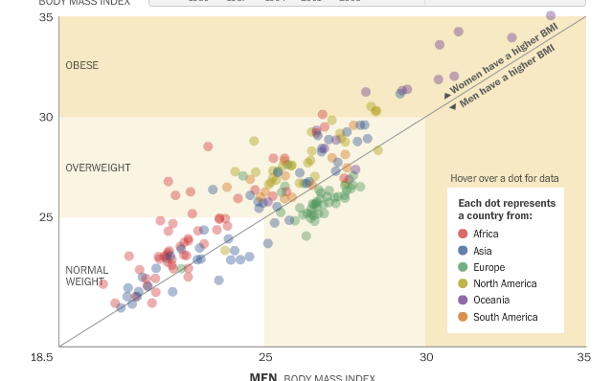
Correlation example

Slide 53

The End

Slide 54
Percentile score
A percentile rank indicates the percentage of a reference or norm group obtaining scores equal to or less than the test-taker's score

Slide 55
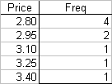

Question 1

Slide 56

Question 2
=1.5*30+125

Slide 57

Question 3
0.1915
=(900-800)/200
=+.5

Slide 58

Question 4
One number that tells us about the spread using all the data.
The group not the individual has a standard deviation.

Slide 59
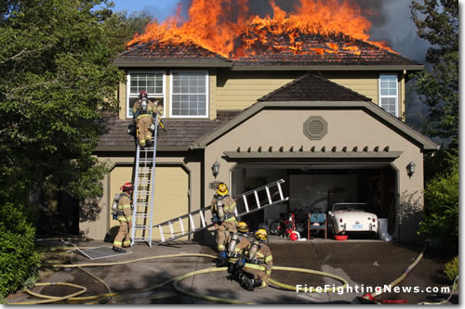
Problem
Mean loss $250
Std dev $1,000
If they sell 10,000 policies what are the chances the loss will be less than $275?

Slide 61
Problem
Sampling Distribution Mean
$250
Sampling Distribution Standard Deviation
$1,000/sqrt 10,000
$10

Slide 62
Z= xbar- μ/ σ
275-250/10
Z=2.5
To the left .9938
99.4% certain that it will not exceed $275

Slide 63
Put simply, the standard error of the sample is an estimate of how far the sample mean is likely to be from the population mean, whereas.
the standard deviation of the sample is the degree to which individuals within the sample differ from the sample mean

Slide 64
Measuring spread with the standard deviation
The standard deviation is the most common measure of statistical dispersion, measuring how widely spread the values in a data set are.
  If many data points are close to the mean, then the standard deviation is small;
  if many data points are far from the mean, then the standard deviation is large.
If all the data values are equal, then the standard deviation is zero
18
Notes:
18
16
12
10
9

Slide 65
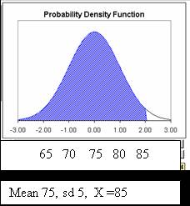
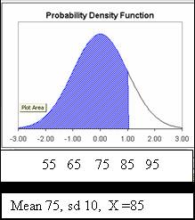
Z=2.0 Percentile = 97.7%
Z=1.0 Percentile = 84%

Slide 66
Wikipedia
A percentile is the value of a variable below which a certain percent of observations fall.
So the 20th percentile is the value (or score) below which 20 percent of the observations may be found.

Slide 67
Percentile
A test score in and of itself is usually difficult to interpret.
For example, if you learned that your score on a measure of shyness were 35 out of a possible 50, you would have little idea how shy you are compared to other people.
More relevant is the percentage of people with lower shyness scores than yours.

Slide 68
65th Percentile
If 65% of the scores were below yours, then your score would be the 65th percentile

