Slide 1
Introduction to Inference
Confidence Intervals
William P. Wattles, Ph.D.
Psychology 302

Slide 2
Statistical Inference
Provides methods for drawing conclusions about a population from sample data.
Population (parameter)
Sample (statistic)

Slide 3
The problem
Sampling Error

Slide 4
Sampling error results from chance factors that produce a sample statistic different from the population parameter it represents.

Slide 5
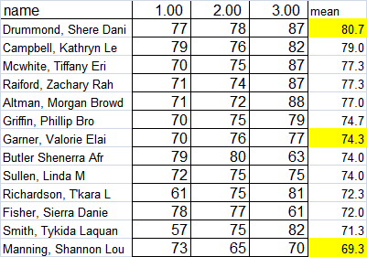

Slide 6
Inferential statistics
How well does the sample statistic predict the unknown population parameter?
Population
Sample

Slide 7
Dealing with sampling error
Confidence intervals
Hypothesis testing

Slide 8
Confidence interval
Point versus interval estimation
confidence interval= estimate±margin of error

Slide 9
Margin of error example
Imagine catering a function where you expect 120 students.

Slide 10
Margin of error example
Imagine catering a function where you expect 120 students plus or minus 30
What are the upper and lower limits?

Slide 11
Margin of error example
Imagine catering a function where you expect 120 students plus or minus 30
What are the upper and lower limits?
Minimum (lower limit) 90
Maximum (upper limit) 150

Slide 12
Upper and Lower limits
Bob estimates that Mary weighs 120 pounds “give or take” ten. Calculate the upper and lower limits of his estimate.

Slide 13
Upper and Lower limits
Bob estimates that Mary weighs 120 pounds “give or take” ten. Calculate the upper and lower limits of his estimate.
Upper 130
Lower 110

Slide 14
Upper and Lower limits
Tom is giving a party and tells the caterer that he expects 80 friends plus or minus 20. Determine the upper and lower limits

Slide 15
Upper and Lower limits
Tom is giving a party and tells the caterer that he expects 80 friends plus or minus 20. Determine the upper and lower limits
Upper 100
Lower 60

Slide 16
Upper and Lower limits
If something costs $250 the margin of error is $25, what is the lower limit, the least you would expect to pay? What is the upper limit or the most you would expect to pay.

Slide 17
Upper and Lower limits
If something costs $250 plus or minus $25, what is the lower limit, the least you would expect to pay?
Upper $275
Lower $225

Slide 18
Confidence intervals tell us two things
1. the interval
2. the level of confidence (for example 95%)

Slide 19
Obtaining confidence intervals
Confidence interval for a population mean

Slide 20
First, calculate the margin of error

Slide 21
Determining critical Z
What is the Z for an 80% confidence interval?
We need a number that cuts off the upper 10% and the lower 10%
Table A look for .90 and .10
Z= -1.28 to cut off lower 10%
+1.28 to cut off upper 10%

Slide 22
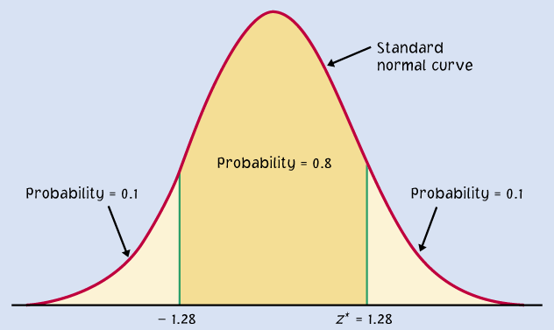

Slide 23
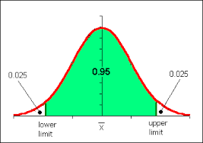
95% confidence Interval
0.025
0.025
Lower
limit
Upper
limit

Slide 24
Determining Critical values of Z
Confidence area Z-score
90% .05 1.645
95% .025 1.96
99% .005 2.576

Slide 25
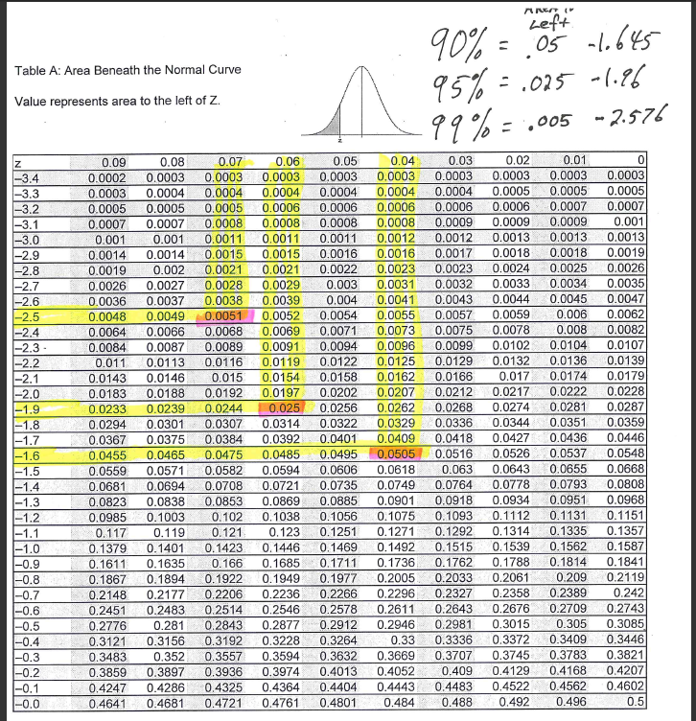

Slide 26
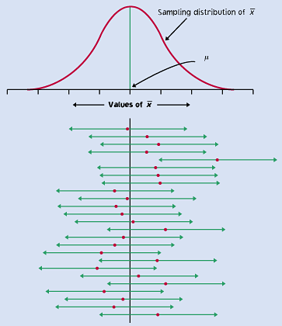
Notes:
Page 363

Slide 27
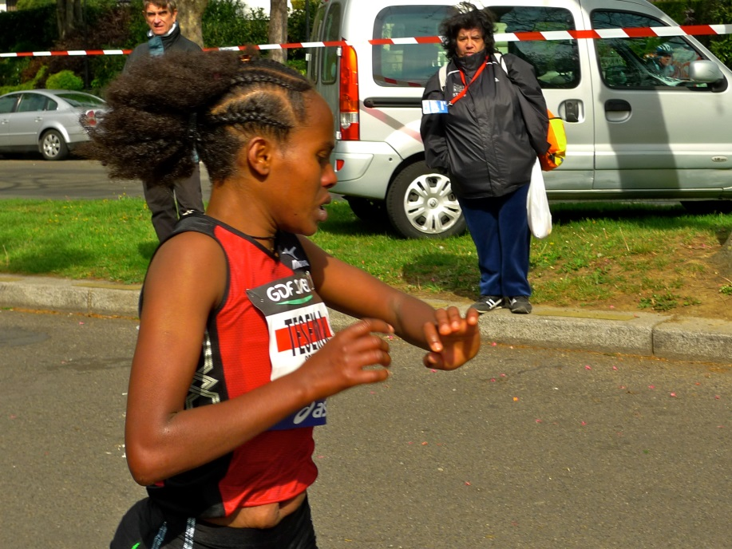
Example body mass index of young women.
Want 95% confidence interval
σ =7.5
Mean BMI= 26.8
n=654
Notes:
Moore page 360

Slide 28
To calculate a confidence interval

Slide 29
First calculate margin of error

Slide 30
Margin of Error
Want 95% confidence interval
σ =7.5
Mean= 26.8
n=654
Z= 1.96
1.96 * 7.5 /sqrt 654
Margin of Error= .6

Slide 31
Steps to upper limit
The Upper limit equals the Mean + Margin of error
The Lower limit equals the Mean – the Margin of error.

Slide 32
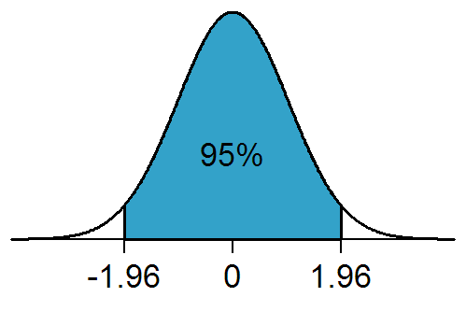
95% Confidence Interval
Estimate +-Margin of error
Estimate 26.8
Margin of error .60
Upper limit
  27.4
Lower Limit
  26.2
26.2 26.8 27.4

Slide 33
APA style reporting of Confidence Intervals
95% CI [5.62, 8.31]

Slide 34
Example from cliff notes
: Suppose that you want to find out the average weight of all players on the football team. You are select ten players at random and weigh them.
The mean weight of the sample of players is 198, so that number is your point estimate.
The population standard deviation is σ = 11.50. What is a 90 percent confidence interval for the population weight, if you presume the players' weights are normally distributed?

Slide 35
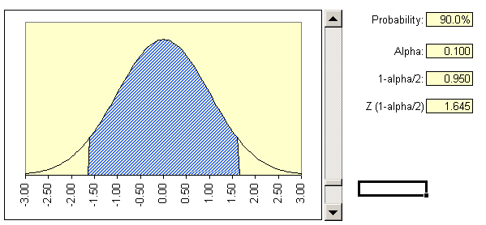
90% confidence interval
Area to the right 5%
Z value 1.65
5
90
5

Slide 36
90% Confidence Interval
Want 90% confidence interval
σ =11.5
Mean= 198
n=10
Z= 1.65
1.65 * 11.5/sqrt 10
Margin of error 6

Slide 37
90% Confidence Interval
Estimate +-Margin of error
Estimate 198 lbs.
Margin of error 6 lbs.
Upper limit
  204
Lower Limit
  192
90%
-1.65
1.65
192 198 204

Slide 38

Confidence Intervals
Student Study Times

Slide 39
Confidence Intervals
Students (269) asked how many minutes do you study on a typical weeknight?
  sample mean 137 minutes
  study times standard deviation is 65 minutes
  Create a 99% confidence interval

Slide 40
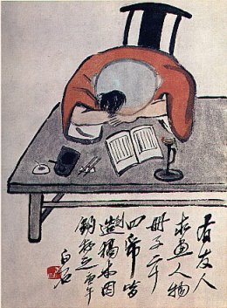
Problem 14.30

Slide 41

Problem 14.54 page 390
Wine odors

Slide 42
DMS odor threshold
Mean 30.4
Std dev 7
95% conf interval
10 smellers

Slide 43

Problem 14.27
Notes:
trained wine testers threshold is 25. Their threshold is lower than the students’ thus if they say no smell then most will say no smell

Slide 44

Confidence Intervals
IQ test
Standard deviation 15
450 students takes the test
Sample mean 103
95% confidence interval

Slide 45
IQ test 95% confidence interval
Standard deviation 15
450 students takes the test
Sample mean 103
95% confidence interval
Standard error .70
Margin of error 1.3
Upper 104.3
Lower 101.6

Slide 46
Parametric statistics
Assume raw scores form a normal distribution
Assume the data are interval or ratio scores (measurement data)
Assume raw scores are randomly drawn
Robust refers to accuracy of procedure if one of the assumptions is violated,

Slide 47
Random error versus bias
The margin of error in a confidence interval covers only random sampling errors.

Slide 48
Estimating with confidence
x
Although the sample mean is a unique number for any particular sample, if you pick a different sample, you will probably get a different sample mean.
In fact, you could get many different values for the sample mean, and virtually none of them would actually equal the true population mean, μ.

Slide 49
Confidence intervals are extremely important in statistics, because whenever you report a sample mean, you need to be able to gauge how precisely it estimates the population mean.

Slide 50
Characteristics of confidence intervals
The margin of error gets smaller when:
  Z gets smaller. More confidence=larger interval. (i.e., Only 90% confident versus 95%)
  sigma gets smaller. Less population variation equals less noise and more accurate prediction
  n gets larger.

Slide 51
Biology students hunt for plant species. Assume the population standard deviation is 8 and that a sample of 18 students finds an average of 25.67 plants. Construct a 95% confidence interval for these data
Notes:
stand dev 8 n 18 mean 25.67 sem 1.885618 alpha 0.05 z 1.96 margin of er 3.695811 upper 29.36581 lower 21.97419

Slide 52
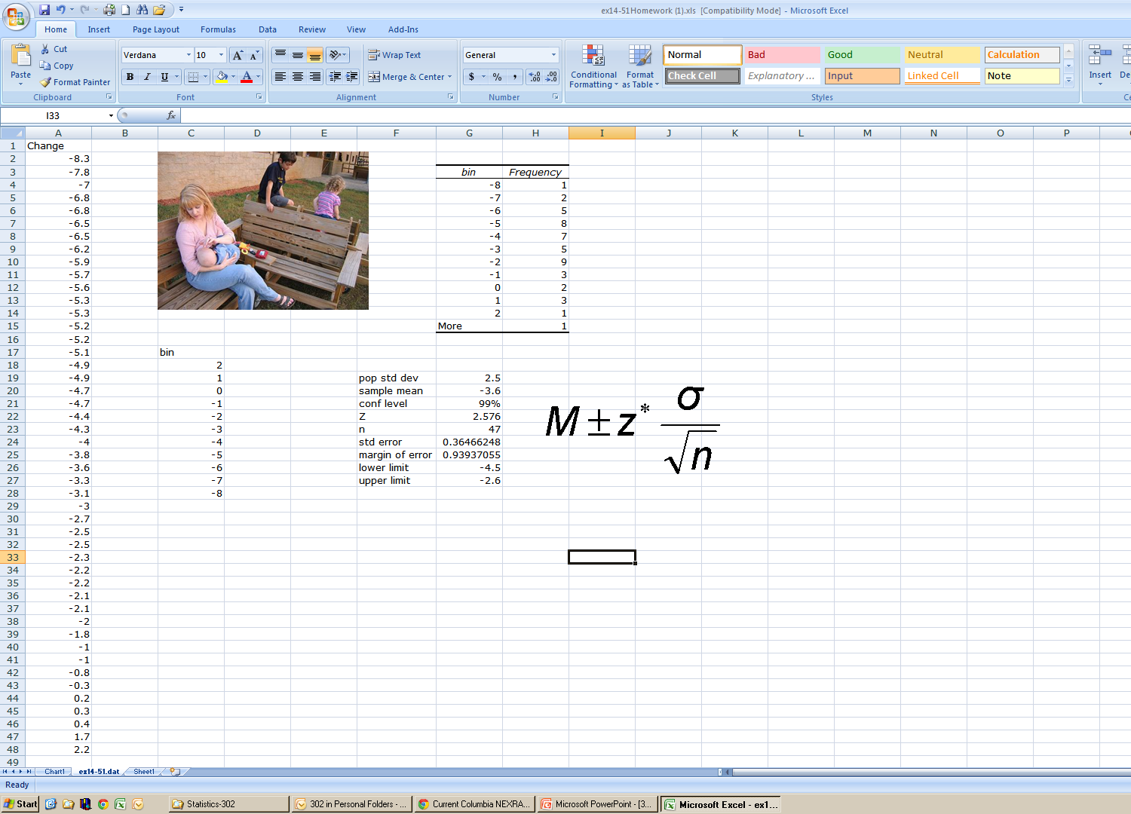
Homework

Slide 53
Dichotomous thinking
Black and White Thinking
  Good or bad teacher
The opposite is thinking on a continuum
  One of the best or one of the worst.

Slide 54
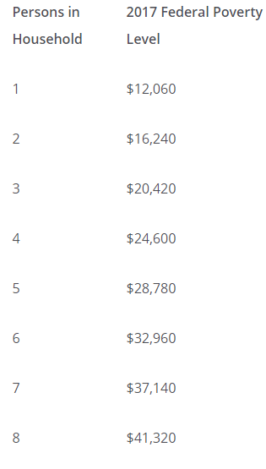
The tyranny of the discontinuous mind
How many people live below the poverty line?
Marcus with an income of $12,059 lives in poverty
Hans with an income of $2 more, $12,061 is not living in poverty

Slide 55
False Clarity, hiding uncertainty
Ty with a .794 gets a C+
Shaquan with a .795 gets a B

Slide 56
Tyranny of the discontinuous mind.
Take Barack Obama, for example. He is commonly considered America’s first black president, although his mother was white.
The classification as black is tied to the legacy of racist laws that relied on the so-called “one-drop rule,” so that even a tiny amount of black ancestry meant a person was considered black

Slide 57
Point vs interval estimation
A point estimate is something like “The average pay of the last 25 hires is $100K a year”. Sounds pretty good!
An interval is “The pay for the last 25 hires has been between $20K and $180K a year”. That might tell you that there’s a lot of variation.

Slide 58

The End

