Slide 1
Inference about a population proportion.

Slide 2


Slide 3


Slide 4


Slide 5
Abstract
Decide if you want to read the article
Capture the essence of the finding without reading the article
Do NOT assume reader will read abstract.

Slide 6


Prediction

Slide 7

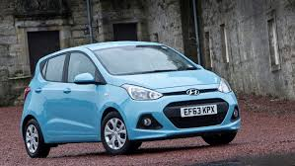
Prediction

Slide 8
Probabilistic Reasoning
“The Achilles’ heel of human cognition.”

Slide 9

Probabilistic Reasoning
“Men are taller than women”
“All men are taller than all women”

Slide 10

Probabilistic Reasoning
A probabilistic trend means that it is more likely than not but does not always hold true.
Notes:
See How to think straight about Psychology by Keith Stanovich

Slide 11
Probabilistic Reasoning
Knowledge does not have to be certain to be useful.
Individual cases cannot be predicted but trends can

Slide 12
Proportions
The proportion of a population that has some outcome (“success”) is p.
The proportion of successes in a sample is measured by the sample proportion:
“p-hat”

Slide 13
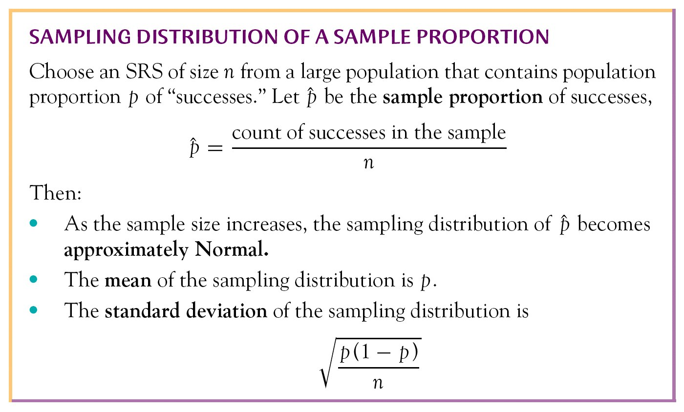
Inference about a Proportion
Simple Conditions

Slide 14
Example 19.5 page 508
What proportion of Euros have cocaine traces?
Sample 17 out of 20
85%

Slide 15
Dealing with sampling error
Confidence intervals
Hypothesis testing

Slide 16
Obtaining confidence intervals
estimate + or - margin of error

Slide 17
Determining Critical values of Z
90% .05 1.645
95% .025 1.96
99% .005 2.576
Critical Values: values that mark off a specified area under the standard normal curve.

Slide 18
Problem 19.6 page 507
What proportion of SAT takers have coaching? 99% Confidence Interval
427 coaching
2733 did not
3160 total

Slide 19
Problem 19.6 page 507
What proportion of SAT takers have coaching? 99% Confidence Interval
427 coaching
2733 did not
3160 total

Slide 20
19.25 page 517
Do smokers know it is bad for them? 95% confidence interval
Yes 848
Total 1010

Slide 21
19.25 page 517
Do smokers know it is bad for them? 95% confidence interval
Yes 848
Total 1010

Slide 22

Problem 19.5 page 307
What percent of Canadians support gun registration?
Total 1505
Number who answered yes 1288
Give a 95% confidence interval

Slide 23
Problem 19.5 page 307
What percent of Canadians support gun registration?
Total 1505
Number who answered yes 1288
Give a 95% confidence interval

Slide 24
Two-way tables
William P. Wattles, Ph.D.

Slide 25
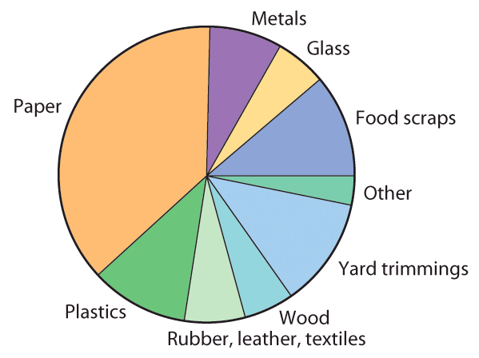
Categorical Data
Examples, gender, race, occupation, type of cellphone, type of trash are categorical

Slide 26
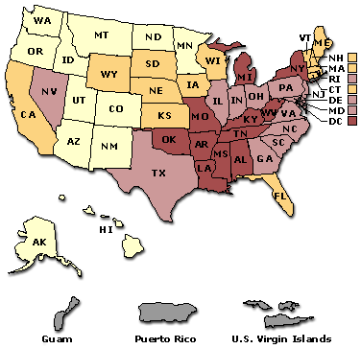
Categorical Data
Sometimes measurement data is grouped into categorical.

Slide 27
Categorical Data
Expressed in counts or percents
Less than 219.2
219.2 to 247.9
248.0 to 282.0
More than 282.0

Slide 28
Population
Parameter
p = population proportion
Sample
phat=sample proportion

Slide 30
Categorical Variables
Now we will study the relationship between two categorical variables (variables whose values fall in groups or categories).
To analyze categorical data, use the counts or percents of individuals that fall into various categories.

Slide 31
Two-Way Table
When there are two categorical variables, the data are summarized in a two-way table
  each row in the table represents a value of the row variable
  each column of the table represents a value of the column variable
The number of observations falling into each combination of categories is entered into each cell of the table

Slide 32
Two-way table
Organizes data about two categorical variables

Slide 33
Two-way table

Slide 34
Marginal Distributions
A distribution for a categorical variable tells how often each outcome occurred
  totaling the values in each row of the table gives the marginal distribution of the row variable (totals are written in the right margin)
  totaling the values in each column of the table gives the marginal distribution of the column variable (totals are written in the bottom margin)

Slide 35
175,230

Slide 36
Marginal Distributions
It is usually more informative to display each marginal distribution in terms of percents rather than counts
  each marginal total is divided by the table total to give the percents
A bar graph could be used to graphically display marginal distributions for categorical variables

Slide 37
175,230

Slide 38
Case Study
Age and Education
(Statistical Abstract of the United States, 2001)
Data from the U.S. Census Bureau for the year 2000 on the level of education reached by Americans of different ages.

Slide 39
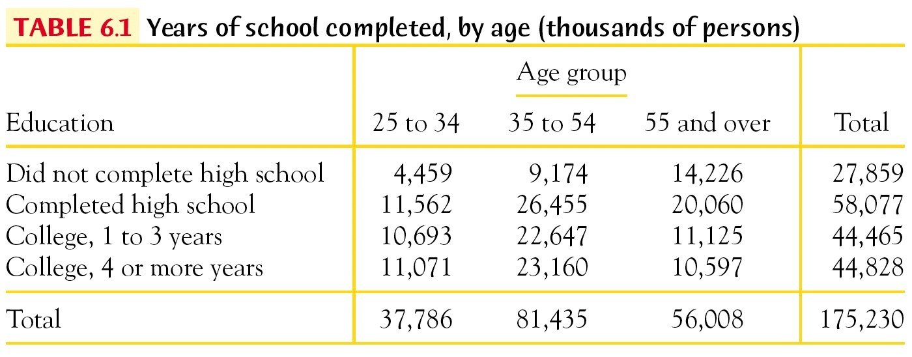
Case Study
Age and Education
Variables
Marginal distributions

Slide 40
Case Study
Age and Education
Variables
15.9%
33.1%
25.4%
25.6%
21.6% 46.5% 32.0%
Marginal distributions

Slide 41
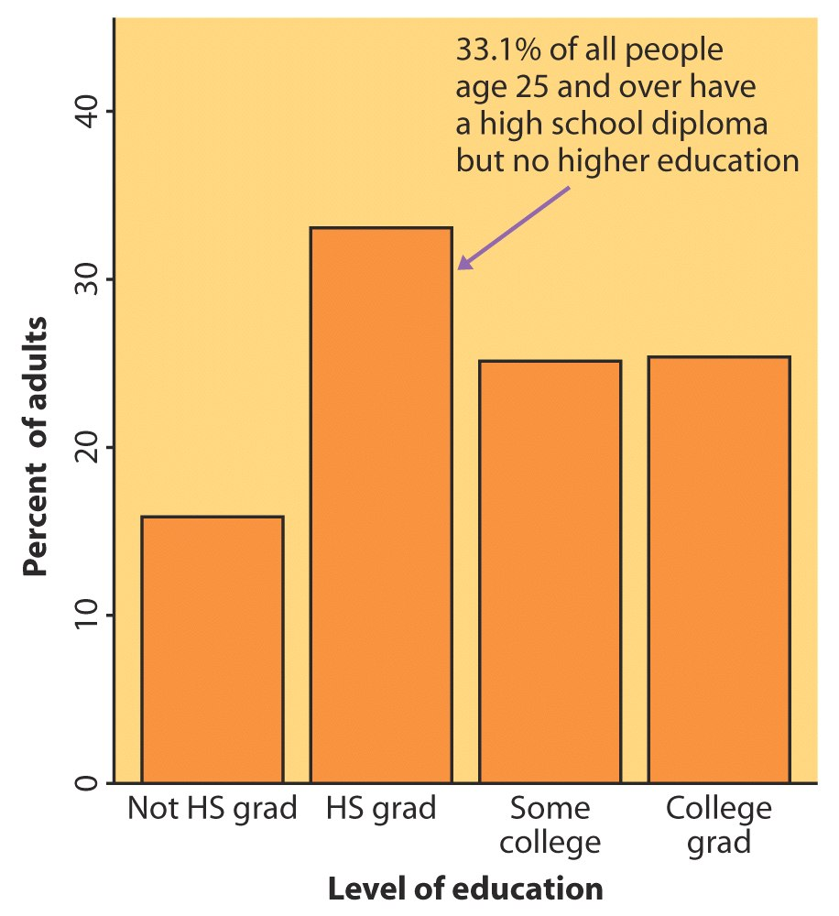
Case Study
Age and Education
Marginal Distribution
for Education Level
Not HS grad | 15.9%
HS grad | 33.1%
College 1-3 yrs | 25.4%
College ≥4 yrs | 25.6%

Slide 42
Conditional Distributions
Relationships between categorical variables are described by calculating appropriate percents from the counts given in the table
  prevents misleading comparisons due to unequal sample sizes for different groups

Slide 43
Case Study
Age and Education
Compare the 25-34 age group to the 35-54 age group in terms of success in completing at least 4 years of college:
Data are in thousands, so we have that 11,071,000 persons in the 25-34 age group have completed at least 4 years of college, compared to 23,160,000 persons in the 35-54 age group.
The groups appear greatly different, but look at the group totals.

Slide 44
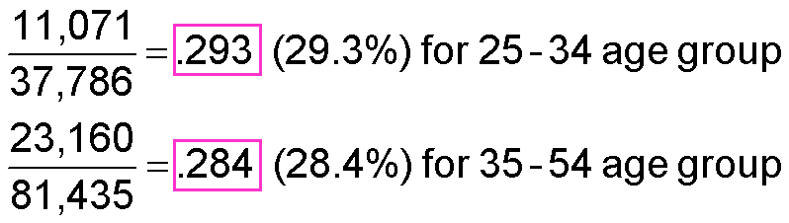
Case Study
Age and Education
Compare the 25-34 age group to the 35-54 age group in terms of success in completing at least 4 years of college:
Change the counts to percents:
Now, with a fairer comparison using percents, the groups appear very similar.

Slide 45
Case Study
Age and Education
If we compute the percent completing at least four years of college for all of the age groups, this would give us the conditional distribution of age, given that the education level is “completed at least 4 years of college”:
Age: | 25-34 | 35-54 | 55 and over
Percent with ≥ 4 yrs college: | 29.3% | 28.4% | 18.9%

Slide 46
Conditional Distributions
The conditional distribution of one variable can be calculated for each category of the other variable.
These can be displayed using bar graphs.
If the conditional distributions of the second variable are nearly the same for each category of the first variable, then we say that there is not an association between the two variables.
If there are significant differences in the conditional distributions for each category, then we say that there is an association between the two variables.

Slide 47
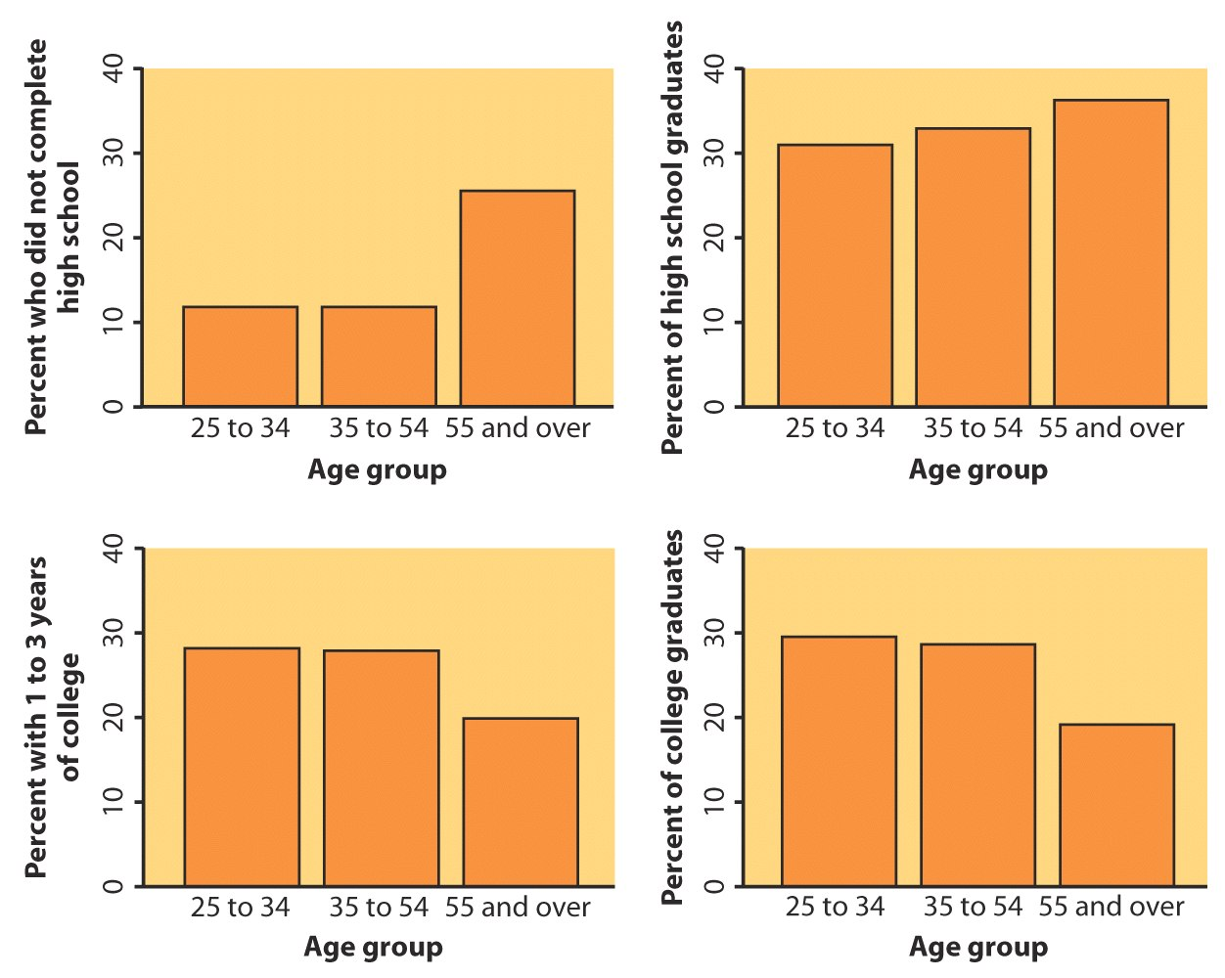
Case Study
Age and Education
Conditional Distributions of Age for each level of Education:

Slide 48
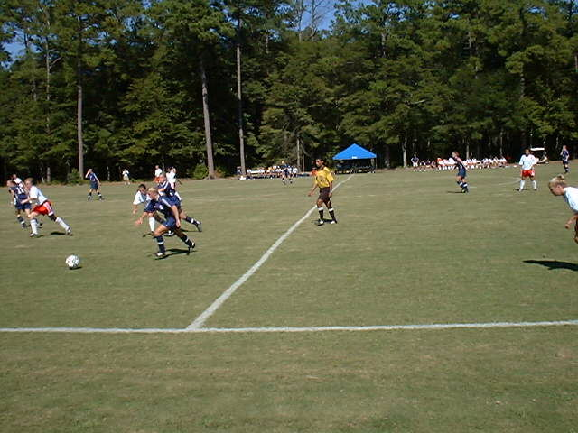
Two-way Tables
Relationships between categorical variables

Slide 49
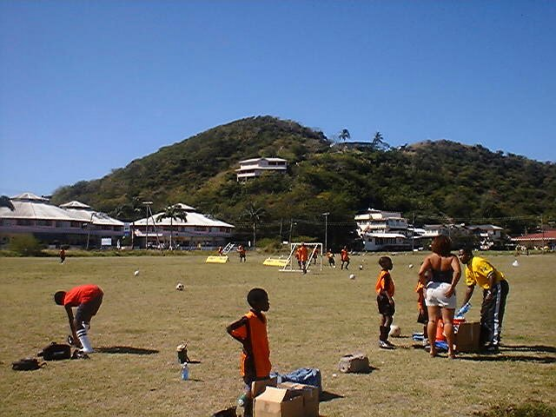
Relationships between categorical variables
Each category as percent of whole

Slide 50

Relationships between categorical variables
Calculate percent of players who had arthritis

Slide 51
Relationships between categorical variables
Calculate percent of players who had arthritis

Slide 52

Categorical data
Smoking Data

Slide 53

Categorical data
Smoking Data

Slide 54

Categorical data
Smoking Data

Slide 56
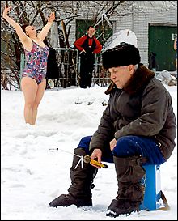
Evaluating Treatment

Slide 57

Evaluating Treatment

Slide 58


Slide 59
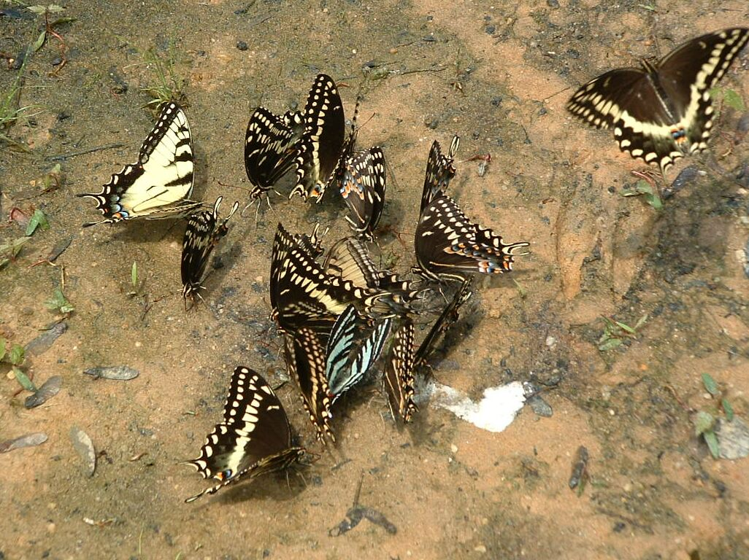
The End

