Slide 1

Quantitative and Psychometric Methods PSY 302
William P. Wattles, Ph.D.
Spring 2020

Slide 2


Slide 3


Slide 4


Slide 5


Slide 6
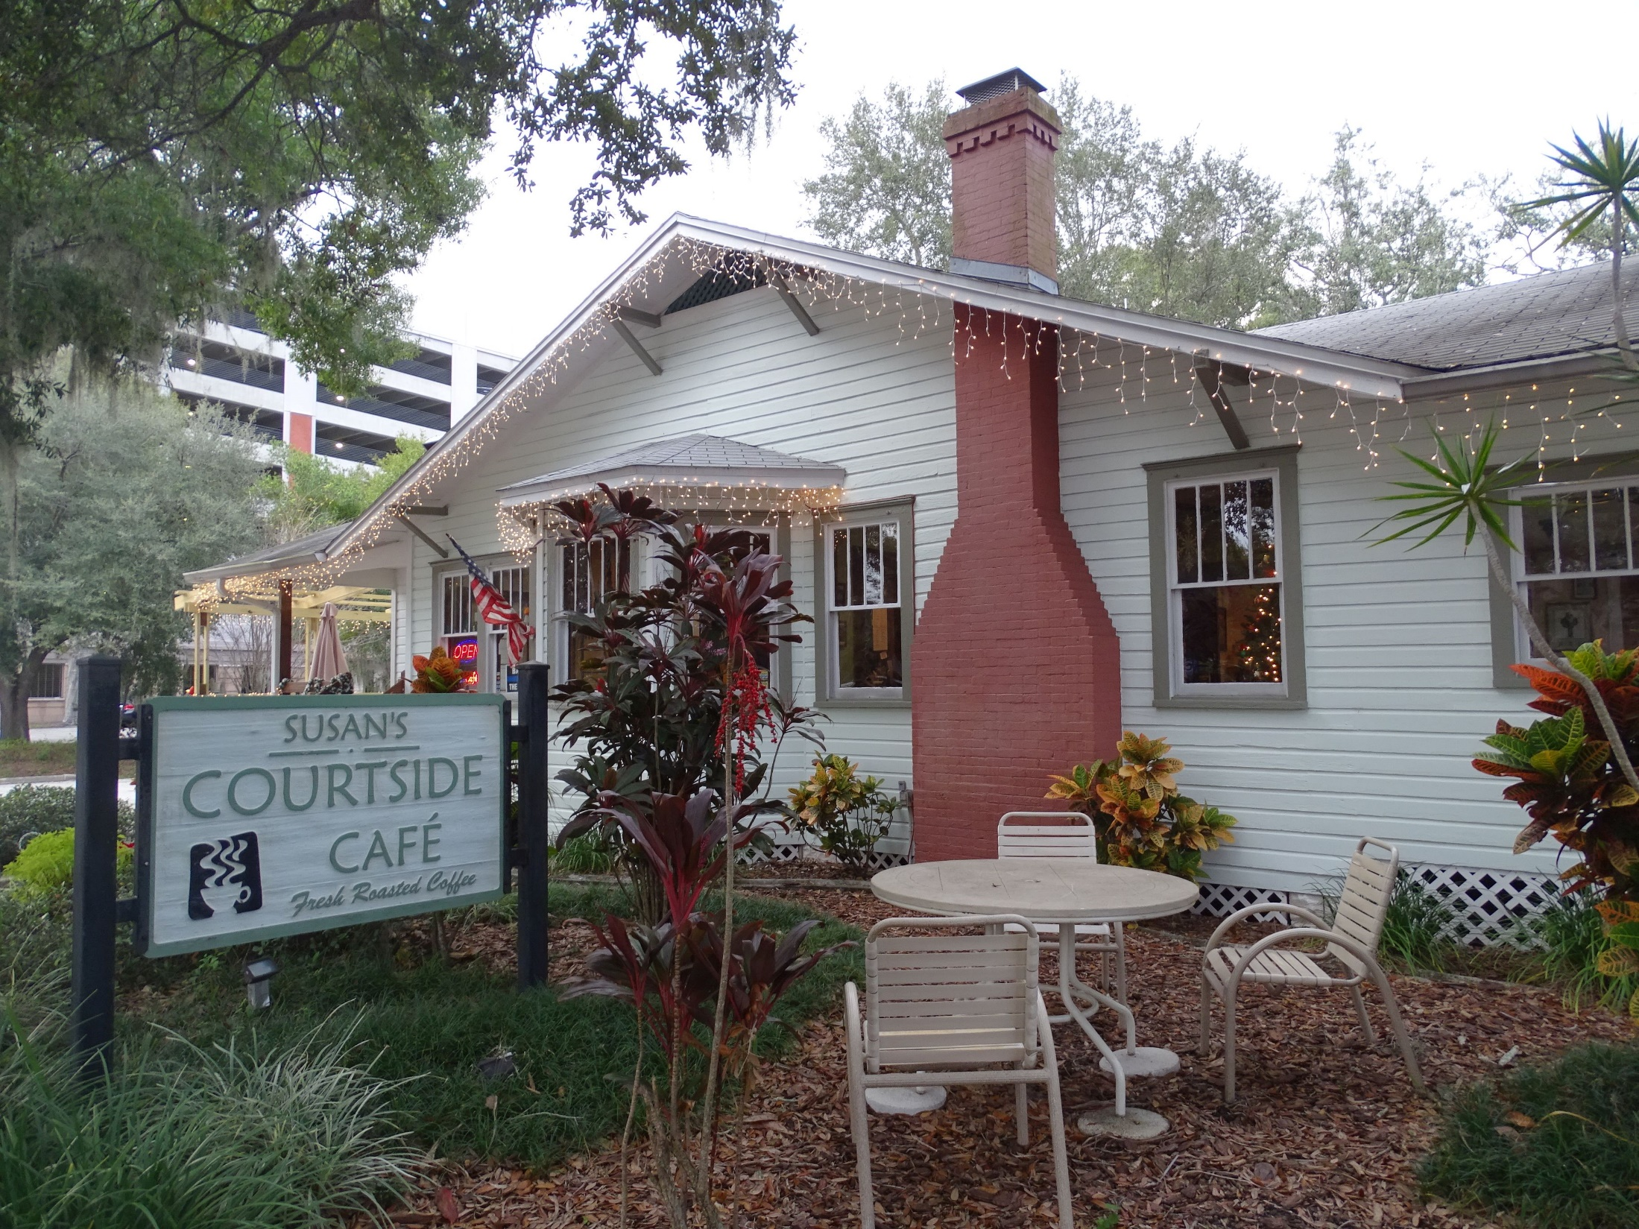

Slide 7


Slide 8


Slide 9


Slide 10
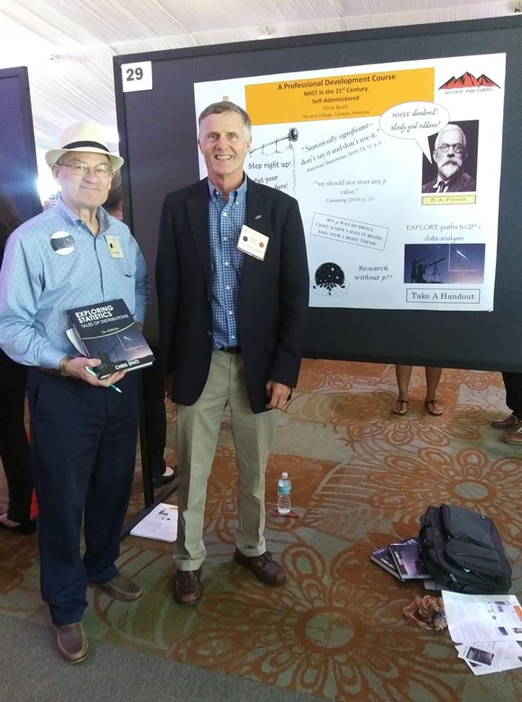
With Dr. Chris Spatz at National Institute of the Teaching of Psychology

Slide 11
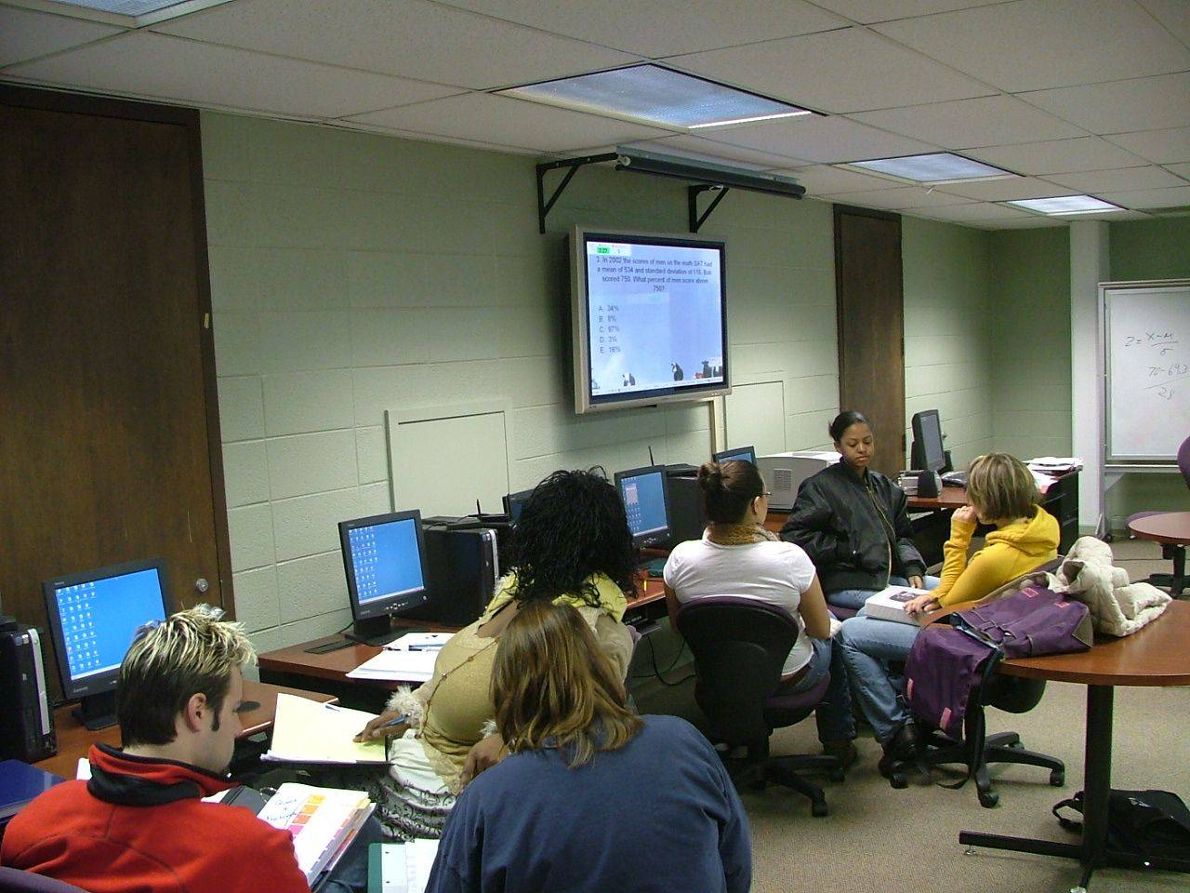
Successful students

Slide 12
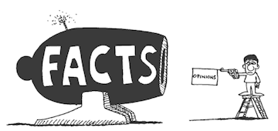
Why statistics?

Slide 13
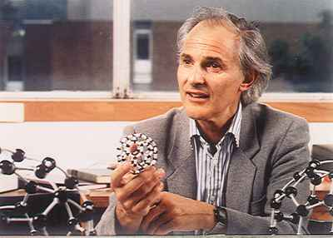
Peter Medawar
science — ‘ incomparably the most successful activity human beings have ever engaged upon’.

Slide 14

Belief/Data example
Notes:
Snow, an obstetrician who pioneered the use of anesthesia in Britain, published On the Mode of Communication of Cholera in 1849. His hypothesis (and supporting data) held that the scourge was caused by sewage pollution in drinking water and "always commences with disturbances of the functions of the alimentary canal.“This position went largely ignored by the medical establishment and authorities and was opposed by a local water company near one London outbreak. Prevailing views thought that, as with most diseases, "miasma" or bad air was the culprit.

Slide 15
Fixation of Belief -Peirce
method of tenacity
Method of authority
a priori method
method of science
Notes:
Swimming after lunch
Copernicus and Galileo

Slide 16
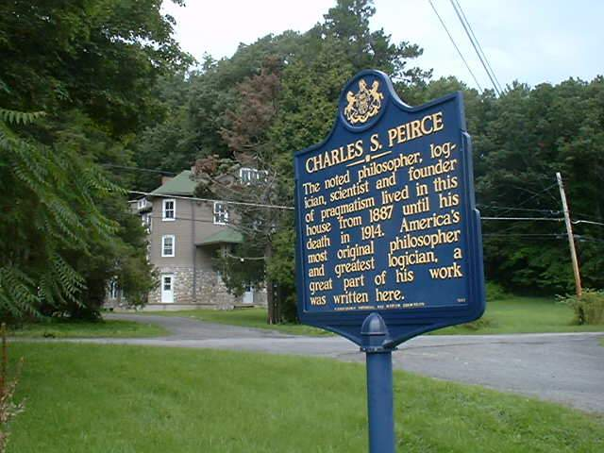

Slide 17
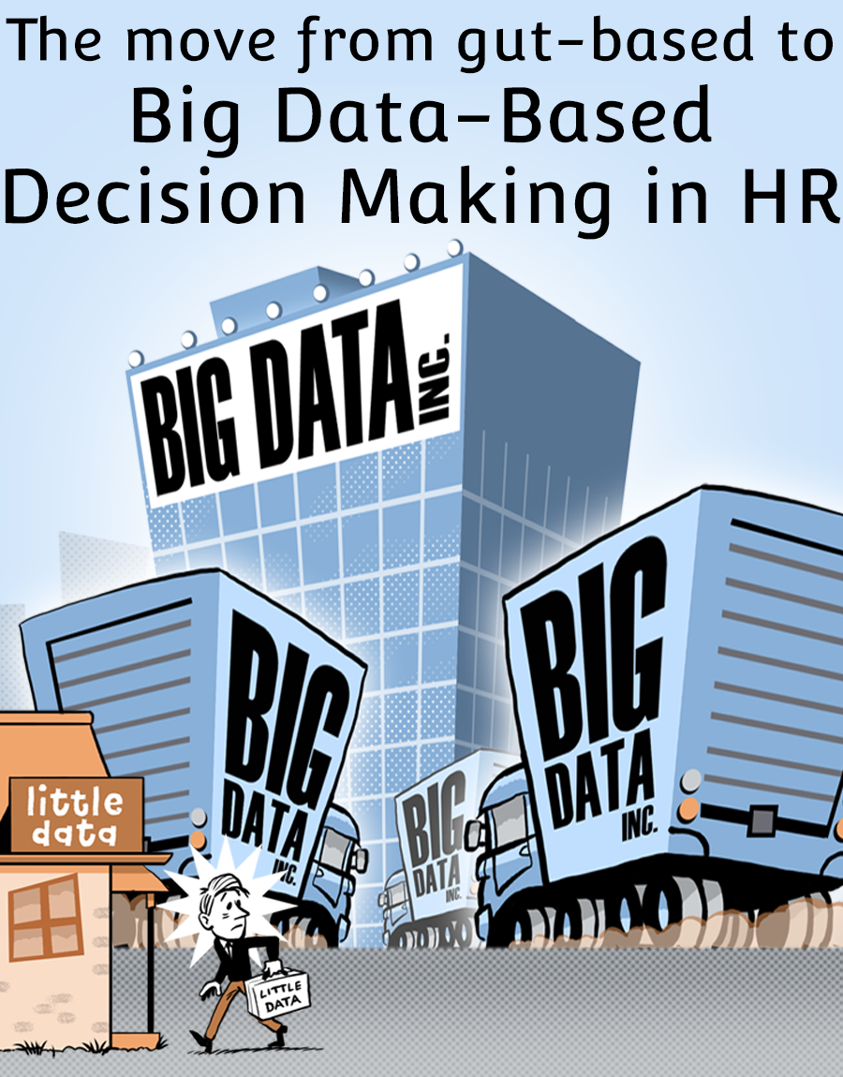

Slide 18

Empirical Example
New York Times in class

Slide 19
Empirical Data Example

Slide 20
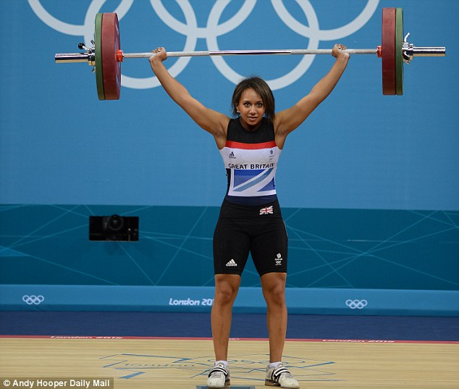
The Scientific Method
empirical:
a. Relying on or derived from observation or experience: “empirical results that supported the hypothesis.”

Slide 21
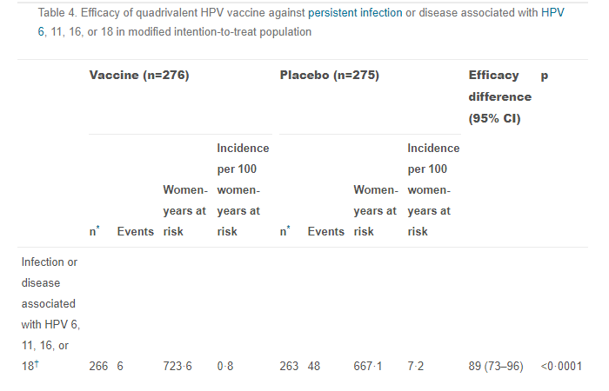
Reduction in infection with HPV vaccine

Slide 22
Does flu shot help prevent flu?

Slide 23
Data show unvaccinated 3 times more likely to get the flu.
Notes:
2. Monto AS, Ohmit SE, Petrie JG, Johnson E, Truscon R, Teich E, Rotthoff J, Boulton M, Victor JC. Comparative efficacy of inactivated and live attenuated influenza vaccines. N Engl J Med. 2009;361(13):1260-7
https://blog.minitab.com/blog/adventures-in-statistics-2/how-effective-are-flu-shots

Slide 24
First Homework
Use the form in the homework section of the web page.
Complete two nonsense quizzes and give me your percent score for each test.
This will allow us to collect some data

Slide 25
Homework
All homework submitted via forms
Adhere to deadline to get credit
Homework returned for correction is not credited unless the corrections are made.
16 assignments

Slide 26

Texts
Exploring Statistics: Tales of Distributions
https://exploringstatistics.com/

Slide 27
Psychology
The science that deals with mental processes and behavior.

Slide 28
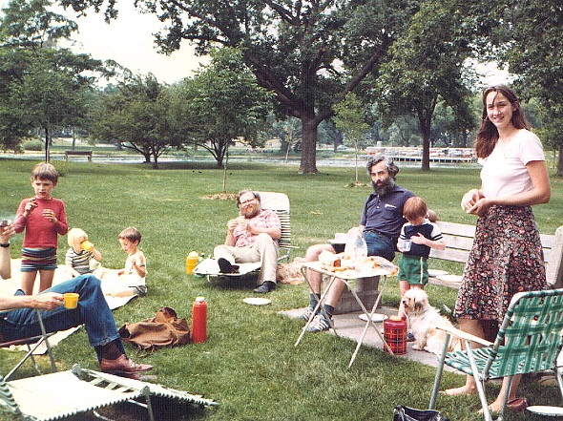
Human Behavior
Individual differences
  Predict
  Understand
  Change

Slide 29
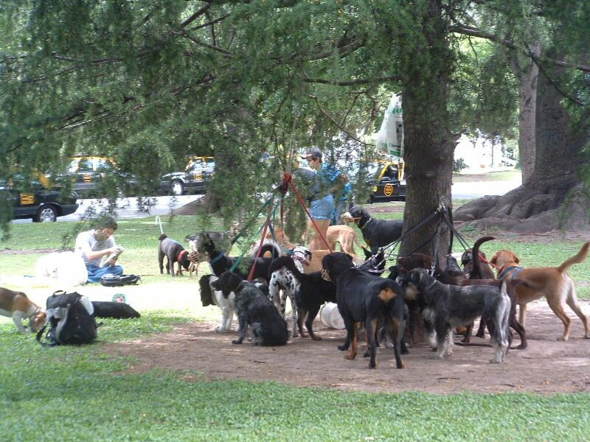
Individual Differences
Variations in the psychological variables between organisms

Slide 30
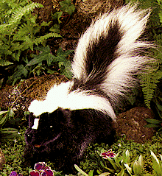
Individual Differences
We rarely or never find absolute results.

Slide 31

Individual differences
People vary in their ability to learn.
  Some learn quickly with little effort
  Some learn slowly with much effort

Slide 32

Don’t put yourself down
You can pass this course.
Must work daily.
Prepare for class
Attend class
Review
Do Homework
Notes:
Earl: I done told myself I can’t learn it and now I can’t.

Slide 34
Statistics
Statistics: The science of gaining information from numerical data.
Data: numbers with a context. Collections of measurements for objects.
Data analysis: using numbers and graphs to make sense of data

Slide 35


How Theo Epstein's Love of Data Helped the Red Sox and Cubs Finally Win the World Series
Notes:
Cubs 108 red sox 86 first since 1908, ending the longest world championship drought in North American professional sports history.

Slide 36

How the music industry uses big data to create the next big hit

Slide 37
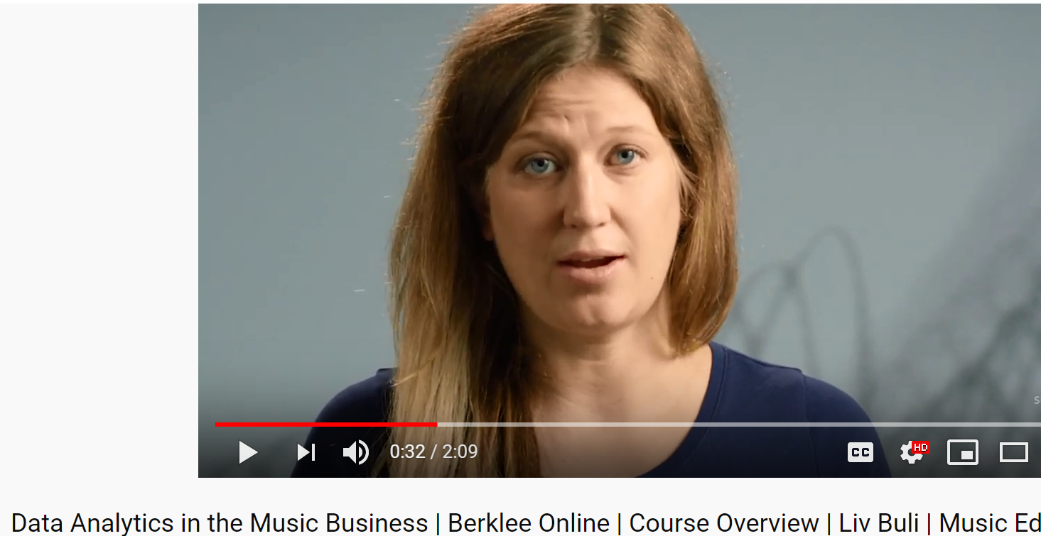
How Data Science Is Revolutionizing The Music Industry

Slide 38
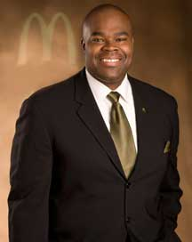
McDonald’s Names U.S. Chief as Its No. 2 Executive
Over the last year, the company had counted 120,000 requests on Twitter calling for them to sell breakfast items all day.
Notes:
Yesterdays new york times, Purdue University with engineering degree began in 1990. Don Thompson
As President and Chief Operating Officer, Don Thompson directs global strategy and operations for the 32,000 McDonald’s restaurants in 117 countries to create value for McDonald’s and its shareholders.
As Innovation Orchestration Leader of McDonald's Restaurant Solutions Group, Thompson headed groups that identified new markets and trends that the chain might exploit, both in the United States and overseas. One of the most visible outcomes of Thompson's work was a new proliferation of menu items tailor-made to local tastes in McDonald's markets such as Japan, where a McDonald's shrimp burger was introduced in 2005. Thompson oversaw menu management, concept development, and research for McDonald's in the 120 countries in which the chain operated. His work showed results as McDonald's worldwide sales rose 7.9 percent in 2004, with same-store sales rising an impressive 7.1 percent.
Read more: Don Thompson Biography - Assumed Call Was from McDonnell-Douglas, Became First African-American Division Head http://biography.jrank.org/pages/2992/Thompson-Don.html#ixzz1B1P6EbOx
McDonald’s and our franchisees collectively employ more than 1.6 million people around the world.

Slide 39
The behavior I wonder about is why adults physically, sexually, and mentally abuse children. Their own children in particular.
Why are some people altruistic without any return?
I wonder how people can continue to treat their bodies poorly after having a health scare or other health issues.
Why do people commit suicide?
A mental behavior such as depression.
Why do criminals commit crimes they know will result in jail time?
Why are people afraid of loud noises?

Slide 40
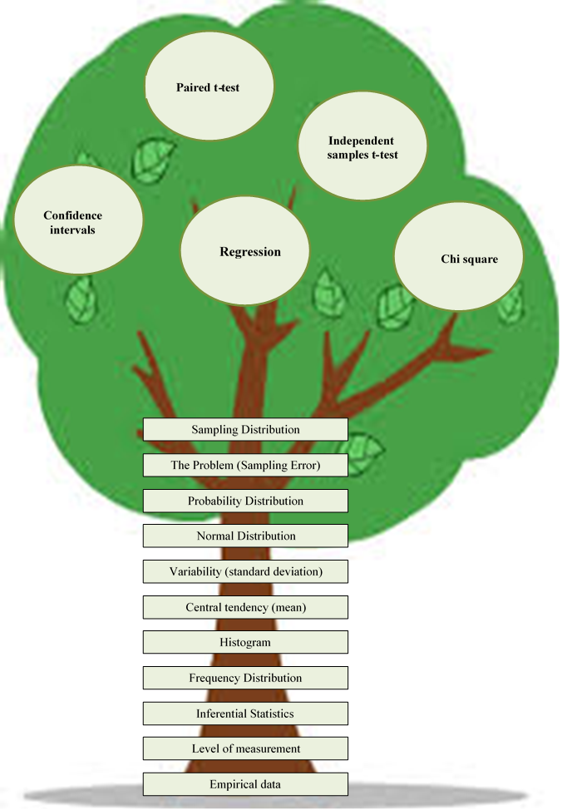

Slide 41
Variables
Data: numbers with a context. Collections of measurements for objects.
Variable: any characteristic of an individual. Can take different values for different individuals.
Variables can be quantitative or categorical

Slide 42
Level of Measurement
Two broad types of variables
categorical or qualitative
  Something that falls into one of several categories. What can be counted is the count or proportion of individuals in each category.
  Example: Your blood type (A, B, AB, O), your hair color, your ethnicity, whether you paid income tax last tax year or not.

Slide 43
Level of Measurement
quantitative or measurement
  Something that can be counted or measured for each individual and then added, subtracted, averaged, etc., across individuals in the population.
  Example: How tall you are, your age, your blood cholesterol level, the number of credit cards you own.

Slide 44
Level of Measurement
Categorical or Qualitative
  Nominal
    Francesca’s secret code for posting grade
  Ordinal
    Anisha was first, Francesca was second

Slide 45
Level of Measurement
Quantitative or Measurement
  Interval
    Score on the music trivia quiz
  Ratio
    Also score on music trivia, age

Slide 46
Measurement vs. Categorical Data

Slide 47
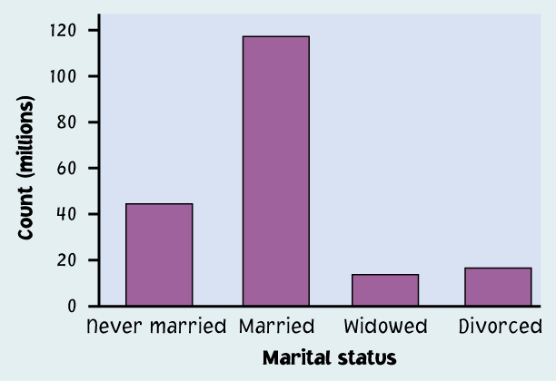
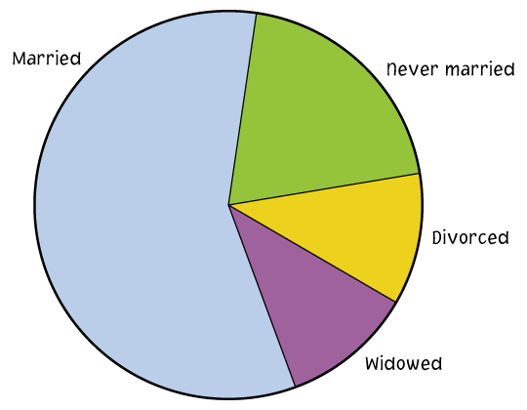
Ways to chart categorical data
  Bar graphs
  Each category is
  represented by
  a bar.
  Pie charts
  The slices must
  represent the parts of one whole.

Slide 48
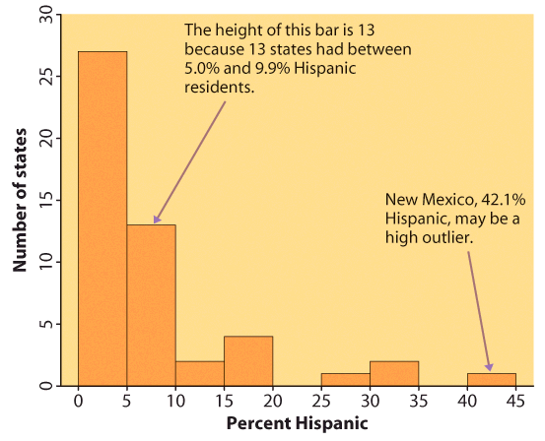
Histogram to chart Measurement Data
The range of values that a variable can take is divided into equal-size intervals.
The histogram shows the number of individual data points that fall in each interval.

Slide 49
Example of data

Slide 50
How do you decide if a variable is categorical or quantitative?
Homework
Annisha #1
Francesca #2
What is being recorded about the individuals?
Is that an amount (quantitative)
or a statement (categorical)?
Flower quiz
Deona 30%
Regina 70%

Slide 51
Example
Categorical
Each individual is assigned to one of several categories
Quantitative
Each individual is attributed a numerical value
Individuals in sample | DIAGNOSIS | AGE AT DEATH
Patient A | Heart disease | 56
Patient B | Stroke | 70
Patient C | Stroke | 75
Patient D | Lung cancer | 60
Patient E | Heart disease | 80
Patient F | Accident | 73
Patient G | Diabetes | 69

Slide 52
Level of Measurement
Quantitative or Measurement
  Interval
  Ratio
Categorical or Qualitative
  Nominal
  Ordinal

Slide 53
Examples
935,935 workers on U.S. soil
Ezekiel Elliott wears number 21, Dak Prescott is number 4
Education is largest department, business is second
My cabina in Costa Rica cost 2500 colones.
Miriam is 5 feet 4 inches tall
Tom is the tallest person at his work
Wednesday’s most active stock was Bed, Bath and Beyond
Bed, Bath and Beyond traded 55,300,000 shares

Slide 54
Descriptive versus Inferential
Descriptive statistics: methods used to describe the data that has been collected.
Inferential statistics: estimating population parameters based on sample statistics.

Slide 55
Descriptive Statistics
Wendy’s world's third largest hamburger fast food chain with approximately 6,700 locations following McDonald's 36,615 locations and Burger King's 15,243 locations.

Slide 56
Inferential statistics
Students in Fall 2003 liked the New York Times, I infer others will
According to Rasmussen 1/8/2017 58% approve of President Obama and 40% disapprove
“At McDonald's restaurants. We brainstorm and test hundreds of menu items each month”
Notes:
mean 74.4 std dev 7.4 n 200.0

Slide 57
Inferential Statistics
Population: a group of objects or individuals that can be measured
Individuals: the objects described by a set of data. Individuals may be people, animals or things
Sample: a sub-group of objects subjects or individuals.

Slide 59
Population
Sample

Slide 60
Characteristics of data
Parameter: measurable characteristic of a population. A number that describes the population
Statistic: measurable characteristic of a sample. A number that describes the sample and can be computed from sample data.

Slide 61
Population
Parameter
Sample
Statistic

Slide 62

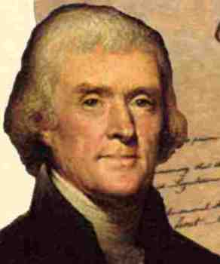
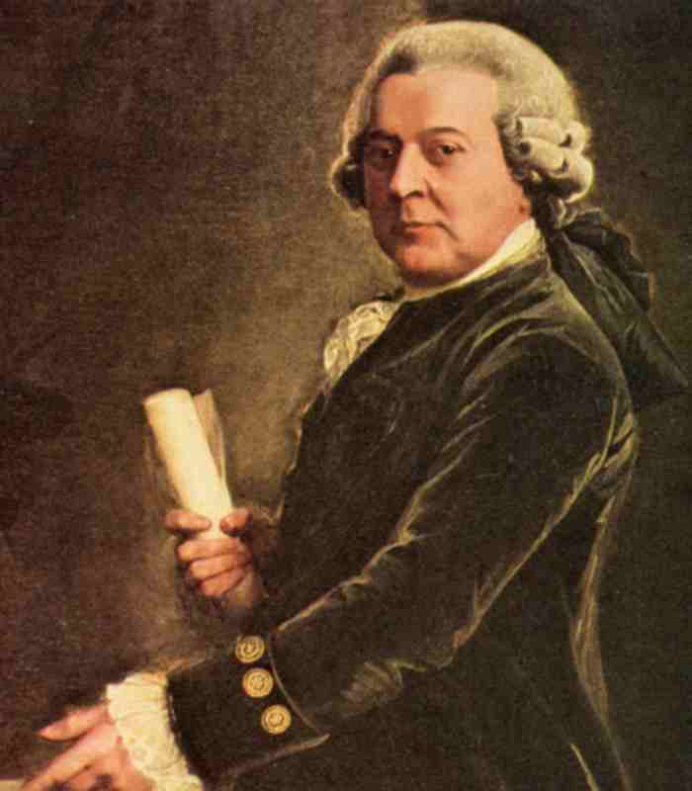
Chance Happens
Died July 4, 1826.
Notes:
Adams 91 Jefferson 83
Two Lindsay Smith’s in Psy 302
Coming back from Florence Italy on my way to Florence, SC I sat on the plane next to a man from Florence, Alabama

Slide 63
Sampling Error
True Population Mean
74.4

Slide 64
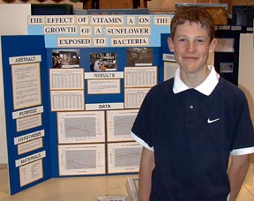
Jonathan A. 7th Grade
Selah Intermediate School
The results of the experiment were that the average height of the plants of variable group A was greater than that of the other variable groups.
What’s the problem with his conclusion?
______ _______

Slide 65
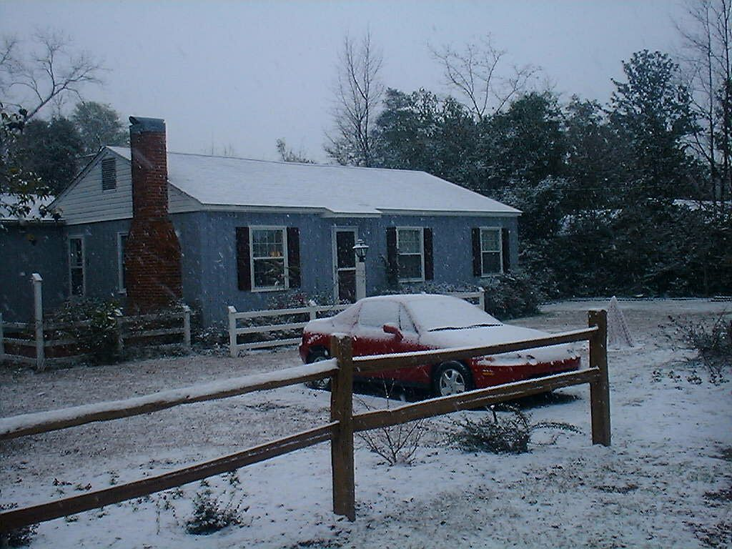
Capitalizing on Chance
One day in January it was colder in Florence, SC than in New Vineyard, Maine.

Slide 66
Review so far
Psychology as a science requires empirical observation to support our hypotheses.
Data are numbers that represent our observations.
We use inferential statistics to draw conclusions about a population based on a sample.
Chance can lead to misleading data

Slide 67
Frequency Distributions
Chapter 1

Slide 68
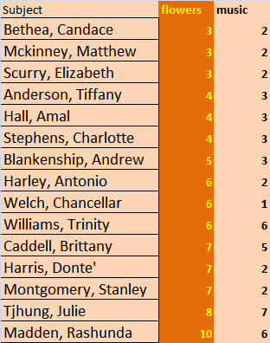
Data example
What type of variable?

Slide 69
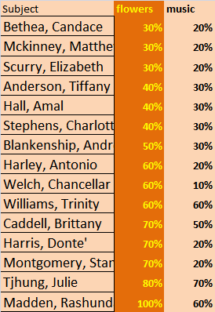
Data example
What type of variable?
Per cent
Notes:
Per cent is per hundred 3 out of 10 equal 3 out of 100

Slide 70
Frequency Distribution
All the values a variable can take and how often each occurs.

Slide 71
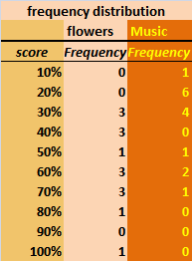
Frequency Distribution
All the values a variable can take and how often each occurs.

Slide 72
Frequency Distribution
The most common graph of the distribution of one quantitative variable is a histogram

Slide 73
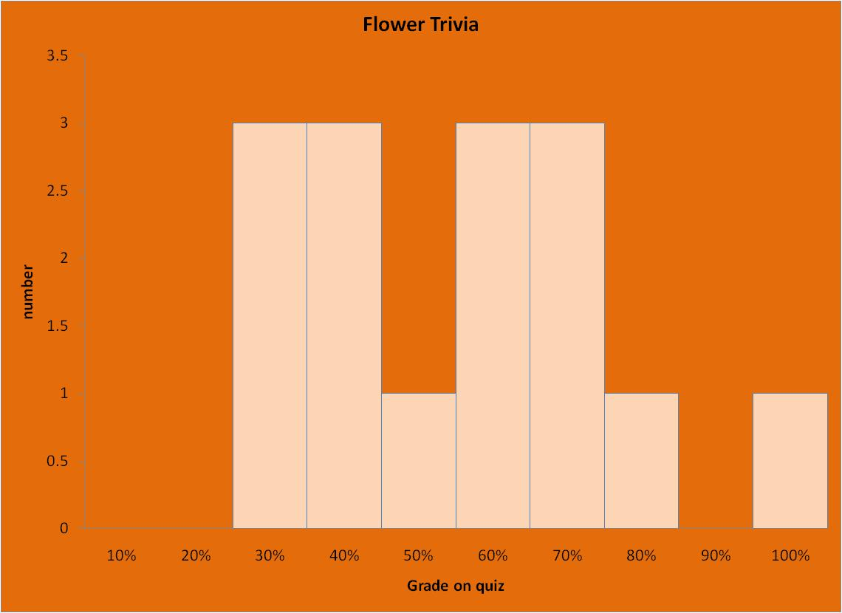

Slide 74
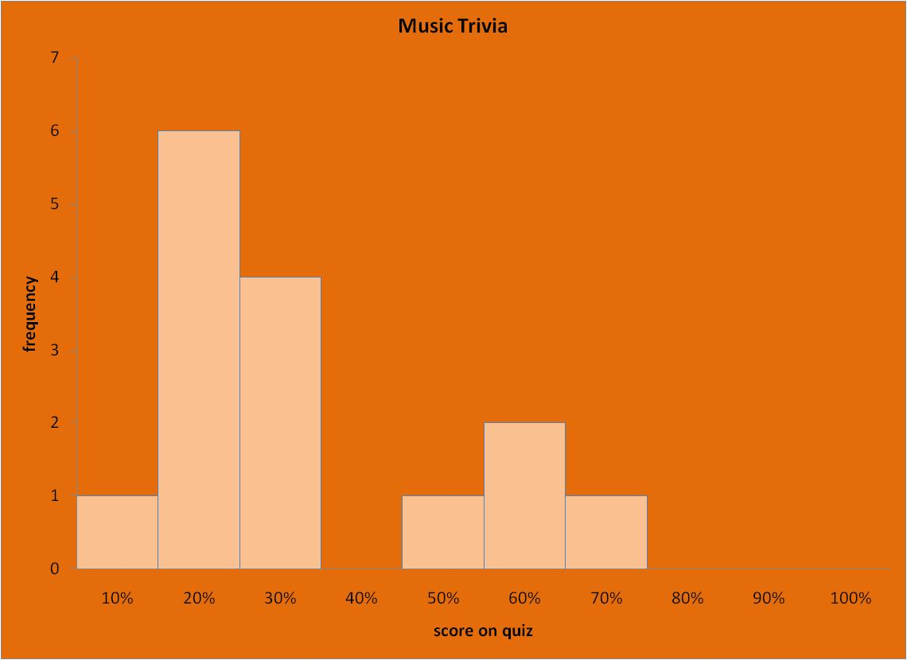

Slide 75
Frequency Distribution
Concerned with frequency of values of one variable called X
Represented by histogram or density curve
The levels of the variable on the horizontal axis and frequency on the vertical axis.
Symmetrical distributions described by mean and standard deviation

Slide 76
Describing a distribution
Center: where is the middle of the data?
Spread: is the data tightly bunched or spread out?
Shape: are the data symmetrical?
Outliers: Are there extreme values which may suggest an error or require a special explanation?

Slide 77
Histograms
Used for:
A Measurement Data
B Qualitative Data
C Categorical Data
D. All of the above

Slide 78
Homework
Grade on web
Credit for a “reasonable effort”
  Help menu
  Do what you can
Must make corrections if I return it.

Slide 79
Homework 2 Heather

Slide 80
Frequency Distribution
Concerned with frequency of values of one variable called X
Represented by histogram or density curve
The levels of the variable on the horizontal axis and frequency on the vertical axis.
Symmetrical distributions described by mean and standard deviation

Slide 81
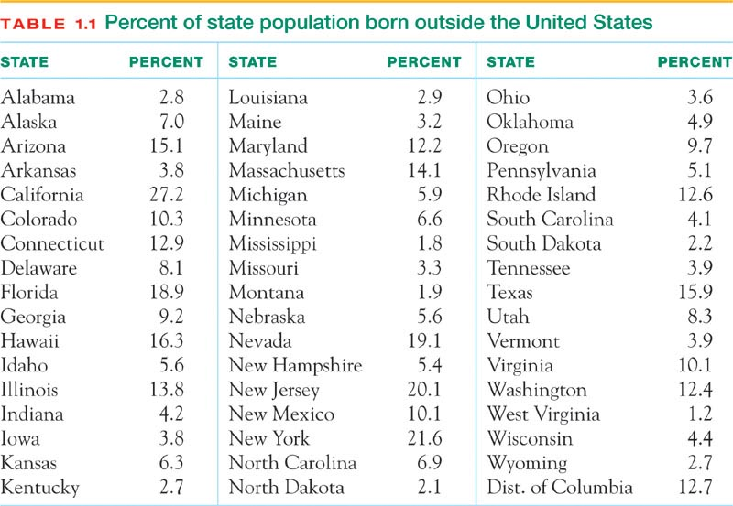

Slide 83
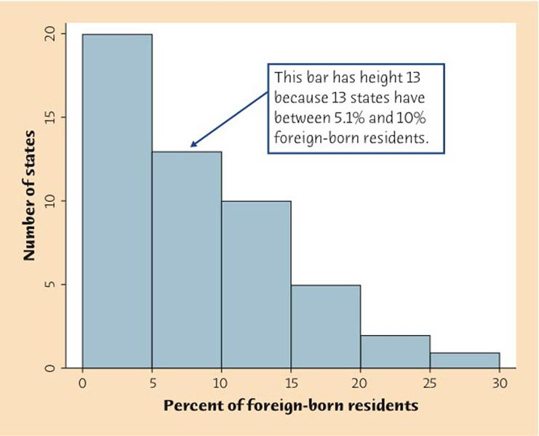

Slide 84
Distribution
All the values a variable can take and how often each occurs.

Slide 85
Describing a distribution
Center: where is the middle of the data?
Spread: is the data tightly bunched or spread out?
Shape: are the data symmetrical?
Outliers: Are there extreme values which may suggest an error or require a special explanation?

Slide 86
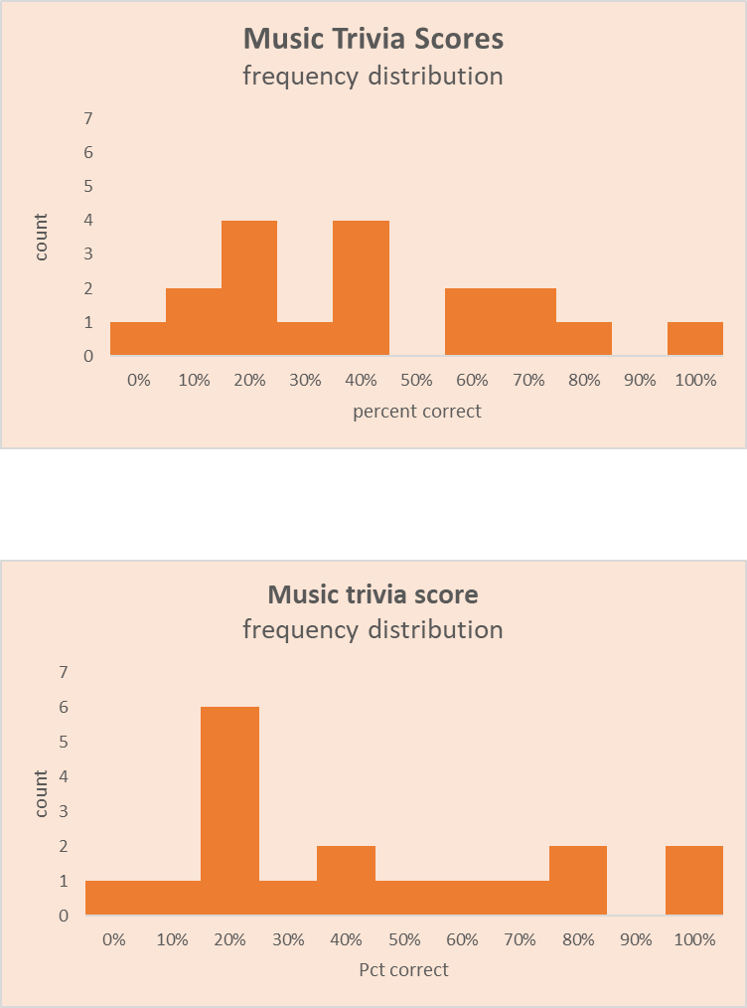

Slide 87
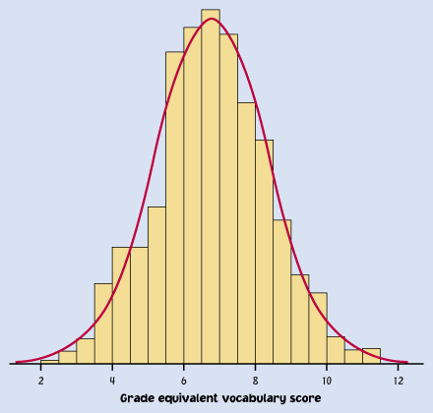
9

Slide 88
Density Curves
Represent the proportion of observations that fall in each range of values
The total area under the curve is exactly 1

Slide 89
Density Curves
A density curve describes the overall pattern of a distribution.
Curves give us a picture but numbers give us a more precise description.

Slide 90


Slide 91
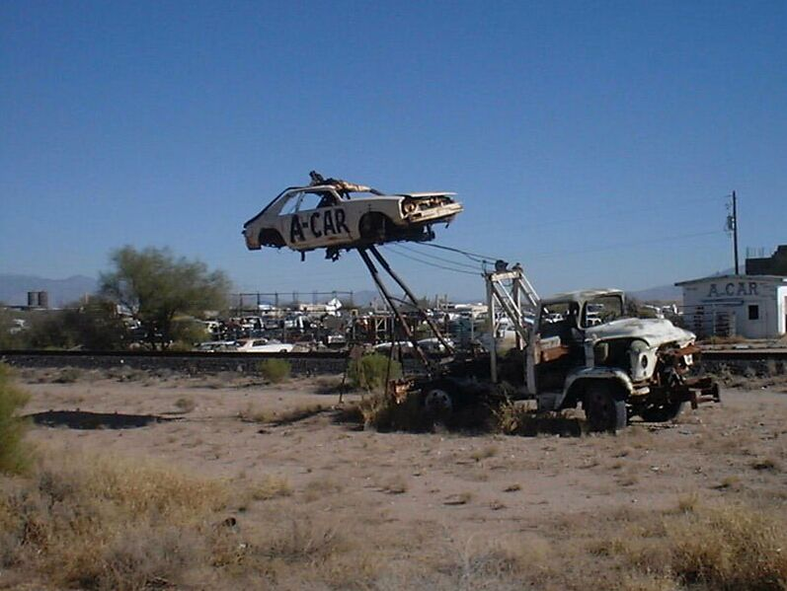
The End
The End

Slide 92


Slide 94
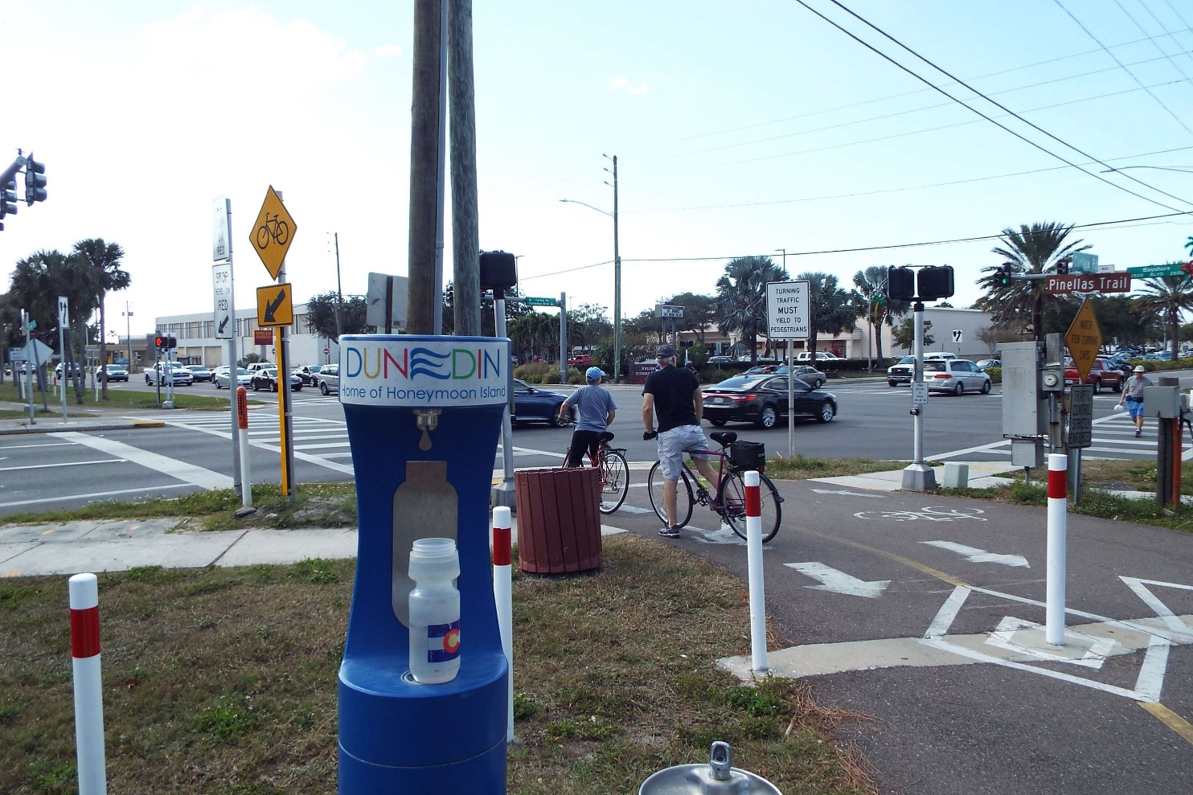
Why do people buy water?

Slide 95

Why do some people travel?

Slide 96
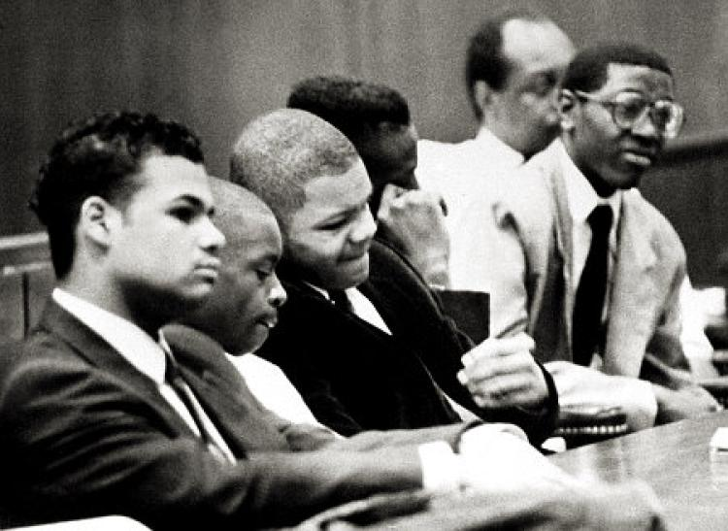
Why do some people confess to crimes they did not commit?

Slide 97
