Slide 1
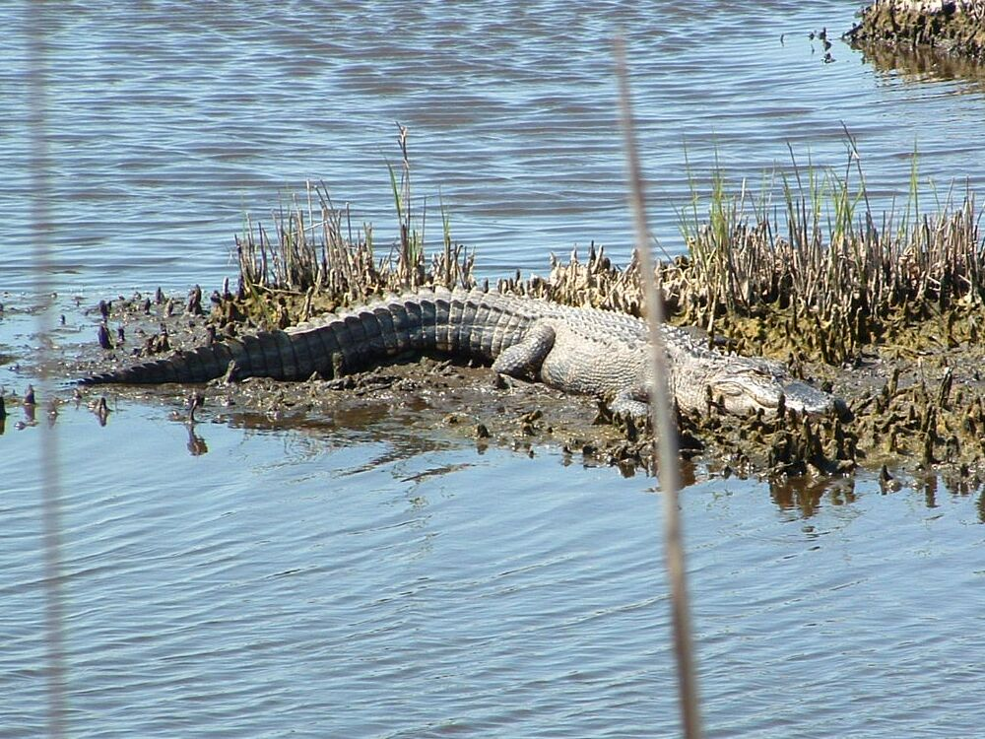
T-tests
Inference When the Population Standard Deviation Is Not Known.

Slide 2
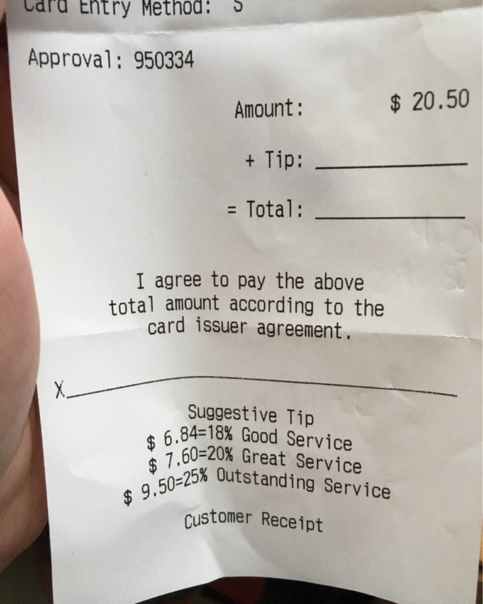

Slide 3
Time to get real
Z scores assume that we know the standard deviation of the population. Which is usually not the case.
Improve accuracy and power by using T-distributions for small samples

Slide 4
Music Trivia

Slide 5
Music Trivia

Slide 6
Hypothesis test for music trivia data

Slide 7
t distribution
Table C
There is a different t distribution for each sample size.
t same formula as Z but uses a different table of values
Degrees of freedom determined by sample size tells which t distribution to use.

Slide 8
t distributions
similar in shape to the normal curve
the spread is greater because using s to estimate the pop standard deviation introduces more variation.
As the degrees of freedom increase the curve approaches the normal curve.
Table c when n= 1000 T is nearly equal to Z

Slide 9
T Distributions
Different for different sample sizes
Select appropriate distribution by determining degrees of freedom (n-1)
Critical value is different for different sample sizes.
Critical value similar to Z in large samples

Slide 10
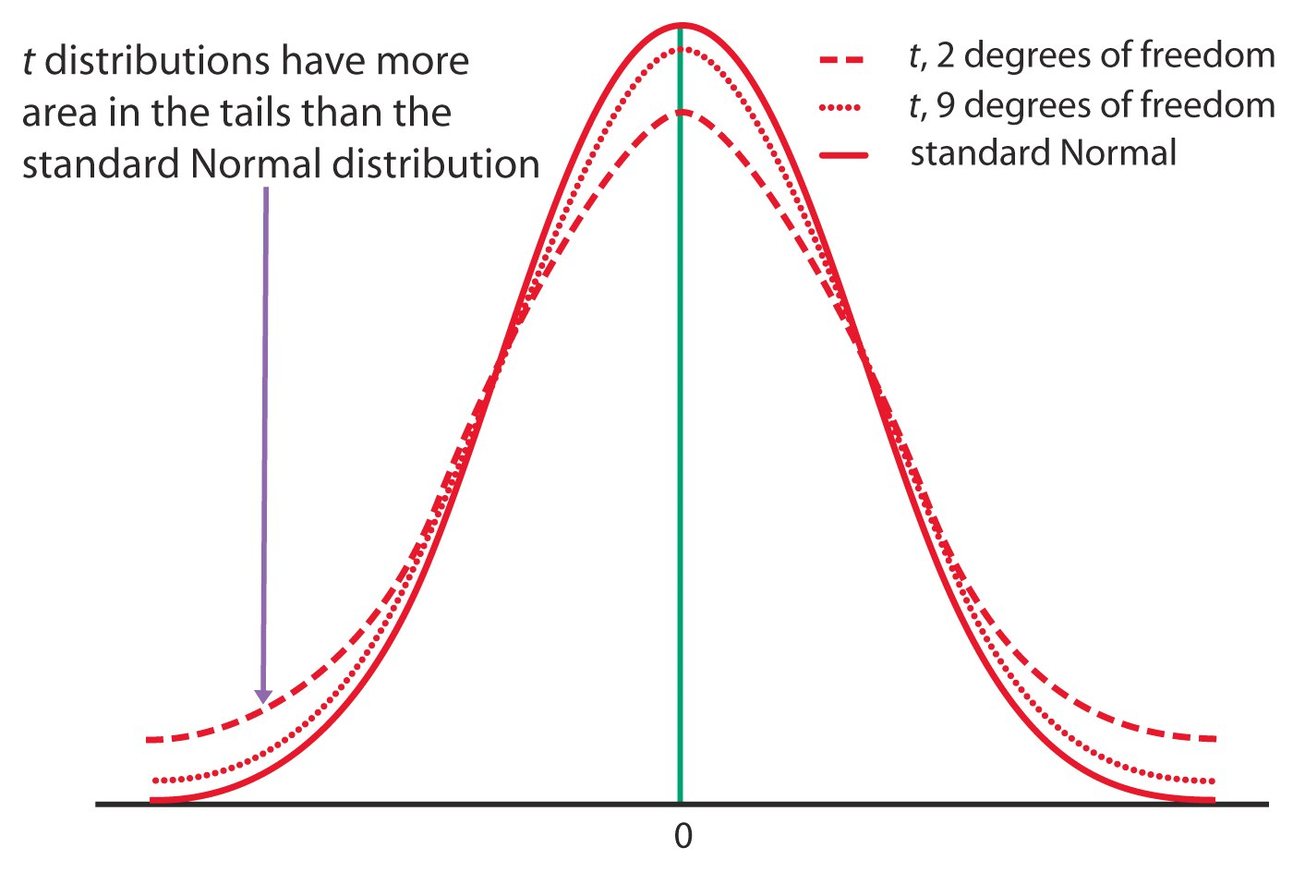
The t Distributions

Slide 11
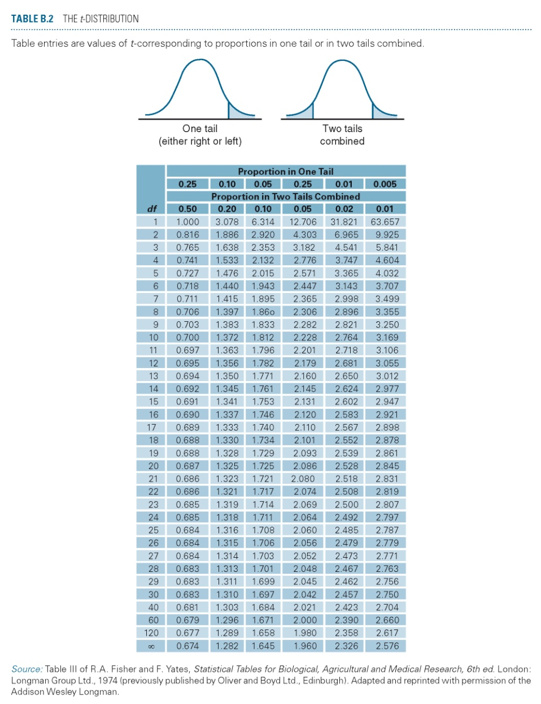
Using Table B.2
Table B.2 on page 633 gives critical values having upper tail probability p.

Slide 12
T-test example from student paper
Baseball | Basketball
4 | 6
6 | 6
9 | 7
5 | 8
5 | 9
6 | 8
6 | 6
3 | 4
5 | 6
5 | 5
6 | 6
5 | 7
10 | 9
5 | 9
4 | 7
I asked 36 random students who live near me whether they would rather attend a basketball or baseball game, and then asked their likelihood of attending the sport of their choice the next evening, given they had free time. The independent variable was their choice of baseball or basketball, and the dependent variable was their likelihood of attending the sport of their choice the next evening based on a 1-10 scale.
Notes:
Detrek Browning

Slide 15

Confidence intervals with t distribution
Calculation similar to using Z.
Substitute the sample standard deviation for the population deviation
Look up the critical value in table B.2

Slide 16

Excel
User friendly
  manipulate data
  make charts
  limited data analysis

Slide 17
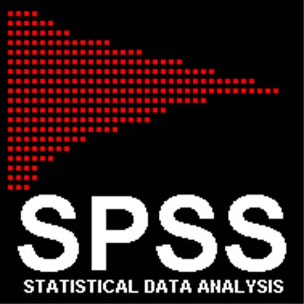
SPSS
Powerful statistical package

Slide 18
T-test to two sample Data
Compare urban and rural nursing homes for revenue.

Slide 19
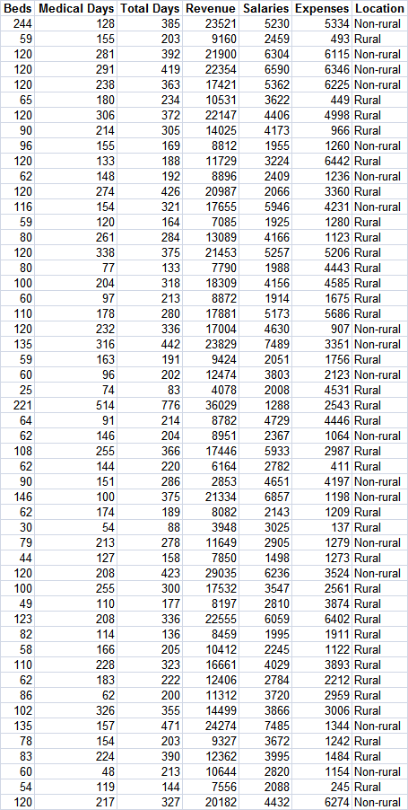
Analyze Data
Type of test
  Matched Pairs
  One-sample
  Independent Samples
One-tail or two
  Ho µ = 0
  Ha
    µ =/= 0
    µ < 0
    µ > 0

Slide 20
Nursing home data

Slide 21
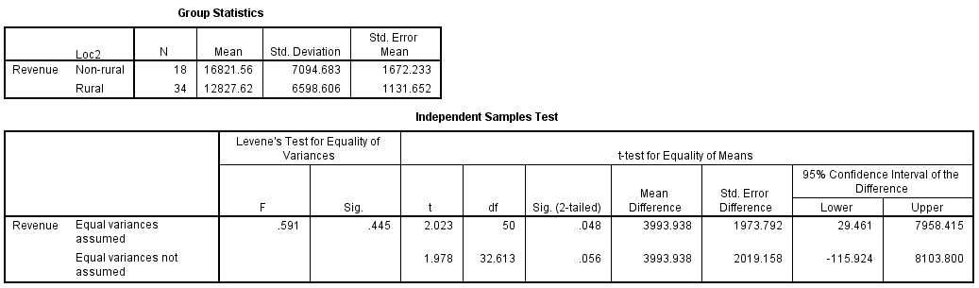

Slide 22
T-test to two sample Data
Compare urban and rural nursing homes for patient days.

Slide 23
Nursing home data

Slide 24
SPSS output

Slide 25
Effect Size
Hypothesis testing looks at the statistical significance of the effect
Effect size looks at the size of the effect.
Different procedures use different measures of effect size.

Slide 26
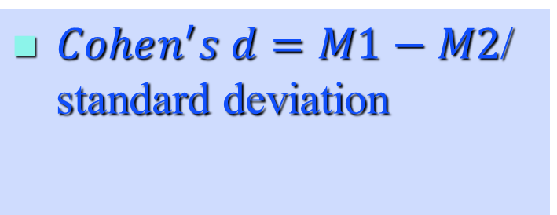
Cohen’s d
The number of standard deviations an effect shifted above or below the mean stated in the null hypothesis.
$Cohen^{′}s d=M1−M2$/ standard deviation
Notes:
https://www.socscistatistics.com/effectsize/Default3.aspx

Slide 27
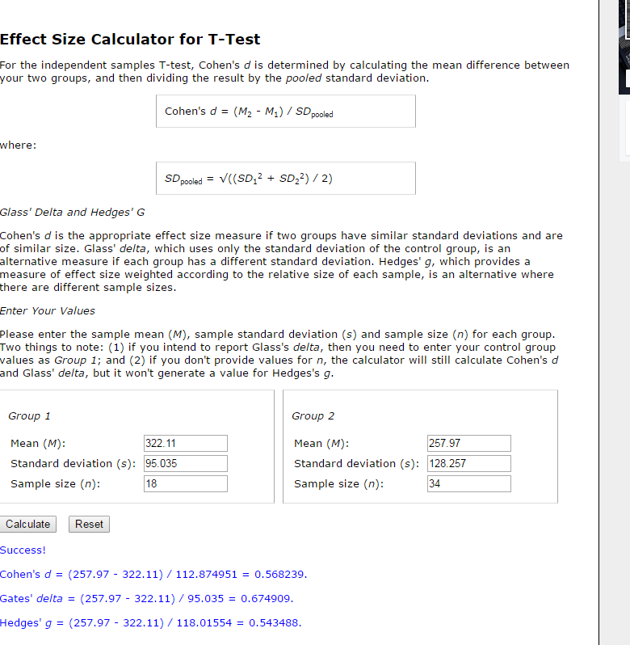
Notes:
https://www.socscistatistics.com/effectsize/Default3.aspx

Slide 28
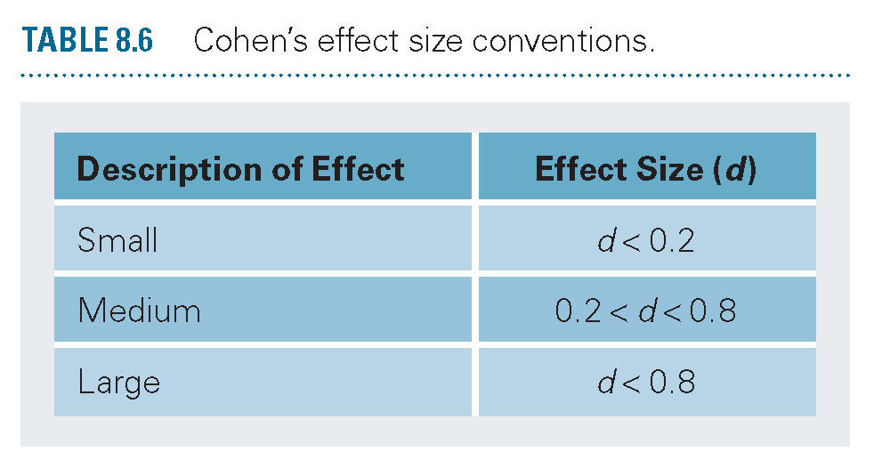
Cohen’s d
Cohen’s d equals zero when the means are the same and rises as they differ.

Slide 29
T-test for Paired data
Women in the workforce
Alternative hypothesis there is some change direction not assumed

Slide 30

Paired data

Slide 31
Analyze Data
Type of test
  Matched Pairs
  One-sample
  Independent Samples
One-tail or two
  Ho µ = 0
  Ha
    µ =/= 0
    µ < 0
    µ > 0

Slide 32
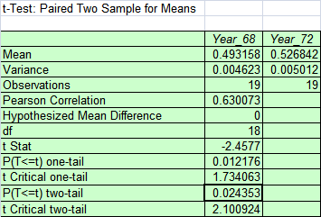
Excel Output

Slide 33
SPSS output

Slide 34
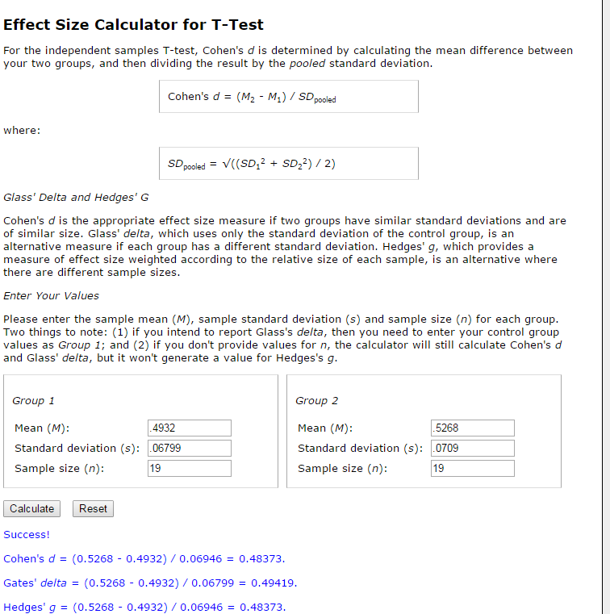
Notes:
https://www.socscistatistics.com/effectsize/Default3.aspx

Slide 35
Two sample versus matched pairs
Cases or subjects in one sample have no connection to or influence of cases or subjects in the other sample.
Sampling distribution of the differences of means.

Slide 36
Religiosity example
Open Religiosity Data
Do these data show a difference in religiosity between men and women?

Slide 37
T-test for independent samples assume unequal variance

Slide 39
T-test for matched pairs
Notes:
Note that means are the same.

Slide 40
Paired samples t-test can be have more power
Paired doesn’t always mean same person.
The item in one column is in some way related to the other.

Slide 41
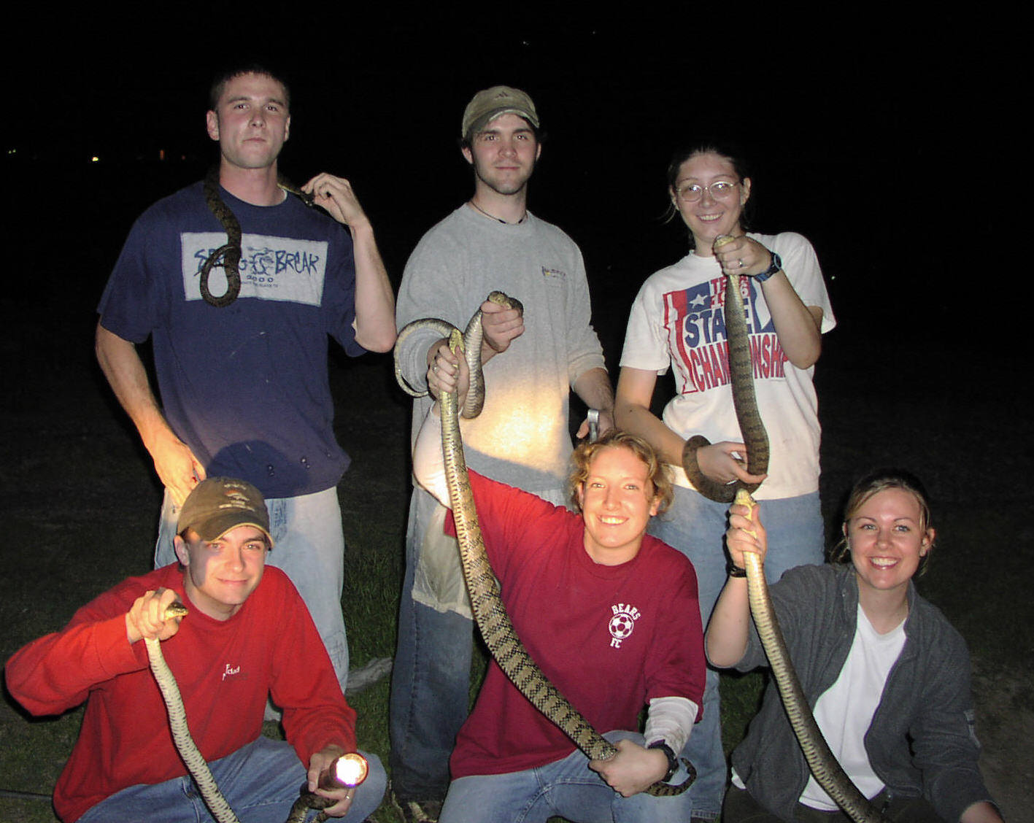
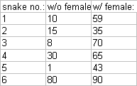
Do male snake encounters last longer in the presence of a female. Six males were tested in the presence of a female and again in the absence of a female. Whether each male was tested first with or without a female was randomly determined. The results in interaction time (min.) are as follows

Slide 42
Analyze Data
Type of test
  Matched Pairs
  One-sample
  Independent Samples
One-tail or two
  Ho µ = 0
  Ha
    µ =/= 0
    µ < 0
    µ > 0

Slide 43
Excel Output, 2-tail matched pairs

Slide 44
SPSS output

Slide 45
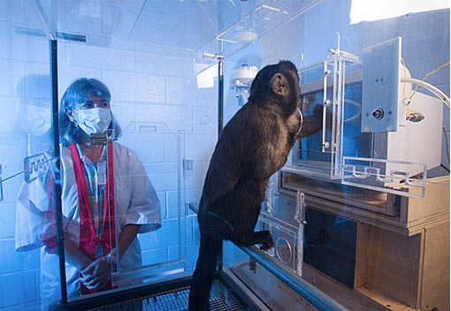
Brain responds to sound pg 456
Do monkey cells respond more strongly to monkey calls than pure tones?
Monkey is exposed to a tone and then to a call.

Slide 46
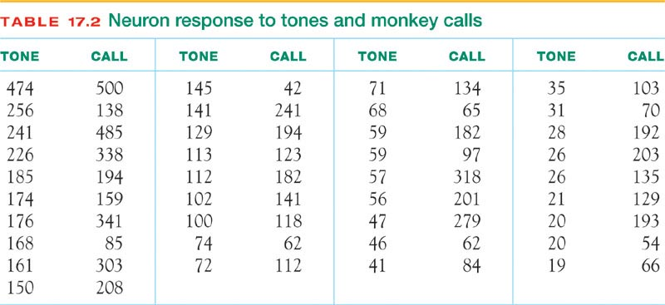
Analyze Data
Type of test
  Matched Pairs
  One-sample
  Independent Samples
One-tail or two
  Ho µ = 0
  Ha
    µ =/= 0
    µ < 0
    µ > 0

Slide 47
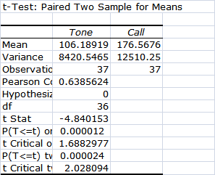
Excel Output

Slide 48
SPSS output

Slide 49
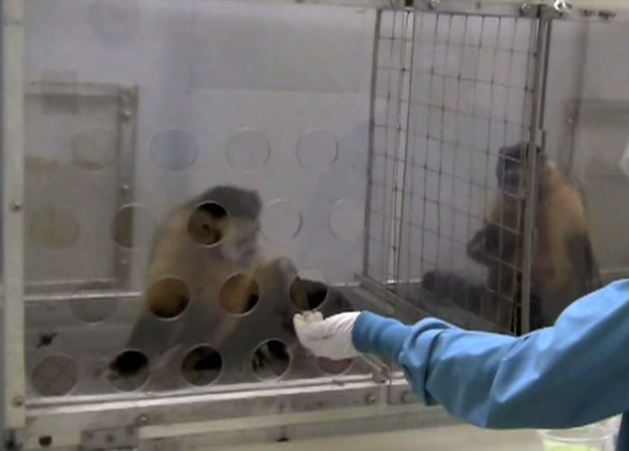
https://www.youtube.com/watch?v=meiU6TxysCg

Slide 50
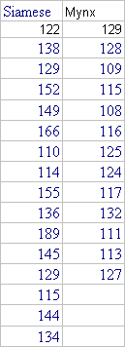
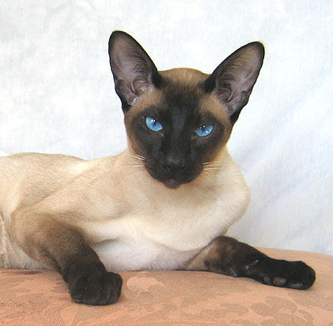
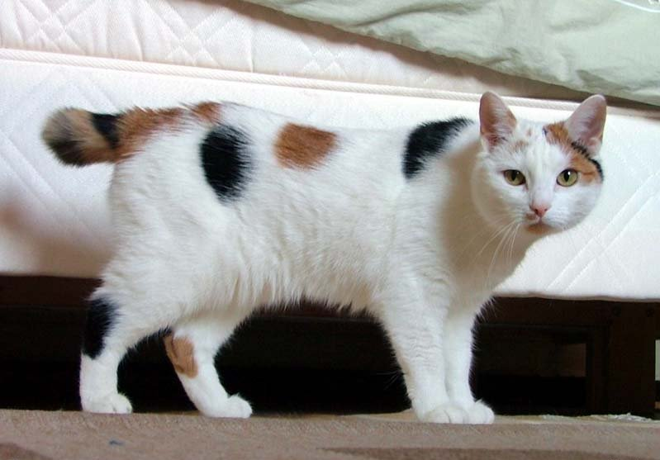
Which has higher blood pressure?

Slide 51
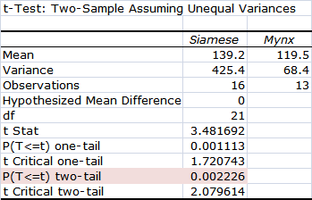
Excel Output
Two tail, independent samples

Slide 52
Just simply say: reject the null hypothesis
Or fail to reject the null hypothesis.

Slide 53
SPSS output

Slide 54
Inference as a decision
We make a decision to accept Ho or Ha.
Sometimes we are correct
Sometimes we are wrong.

Slide 55
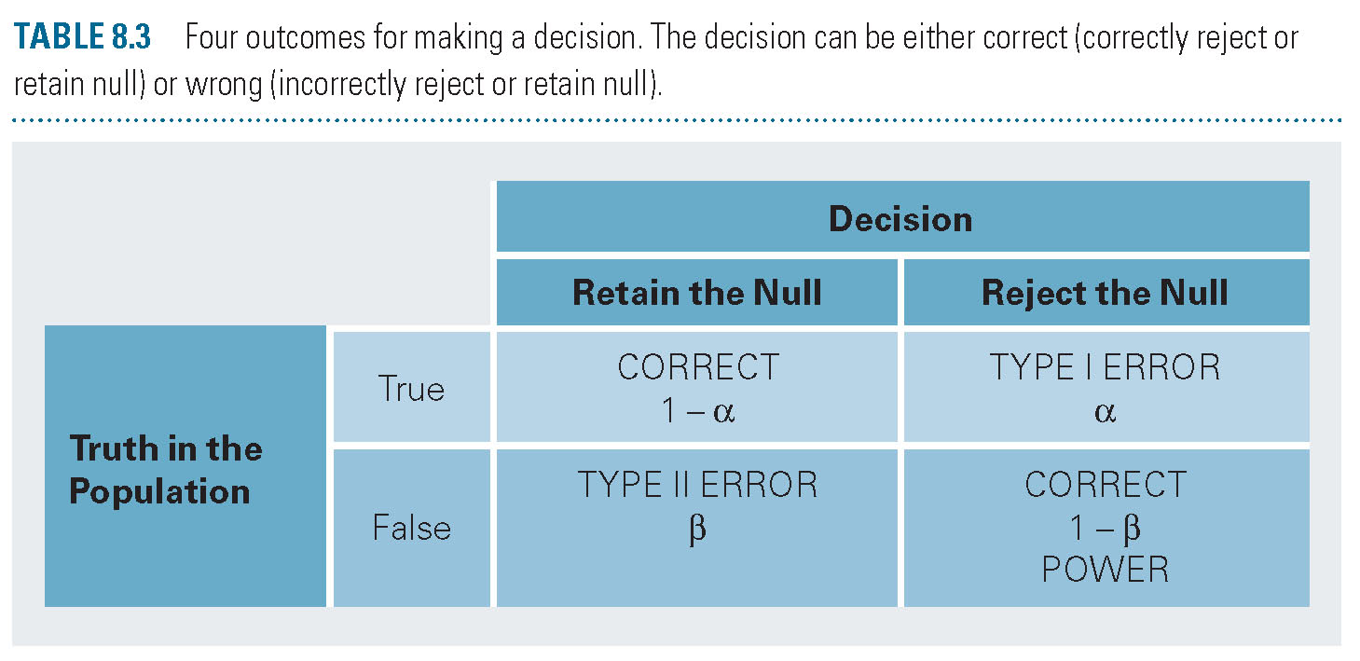
Type I and Type II errors

Slide 56
Type I error
If we reject Ho when in fact Ho is true
If we decide it was not chance when in fact it was chance.

Slide 57
Type II error
If we accept Ho when Ho is false.
If we attribute a result to chance when it is not chance.

Slide 58
Statistical significance versus effect size.
Hypothesis testing does not, however, inform us of how big the effect size is.
The Smell of Virtue example
  Significant?
  Effect size?

Slide 59
Effect Size
Hypothesis testing looks at the statistical significance of the effect
Effect size looks at the size of the effect.
Different procedures use different measures of effect size.

Slide 60
Cohen’s d
The number of standard deviations an effect shifted above or below the mean stated in the null hypothesis.

Slide 61
Cohen’s d
Cohen’s d equals zero when the means are the same and rises as they differ.

Slide 62
Money thinking.
Will students who think about money persist longer at a task?

Slide 63
18.45 Money thinking
Type of test
  Matched Pairs
  One-sample
  Independent Samples
One-tail or two
  Ho µ = 0
  Ha
    µ =/= 0
    µ < 0
    µ > 0

Slide 64
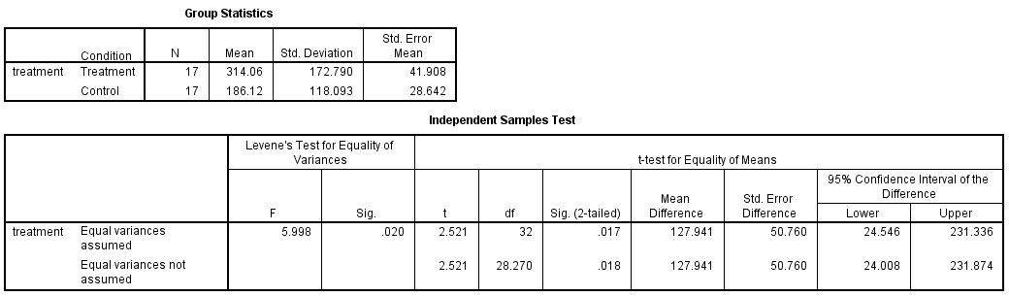
Note: should use bottom line!

Slide 65
Does study effect sleep
Do these data support the hypothesis studying more cause you to sleep less?
Do they show that those who study more sleep more?
Notes:
Chelsea Welty

Slide 67
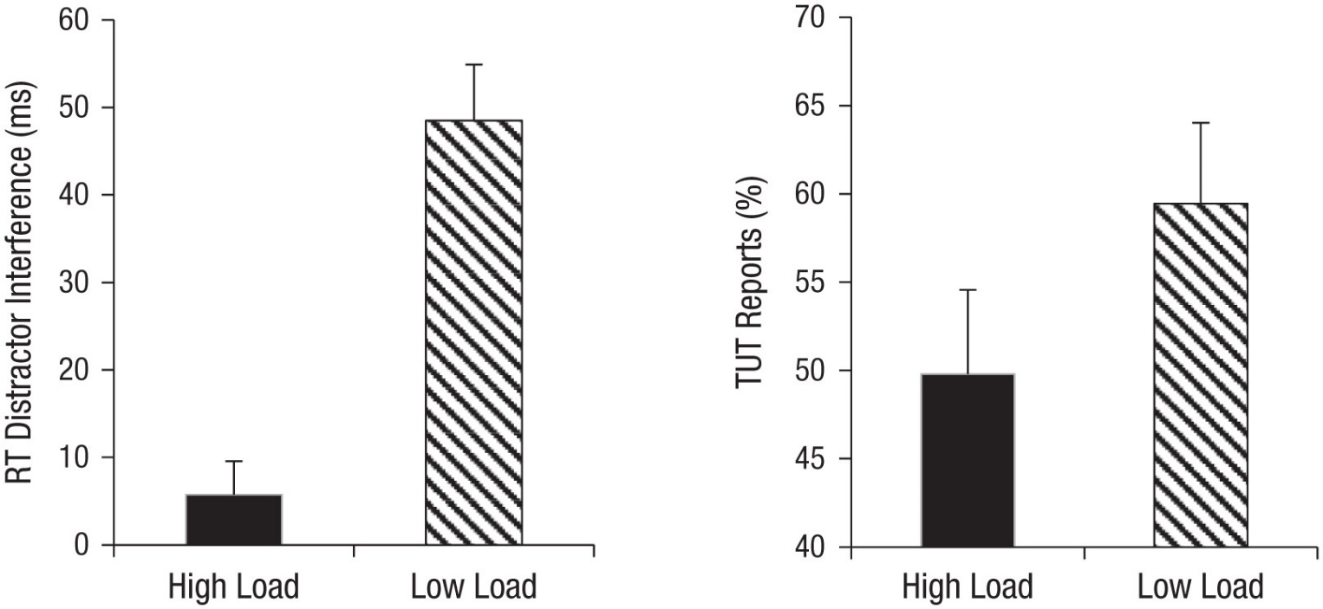
Fig. 2. Mean reaction time (RT) distractor interference (left) and task-unrelated thoughts (TUTs; right) in the high- and low-load conditions of Experiment 1. RT distractor interference was calculated by subtracting the mean RT for compatible distractors from the mean RT for incompatible distractors. Error bars represent standard errors.
Published in: Sophie Forster; Charles Spence; Psychol Sci 29, 1642-1652.
DOI: 10.1177/0956797618781325
Copyright © 2018 Association for Psychological Science

Slide 68
Fig. 2. Mean reaction time (RT) distractor interference (left) and task-unrelated thoughts (TUTs; right) in the high- and low-load conditions of Experiment 1. RT distractor interference was calculated by subtracting the mean RT for compatible distractors from the mean RT for incompatible distractors. Error bars represent standard errors.

Slide 69
The percentage of thought probes at which participants reported mind wandering (i.e., task-unrelated thoughts) varied among participants from 0% to 100%. this difference did not reach significance in the present between-participants manipulation of load, t(38) = 1.46, p= .153, 95% confidence interval (CI) for the mean difference = [−3.74, 23.03].

Slide 70
Active vs. Passive Learning
Children were assigned at random to Active and Passive Groups.
Is there good evidence that active learning has a different outcome than passive learning?

Slide 71
18.46 Active Learning
Type of test
  Matched Pairs
  One-sample
  Independent Samples
One-tail or two
  Ho µ = 0
  Ha
    µ =/= 0
    µ < 0
    µ > 0

Slide 72
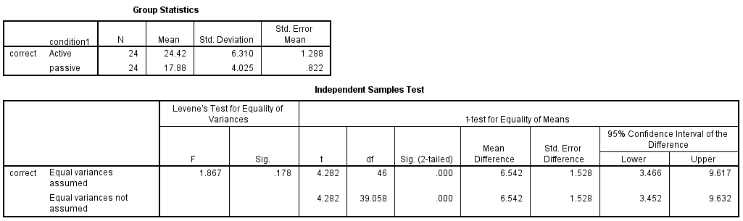
Active vs Passive SPSS output

Slide 73

The End

