Slide 1
Examining Relationships in Data
William P. Wattles, Ph.D.
Francis Marion University
1
Notes:
1

Slide 2
Examining relationships
Correlational design-
observation only
look for relationship
does not imply cause
Experimental design- A study where the experimenter actively changes or manipulates one variable and looks for changes in another.
12
Notes:
12
3
Book uses response and explanatory because students have trouble learning dependent and independent. That’s a nice gesture but everyone else calls them dependent and independent.
Studies where we observe two variables but do not manipulate either. Relatively easy to do. We look to see if they are related. Are changes in one associated with changes in the other?

Slide 3
Dependent Variable
What we are trying to predict.
It measures the outcome of a study.

Slide 4
Independent Variable
Is used to explain changes in the dependent variable

Slide 5
Correlation
The relationship between two variables X and Y.
In general, are changes in X associated with Changes in Y?
If so we say that X and Y covary.
We can observe correlation by looking at a scatter plot.
15
Notes:
15
6
Let’s look at an example.
We have grades from PSY300 that I taught last semester
It all comes down to a lot of numbers, nice to have a machine to do the calculations.
Do you think there would be a relationship between scores on exam 2 and exam 3?
In general we’d expect those that scored well on 2 to score well on 3
Lets look for a pattern.

Slide 6
16
Notes:
16
7

Slide 7
Scatterplot
Relationship between two quantitative variables
Measured on the same individual
Y axis is vertical
X axis horizontal
Each point represents the two scores of one individual
17
Notes:
17
8

Slide 8
Type of correlation
Positive correlation. The two change in a similar direction. Individuals below average on X tend to be below average on Y and vice versa.
Negative correlation the two change in the opposite direction. Individuals who are above average on X tend to be below average on Y and vice versa.
18
Notes:
18
9

Slide 9
Example of correlation from New York Times
Early studies have consistently shown that an "inverse association" exists between coffee consumption and risk for type 2 diabetes, Liu said. That is, the greater the consumption of coffee, the lesser the risk of diabetes

Slide 11
Examples
Positive correlations: Hours spent studying and g.p.a.; height and weight, exam 1 score and exam 2 score,
Negative correlations; temperature and heating bills; hours spent watching TV and g.p.a.; SAT median and % taking the test. Age and price of used cars.
19
Notes:
19
10

Slide 12
Correlation Coefficient
One number that tells us about the strength and direction of the relationship between X and Y.
Has a value from -1.0 (perfect negative correlation) to +1.0 (perfect positive correlation)
Perfect correlations do not occur in nature
20
Notes:
20
11

Slide 13
Correlation Coefficient
The Pearson Product Moment Correlation Coefficient or Pearson Correlation Coefficient is symbolized by r.
When you see r think relationship.
21
Notes:
21
12

Slide 14
Strength of Correlation
Weak .10, .20, .30
Moderate .40,.50, .60
Strong .70, .80, .90
No correlation 0.0
22
Notes:
22
13

Slide 15
Calculating a correlation coefficient
Deviation score for X (X-Xbar)
Deviation score for Y (Y-Ybar)
Standard deviations (SD) for X and Y
Number of subjects (n)
23
Notes:
23
14

Slide 16
Correlation Coefficient
24
Notes:
24
15

Slide 17
Correlation Coefficient
25
Notes:
25
16

Slide 18
Pearson Correlation Coefficient
Sum of (X-Xbar) times (Y-Ybar)/SD of X * SD of Y * n-1
A Pearson correlation coefficient does not measure non-linear relationships
We represent the Pearson correlation coefficient with r.
26
Notes:
26
17

Slide 19
Here we have two quantitative variables for each of 16 students.
1. How many beers they drank, and
2. Their blood alcohol level (BAC)
We are interested in the relationship between the two variables: How is one affected by changes in the other one?
Student | Number of Beers | Blood Alcohol Level
1 | 5 | 0.1
2 | 2 | 0.03
3 | 9 | 0.19
6 | 7 | 0.095
7 | 3 | 0.07
9 | 3 | 0.02
11 | 4 | 0.07
13 | 5 | 0.085
4 | 8 | 0.12
5 | 3 | 0.04
8 | 5 | 0.06
10 | 5 | 0.05
12 | 6 | 0.1
14 | 7 | 0.09
15 | 1 | 0.01
16 | 4 | 0.05

Slide 20
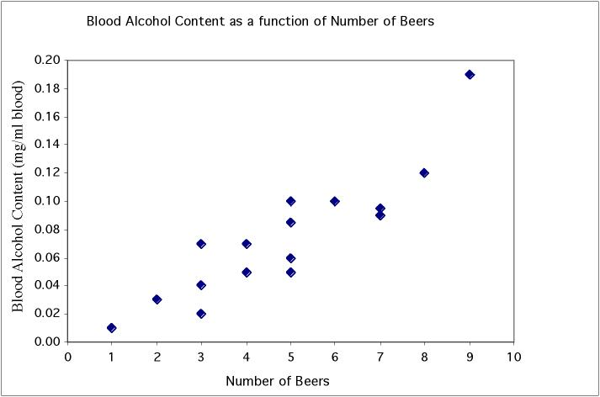
In a scatterplot one axis is used to represent each of the variables, and the data are plotted as points on the graph.
Student | Beers | BAC
1 | 5 | 0.1
2 | 2 | 0.03
3 | 9 | 0.19
6 | 7 | 0.095
7 | 3 | 0.07
9 | 3 | 0.02
11 | 4 | 0.07
13 | 5 | 0.085
4 | 8 | 0.12
5 | 3 | 0.04
8 | 5 | 0.06
10 | 5 | 0.05
12 | 6 | 0.1
14 | 7 | 0.09
15 | 1 | 0.01
16 | 4 | 0.05
Notes:
Quantitative data - have two pieces of data per individual and wonder if there is an association between them. Very important in biology, as we not only want to describe individuals but also understand various things about them. Here for example we plot BAC vs number of beers. Can clearly see that there is a pattern to the data. When you drink more beers you generally have a higher BAC. Dots are arranged in pretty straight line - a linear relationship. And since when one goes up, the other does too, it is a positive linear relationship. Also see that

Slide 21
Explanatory and response variables
A response variable measures or records an outcome of a study. An explanatory variable explains changes in the response variable.
Response
(dependent)
variable:
blood alcohol
content
y
x
Explanatory (independent) variable:
number of beers
Notes:
An example of a study in which you are looking at the effects of number of beers on blood alcohol content. If you think about it, the response is obviously an increase in blood alcohol, and we want see if we can explain it by the number of beers drunk. Always put the explanatory variable on the x axis and response variable on the y axis.

Slide 22
Explanatory and response variables
Typically, the explanatory or independent variable is plotted on the x axis and the response or dependent variable is plotted on the y axis.
Response
(dependent)
variable:
blood alcohol
content
y
x
Explanatory (independent) variable:
number of beers
Notes:
An example of a study in which you are looking at the effects of number of beers on blood alcohol content. If you think about it, the response is obviously an increase in blood alcohol, and we want see if we can explain it by the number of beers drunk. Always put the explanatory variable on the x axis and response variable on the y axis.

Slide 23
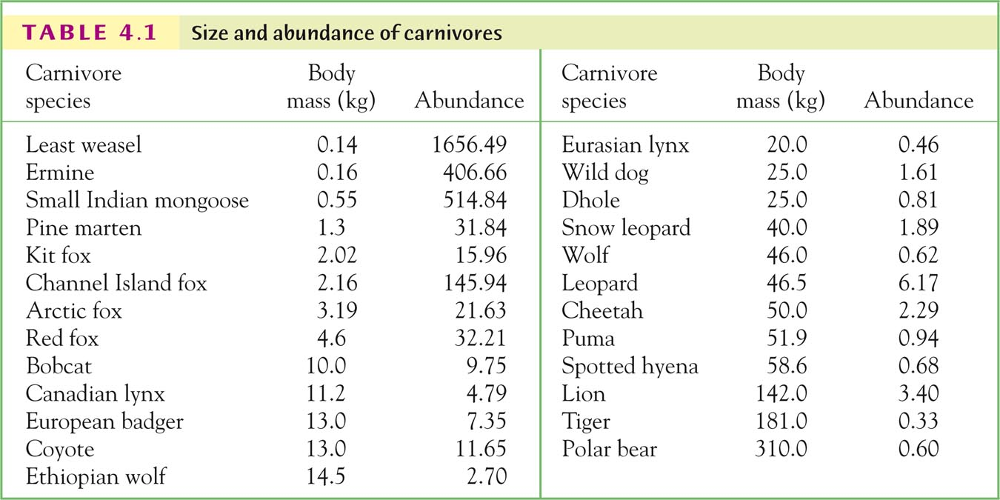

Slide 24
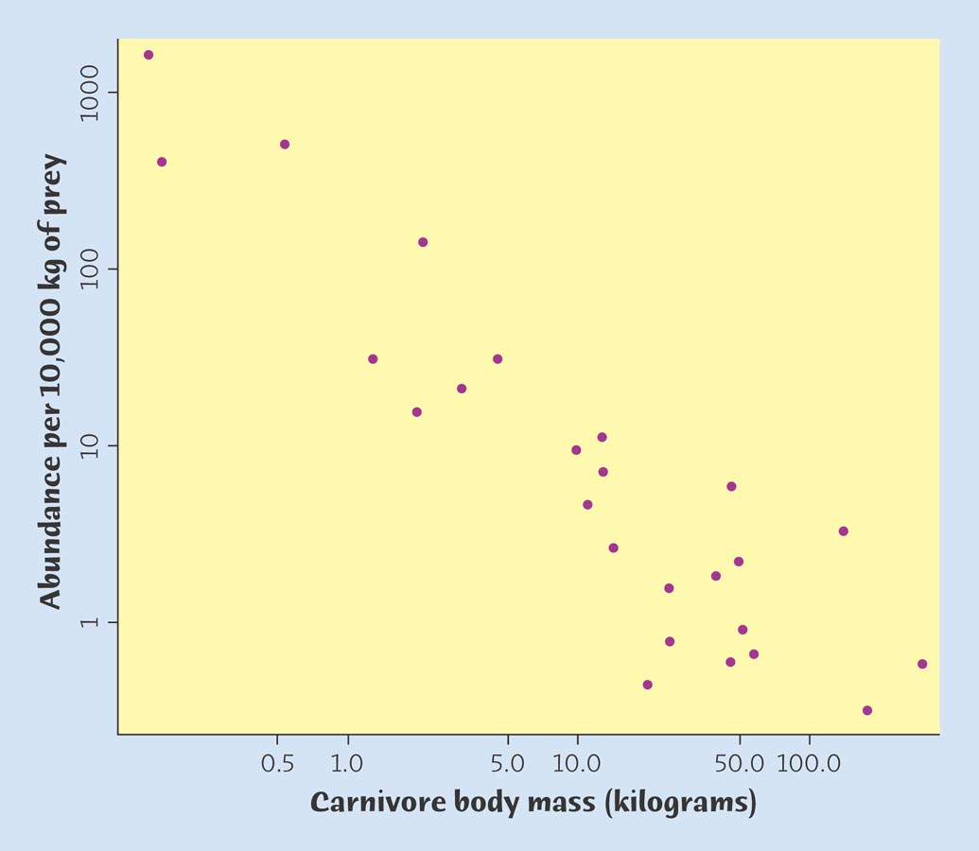

Slide 25
Linear relationships
The Pearson correlation coefficient only works for linear relationships.
The assumption of linearity can be verified by examining a scatterplot.
Assumes that the relationship between X and Y is the same at different levels of X and Y
27
Notes:
27

Slide 26
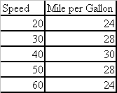
Is mileage related to speed?

Slide 27
Correlation?
Height
Inseam

Slide 28
Obesity and soft drink consumption
APS Observer 10/2009
As diet soft drink increases so does obesity
As regular soda increases so does obesity

Slide 29
Correlation does not imply causation!
28
Notes:
28
18

Slide 31
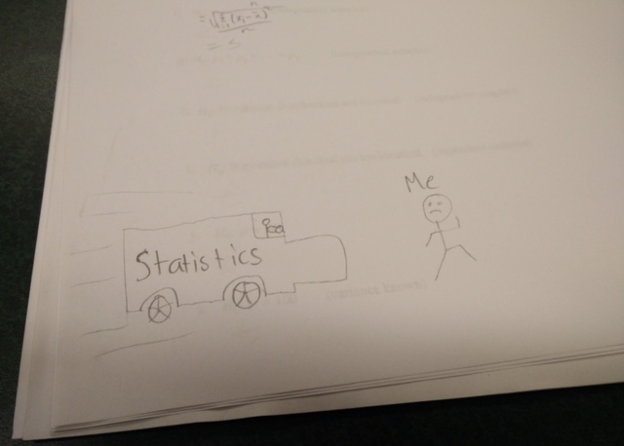

Slide 32
Frequency Distribution

Slide 33
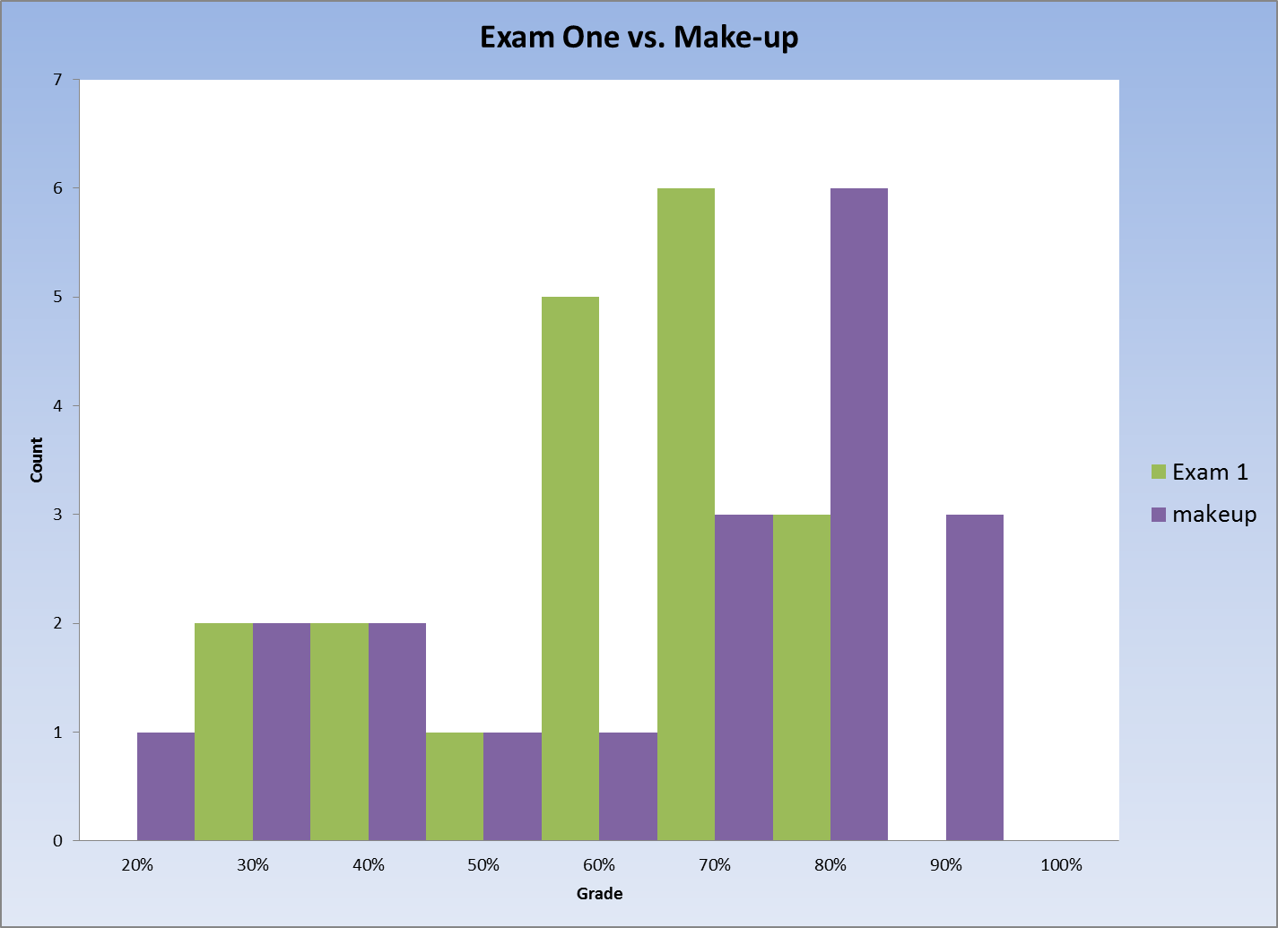
Frequency Distribution

Slide 34
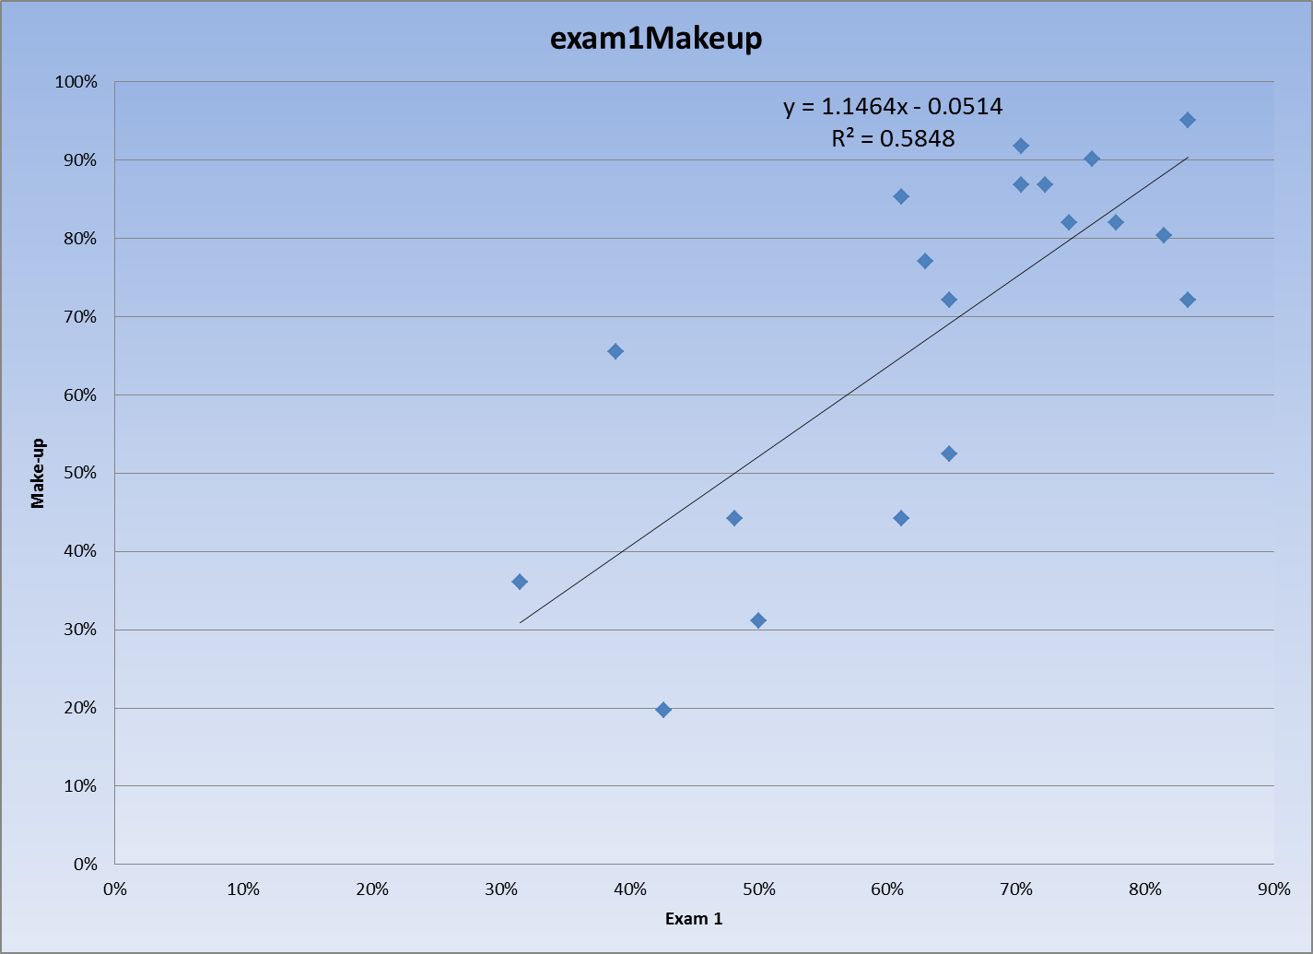

Slide 35
Cigarette Taxes
Does cigarette tax correlate with percent who smoke?
Does it correlate with stroke rate?
Create a scatter plot and use the excel Correl function to calculate the correlation coefficient.

Slide 36
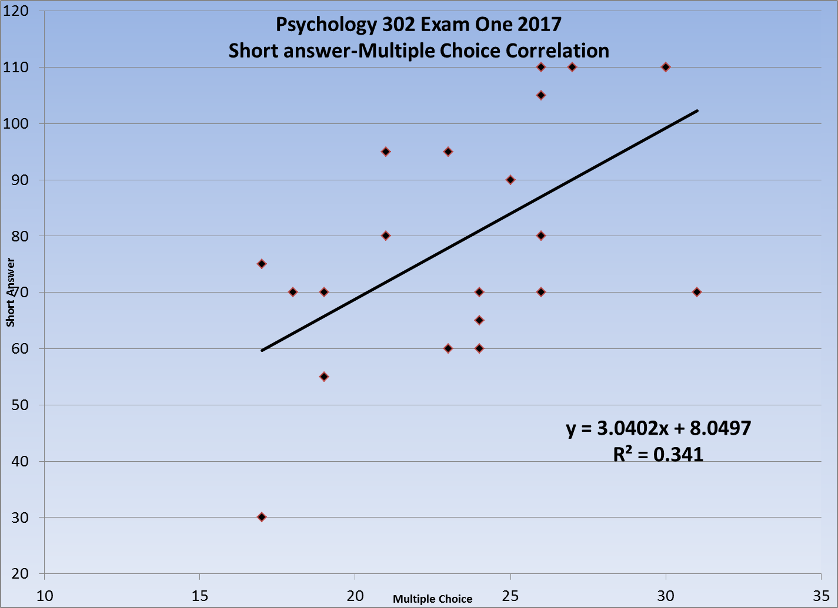
Correlation = .59

Slide 37
Based on the information above what would be the percentile rank of a person who scored 147 on the GRE verbal and 142 on the GRE Quant.

Slide 38
The End

Slide 39
What is a Z score?
3
Notes:
3

Slide 40
What is the standard deviation?
4
Notes:
4

Slide 41
What percentage of observations
lie within one standard deviation of the mean?
5
Notes:
5

Slide 42
What is the mean?
6
Notes:
6

Slide 43
What is the formula for the standard deviation?
7
Notes:
7

Slide 44
What percentage score less than a z-score of +1?
8
Notes:
8

Slide 45
What is a Z-score?
9
Notes:
9

Slide 46
What is the formula for a Z-score?
10
Notes:
10

Slide 47
17/21= .81

Slide 48
4/21= .19 x 100= 19%

Slide 49
One number that tells about the variability in the sample or population.

Slide 50
How many standard deviations an individual's score lies above or below the mean.

Slide 51
68%

Slide 52
One number that tells us about the middle of the data, using all the data.

Slide 54
84%

Slide 55
How many standard deviations a score lies above or below the mean.

Slide 56
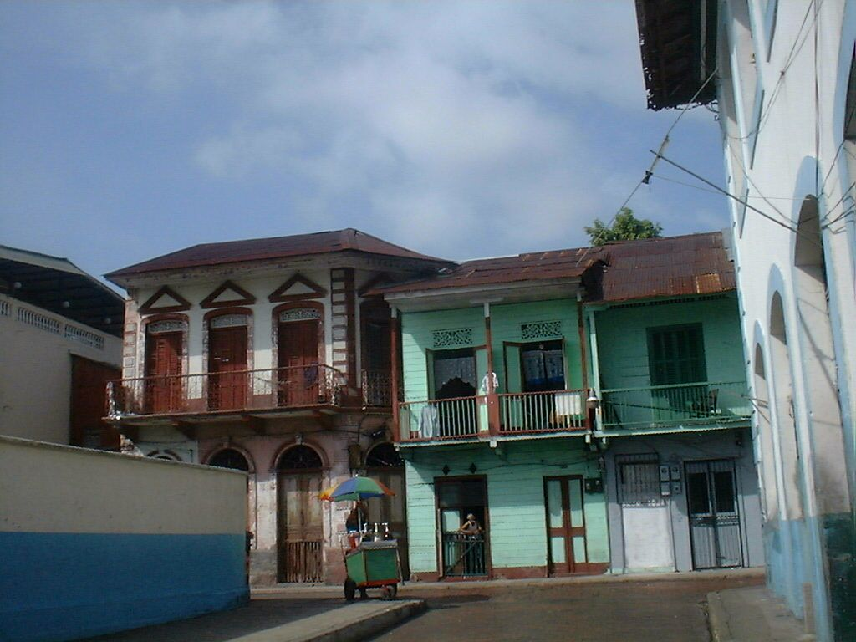
33
Notes:
33
27
23
17
14

Slide 57
The End
The End

