Slide 1
Effect size for paired and independent samples t-tests.
William P Wattles, Ph.D.
Francis Marion University

Slide 2
Statistical Significance
For both matched pairs and independent samples t-test:
Tells us the probability (p-value) that the observed difference between the means occurred by chance.
If that probability is low, less than alpha (usually .05), we conclude that it was probably not chance.

Slide 3
The significance test does not tell us if the difference is meaningful, only that it probably did not occur by chance.

Slide 4
Effect size for t-test
Tells us the magnitude of the difference between the two means.
Nearly all statistical tests have an effect size associated with them.

Slide 5
Effect size for t-test
The basic formula is the size of the difference divided by the standard deviation.

Slide 6
Effect size for t-test
Paired-sample and independent samples unfortunately have slightly different formulas.

Slide 7
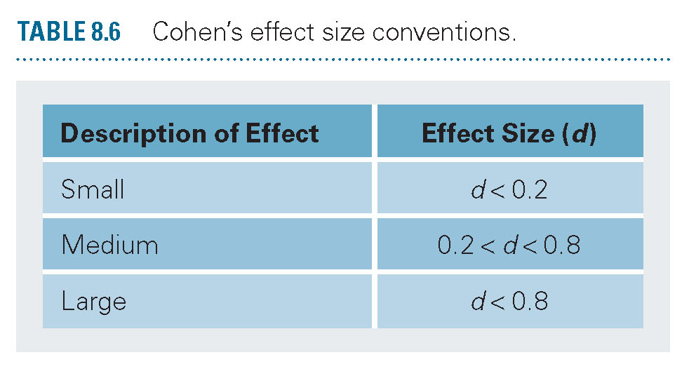
Effect size conventions
Cohen’s d equals zero when the means are the same and rises as they differ.

Slide 8
Matched Pairs Cohen’s d
d=mean difference/standard deviation.

Slide 9
Independent Samples Cohen’s d
d=mean difference/standard deviation.

