Slide 1
The Nervous System
William P. Wattles, Ph.D.
Francis Marion University
Psy 314 Behavioral Medicine

Slide 2
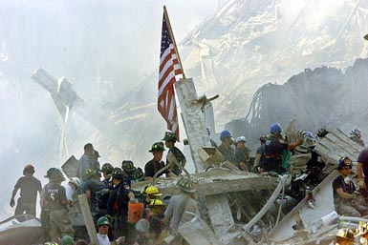

Slide 3
Brianna LaHara a 12-year-old New York City girl was frightened to learn she was among the hundreds of people sued yesterday by giant music companies in federal courts around the country.
"I got really scared. My stomach is all turning," Brianna said last night at the city Housing Authority apartment where she lives with her mom and her 9-year-old brother.

Slide 4
Sympathetic Nervous system
If an animal is under threat, for whatever reason, its sympathetic nervous system is activated.
The activation occurs virtually instantaneously.

Slide 5
The Nervous System
Text says that the basic function of the nervous system is to integrate all the body’s systems.
The nervous system is made up of nerve cells or neurons.
  afferent (sensory) neurons
  efferent (motor) neurons
  Interneurons

Slide 6
Neurons
Dendrite
Cell Body
Axon
Neurons don’t touch
They communicate via neurotransmitters, chemicals that cross the synaptic cleft (space between neurons)

Slide 7
Synaptic Transmission
Nerve Impulse
  A brief electrical charge that travels down
  an axon
  Generated by the movement of positively charges atoms in and out of channels in
  the axon’s membrane
  All-or-none response
Threshold
  The level of stimulation required to trigger
  a neural impulse

Slide 8
Synaptic Transmission
Synapse [SIN-aps]
  Junction between the axon tip of the sending neuron and the dendrite or cell body of the receiving neuron
Neurotransmitters
  Chemical messengers
  May be excitatory or inhibitory
  Released by the sending neuron, neurotransmitters travel across the synapse and bind to receptor sites
  on the receiving neuron, thereby influencing whether it will generate a nerve impulse

Slide 9
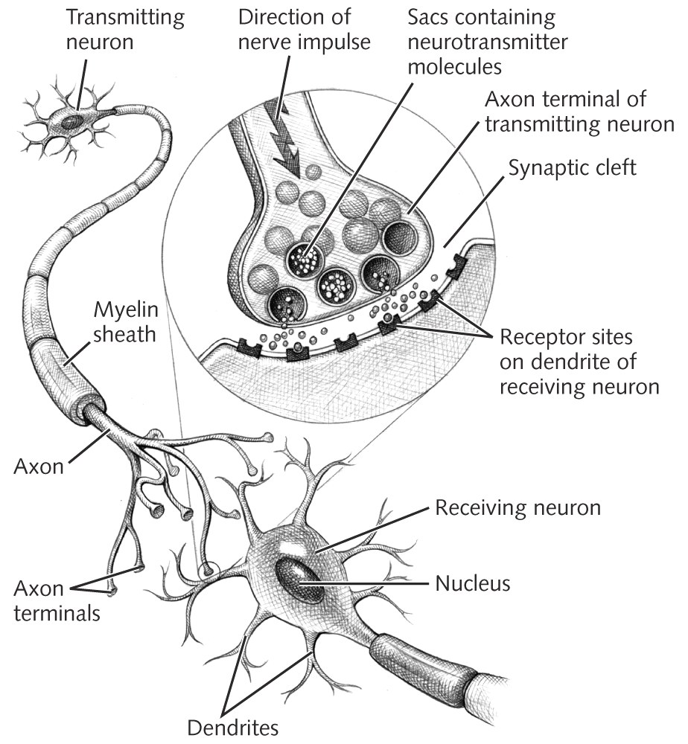
Synaptic Transmission

Slide 10
Subdivisions of the vertebrate nervous system (page 111)
Central Nervous System
  Brain
  Spinal Cord
Peripheral Nervous System
  Somatic nervous System
  Autonomic Nervous System
    Sympathetic division
    Parasympathetic division

Slide 11
Somatic Nervous System
Controls voluntary muscles
Consists of nerves that:
  convey sensory messages to the CNS
  convey messages from the CNS to muscles and glands

Slide 12
Autonomic Nervous System
Autonomic means self-governing
Receives information from and sends messages to the heart, intestines and other organs.
Sympathetic and parasympathetic systems operate in opposition to each other.

Slide 13
Autonomic Nervous System
Sympathetic Division
Parasympathetic Division

Slide 14
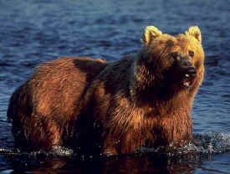
Autonomic arousal

Slide 15
Sympathetic Nervous System
Prepares the body for intense, vigorous, emergency action
The “fight or flight” response
Heart and breathing rate increases
Mental activity increases
Digestion decreases
Blood flow increases to the skeletal muscles

Slide 16

Notes:
This fact refers to the body's fight or flight response. When the amygdala region of the brain signals fear, the hypothalamus triggers a number of autonomic body responses. Among these responses is a dilation of the pupils to take in as much light as possible

Slide 17
The Fight or Flight Response
Passed down via evolution
Survival of the fittest
Adaptive-enhances the survival of the organism
Ability to focus body’s resources in time of danger is adaptive.
More likely to live long enough to have progeny and raise those progeny.

Slide 18
Animal that averages 2 offspring
8 in 3 generations

Slide 19
Animal that averages 3 offspring
27 in 3 generations

Slide 20
Sympathetic arousal or the stress response
The mind must be able to influence the body for survival.
Stress is a mental/emotional reaction to a threat or challenge.
Adaptive in nature where we face relatively rare threats to our survival

Slide 21
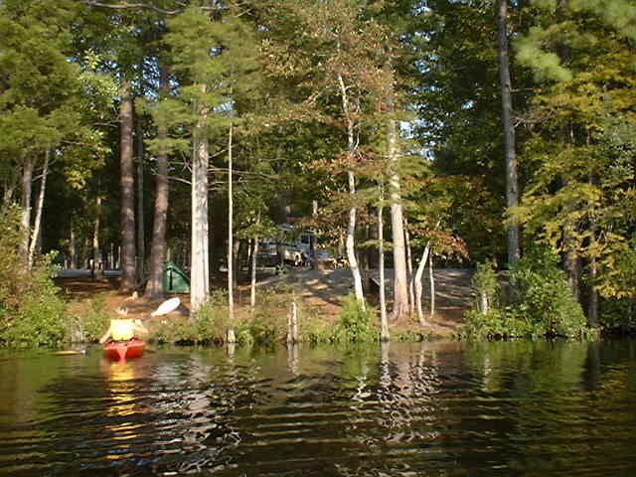

Slide 22
Parasympathetic Nervous System
Promotes relaxation and functions under normal conditions.

Slide 23
Parasympathetic Nervous System
Increases digestion
Promotes processes associated with relaxation
Conserves energy
Allows body to restore itself

Slide 24
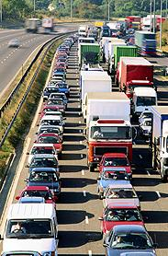

Daily Hassles
Experiences of daily living that have been appraised as salient and harmful or threatening to our well being.

Slide 25
Selye’s View of Stress
Selye views stress as a response and
Stressor is a stimulus
General Adaptation syndrome
  alarm stage
  resistance
  exhaustion stage

Slide 26
Alarm state
Fight or Flight response
Body is prepared for anything

Slide 27
Resistance Stage
Body adapts to the stressor. Physiologically the body’s internal functioning is not normal

Slide 28
Exhaustion State
Ability to resist is depleted, depression even death can result.

Slide 29
New Texas road to be 85 mph
Texans do not necessarily love speed so much as they hate limits. In a state where legislators repealed a law requiring motorcyclists to wear helmets, granting drivers permission to go 5 m.p.h. faster struck many as a reasonable move, though a number of groups expressed concern, including the governors’ association.

Slide 30
Prevention

Slide 31
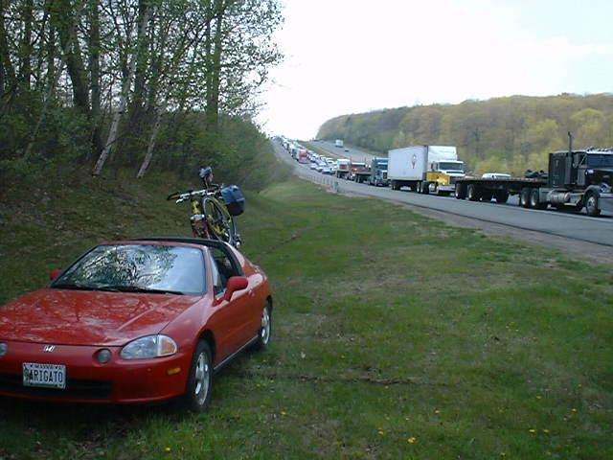
Perception of stress

Slide 32
Lazrus model of stress
Reaction is dependent upon how demands are perceived, evaluated and appraised.
The same demands can therefore mean challenge for one person yet pose a threat to another.

Slide 33
Lazarus transactional position
Effect of a stressor based on the perception of:
  threat
  vulnerability
  ability to cope
It is not the life event but one’s view of it that determines the level of stress.

Slide 34
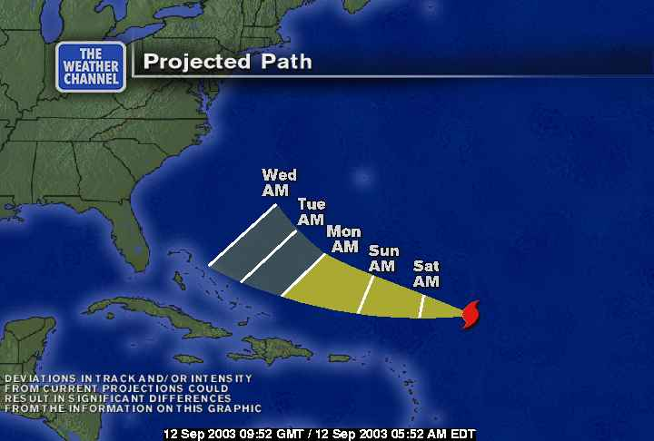

Slide 35
Primary appraisal
When confronted with a stressor people make a fist or initial appraisal.
A stressful appraisal involves:
  threat
  harm
  challenge

Slide 36
Secondary appraisal
What options are available?
How likely am I to be able to apply the necessary strategies?
Will the procedure work?

Slide 37
Reappraisal
Can lead to greater or less stress.

Slide 38
Lazrus model of stress
Vulnerability determines the effect of stressors.
Coping
  a process
  learned
  effortful
  an effort to manage the situation

Slide 39
Stress but not for all
Tennes and Kreye, 1985
Some children had elevated levels of Cortisol and test day but some did not.
Notes:
Tennes and Kreye, 1985

Slide 40
Hardiness
The ability to withstand stress
  health and energy
  positive belief (self-efficacy)
  problem-solving skills
  social skills
  social support
  material resources

Slide 41
Endocrine system
Works with the nervous system
Releases hormones which are carried in the blood stream
Hormones are slower to reach their target and last longer.

Slide 42
Adrenal glands
Located on the kidneys
produce Cortisol a hormone used to measure levels of stress
also produce epinephrine sometimes called adrenaline.

Slide 43
Sources of Stress
Crowding-density versus crowding
Pollution
Noise
Urban Press-road rage
Occupation-school pressure
personal relationships
sleep problems

Slide 44
100 Death of spouse
73 Divorce
65 Marital separation
63 Jail Term
63 Death of family member
53 Personal injury or illness
50 Marriage
47 Fired at Work
45 Marital Reconciliation
45 Retirement
40 Pregnancy
Social Readjustment Rating Scale
25 Change in living conditions
24 Revision of personal habits
23 Trouble with boss
20 Change in work hours
20 Change in residence
19 Change in recreation
19 Change in church activities
18 Change in social activities
17 Personal loan
16 Change in sleeping habits
13 Vacation
12 Christmas or Chanukah

Slide 45
Percentage of People with Illness

Slide 46
Measuring life stress
Social Readjustment Rating Scale much criticized.
Everyday hassles scale.
  Hassles
  Uplifts

Slide 47
Hassles and Uplifts Scale
Supports Lazrus’s contention that perception of an event more important than the event.

Slide 48
Microaggressions
Insults, indignities and marginalizing messages delivered by seemingly well-intentioned people.

Slide 49
Stress and the heart
Parasympathetic nervous system control the heart at rest with a heart rate as low as 20-30 beats per minute
Sympathetic Nervous system can push the heart rate up to 250 bpm.
Sudden cardiac death and arrhythmias important in those with heart disease

Slide 50
The Vascular System
vascoconstriction-muscles around the arteries, arterioles and veins constrict reducing blood flow.
vasodilatation-The opposite process when vessels dilate or open to allow more blood flow
the stress response redirects blood to deep muscles needed for fight or flight

Slide 51
Cardiovascular disorders related to stress
Angina pectoris-Severe paroxysmal pain in the chest associated with an insufficient supply of blood to the heart
Atherosclerosis-plaque build-up impair blood circulation. major cause of death in the U.S.
Essential hypertension-High blood pressure. Above 140/90

Slide 52
Migraine headaches
Debilitating headaches related to vascular constriction.
Classical-preceded by an “aura”
common to warning
Triggered by certain foods and/or stress
May be more common in those who are perfectionistic, compulsive and overly responsible.

Slide 53
Blood Pressure
Systolic-maximum pressure in the arteries as the heart beats
Diastolic-minimum pressure as the hear is filling.
BP recorded as systolic/diastolic
120/80 generally considered optimal
Important risk factor in cardio-vascular illness

Slide 54
Gastrointestinal system
Functions in absorption of nutrients and elimination of wastes.
Digestion begins with anticipation of eating
Generally the activity of the GI system is unnoticed.
Designed to shut down during stress

Slide 55
Gastrointestinal problems
Ulcers -sores on the mucus lining of the stomach
Irritable Bowel Syndrome-aka spastic colon. Pain, diarrhea, constipation, “bloating” and gas
Colitis-inflammation of the colon

Slide 56
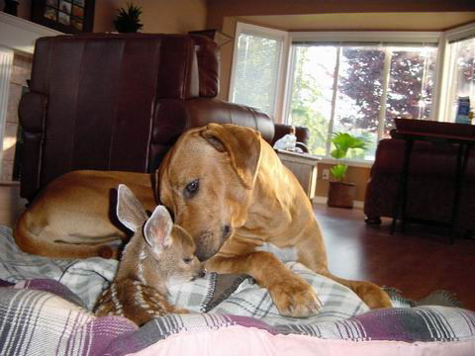
Social Support
Four types identified:
  Emotional
    Comfort and listening
  Appraisal
    Suggestions improve performance
  Informational
    Knowledge shared about better meds
  Instrumental
    Baby-sit so you can see doctor

Slide 57
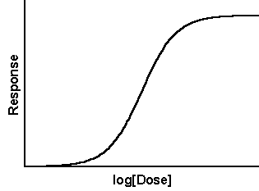
Dose Response Relationship
A direct, consistent association between an independent variable, such as a behavior, and a dependent variable, such as a disease.

Slide 58
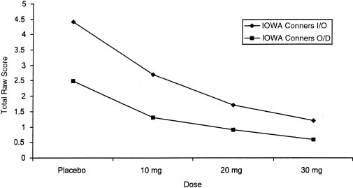
Dose Response
Describes how a response variable--a biological measurement or epidemiologic population statistic--depends on the level of dose.
Notes:
Industrial noise and BP
Medication and BP

Slide 59
Requirements for Reaction Paper
Minimum two pages. 1 ¾ pages is not 2 pages.
Typed double-spaced standard font 10 or 12.
Free of grammar and spelling errors
Paper must be about your reactions to the story. NOT a synopsis of the article.

Slide 60
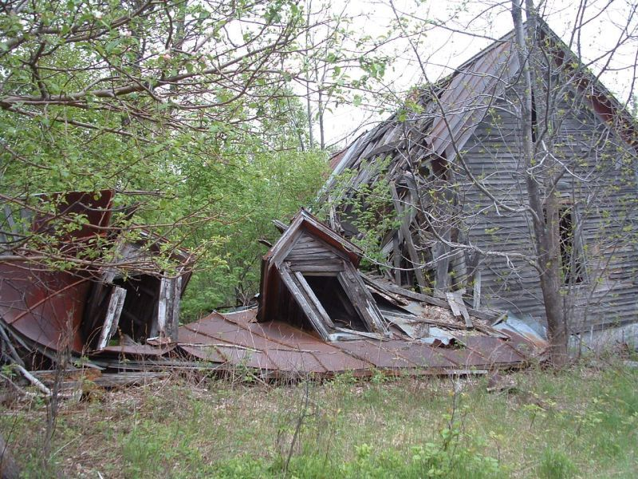
The End

