Slide 1
Stress and Disease
William P. Wattles, Ph.D.
Francis Marion University
Psychology 314

Slide 2
Health Belief Model
Beliefs contribute to behavior
Perceived:
severity
susceptibility
benefits
barriers

Slide 3
Social Readjustment Rating Scale
Measure of Stress
100 Death of spouse
73 Divorce
65 Marital separation
63 Jail Term
63 Death of family member
53 Personal injury or illness
50 Marriage
47 Fired at Work
45 Marital Reconciliation
45 Retirement
40 Pregnancy
25 Change in living conditions
24 Revision of personal habits
23 Trouble with boss
20 Change in work hours
20 Change in residence
19 Change in recreation
19 Change in church activities
18 Change in social activities
17 Personal loan
16 Change in sleeping habits
13 Vacation
12 Christmas or Chanukah

Slide 4
More stress=more illness
Percent of people with illness

Slide 5
More stress=more illness
Stress does not influence disease in some mystic fashion.
The physiological status of the host is altered in some way.

Slide 6
Immunosuppression
Stress may cause a suppression in the immune system which may make it easier for foreign organisms to invade the body.

Slide 7
Germs always present in our environment
Germ: A microorganism, especially a pathogen.
Pathogen: An agent that causes disease, especially a living microorganism such as a bacterium or fungus.
Vorticella

Slide 8
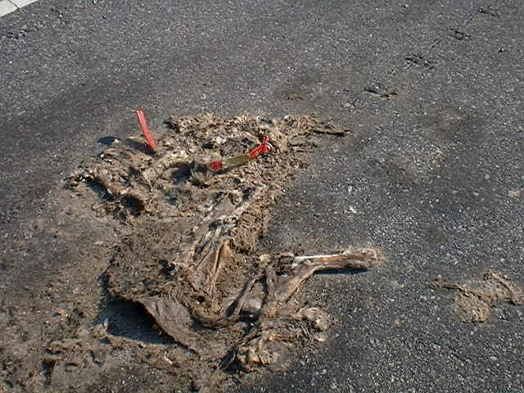
Road kill

Slide 9
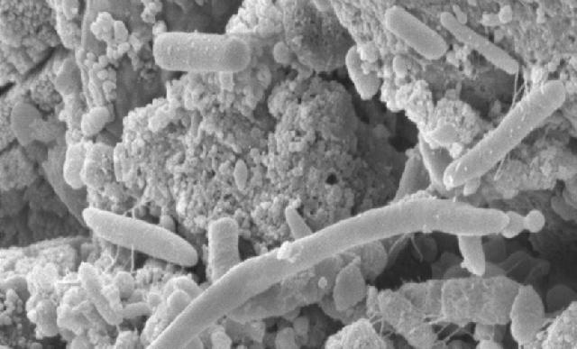
Microorganisms on Chicken gut

Slide 10
Immune system protects the body from attack
Foreign organisms include:
bacteria
viruses
parasites
fungi
cancerous and other diseased cells
Intact skin and mucous membranes block most foreign substances.
Notes:
2
antigen often used to refer to foreign non-self materials.

Slide 11
Immune system identifies and eliminates (non-self) material.
Identifies foreign organisms by detecting antigens (antibody generator molecules).
bacteria
viruses
parasites
fungi
cancerous and other diseased cells
Antigens are microorganism surface proteins that differ from those of host.
Notes:
2
antigen often used to refer to foreign non-self materials.

Slide 12
Psychoneuroimmunology
The study of interactions among:
Behavior (psychological)
Neural and endocrine function
Immune processes
Notes:
1
New field has exploded in recent years.
new articles weekly
collaborative model, many disciplines

Slide 13
Immune System Functioning
Intact skin and mucous membranes block most foreign substances.
Two types of responses to invaders
Non-specific responses
Phagocytosis
inflammation
Specific Immune system responses
T-cells
B-cells

Slide 14
Nonspecific Responses
Phagocytosis- the attack of foreign particles by leukocytes
Granulocytes release chemicals
Macrophages
Inflammation-
Basically increased blood flow aids in restoration of cells and destruction of invaders

Slide 15
Immune system made up of Leukocytes
White blood cells
Produced in the bone marrow but travel to other areas such as spleen, thymus, and lymph nodes.
Different ways to measure the immune system function
Can learn from experience hence immunity
Notes:
3
Measurement techniques include
lymphocyte blastogensis (proliferation) in response to mitogens such as pokeweed.
NK cell function
Levels of antibodies
levels of interleukins, lymphokines, interferon. communication chemicals
When the body has attacked a certain antigen it develops antibodies which can in the future identify the intruder and speed the response.

Slide 16
Immunity
A specific, rapid response to foreign microorganisms based on previous exposure.

Slide 17
Vaccination
Induced immunity
A weakened form of the virus or bacterium introduced into the body to stimulate the production of antibodies.

Slide 18
Types of Leukocytes
Macrophages (big eaters) engulf and attack microorganisms.
B cells (mature in bone marrow) attaches to foreign body and produces an antibody to weaken it.
T cells (mature in thymus) directly attack intruder cells.
Natural killer cells destroy certain kinds of tumors and virus-infected cells.
Notes:
4

Slide 19
Effects of stress on natural killer cell activity
Sieber et. al. (1992) Brain, Behavior and Immunity
105 males age 18-26
Diet controlled
Stress caused by unpredictable 90 decibel 3000 Hz tone
NK levels measured five times
Notes:
5

Slide 20
Natural Killer Cell Activity In stressed and non-stressed adults
Notes:
6

Slide 21
Psychological Stress and susceptibility to the common cold.
Cohen et al (1991). New England Journal of Medicine
154 men and 266 women
All in good health
22% no high school, 51 % h.s. grad, 27% some college
Notes:
7

Slide 22
Procedure
Subjects given nasal drops containing a low infectious dose of one of five respiratory viruses.
rhinovirus type 2
rhinovirus type 9
rhinovirus type 14
respiratory syncytial virus
corona virus type 229 E
Notes:
8

Slide 23
Independent variable: Stress
Three measures of psychological stress were used
Major stressful life events, similar to Holmes and Rahe
10-item Perceived Stress Scale
15-item negative affect scale
Notes:
9

Slide 24
Dependent variables: cold symptoms & infections
Subject infected if virus detected or significant increase in anti-bodies
Subject and physician rating of symptoms
Both required for classification as having a clinical cold
Notes:
10

Slide 25
Rates of infection following exposure to cold viruses
Notes:
11

Slide 26
Lung metastases in stressed versus non-stressed rats
Notes:
12
Stress-weight tied to tail, rat placed in tank of warm water.
1 hour after stress rats were injected with tumor cells.
12 days later metastases assessed

Slide 27
Number of lung metastases as a function of timing of stress
Notes:
13
Time of stress in relationship to tumor injection.

Slide 28
Cortisol
Hormone released by the sympathetic nervous system.
Shifts energy toward increasing blood sugar thus maximizing muscle endurance.
Shifts energy away from synthesis of proteins including those essential to the immune system.
Suppresses T cell numbers
Notes:
14

Slide 29
Acute stressors and immune functioning
Glaser et al. (1985) found decreased mitogen response during exams.
Stone et al. (1993) showed reduced response to mitogens in students exposed to 20 minutes of mental tasks.
Zakowski (1995) caused decreased mitogen response in subjects by exposing stress involving immersion in cold water.
Notes:
15

Slide 30
Stress Management and Immune Functioning
Psychotherapy and Psychosomatics Sept. 2003
43 Alzheimer caregivers, 27 similar age controls.
8-week Stress Management program resulted in an increased immune response to flu vaccine.
Notes:
Background: Previous research has demonstrated that the psychological morbidity experienced by informal caregivers is associated with increased vulnerability to infectious diseases, in particular influenza. A pragmatic trial was conducted to examine whether a stress management intervention (SMI) could reduce psychological morbidity and enhance the antibody response to influenza vaccination in the elderly, and whether changes in immune response of SMI participants were associated with hypothalamic-pituitary-adrenal (HPA) axis activity. Methods: Forty-three elderly spousal carers of dementia patients and 27 non-carer controls were recruited. Sixteen carers were allocated to an 8-week SMI or a non-intervention condition (n = 27). The non-carers formed a no treatment, 'normal' comparison group. At the end of the SMI or its equivalent time period, all participants received an influenza vaccination. IgG antibody titres to the vaccine were measured 0, 2, 4 and 6 weeks post-vaccine. Results: There was evidence of elevated distress in both carer groups compared with non-carer controls throughout the SMI period, but no between-group differences in salivary cortisol. Immune responses to the vaccine revealed that 50% of SMI carers, 7% of non-intervention carers and 29% of non-carer controls produced a four-fold increase in antibody titre. Conclusions: The immune response to influenza vaccination appears amenable to improvement through stress management, although the mechanisms underlying this effect remain unclear.

Slide 31
Chronic stress and immune functioning
McKinnon et al (1989) reported fewer B cells. T cells and NK cells in Three Mile Island residents.
Arnetz et al. (1987) found reduced mitogen response in unemployed women in Sweden.
Kiecolt-Glaser et al. (1987) demonstrated lower levels of T cells in caregivers of Alzheimer’s patients.
Notes:
16

Slide 32
Caveat
Mechanisms not fully understood
The effect, while present, is often small
Research not always consistent
Stress doesn’t explain many illnesses
Notes:
17
Stress may increase your risk of illness but not very much.

Slide 33
AIDS
Acquired immune deficiency syndrome
HIV virus attacks the immune system
AIDS patients suffer from a variety of opportunistic diseases.

Slide 34
Autoimmune diseases
When the immune system attack the body.

Slide 35
Systemic Lupus erythematosus
Currently we cannot cure lupus. However, lupus can be effectively treated with drugs, and most people with the disease can lead active, healthy lives.

Slide 36
Common Symptoms of Lupus
Painful or swollen joints and muscle pain
Unexplained fever
Red rashes, most commonly on the face
Chest pain upon deep breathing
Unusual loss of hair
Pale or purple fingers or toes from cold or stress (Raynaud's phenomenon)
Sensitivity to the sun
Swelling (edema) in legs or around eyes
Mouth ulcers
Swollen glands
Extreme fatigue

Slide 37
Causes of lupus
Scientists believe that genes alone do not determine who gets lupus and that other factors also play a role. Some of the factors scientists are studying include sunlight, stress, certain drugs, and infectious agents such as viruses.

Slide 38
Rheumatoid arthritis
Rheumatoid arthritis (rue-ma-TOYD arth-write-tis) is a chronic disease, mainly characterized by inflammation of the lining, or synovium, of the joints. It can lead to long-term joint damage, resulting in chronic pain, loss of function and disability

Slide 39
Rheumatoid arthritis
RA is a systemic disease, which means it can affect other organs in the body.
RA is a chronic disease meaning that it continues indefinitely and may not go away.
Studies have shown that early aggressive treatment of RA can limit joint damage.

Slide 40
Multiple sclerosis
MS is thought to be an autoimmune disease that affects the central nervous system (CNS).
The CNS consists of the brain, spinal cord, and the optic nerves.

Slide 41
Multiple sclerosis
Surrounding and protecting the nerve fibers of the CNS is a fatty tissue called myelin, which helps nerve fibers conduct electrical impulses.
In MS, myelin is lost in multiple areas, leaving scar tissue called sclerosis.

Slide 42
Multiple sclerosis
MS is a chronic, unpredictable neurological disease that affects the central nervous system.
MS is not contagious and is not directly inherited.
Most people with MS have a normal or near-normal life expectancy.
The majority of people with MS do not become severely disabled.
There is no cure for MS yet, but drugs can help slow the course and/or symptoms in some patients.

Slide 43
Illnesses exacerbated by stress
Cardiovascular disease
Diabetes
Asthma
Rheumatoid arthritis
Headaches
Infectious disease

Slide 44
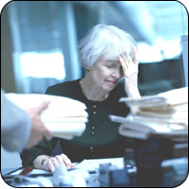
Diathesis-stress model
Two factors necessary to produce illness:
A predisposition or diathesis is inherited
Presence of environmental stressors

Slide 45
Ulcers
An example of diathesis-stress where the diathesis is infection by bacterium H. pylori.
Most people infected with H. pylori do not develop ulcers

Slide 46
Stress is mediated by perception
People can manage stress
Stress management programs

Slide 47
Stress management
Change your body
Change your beliefs
Change your situation
Change your reaction

Slide 48
Sleep deprivation
People who do not get sufficient sleep often feel tired, anxious, drowsy, weary and fatigued.
The number of people effected has been estimated between 30% and 50% of the Population.

Slide 49
New York Times Sleep
A researcher describes sleep-deprived teenagers as existing in a ''kind of gray cloud.''
''We just ignore these bad feelings from not enough sleep and get used to it,'' she said.
''We forget what it's like to feel good, and how much more efficiently you can do things.''

Slide 50
Lack of Sleep and Learning
Lack of sleep can interfere with learning:
tired students have a hard time paying attention
They may forget what they were taught because memory formation takes place partly during sleep.
“Also kids with less sleep tend to fall asleep in morning classes, which teachers hate.”

Slide 51
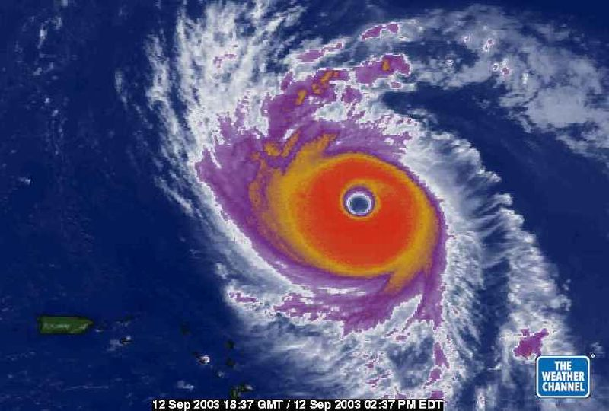
The End

