Slide 1
Coping with Stress and Pain
William P. Wattles, Ph.D. Behavioral Medicine Psy 314
Notes:
1

Slide 2
Papers
Good so far
Mia and priming example, Focus with Will Smith and Margot Robbie.

Slide 3
Exam
40 multiple choice
4 short answer
text 1-5,
PPT 1, 2, 5, 6 & 8.
class lectures
Science article on automatic processes
Setting the Mood for Smaller Meals article

Slide 5
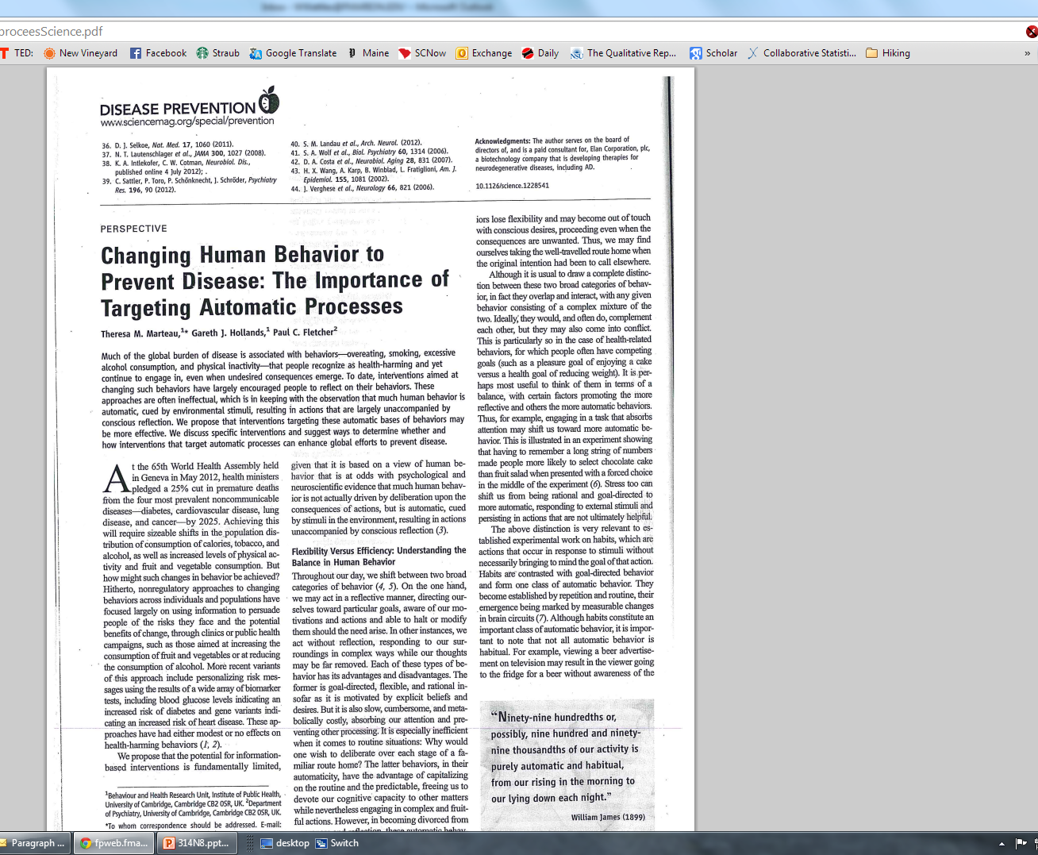

Slide 6
Social Support
One of the most robust findings in psychology.
Social Support: a variety of material and emotional supports a person receives from others.
Research demonstrates a negative correlation between social support and health problems.
Notes:
3

Slide 7
Social support
Research suggests that for men marriage is a crucial source of social support.
This finding does not hold up for women.
Results are much weaker for African Americans.
Notes:
4

Slide 8
How does it work?
Correlation or causation?
Notes:
5

Slide 9
How does it work?
Correlational research thus we cannot infer cause.
Isolated people may have a less healthy environment.
Buffering hypothesis. Somehow social support protects from some of the effects of stress.
Notes:
6

Slide 10
Personality and social support
Connell and D’Augelli model
affiliation
succorance (receiving help)
nurturance (giving help)
Friendly people have more social support but grouches can improve.
Notes:
7

Slide 11
Pets as social support
Research suggests health benefits of having pets.
Small advantages in BP, triglycerides

Slide 12
Perception of Control
Research suggests increased feelings of control associated with better health
Nursing home group more healthy, active, sociable, vigorous, and self-initiating

Slide 13
Conclusion
Low social support associated with increased mortality rates.
Notes:
8

Slide 14
Relaxation Procedures
William P. Wattles, Ph.D.
Francis Marion University
Notes:
10

Slide 15
Relaxation Response
A tool for maintaining homeostasis
A learned skill.
Relaxation training as “behavioral aspirin”
Notes:
11

Slide 16
Relaxation Techniques
Progressive Relaxation
Jacobson
Autogenic Training
Schultz
The Relaxation Response
Benson
The Quieting Reflex
Stroebel
Notes:
12

Slide 17
Progressive Relaxation
Based on James-Lang Theory of emotion Assumes a close and interactive relationship between bodily states (tension) and emotional states (anxiety)
Reducing skeletal muscle tension could reduce anxiety
Jacobsen’s P. R. time consuming
Notes:
13

Slide 18
Progressive Relaxation
Tense and relax various muscle groups.
Become aware of sensations of tension and relaxation
Requires practice
Focus on breathing
Typical 35-40 minutes for 14 muscle groups
Notes:
14

Slide 19
Muscle Groups
Dominant hand and arm
Non dominant hand and arm
Forehead and eyes
Upper cheeks and nose
Jaw, lower face and nose
Shoulders upper back and chest
Abdomen
Buttocks
Dominant upper leg
Dominant lower leg
Dominant foot
Nondominant upper leg
Nondominant lower leg
Nondominant foot
Notes:
15

Slide 20
Autogenic Training
Schultz wanted to achieve optimal homeostatic level of arousal.
Schultz was interested in hypnosis and self-hypnosis.
Focuses a person’s attention on internal sensations.
warmth
heaviness
Notes:
17

Slide 21
Autogenic Training
Popular in Europe
A passive form of controlling arousal
Allowing rather than forcing relaxation
Notes:
18

Slide 22
The Quieting Response
Developed to be more practical for busy people
The quieting reflex six seconds
Uses techniques from the other methods
Notes:
20

Slide 23
Relaxation Training
Three common factors
muscle relaxation
quieting the mind (distracting it through altering the focus)
conscious deep breathing
A powerful technique backed up by voluminous research.
Notes:
23

Slide 24
Relaxation and the Immune system
Research suggests that relaxation training can lead to increased levels of immune system functioning.
enhanced natural killer cell activity
increased neutrophil activity
Notes:
22

Slide 25
Relaxation and drugs
Psychoactive drugs interfere with normal bodily processes.
Stimulants can negate relaxation efforts
Synergistic effect of stimulants and stress
Notes:
24

Slide 26
Effectiveness of Relaxation
hypertension
tension headache
chronic pain
nausea from chemotherapy
burn pain
stress
anxiety
phobias
low back pain
tmj pain
migraine headache
Notes:
25

Slide 27
Biofeedback Training
William P. Wattles, Ph.D.
Francis Marion University
Notes:
26

Slide 28
Biofeedback
Procedures that provide information (feedback) to a subject about one or more biological responses.
skin temperature
muscle tension
blood pressure
sweat gland activity
brain waves
Notes:
27

Slide 29
Consciousness leads to control.
We’re not conscious of many body functions.
Machines can translate physiological information into visual or audible signals
Biofeedback as a physiological mirror
Chronic tension may feel normal or like nothing at all
Notes:
28

Slide 30
Mechanism of biofeedback
The power to create change lies solely with the individual.
Biofeedback equipment provides information only.
No stimulus travels from the machine to the individual.
Assumes individuals need feedback in order to change body’s response
Notes:
29

Slide 31
Muscle Tension feedback
Electromyography EMG feedback
measures muscle activity
Frontalis muscle frequently used
Signal changes in pitch and pulse
Often difficult to change the signal
Notes:
30

Slide 32
Biofeedback History
Developed extremely rapidly because of successful outcomes.
Early research had a lack of controls
Notes:
31

Slide 33
Study at Carolina
Drennen, W. T., Rutledge, L. R., & Wattles, W.P.(1985). EMG biofeedback with college student volunteers: Limitations of effects of independent variables. Psychological Reports, 57, 647 651
Notes:
32

Slide 34
Independent Variable
Random assignment to three groups:
control(told to sit quietly)
relax (told to relax)
biofeedback (given biofeedback signals)
Notes:
33

Slide 35
Dependent Variable
Self-report measure of state anxiety
Pre post EMG reading
Notes:
34

Slide 36
Procedure
Subjects sat in a recliner for 30 minutes
dim light
sound-proof lab
comfortable temperature
Notes:
35

Slide 37
Results
All 90 subjects showed reduced anxiety on both measures.
There were no differences between the 3 groups.
Results suggest that relaxation significantly reduces anxiety but that biofeedback adds nothing beyond relaxation.
Notes:
36

Slide 38
Biofeedback effectiveness
Raynaud’s disease
Neuromuscular reeducation
drug-resistant types of epilepsy
Notes:
37

Slide 39
Behavior Modification
William P. Wattles, Ph.D.
Francis Marion University
Notes:
38

Slide 40
Systematic Desensitization
Used to treat maladaptive anxiety
Phobia- A persistent, abnormal, or irrational fear of a specific thing or situation that compels one to avoid the feared stimulus.
Learned fear relating to past bad experiences.
Resistant to treatment by conventional therapies.
Notes:
39

Slide 41
Systematic Desensitization
Classical conditioning used to create phobia-like fears in laboratory cats.
Counterconditioning had been used with cats conditioned to fear a buzzer.
In counterconditioning processes new associations replace old unadaptive ones.
Wolpe used food to reduce anxiety
Notes:
40

Slide 42
Bell paired with electric shock
Cat learns to associate the bell with the shock. We know this because the bell elicits the fear response.
Notes:
41

Slide 43
CS
conditioned stimulus
elicits
bell
CR
conditioned stimulus
fear
elicits
US
UR
Unconditioned stimulus
unconditioned response
shock
fear
Notes:
42

Slide 44
Bell paired with food
Cat learns to associate the bell with the food. We know this because the bell elicits eating responses and calmness
Notes:
43

Slide 45
CS
conditioned stimulus
elicits
bell
CR
conditioned stimulus
calm
elicits
US
UR
Unconditioned stimulus
unconditioned response
food
calm
Notes:
44

Slide 46
Systematic desensitization
Wolpe moved from cats to people.
Modified Jacobson’s progressive relaxation (6-10 sessions) in place of food
Used imagery in place on in vivo exposure.
Wolpe reported 90% success
Founded Behavior Therapy
Notes:
45

Slide 47
Systematic desensitization
Currently widely used but with lower than 90% success rates.
Hierarchy of feared situations.
Slow, relatively comfortable procedure
Used to treat acrophobia, agoraphobia, and fear of: dentists, flying, insects, water, exams, public speaking, snakes, spiders,
Notes:
46

Slide 48
Flooding
Repeated exposure to the feared object without allowing avoidance responses.
Also called Response Prevention
Based on assumption that avoidance conditioning has occurred.
Notes:
47

Slide 49
Avoidance conditioning
Ringo
Notes:
48

Slide 50
Antecedent-feared object
Behavior-avoidance
Consequence-fear reduced
Notes:
49

Slide 51
Papers
Most two pages. Thank you!
Gym intimidating
Tough to get started
Wish we had a doctor that cares

Slide 52
Flooding
Prevent individual from avoiding situation to learn that no harm occurs.
Provides relatively fast results.
Highly unpleasant process.
Notes:
50

Slide 53
Flooding example

Slide 54
Fear extinguished

Slide 55
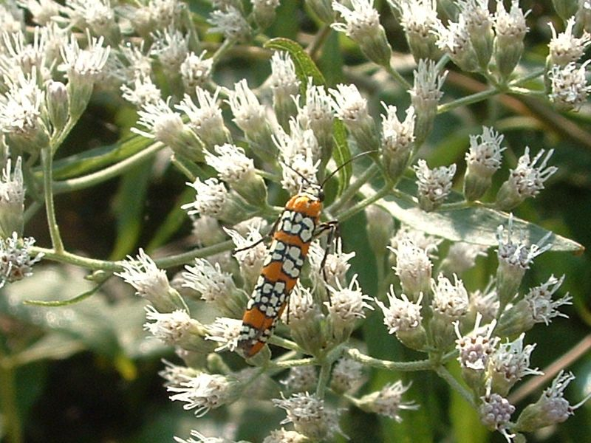
The End

