Slide 1
Behavioral Factors and heart disease
William P. Wattles, Ph. D.
Notes:
1

Slide 2
Causes of death (U.S. 2003) total all causes 2,448,288
Diseases of heart | 685,089 | 28.0%
Malignant neoplasms | 556,902 | 22.7%
Cerebrovascular diseases | 157,689 | 6.4%
Chronic lower respiratory diseases | 126,382 | 5.2%
Accidents (unintentional injuries) | 109,277 | 4.5%
Diabetes mellitus | 74,219 | 3.0%
Influenza and pneumonia | 65,163 | 2.7%
Alzheimer's disease | 63,457 | 2.6%
Nephritis, nephrotic syndrome and nephrosis | 42,453 | 1.7%
Septicemia | 34,069 | 1.4%
Intentional self-harm (suicide) | 31,484 | 1.3%
Chronic liver disease and cirrhosis | 27,503 | 1.1%
hypertensive renal disease | 21,940 | 0.9%
Parkinson's disease | 17,997 | 0.7%
Assault (homicide) | 17,732 | 0.7%

Slide 3
Cardiovascular Disease
Heart disease and stroke
31% of all deaths in the U. S. Heart Disease
6.7% Stroke

Slide 4
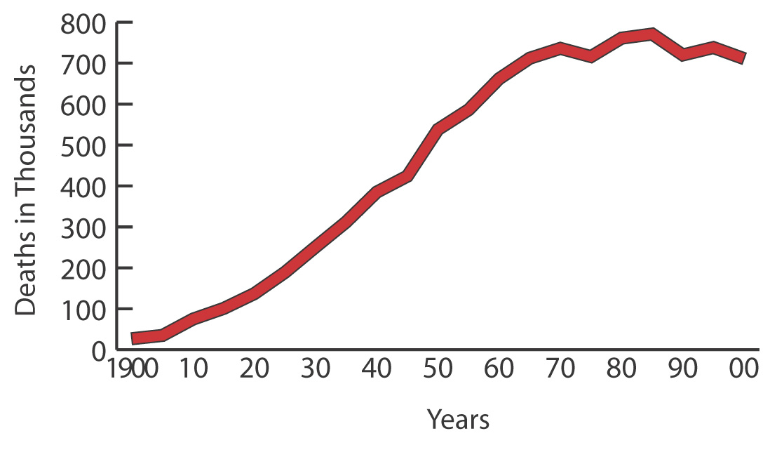
Deaths From Diseases of the Heart United States: 1979-2000
P 5

Slide 5
South Carolina DHEC
General Statistics
South Carolina ranks 3rd in the nation of overall cardiovascular disease and 1st for stroke
Diabetes is the 6th leading cause of death in South Carolina

Slide 6

United States Total Population Ages 35+, Stroke Death Rates, 1991-1998

Slide 7
Stroke Rate by state (per 100,000)
rank state stroke rate
1 South Carolina 81.4
2 North Carolina 78.5
2 Tennessee 78.5
4 Arkansas 77.2
5 Georgia 74.8
6 Mississippi 74
7 Oregon 71.6
8 Alabama 71.5
8 Indiana 71.5
10 Oklahoma 69.5
11 Washington 68.7
41 North Dakota 55.5
42 Vermont 54.9
43 Arizona 53.8
44 Massachusetts 51.5
45 Connecticut 51.4
46 New Mexico 50.6
47 Florida 49.6
48 New Jersey 49
49 Rhode Island 45.6
50 DColumbia 44.4
51 New York 40.9

Slide 9
According to Behavioral Risk Factor Surveillance System (BRFSS)
2001, adults in South Carolina reported risk factors for heart disease and stroke:
28.7% had high blood pressure
27.6% had high blood cholesterol
8.1% had diabetes
26% were current smokers
61.3% were overweight or obese (Body Mass Index greater than or equal to 25.0)
Approximately 80% had one or more of these five risk factors.

Slide 10
Cardiovascular disease (CVD)
Since 1900, CVD has been the No. 1 killer in the United States every year but 1918
More than 2,600 Americans die of CVD each day, an average of 1 death every 33 seconds

Slide 11
Cardiovascular disease (CVD)
CVD claimed 949,619 lives in the United States in 1998. This is 40.6 percent of all deaths or 1 of every 2.5 deaths.
Other causes of death in 1998 --- cancer 541,532; accidents 97,835; HIV (AIDS) 13,426
CVD claims almost 10,500 more lives each year than the next 6 leading causes of death combined

Slide 12

Cardiovascular disease (CVD)
CVD claims almost 10,500 more lives each year than the next 6 leading causes of death combined

Slide 13
Cardiovascular disease (CVD)
CVD was about 70 percent of “total mention mortality,” which means that of the more than 2,000,000 deaths from all causes, CVD was listed as a primary or contributing cause on about 1,400,000 death certificates.

Slide 14
Prevalence
60,800,000 Americans have one or more types of cardiovascular disease (CVD) according to current estimates.

Slide 15
Prevalence
High blood pressure --- 50,000,000.
Coronary heart disease --- 12,400,000.
Myocardial infarction --- 7,300,000.
Angina pectoris --- 6,400,000.
Stroke --- 4,500,000.
Congenital defects --- 1,000,000.
Congestive heart failure --- 4,700,000.
Notes:
Congestive heart failure, or heart failure, is a condition in which the heart is unable to adequately pump blood throughout the body and/or unable to prevent blood from "backing up" into the lungs.

Slide 16
Cardio vascular anatomy
Heart rate averages 72 but is lower in well conditioned persons, higher in those with diseased hearts.
Notes:
5

Slide 17
The heart
About the size of a grapefruit
weighs between 1/2 and 3/4 of a pound
Newborn pulse 120-140 beats per minute
Adults 60-90
Some athletes 40-45
Light exercise can raise heart rate to 100 and strenuous to 200.

Slide 18
The heart is a pump
Pushes blood through vessels to deliver oxygen and nutrients and remove wastes.
Beats over 100,000 times per day
Pumps 1,800 gallons a day
Sympathetic nervous system increases heart rate while the parasympathetic decreases it.
Notes:
6

Slide 19
Heart Physiology
Physiology: the functions of a living organism or any of its parts
Notes:
Oxygen poor (blue) Blood travels from the right ventricle to the lungs where hemoglobin becomes saturated with oxygen. From the lungs oxygenated blood travels into the left atrium of the heart

Slide 20
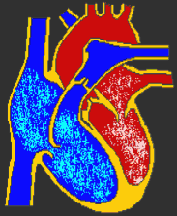
Atria-upper chambers. The atrium or entry way
Ventricles-lower chambers
Left
Atrium
Right
Atrium
Left
Ventricle
Right
Ventricle
Notes:
Oxygen poor (blue) Blood travels from the right ventricle to the lungs where hemoglobin becomes saturated with oxygen. From the lungs oxygenated blood travels into the left atrium of the heart

Slide 21
Aorta
Aorta: The main trunk of the systemic arteries, carrying blood from the left side of the heart to the arteries of all limbs and organs.
Pulmonary Artery carries blood to lungs
pulmonary artery
Left
Atrium
Right
Atrium
Left
Ventricle
Right
Ventricle

Slide 22
Mitral Valve
Tricuspid valve controls blood flow between the right atrium and ventricle
Mitral valve controls blood movement between the left atrium and ventricle
Left
Atrium
Right
Atrium
Left
Ventricle
Right
Ventricle
Tricuspid Valve
Notes:
Oxygen poor (blue) Blood travels from the right ventricle to the lungs where hemoglobin becomes saturated with oxygen. From the lungs oxygenated blood travels into the left atrium of the heart

Slide 23
Pulmonary valve
Mitral Valve
Pulmonary valve controls blood movement from right ventricle into pulmonary artery
The aortic valve controls blood flow from the left ventricle to the aorta
Left
Atrium
Right
Atrium
Left
Ventricle
Right
Ventricle
Tricuspid Valve
Aortic valve

Slide 24
Systolic phase
The right ventricle ejects oxygen-depleted blood through the pulmonary artery to the lungs.
The right atrium fills with oxygen-depleted blood from the body
BP about 130
The left ventricle ejects at high pressure about 8 ounces of oxygen-rich blood into the aorta.
The left atrium fills with oxygen-rich blood from the lungs
More predictive of heart disease

Slide 25
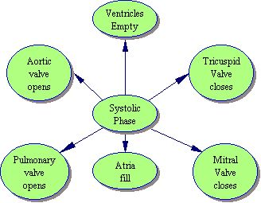
Pulmonary valve
Mitral Valve
Left
Atrium
Right
Atrium
Left
Ventricle
Right
Ventricle
Tricuspid Valve
Aortic valve
Notes:
7

Slide 26
Diastolic phase
The ventricles relax. Aortic and pulmonary valves close.
Tricuspid and mitral valves open and ventricles refill with blood for the next cycle.
The heart can increase the blood it pumps each minute by a factor of 6 to 10

Slide 27
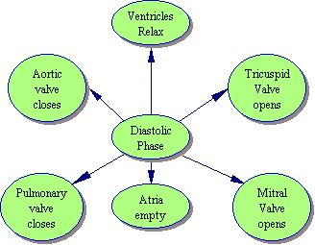
Pulmonary valve
Mitral Valve
Left
Atrium
Right
Atrium
Left
Ventricle
Right
Ventricle
Tricuspid Valve
Aortic valve
Notes:
7

Slide 28
Coronary Artery
Coronary arteries supply blood to the heart muscle.
The heart needs a large amount of blood and 5-7% of blood flows through the coronary arteries.
Notes:
8

Slide 29
HEART ATTACK
Heart attacks result from blood vessel disease in the heart.
Coronary heart disease (CHD) and coronary artery disease (CAD) are more specific names for heart disease.
The medical term for heart attack is myocardial infarction.
Notes:
16

Slide 30
Heart Attack
Occurs when one of the arteries that supply blood to the heart muscle is blocked by an obstruction.
The blockage is sometimes from the buildup of plaque (deposits of fat-like substances) due to atherosclerosis.
A heart attack also can be caused by a blood clot lodged in a coronary artery.
(coronary thrombosis.)
Notes:
18

Slide 31
Coronary Occlusion
A partial or total blockage of the coronary artery prevents the flow of arterial blood beyond the site of the stenosis, causing ischemia, angina and/or ischemic necrosis of the myocardium which is referred to as a myocardial infarction (MI).
Notes:
9

Slide 32
Notes:
15

Slide 33
Atherosclerosis
Disease caused by faulty or incomplete lipid metabolism.
Thus cholesterol, phospholipid and neutral fat are deposited on the walls of arteries.
Over time the body builds fibrous tissue around these fatty deposits (called plaques) which can become calcified into "bony-hard" plates in later stages. This process can occur in any artery
Notes:
12

Slide 34
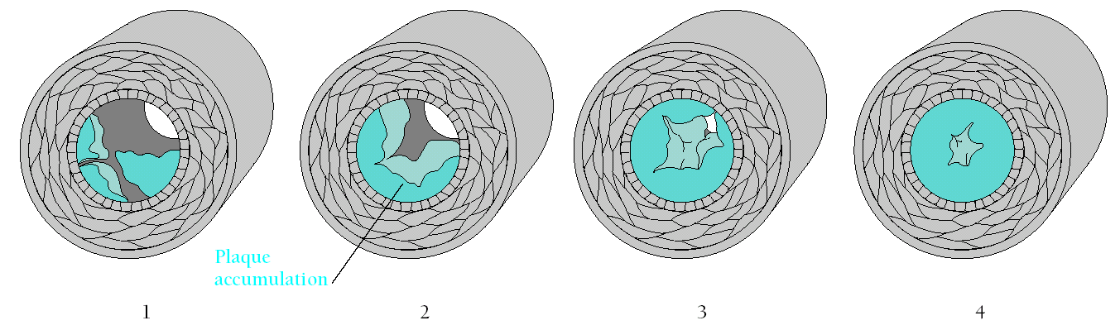
Figure 9.3 (p. 219)
Progressive atherosclerosis.

Slide 35
Framingham Heart Study,
45% of all heart attack victims are under age 65, and 5% are under age 40.
Notes:
19

Slide 36

Recovery after myocardial infarction
Approximately 50% survive first heart attack.

Slide 37
Recovery after myocardial infarction
Lifestyle changes similar to prevention programs
Clients may be more motivated but have permanent damage
Psychological problems including depression.

Slide 38
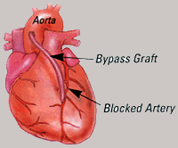
Coronary Bypass
The number of heart bypass operations performed in the United States each day -- about 1,000

Slide 39
Coronary Bypass
The bypass restores healthy circulation to the heart so it can beat stronger and more safely.
The odds, however, are solidly on the patient's side. The survival rate for a heart bypass operation is about 95 percent.

Slide 40
Coronary Bypass
As the operation begins, an incision is made directly through the front wall of the chest. The breast bone is sawed through and the ribs cranked open by a device that works like a carpenter's vise.

Slide 41
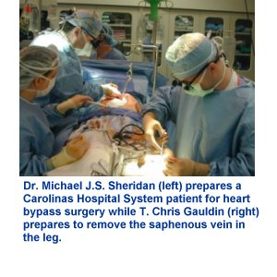

Slide 42
Coronary Bypass
The surgeon takes veins from the chest and the legs to use on the heart. Typically, a long but unessential vein is cut out of the leg and fashioned into one or more bypasses.

Slide 43
Coronary Bypass
While the heart is being repaired, it must be stopped. A heart-lung machine keeps the patient alive for the portion of the operation -- usually one to three hours -- needed to sew in the bypasses.

Slide 44
Coronary Bypass
Electric paddles are usually needed to re-start the heartbeat. Patients leave the operating room in critical condition, but most are able to sit up and even get out of bed by the next day.

Slide 45
Coronary Bypass
Barring complications, many heart bypass patients in the United States go home from the hospital in about five days or less. Some can return to office jobs, part-time at least, about a month after surgery

Slide 46
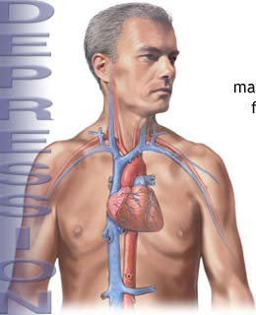
CAD Risk Factors
Inherent risk factors
Physiological conditions
Behavioral factors
psychosocial factors

Slide 47
Adherence
Adherence to medical advice is approximately 50%

Slide 48
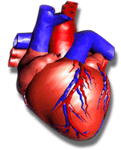
Inherent risk factors
Cannot be changed by behavior.
Diabetes
age
family history
gender
ethnic background

Slide 49
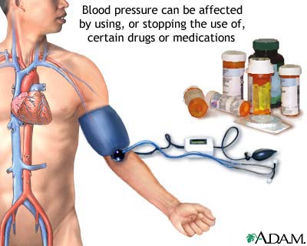
Physiological conditions
Hypertension
serum cholesterol level

Slide 50
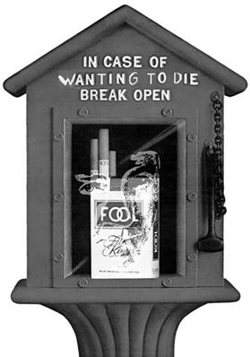
Behavioral Factors
Smoking
Diet

Slide 51
Psychosocial factors
Anxiety
  Anxiety positively related to risk of sudden death from heart attack
Educational level and income.
  Both genders all races.
Marriage and social support
  social support reduces risk of cardiovascular mortality

Slide 52
Personality theories
Natural and appealing
Often over inclusive
Always difficult to show empirically
Notes:
34

Slide 53
Personality
Personality-distinctive patterns of behavior that characterize an individual’s response to the environment.
Traits-stable dispositions that shape behavior.
Notes:
32

Slide 54
Type A behavior
Coronary prone personality
  potential for hostility
  angry once or more per week
  irritability about waiting in lines
  competitiveness in games with peers
  explosive voice modulation
  vigorous responses to interview questions
Notes:
25

Slide 55
Type A and heart disease
Initially lots of confirmatory studies.
More doubt in recent years.
Niaura et al (1992) Type A associated with alterations in lipids to an atherogenic lipid profile.
Ray (1991) Type A is “a false trail that should be abandoned.
Notes:
26

Slide 56
Type A and heart disease
Pfiffen & Battig (1989) No relationship.
Myrtek (1995) “The correlation between TABP and anger/hostility/aggression on the one hand and CHD on the other is so low as to have no practical meaning for diagnosis or treatment.”
We speculate that the rise and fall of the TABP concept may indeed have been due a good deal to publication bias.
Notes:
27

Slide 57
Anger as CHD risk factor
Expression of anger may be risk factor
Suppression of anger may be risk factor

Slide 58
Physiological risk factors
Hypertension single most important risk factor for heart attack (1) and stroke (3)
Dose response relationship exists between blood pressure level and risk for heart disease.
no overt symptoms
  essential hypertension -no known cause
  secondary hypertension

Slide 59
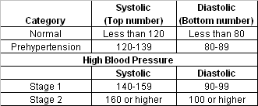
Blood Pressure
National Heart, Lung and Blood Institute
High blood pressure is a blood pressure reading of 140/90 mmHg or higher. Both numbers are important.

Slide 60
Lowering hypertension
Non-medical
  restrict sodium
  weight control
  Exercise
Medication
  dilate blood vessels
  reduce blood volume
  inhibit sympathetic nervous system

Slide 61
Reducing hypertension AHA
-lose weight if you are overweight
-become physically active
-restrict sodium
-reduce or quit drinking alcoholic beverages
You are in the lowest risk category if your systolic (the higher number) is less than 120

Slide 62
Causes of Heart Failure
Coronary artery disease
Unknown (idiopathic)
Hypertension
Heart valve problems
Infections (such as viruses)
Alcohol and illicit drug use
Inherited
Congenital heart disease

Slide 63
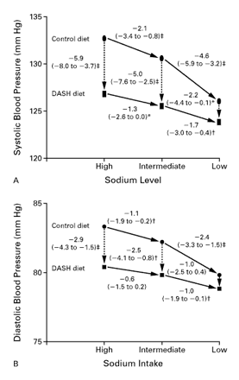
New England Journal of Medicine 2001
Effects on Blood Pressure of Reduced Dietary Sodium and the Dietary Approaches to Stop Hypertension (DASH) Diet
Notes:
Effects on Blood Pressure of Reduced Dietary Sodium and the Dietary Approaches to Stop Hypertension (DASH) Diet
Frank M. Sacks, M.D., Laura P. Svetkey, M.D., William M. Vollmer, Ph.D., Lawrence J. Appel, M.D., George A. Bray, M.D., David Harsha, Ph.D., Eva Obarzanek, Ph.D., Paul R. Conlin, M.D., Edgar R. Miller, M.D., Ph.D., Denise G. Simons-Morton, M.D., Ph.D., Njeri Karanja, Ph.D., Pao-Hwa Lin, Ph.D., for The DASH–Sodium Collaborative Research Group

Slide 64
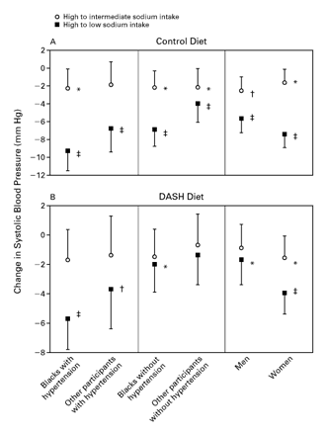
New England Journal of Medicine 2001
The effects of sodium were observed in participants with and in those without hypertension, blacks and those of other races, and women and men.

Slide 65
“This study” provides some of the strongest objective evidence to date that lowering sodium intake, even among those without hypertension, reduces the risk of future cardiovascular disease. Previous studies have been observational, relying on suboptimal measurements of dietary sodium intake, which is extremely difficult to measure. NR Cook, JA Cutler, E Obarzanek, JE Buring, KM … - British Medical Journal, 2007 - Br Med Assoc
Notes:
NR Cook, JA Cutler, E Obarzanek, JE Buring, KM … - British Medical Journal, 2007 - Br Med Assoc

Slide 66
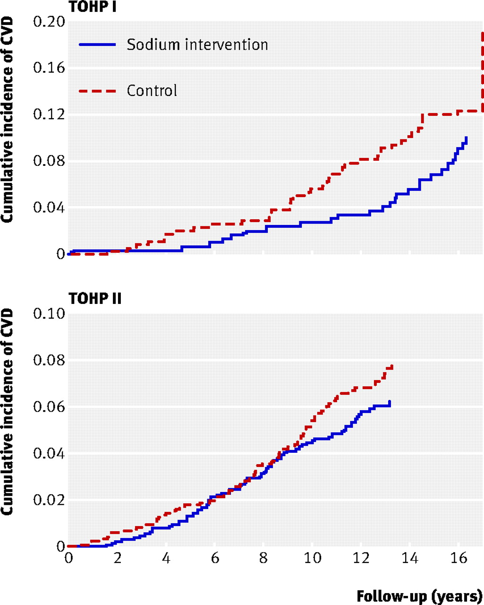

Fig 2 Cumulative incidence of cardiovascular disease (CVD) by sodium intervention group in TOHP I and II, adjusted for age, sex, and clinic
Cook, N. R et al. BMJ 2007;334:885
Copyright ©2007 BMJ Publishing Group Ltd.

Slide 67
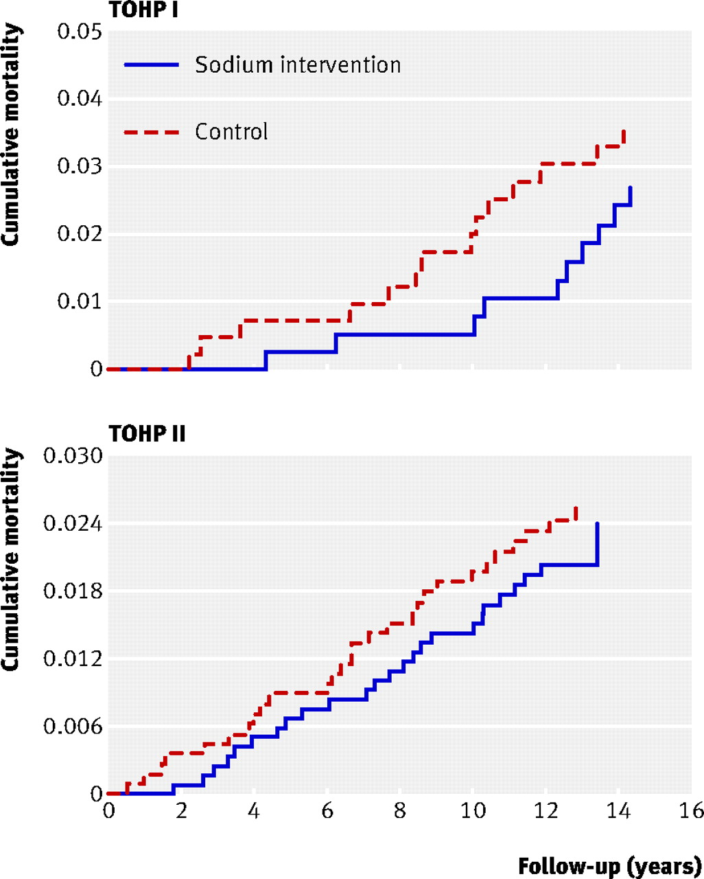
Fig 3 Total mortality by sodium intervention group in TOHP I and II, adjusted for age, sex, and clinic
Cook, N. R et al. BMJ 2007;334:885
Copyright ©2007 BMJ Publishing Group Ltd.

Slide 68
Rand Study
Reducing average population sodium intake to 2300 mg per day, the recommended maximum for adults, may reduce cases of hypertension by 11 million, save $18 billion health care dollars, and gain 312,000 QALYs that are worth $32 billion annually.
Am J Health Promot. 2009 Sep-Oct;24(1):49-57
Notes:
qalys
(QALY) The quality-adjusted life year (QALY) is a measure of disease burden, including both the quality and the quantity of life lived. It is used in assessing the value for money of a medical intervention. .

Slide 69
Sodium Guidelines Set by the FDA
Sodium-free -- less than 5 milligrams of sodium per serving
Very low-sodium -- 35 milligrams or less per serving
Low-sodium -- 140 milligrams or less per serving
Reduced sodium -- usual sodium level is reduced by 25%
Unsalted, no salt added or without added salt -- made without the salt that's normally used, but still contains the sodium that's a natural part of the food itself

Slide 70
Healthy Food
T he FDA and USDA state that a food that has the claim "healthy" must not exceed 360 mg sodium per reference amount. "Meal type" products must not exceed 480 mg sodium per reference amount.

Slide 71
Dietary Guidelines for Americans
Nearly all Americans consume substantially more salt than is recommended.
The general goal is for adults to consume less than 2300 mg of sodium per day.
People who should limit their sodium to 1,500 mg a day are:
  People who are 51 years or older
  African Americans
  People with high blood pressure
  People with diabetes
  People with chronic kidney disease

Slide 72
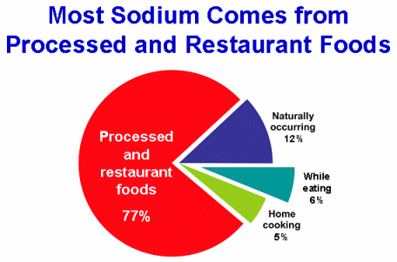
Source: Mattes, RD, Donnelly, D. Relative contributions of dietary sodium sources. Journal of the American College of Nutrition. 1991 Aug;10(4):383-393.

Slide 73
The Institute of Medicine, part of the National Academy of Sciences
The report set the maximum intake per day at 2300 milligrams but recommended not exceeding 1500 milligrams.
"A typical person needs between 1,000 to 1,500 milligrams per day; the new recommendations are right on point," said Edward Rosick, University Health Services physician. "However, most people are eating 5,000 to 7,000 milligrams per day, and if they are eating fast food, the number is probably higher."
Notes:
The Institute of Medicine, part of the National Academy of Sciences,

Slide 74
Top Sources of Sodium in the Diet
Breads and rolls
Cold cuts and cured meats
Pizza
Poultry
Soups
Sandwiches
Cheese
Pasta dishes
Meat dishes
Snacks

Slide 75
Next Paper
Calculate the sodium you consume in one day.
  List everything you eat
  Estimate serving size
  Look up sodium content
  Add to get the total sodium consumed
  Due Sunday October 16 at midnight.

Slide 76
Fast food and sodium
Popular restaurants
http://www.nutritiondata.com/index.html
Sodexho
http://www.balancemindbodysoul.com/nutritioncalc.html

Slide 77
That is it; I will not consider sodium because, I will never be able to eat out again! –Camille Psy314, Fall 2014

Slide 78
Serum Cholesterol Level
Cholesterol -waxy substance essential for life
Comes form diet but is also manufactured in the body
Serum cholesterol measures blood cholesterol.

Slide 79
American Heart Assn.
If your total blood cholesterol is less than 180, you are in the lowest risk category.
240 or higher, you are in the highest risk category. (Note text says 300 but it has changed)
High blood cholesterol can be reduced through changes in diet, weight loss if you are overweight, and medication.

Slide 80
Types of cholesterol
Low-density lipoprotein LDL cholesterol positively related to heart disease
High-density lipoprotein HDL is negatively correlated to heart disease.
HDL can actually retrieve cholesterol left by LDL
VDLD cholesterol or triglycerides

Slide 81
Ratio of LDL to HDL
HDL should be 22% of total for men and 25% of total for women
Ratio now seen as more important predictor than cholesterol level alone.

Slide 82
Improving the ratio
Increase HDL
  exercise
  moderate alcohol consumption
Decrease LDL
  Less saturated fat
  More vegetables

Slide 83
Behavioral risk factors
Smoking
  20% of adults smoke
  major factor in heart disease
Diet
  Fats
  Vitamins
  Fiber
Exercise

Slide 84
American Heart Assn.
People who are inactive are more likely to have heart attacks than people who are active. Even moderate activities, done often, can reduce your risk for heart attack. People who do more vigorous activities have an even lower heart attack risk.
Remember, doing something is better than doing nothing!

Slide 85
Heart Disease and diet
Fats
Diets high in saturated fat positively related to heart disease
Diets low in saturated fat protect against heart disease
Some oils are low in saturated fat:
  olive oil
  safflower oil

Slide 86
Heart Disease and diet
Some research suggests that a diet low in all fats may be preferable

Slide 87
Aspirin in secondary prevention
The American Heart Association recommends the use of aspirin in patients who have experienced a myocardial infarction (heart attack), unstable angina , ischemic stroke, or transient ischemic attacks (TIAs or "little strokes") if not contraindicated.

Slide 88
Aspirin in secondary prevention
This recommendation is based on sound clinical trial evidence showing that aspirin prevents the recurrence of clinical events such as heart attack, hospitalization for recurrent angina, second strokes, etc.
Taking aspirin after the onset of known heart or blood vessel disease is commonly referred to as "secondary prevention."

Slide 89
Aspirin in primary prevention
Using aspirin to prevent a first heart attack, stroke or other vascular event in healthy people is referred to as "primary prevention."
American Heart Association concluded that the clinical decision to use aspirin in primary prevention should be made on an individual basis by a physician.

Slide 90
Considerations for Aspirin in primary prevention
1. All other major risk factors for coronary heart disease and stroke should be determined and a concerted program begun to reduce or modify those risk factors,

Slide 91
Considerations for Aspirin in primary prevention
2. The decision to start taking aspirin regularly should be made only after each person consults with his or her physician.
3. A person who chooses to start a regular aspirin regimen should be aware of its side effects

Slide 92
Aspirin and alcohol
The U.S. Food and Drug Administration warns against drinking alcohol for people who regularly take aspirin.

Slide 93
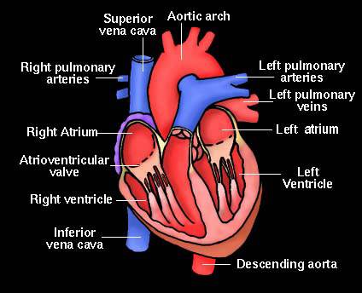
The End
Notes:
The two large veins that collect blood returning from all parts of the body and return it to the heart (right atrium) The inferior vena cava brings blood from the lower half of the body; and the superior vena cava brings blood from the upper half.

Slide 94
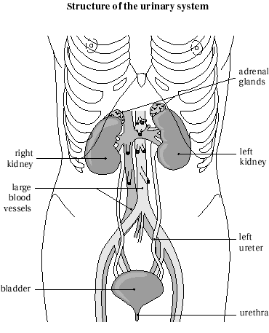
Renal
kidney, relating to the kidneys. Renal failure is kidney failure
Return

Slide 95
Septicemia
Disease caused by the spread of bacteria and their toxins in the bloodstream. Also called blood poisoning
Return

Slide 96
Nephritis
an inflammation of the kidney
Return

Slide 97
Neoplasm
An abnormal mass of tissue that results from excessive cell division. Neoplasms may be benign (not cancerous), or malignant (cancerous). Also called tumor
Return

