Slide 1
Cancer and Behavior
William P. Wattles Ph.D.
Behavioral Medicine
Notes:
1

Slide 2
Causes of death (U.S. 2003) total all causes 2,448,288
Diseases of heart | 685,089 | 28.0%
Malignant neoplasms | 556,902 | 22.7%
Cerebrovascular diseases | 157,689 | 6.4%
Chronic lower respiratory diseases | 126,382 | 5.2%
Accidents (unintentional injuries) | 109,277 | 4.5%
Diabetes mellitus | 74,219 | 3.0%
Influenza and pneumonia | 65,163 | 2.7%
Alzheimer's disease | 63,457 | 2.6%
Nephritis, nephrotic syndrome and nephrosis | 42,453 | 1.7%
Septicemia | 34,069 | 1.4%
Intentional self-harm (suicide) | 31,484 | 1.3%
Chronic liver disease and cirrhosis | 27,503 | 1.1%
hypertensive renal disease | 21,940 | 0.9%
Parkinson's disease | 17,997 | 0.7%
Assault (homicide) | 17,732 | 0.7%

Slide 3
Cancer
Cancer named by Hippocrates
Roman physician Galen first used the word tumor

Slide 4
Cancer
Second leading cause of death in the U. S.
Mortality rates except for lung cancer stable

Slide 5
Cancer Death Rates*, for Men, US,1930-2003
Lung & bronchus
Rate Per 100,000
Stomach
Prostate
Colon & rectum
Pancreas
Leukemia
Liver
*Age-adjusted to the 2000 US standard population.
Source: US Mortality Public Use Data Tapes 1960-2003, US Mortality Volumes 1930-1959,
National Center for Health Statistics, Centers for Disease Control and Prevention, 2006.
Notes:
Most of the increase in cancer death rates for men prior to 1990 was attributable to lung cancer. However, since 1990, the age-adjusted lung cancer death rate in men has been decreasing. Stomach cancer mortality has decreased considerably since 1930. Death rates from prostate and colorectal cancers have also been declining.

Slide 6
Cancer Death Rates*, for Women, US,1930-2003
Rate Per 100,000
Lung & bronchus
Uterus
Breast
Colon & rectum
Stomach
Ovary
Pancreas
*Age-adjusted to the 2000 US standard population.
Source: US Mortality Public Use Data Tapes 1960-2003, US Mortality Volumes 1930-1959,
National Center for Health Statistics, Centers for Disease Control and Prevention, 2006.
Notes:
Lung cancer is currently the most common cause of cancer death in women, with the death rate more than two times what it was 25 years ago. In comparison, breast cancer death rates were virtually unchanged between 1930 and 1990, but have since decreased by about 24%. The death rates for stomach and uterine cancers have decreased steadily since 1930; colorectal cancer death rates have been decreasing for over 50 years.

Slide 7
American Cancer Society
http://www.cancer.org

Slide 8
Cancer
Cancer is not just one disease but rather a group of diseases. All forms of cancer cause cells in the body to change and grow out of control.
Most types of cancer cells form a lump or mass called a tumor.
Cells from the tumor can break away and travel to other parts of the body where they can continue to grow. This spreading process is called metastasis.

Slide 9
Cancer
All cancers have neoplastic growth, altered cells with nearly unlimited growth.
Benign localized
Malignant spread much more threatening
Metastasize cancer cells move to other parts of the body
http://newscenter.cancer.gov/sciencebehind/cancer/cancer01.htm

Slide 10
Tumor
The gradual increase in the number of dividing cells creates a growing mass of tissue called a "tumor" or "neoplasm."

Slide 11
Benign vs. Malignant
Depending on whether or not they can spread by invasion and metastasis, tumors are classified as being either benign or malignant.

Slide 12
Benign vs. Malignant
Benign tumors are tumors that cannot spread by invasion or metastasis; hence, they only grow locally.

Slide 13
Malignant
Malignant tumors are tumors that are capable of spreading by invasion and metastasis. By definition, the term "cancer" applies only to malignant tumors.

Slide 14
Biopsy
Microscopic examination will tell the doctor whether a tumor is actually present and, if so, whether it is malignant (i.e., cancer) or benign.

Slide 15
Types of cancer
Carcinomas -cancers of the epithelial tissue
skin
stomach lining
mucous membranes
Sarcomas -cancers in connective tissue
bones, muscles, cartilage, lymph
Leukemias originate in the blood

Slide 16
Frequency
Carcinoma 85%
Sarcoma 2%
Leukemia 8%

Slide 17
Cancer treatable
A Family Gets Cancer
Second Chance
A little bit of heaven

Slide 18
2007 Estimated US Cancer Cases
Men 766,860
Women 678,060
Prostate 29%
Lung & bronchus 15%
Colon & rectum 10%
Urinary bladder 7%
Non-Hodgkin 4% lymphoma
Melanoma of skin 4%
Kidney 4%
Leukemia 3%
Oral cavity 3%
Pancreas 2%
All Other Sites 19%
26% Breast
15% Lung & bronchus
11% Colon & rectum
6% Uterine corpus
4% Non-Hodgkin lymphoma
4% Melanoma of skin
4% Thyroid
3% Ovary
3% Kidney
3% Leukemia
21% All Other Sites
*Excludes basal and squamous cell skin cancers and in situ carcinomas except urinary bladder.
Source: American Cancer Society, 2007.
Notes:
Now we will turn our attention to the number of new cancers anticipated in the US this year. It is estimated that about 1.4 million new cases of cancer will be diagnosed in 2007. Cancers of the prostate and breast will be the most frequently diagnosed cancers in men and women, respectively, followed by lung and colorectal cancers both in men and in women.

Slide 19
Lifetime Probability of Cancer, Men
Site
Risk
All sites 1 in 2
Prostate 1 in 6
Lung & bronchus 1 in 13
Colon & rectum 1 in 17
Urinary bladder 1 in 29
Non-Hodgkin lymphoma 1 in 47
Melanoma 1 in 57
Leukemia 1 in 69
Oral cavity 1 in 71
Kidney 1 in 72
Stomach 1 in 79
Source: Surveillance, Epidemiology, and End Results Program, 1973-1999, Division of Cancer Control and
Population Sciences, National Cancer Institute, 2002.

Slide 20
Lifetime Probability of Cancer, Women
Site
Risk
All sites 1 in 3
Breast 1 in 8
Lung & bronchus 1 in 17
Colon & rectum 1 in 18
Uterine corpus 1 in 37
Non-Hodgkin lymphoma 1 in 56
Ovary 1 in 58
Pancreas 1 in 80
Melanoma 1 in 81
Urinary bladder 1 in 88
Uterine cervix 1 in 123
Source: Surveillance, Epidemiology, and End Results Program, 1973-1999, Division of Cancer Control and
Population Sciences, National Cancer Institute, 2002.

Slide 21
Relative Survival by Cancer Site
Site
1974-1976
1983-1985
1992-1998
All sites 50 52 62
Breast (female) 75 78 86
Colon & rectum 50 57 62
Leukemia 34 41 46
Lung & bronchus 12 14 15
Melanoma 80 85 89
Non-Hodgkin lymphoma 47 54 55
Ovary 37 41 53
Pancreas 3 3 4
Prostate 67 75 97
Urinary bladder 73 78 82

Slide 22
Cause of cancer
70% of cancer is due to exposure to some environmental agent
Genetics plays a role

Slide 23
Cancer Mortality
One-third of the 500,000 cancer deaths annually in the United States are caused by cigarette smoking

Slide 24
Cancer Mortality
90% of lung cancer deaths in men and 80%in women caused by smoking.
Smoking greatly increases risk of breast cancer

Slide 25
Tobacco Use in the US, 1900-2003
Per capita cigarette consumption
Male lung cancer death rate
Female lung cancer death rate
Notes:
The last set of slides describes at the prevalence of cancer risk factors, such as tobacco use and physical inactivity, and the prevalence of cancer screening, such as use of mammography.
Tobacco use is a major preventable cause of death, particularly from lung cancer. The year 2004 marks the anniversary of the release of the first Surgeon General’s report on Tobacco and Health, which initiated a decline of per capita cigarette smoking in the United States. As a result of the cigarette smoking epidemic, lung cancer death rates showed a steady increase through 1990, then began to decline among men. The lung cancer death rate among US women, who began regular cigarette smoking later than men, continues to increase slightly.

Slide 26
Cancer mortality
Cigarette smoking has synergistic effect with other environmental pollutants.

Slide 27
Cancer Mortality and diet
One-third of cancer deaths is caused by a variety of dietary factors.

Slide 28
Foods that may cause cancer
Foods high in carcinogens
Foods that have too much fat and not enough fiber

Slide 30
Prevention and treatment
Primary prevention-health promotion actions taken to prevent a disease from occurring
Secondary prevention-actions taken to identify and treat an illness early
Tertiary prevention-actions taken to contain or retard damage once a disease has advanced beyond early stages

Slide 31
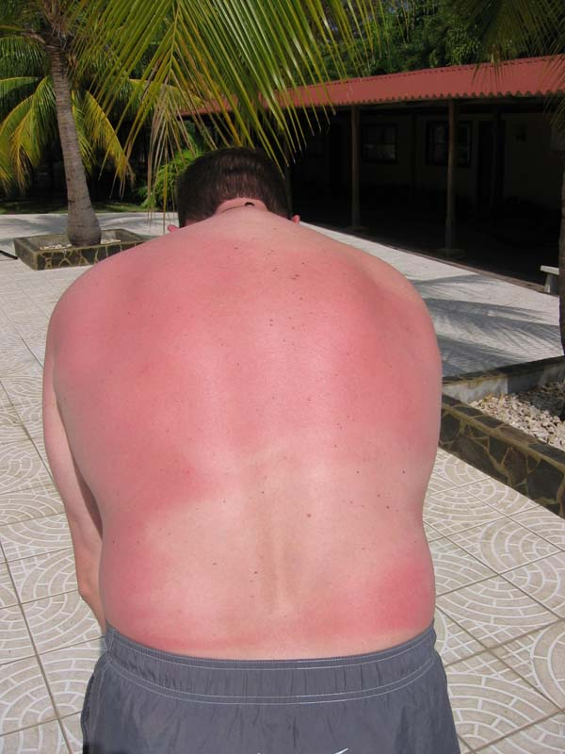
Primary Prevention
Use sunscreen
Lower fat in diet
Stop smoking
Avoid passive smoking

Slide 32
Reactance
Step 1. People perceive an unfair restriction on their actions.
The key word here is, "unfair.". For adults, the unfair restriction is the banned item. Something is denied and that denial is unreasonable, unjust, and maybe even un-American.

Slide 33
Step 2. A state of reactance is activated.
Reactance is an intense motivational state. A person with reactance is emotional, single-minded, and somewhat irrational. Reactance is important to understand because it has strong motivational properties and leads to the final stage.

Slide 34
Step 3. The person must act to remove the reactance.
The motivational qualities of reactance are so strong that the person must do something about it. The reactance cannot be ignored or put aside.
People with reactance will try to get the unfair restriction removed or they will try to subvert the restriction.
People will tend to overvalue the action that was unfairly restricted.

Slide 35
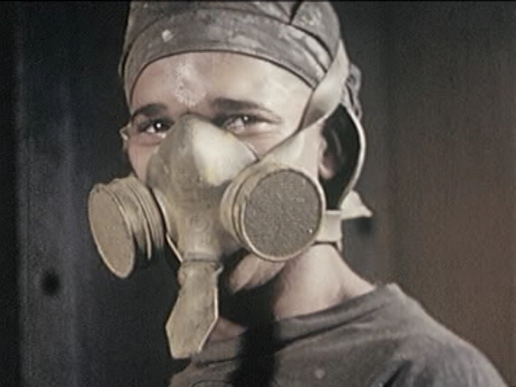
Primary Prevention to reduce Cancer Risk
Eat cancer fighting foods
Fruits and vegetables
Fiber
Moderate or no alcohol
Exercise
Avoid toxic chemicals

Slide 36
American Cancer Society
Based on its review of the scientific evidence, the American Cancer Society revised its nutrition guidelines.
They are consistent in principle with the US Department of Agriculture (USDA) Food Guide Pyramid.

Slide 37
American Cancer Society
To reduce your cancer risk, follow an overall dietary pattern that includes:
A high proportion of plant foods (fruits, vegetables, grains, and beans)
Limited amounts of meat, dairy, and other high-fat foods
A balance of caloric intake and physical activity.

Slide 38
Choose most of the foods you eat from plant sources.
Eat five or more servings of fruits and vegetables each day; eat other foods from plant sources, such as breads, cereals, grain products, rice, pasta, or beans several times each day.

Slide 39
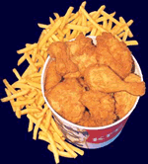
Limit intake of high-fat foods, particularly from animal sources.
Choose foods low in fat; limit consumption of meats, especially high-fat meats. High-fat diets have been associated with an increase in the risk of cancers of colon and rectum, prostate, and endometrium.
Notes:
The glandular mucous membrane that lines the uterus.
The American Heritage Dictionary of the English Language, Third Edition is licensed from Houghton Mifflin Company. Copyright © 1992 by Houghton Mifflin Company. All rights reserved.
Selected Illustrations from the Concise Columbia Encyclopedia. Copyright © 1991 by Columbia University Press.

Slide 40
Limit intake of high-fat foods, particularly from animal sources.
Consumption of meat, especially red meat, has been associated with increased cancer risk at several sites, esp. colon and prostate.
Notes:
The glandular mucous membrane that lines the uterus.
The American Heritage Dictionary of the English Language, Third Edition is licensed from Houghton Mifflin Company. Copyright © 1992 by Houghton Mifflin Company. All rights reserved.
Selected Illustrations from the Concise Columbia Encyclopedia. Copyright © 1991 by Columbia University Press.

Slide 41
Trends in Consumption of Recommended Vegetable and Fruit Servings
Prevalence (%)
1994*
1996
1998
2000

Slide 44
Operant conditioning and primary prevention
Antecedent
Behavior
Consequence

Slide 45
Which makes you hungry? Which would reinforce eating?

Slide 46
Alternatives

Slide 47
Cognitive Dissonance
Cognitions which contradict each other are said to be "dissonant," while cognitions which agree with each other are said to be "consonant."
Dissonance can be reduced either by eliminating dissonant cognitions, or by adding new consonant cognitions.

Slide 48
Techniques for Secondary Prevention
Regular self-examinations of breast for women and testicles for men.
90 % of breast tumors detected through self-examination
5-year survival rates are 95% for testicular cancer caught early

Slide 49
Early diagnosis
Early detection and treatment
Improved chances of survival
Still may have long, unpleasant treatment

Slide 50
Reasons not to screen
Don’t want bad news
Believe it won’t happen to them
No good treatment anyway
No symptoms
Anxiety

Slide 51
Treatment
Surgery-oldest and most effective
Chemotherapy-cure, limit spread or slow tumor growth
Immunotherapy-enhance immune response
Radiation therapy-use x-rays, gamma rays to kill or slow tumors

Slide 52
Physical activity
Lack of regular exercise may be a cancer risk factor.
Good example of correlational research
health causes exercise
exercise causes health
Mixed results

Slide 53
Exercise and breast cancer
Text cites two recent studies showing that exercising four hours a week reduces chances of breast cancer in young women.

Slide 54
Trends in Leisure-Time Physical Activity Prevalence
Prevalence (%)

Slide 55
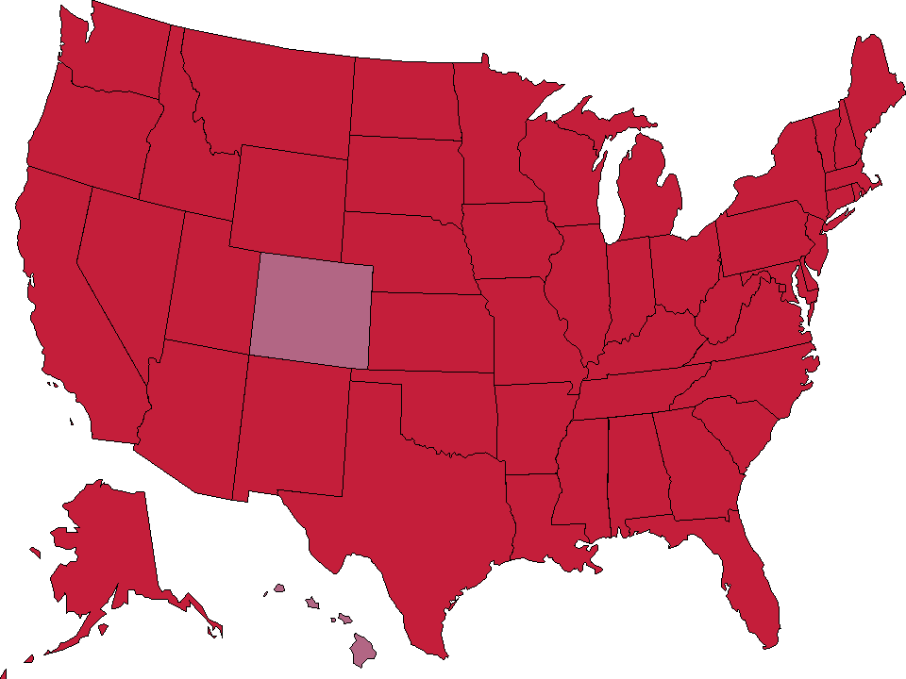
Trends in Overweight* Prevalence (%), Adults 18 and Older, US, 1992-2005
1992
1995
1998
2005
Less than 50%
50 to 55%
More than 55%
State did not participate in survey
Notes:
This slide highlights the obesity epidemic as mentioned in the previous slide. In 2005, over 50% of the adults in all states, including District of Columbia, were overweight or obese, compared to just 12 states in 1992.

Slide 56
Be physically active: achieve and maintain a healthy weight.
Physical activity can help protect against some cancers, either by balancing caloric intake with energy expenditure or by other mechanisms.

Slide 57
Obesity and Cancer
Excess weight may account for 14 percent of cancer deaths in men and 20 % in women.
New England Journal of Medicine

Slide 58
Alcohol as a cancer risk factor
Alcohol may have some effect on cancers research is ambiguous
Alcohol implicated in cancers of the tongue, tonsils, esophagus, pancreas, breast and liver.
Alcohol may have a synergistic effect

Slide 59
American Cancer Society
“Use of alcohol is clearly linked to increased risk of developing breast cancer.”
“Women who have one alcoholic drink a day have a very small increased risk. Those who have 2 to 5 drinks daily have about 1.5 times the risk of women who drink no alcohol.”

Slide 60
Ultraviolet light
Sun exposure accounts for 1 to 2% of cancers.
Good example of interaction
light-skinned people near the equator have higher risk

Slide 61
Sex behavior and cancer
AIDS
Kaposi’s sarcoma
non-Hodgkins lymphoma
Certain sexual practices can contribute to cancer risk.
NYT 10/7/2005 Vaccine prevents most cervical cancer. First cancer vaccine

Slide 62
Stress and cancer
Methodological issues
prospective versus retrospective studies.

Slide 63
Quasi prospective study
Cooper and Faragher (1993) studied women at a breast cancer clinic.
positively related to cancer were bereavement and denying the existence of problems
negatively related were ability to express anger and living a busy lifestyle.
Regular stress lessened risk but a single major event increased it.

Slide 64
“Fighting Spirit” and cancer
New York Times Oct. 19. 1999
Study reported in Lancet states that positive thinking did not increase chances of survival.
Suppression of emotions also appeared unrelated to survival.
Depression and hopelessness did appear to predict an increased risk of dying in 5 years

Slide 65
American Cancer Society
Antiperspirants and bras: Recent internet e-mail rumors have suggested that underarm antiperspirants and underwire bras hamper lymph circulation and increase the risk of breast cancer. There is no evidence to support this idea.

Slide 66
Cancer and Cell Phones
The Institute of Environmental Medicine in Stockholm said 10/15/2004 that it has found that 10 or more years of cell phone use may increase the risk of acoustic neuroma, a noncancerous tumor, in humans

Slide 67
Cell phones and cancer
The risk of developing a tumor was almost double for those who started to use phones before their diagnosis. In addition, the tumor risk was almost four times higher on the side of the head where the phone was held, Ahlbom and Feychting said
Notes:
focused on 750 Swedes who had used cell phones for at least 10 years. It was published in the International Journal of Epidemiology.
In the study, researchers questioned 150 patients already diagnosed with acoustic neuroma, a benign tumor on the auditory nerve that takes several years to grow before being diagnosed, and 600 who did not have it, about their cell phone use.
``At the time the study was conducted, only analog mobile phones had been in use for more than 10 years and therefore we cannot determine if the results are confined to use of analog phones or if the results would be similar after long-term use of digital phones,'' the report said.

Slide 68
Court throws out cancer case.
The district court also questioned the reliability of Dr. Hardell?s research because it failed to demonstrate a dose-response relationship, that is, it failed to show that with greater use of cellular phones, a person faced a greater risk of developing a tumor. Showing a dose-response relationship is, as Dr. Hardell agreed, an important factor in establishing causation.

Slide 69
Peer review
Peer-review: a process through which a research paper or other piece of writing is critically reviewed prior to publication, by individuals with in-depth knowledge of the authors' area of research or investigation, to ensure that the work under review is accurate, reliable, well-written, and worthy of publication.

Slide 70
Capitalizing on Chance
One day in January it was colder in Florence, SC than in New Vineyard, Maine.

Slide 71
Cancer and Cell Phones
The U.S. Food and Drug Administration has said previously that while mobile phones do emit electromagnetic radiation, the amount of energy dispersed by the devices is similar to that emitted by other common household devices, such as television sets and microwave ovens, and does not pose a measurable health risk.

Slide 72
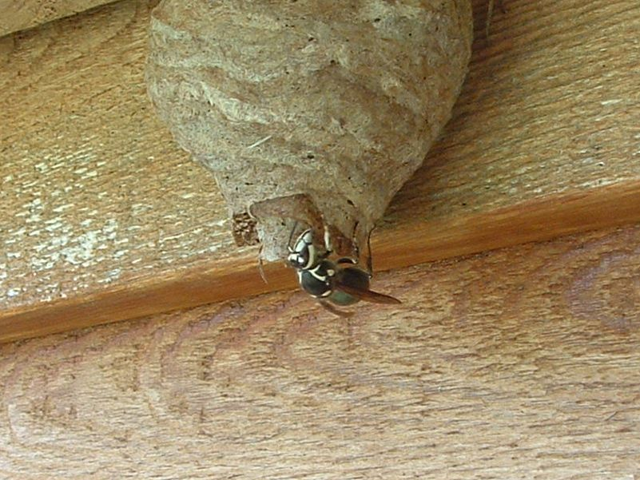
The End

Slide 73
The End

Slide 74
Endometrium
The glandular mucous membrane that lines the uterus.

