Slide 1
Alcohol and other drugs
William P. Wattles, Ph.D.
Psychology 314

Slide 2
http://www.nytimes.com/2014/11/02/education/edlife/this-is-your-brain-on-drugs-marijuana-adults-teens.html?ref=science

Slide 3
Dr. Gilman was reviewing a composite scan of the brains of 20 pot smokers, ages 18 to 25. What she and fellow researchers at Harvard and Northwestern University found within those scans surprised them. Even in the seven participants who smoked only once or twice a week, there was evidence of structural differences in two significant regions of the brain. The more the subjects smoked, the greater the differences.

Slide 4
Behavior Change with applied psychology.
http://www.youtube.com/watch?v=AdKUJxjn-R8
A—B—C
Antecedent (trigger)
Behavior
Consequence

Slide 8
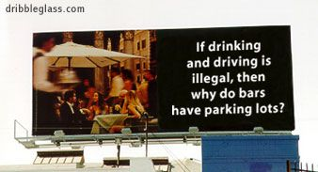

Slide 9
Prevalence of drinking
51% drink at least moderately.
49% nondrinkers
21.4% light drinkers
22.9% binge
6.7% heavy
10% of drinkers consume 50% of alcohol.

Slide 10
Abstinence
Business and alcohol.
http://well.blogs.nytimes.com/2012/10/01/feeling-the-pressure-to-drink-for-work/?ref=health

Slide 11
2002 NSDUH
Current use - At least one drink in the past 30 days
Binge use - Five or more drinks on the same occasion at least once in the past 30 days
Heavy use - Five or more drinks on the same occasion on at least 5 different days in the past 30 days.

Slide 12
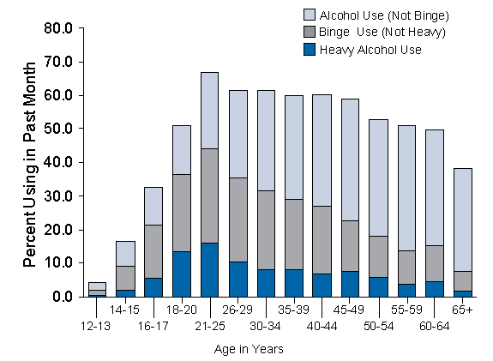

Slide 14
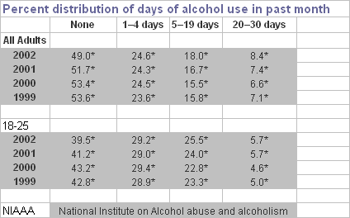
Notes:
62-66% ever drink

Slide 15
Journal of the American Medical Association
Alcohol contributes to 100,000 deaths annually, making it the third leading cause of preventable mortality in the US, after tobacco and diet/activity patterns

Slide 16
Suicide
Alcohol use is involved in half of
suicides.

Slide 17
Murder
Alcohol use is involved in half of all murders

Slide 18
Accidents
Alcohol use is involved in half of accidental deaths

Slide 19
MADD
What is MADD?
Mothers Against Drunk Driving is a 501(c)(3) non-profit grass roots organization with more than 600 chapters nationwide. MADD is not a crusade against alcohol consumption. Our focus is to look for effective solutions to the drunk driving and underage drinking problems.

Slide 20
MADD
MADD was founded by a small group of California women in 1980 after a 13-year-old-girl was killed by a hit-and-run driver. He had been out of jail on bail for only two days for another hit-and-run drunk driving crash and had three previous drunk driving arrests and two convictions.

Slide 21
Alcohol as a Risk Factor for Injuries
About 50% of falls involve alcohol.

Slide 22
Aviation
Alcohol involved in a third aviation deaths

Slide 23
Drowning
A 1990 California study found that 41 percent of all drowning deaths were alcohol associated.

Slide 24
Boating
A 1983 National Transportation Safety Board study estimated that alcohol was involved in 69 percent of boat-related drownings.

Slide 25
Commerce
The Exxon Valdez oil spill was one of the most publicized and studied environmental tragedies in history.

Slide 26
Fire
Nearly half of household fires are linked with people who have been drinking.

Slide 27
Domestic Abuse
Alcohol is present in more than 50 percent of all incidents of domestic violence.

Slide 28
Child Abuse
In 1987, 64 percent of all reported child abuse and neglect cases in New York City were associated with parental AOD abuse

Slide 29
Head Injuries
Around half of all adults admitted to hospital with head injuries are drunk.

Slide 30
Adolescent arrest
32% of incarcerated teens were drunk at the time of their crime and/or arrest

Slide 31
Crime
Alcohol involved in half of all crimes

Slide 32
College Dropout
Difficulty meeting academic responsibilities is one of the most common consequences of alcohol use. The NIAAA Task Force on College Drinking reports that about 25 percent of college students report academic problems caused by alcohol use

Slide 33
Date rape
Approximately 70% of sexual assaults involving college students, involve the use of alcohol.

Slide 34
National Institute on Alcohol Abuse and Alcoholism (NIAAA)
For most people, alcohol is a pleasant accompaniment to social activities. Moderate alcohol use is not harmful for most adults

Slide 35
Average consumption?
College Students drink, on average, fewer than one alcoholic beverage a day.

Slide 36
National Institute on Alcohol Abuse and Alcoholism
Moderate alcohol use:
up to two drinks per day for men and one drink per day for women and older people (A standard drink is one 12-ounce bottle of beer or wine cooler, one 5-ounce glass of wine, or 1.5 ounces of 80-proof distilled spirits)

Slide 37
National Institute on Alcohol Abuse and Alcoholism
Some abuse alcohol by drinking frequently or by binge drinking--often defined as having five or more drinks in a row.
(A standard drink is one 12-ounce bottle of beer or wine cooler, one 5-ounce glass of wine, or 1.5 ounces of 80-proof distilled spirits)

Slide 38
NIAAA, Alcohol Health & Research World
In 1992, more than seven percent of the population ages 18 years and older--nearly 13.8 million Americans--had problems with drinking, including 8.1 million people who are alcoholic.

Slide 39
NIAAA, Alcohol Health & Research World
Almost three times as many men (9.8 million) as women (3.9 million) were problem drinkers, and prevalence was highest for both sexes in the 18-to-29-years-old age group

Slide 40
National Center For Health Statistics
About 43% of US adults--76 million people--have been exposed to alcoholism in the family: they grew up with or married an alcoholic or a problem drinker or had a blood relative who was ever an alcoholic or problem drinker

Slide 41
National Institute on Alcohol Abuse and Alcoholism
From 1985 to 1990, the economic cost of alcoholism and alcohol-related problems rose 40% to $98.6 billion. Reduced or lost productivity and premature death accounted for 71% of this cost; medical care for more than 10%; and crime for nearly 6%

Slide 42
DSM-V What Is Alcoholism?
Substance Use Disorder

Slide 43
Substance use disorder, 2 or more within 12 months.
Tolerance: The need for increasing amounts of alcohol in order to get "high.“
withdrawal symptoms. Physical dependence.
1. Loss of control: Substance often taken in larger amounts or over a longer period of time than intended.
2. Persistent Efforts or desire to cut down or control.

Slide 44
Substance use disorder, 2 or more within 12 months.
3. A great deal of time is spent in activities necessary to obtain, use or recover from the substance.
4. Craving or strong desire to use
5. Important social, occupational or recreational activities given up or reduced due to substance use.
6. Continued use despite social problems

Slide 45
Substance use disorder, 2 or more within 12 months.
7. Important social, occupational or recreational activities given up due to use
8. Recurrent use in physically hazardous situations
9. Continued drinking despite physical or psychological problems caused or worsened by the effects of alcohol.

Slide 46
Classes of substances
Alcohol
Amphetamines
Caffeine
Cannabis
Cocaine
Hallucinogens
Inhalants
Nicotine
Opoids
Phencyclidine (PCP)
Sedative, hypnotics and anxiolytics

Slide 47
Substance Abuse
Does not meet criteria for dependence but one or more of:
Failure to fulfill role obligations
Recurrent use in physically hazardous situations
Recurrent substance related legal problems
Continued use despite interpersonal problems.

Slide 48
Intoxication vs. Dependence
Intoxication
Reversible substance-specific syndrome due to recent ingestion of a substance.
Belligerence, mood lability, cognitive impairment, impaired judgment, impaired social functioning.

Slide 49
What Are the Signs of a Problem?
Have you ever felt you should Cut down on your drinking?
Have people Annoyed you by criticizing your drinking?
Have you ever felt bad or Guilty about your drinking?
Have you ever had a drink first thing in the morning to steady your nerves or to get rid of a hangover (Eye opener)?

Slide 50
Can Alcoholism Be Cured? (NIAAA)
While alcoholism is a treatable disease, a cure is not yet available. That means that even if an alcoholic has been sober for a long while and has regained health, he or she remains susceptible to relapse and must continue to avoid all alcoholic beverages. "Cutting down" on drinking doesn't work; cutting out alcohol is necessary for a successful recovery.

Slide 51
Virtually all alcoholism treatment programs also include meetings of Alcoholics Anonymous (AA),which describes itself as a "worldwide fellowship of men and women who help each other to stay sober."

Slide 52
While AA is generally recognized as an effective mutual help program for recovering alcoholics, not everyone responds to AA's style and message, and other recovery approaches are available.

Slide 53
Controlled Drinking
Popular concept has little empirical support.
Its supporters acknowledge it only works for some.
Most have tried it informally

Slide 54
Youth drinking
Reported drinking within the past month:
26 percent of 8th graders
40 percent of 10th graders
51 percent of 12th graders
Binge drinking at least once during the 2 weeks:
16 percent of 8th graders
25 percent of 10th graders
30 percent of 12th graders.

Slide 55
Mental retardation
Fetal alcohol syndrome (FAS), which can occur when women drink during pregnancy, is the leading known environmental cause of mental retardation in the Western World

Slide 56
August 2001
Findings from a recent series of Danish studies suggest that moderate wine drinkers are healthier than those who drink other alcoholic beverages or those who abstain.

Slide 57
Wine drinking was significantly associated with higher IQ, higher parental educational level, and higher socioeconomic status.

Slide 58
Consequently, the association between drinking habits and social and psychological characteristics, in large part, may explain the apparent health benefits of wine.

Slide 59
Correlation does not imply causation.

Slide 60
World Health Organization
''The leading cause-of-disease burden in (emerging countries, mainly Asian nations like China and Thailand), is actually alcohol.”

Slide 61
AMERICAN CANCER SOCIETY
Alcoholic beverages cause cancers of the oral cavity, esophagus, and larynx.
Cancer risk increases with the amount of alcohol consumed and may start to rise with intake of as few as two drinks per day.
A drink is defined as 12 ounces of regular beer, 5 ounces of wine, and 1.5 ounces of 80-proof distilled spirits.

Slide 62
AMERICAN HEART ASSOCIATION
Incidence of heart disease in those who consume moderate amounts of alcohol (an average of 1 to 2 drinks per day for men and 1 drink per day for women) is lower than that in nondrinkers.

Slide 63
AMERICAN HEART ASSOCIATION
However, with increased consumption of alcohol, there are increased public health dangers, such as:
alcoholism,
hypertension,
obesity,
stroke,
cardiomyopathy,
a number of cancers
liver disease,
accidents,
suicides
fetal alcohol syndrome

Slide 64
AMERICAN HEART ASSOCIATION
In consideration of these risks, the AHA concludes that it is not advisable to issue guidelines to the general population that may lead some persons to increase their intake of alcohol or start drinking if they do not already do so.

Slide 65
Oxycontin and other prescription drugs.
Experts estimate that more than 100,000 people have died in the last decade from overdoses involving the drugs.

Slide 66
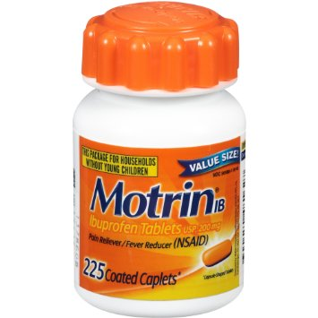
Over the counter pain relievers.

Slide 67
Lobbying groups representing interests like drugstores and patient organizations like the American Cancer Society had long argued that changing the medication’s scheduling would have broad patient effects and that other steps could be taken to curtail the drugs’ abuse. Such patient groups receive drug company contributions,

Slide 68
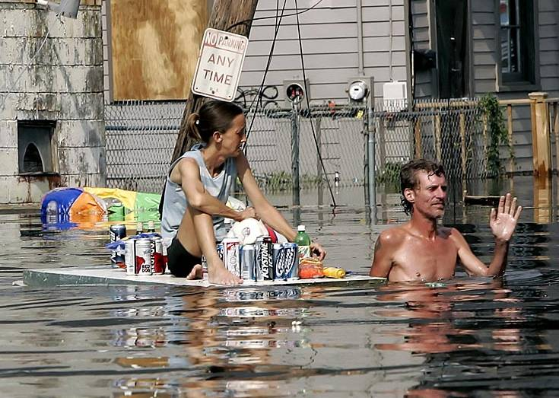
The End
The End

