Slide 1
Healthy Lifestyle and Diet
William P. Wattles
Psy 314 Behavioral Medicine
1

Slide 2


Slide 3
Dose Response relationship
A quantitative relationship between the dose of a drug and the degree of an effect caused by the drug

Slide 4
Causation
Sadly, there is no sufficient way to prove that an association between a factor and a disease is a causal relationship.
http://www.med.uottawa.ca/sim/data/Causation_e.htm
Strength
Consistency
Specificity
Temporality
Dose response (biological gradiant)
Plausibility
Coherence
Notes:
Strength: A small association does not mean that there is not a causal effect, though the larger the association, the more likely that it is causal.^{[1]}
Consistency: Consistent findings observed by different persons in different places with different samples strengthens the likelihood of an effect.^{[1]}
Specificity: Causation is likely if a very specific population at a specific site and disease with no other likely explanation. The more specific an association between a factor and an effect is, the bigger the probability of a causal relationship.^{[1]}
Temporality: The effect has to occur after the cause (and if there is an expected delay between the cause and expected effect, then the effect must occur after that delay).^{[1]}
Biological gradient: Greater exposure should generally lead to greater incidence of the effect. However, in some cases, the mere presence of the factor can trigger the effect. In other cases, an inverse proportion is observed: greater exposure leads to lower incidence.^{[1]}
Plausibility: A plausible mechanism between cause and effect is helpful (but Hill noted that knowledge of the mechanism is limited by current knowledge).^{[1]}
Coherence: Coherence between epidemiological and laboratory findings increases the likelihood of an effect. However, Hill noted that "... lack of such [laboratory] evidence cannot nullify the epidemiological effect on associations".^{[1]}
Experiment: "Occasionally it is possible to appeal to experimental evidence".^{[1]}
Analogy: The effect of similar factors may be considered.^{[1]}

Slide 5
In British Journal of Sports Medicine, UK researchers found an increase in regular exercise is linked to improved academic performance amongst teens.
The academic improvements were seen over the long term, with the results indicating a dose-response effect, meaning more intensive exercise produced greater effects on test results.

Slide 6
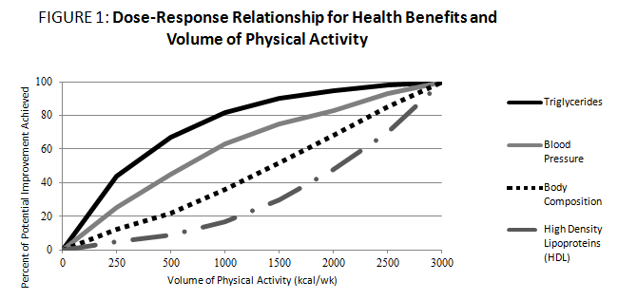

Slide 7
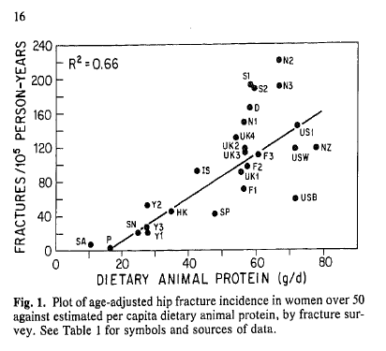
Dose Response
The presence of a dose response relationship makes it less likely that a third variable explains the relationship thus providing support for a causal interpretation.
Notes:
The Bradford Hill criteria, otherwise known as Hill's criteria for causation, are a group of minimal conditions necessary to provide adequate evidence of a causal relationship between an incidence and a consequence, established by the English epidemiologist Sir Austin Bradford Hill(1897–1991) in 1965.
The list of the criteria is as follows:
Strength: A small association does not mean that there is not a causal effect, though the larger the association, the more likely that it is causal.^{[1]}
Consistency: Consistent findings observed by different persons in different places with different samples strengthens the likelihood of an effect.^{[1]}
Specificity: Causation is likely if a very specific population at a specific site and disease with no other likely explanation. The more specific an association between a factor and an effect is, the bigger the probability of a causal relationship.^{[1]}
Temporality: The effect has to occur after the cause (and if there is an expected delay between the cause and expected effect, then the effect must occur after that delay).^{[1]}
Biological gradient: Greater exposure should generally lead to greater incidence of the effect. However, in some cases, the mere presence of the factor can trigger the effect. In other cases, an inverse proportion is observed: greater exposure leads to lower incidence.^{[1]}
Plausibility: A plausible mechanism between cause and effect is helpful (but Hill noted that knowledge of the mechanism is limited by current knowledge).^{[1]}
Coherence: Coherence between epidemiological and laboratory findings increases the likelihood of an effect. However, Hill noted that "... lack of such [laboratory] evidence cannot nullify the epidemiological effect on associations".^{[1]}
Experiment: "Occasionally it is possible to appeal to experimental evidence".^{[1]}
Analogy: The effect of similar factors may be considered.^{[1]}

Slide 8
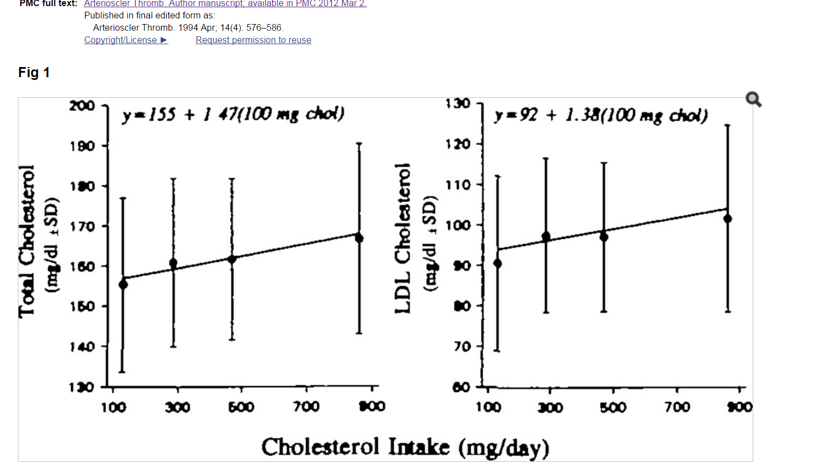
A Dose-Response Study of the Effects of Dietary Cholesterol on Fasting and Postprandial Lipid and Lipoprotein Metabolism in Healthy Young Men

Slide 9
Dose-Response Relation between
Physical Activity and Health:
An Observational Epidemiologic Perspective
I-Min Lee, MD, ScD

Slide 10
Why the Interest in Dose-Response?

Slide 11
1. Knowledge is useful in clinical and public health setting
2. Dose-response is one criterion used to judge cause-and-effect relation in observational studies (most studies of PA-chronic disease are observational)
3. Dose-response can help us understand the biology underlying physical activity-disease relation

Slide 12
Dose-response curves for physical activity and physical fitness in relation to CVD
Williams PT, MSSE 2001;33:754-761

Slide 13
Unintended injury
From text: “The terms injury and trauma are replacing use of the word accident to underscore the fact that most injuries are not random, unavoidable events—they are predictable and preventable.”

Slide 14


What’s wrong with this sign?

Slide 15

What’s wrong with this sign?

Slide 16


More accurate term

Slide 17

Chance or carelessness?

Slide 18

Minnesota bridge collapse
Faulty Design Led to Minnesota Bridge Collapse, Inquiry Finds

Slide 19
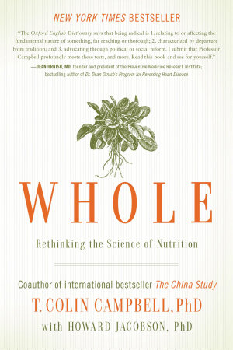
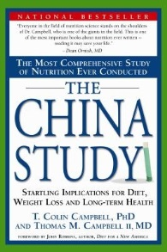
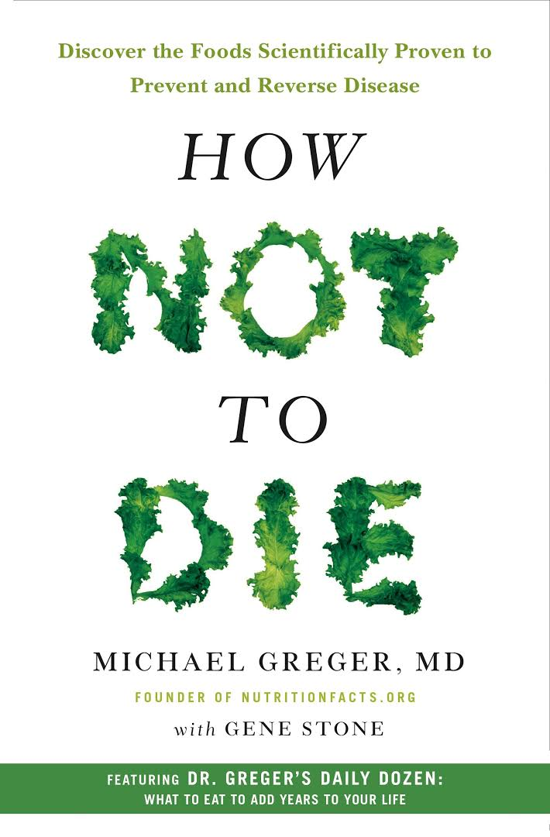
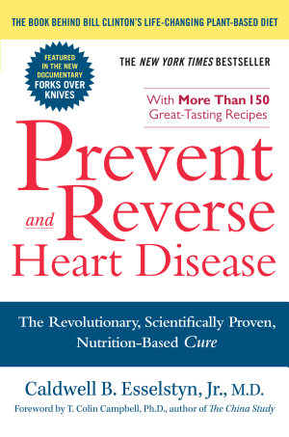
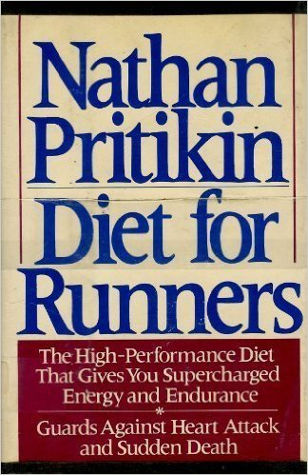
Last Reaction Paper
Nutritional Update for Physicians: Plant-Based Diets.

Slide 20
Bring a Calculator to Class

Slide 21
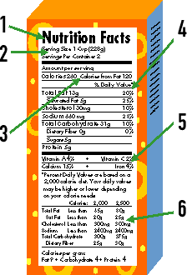
Tuesday
Bring food labels to class

Slide 22
Lifestyle
Refers to habits that make up the way that we live.
2

Slide 23
Lifestyle examples
exercise
diet
no smoking
no drug/alcohol abuse
stress management
meaningfulness
wear seat belts
take medication
follow medical advice
sleep
assertiveness
nonviolence
play
social
2

Slide 24
Healthy Lifestyle
Increases the likelihood of a long, disease-free life.
Deals with risk factors. How to put the odds in your favor.
Identification of factors under our control that predict death and illness.
3

Slide 25
Idiographic vs Nomothetic data
Idiographic refers to the individual.
Nomothetic - Of or relating to the study or discovery of general scientific laws.
When we use nomothetic data we gain and. We lose specificity to the individual but we gain in that we can now generalize to others.
4

Slide 26
Diet
Pattern of everyday eating habits and food selection which result in a specific nutrient consumption
A good diet:
  Provides necessary nutrients and calories
  Avoids excessive or harmful elements
5

Slide 27
Dietary goals
1. Nutrition-provide body with essentials
2. Weight control -Obesity correlates with many illnesses
3. Reduce Coronary heart disease
4. Reduce hypertension
5. Maximize Athletic performance
6

Slide 28
Seven Dietary Guidelines.
1. Eat a variety of foods.
2. Maintain a healthy weight
3. Choose a diet low in fat, saturated fat and cholesterol.
4. Choose a diet with plenty of vegetables, fruits and grain products.
5. Use sugar in moderation
7

Slide 29
Seven Dietary Guidelines
6. Use salt and other forms of sodium in moderation.
7. If you drink alcoholic beverages do so in moderation.
In moderation all foods can fit into a healthy diet.
8

Slide 30
Nutrition
The process by which materials from the environment are taken up by the body in order to provide the nutrients and energy necessary to keep the body alive and healthy.
9

Slide 31
Nutrients
Components in the food we eat that the body needs to be alive and healthy.
Carbohydrates
Fats
Proteins
Vitamins
Minerals
Trace elements
Dietary fiber
Water
10

Slide 32
Energy
Primary need for food is to provide energy .
The ultimate source of energy is the sun
Plants synthesize complex organic substances from light and inorganic materials such as carbon dioxide and water.
We get energy either directly from the plants or via animal tissue that got it from plants.
11

Slide 33
Digestion
The process by which food is converted into useful proteins, fats, carbohydrates, vitamins and minerals.
Useful components of food converted into particles that can be absorbed rest is excreted.
These molecules are carried by the blood to all cells for energy and repair
12

Slide 34
Protein
Large molecules that are broken down into simply units called amino acids.
The body needs 21 amino acids.
8 essential amino acids. Cannot be made by the body and must be eaten in the diet.
These amino acids critical for restoring the body tissues, hormones and enzymes.
13

Slide 35
Carbohydrates CHO
Provide the energy for the body
Complex carbohydrates-contain vitamins, minerals and fiber in addition to energy
Simple sugars. Contain CHO but little else thus, less nutritious
Also used to synthesize important compounds in the body
14

Slide 36
Fats
Basic component is triglycerides.
  Saturated
  Monounsaturated
  Polyunsaturated
Average person needs about one tablespoon a day but gets about 6 per day.
Fat need to produce energy and synthesize important compounds and tissue.
15

Slide 37
Cholesterol
A type of fat found in animal fat and produced by the body.
High cholesterol linked to cardio-vascular disease. Major cause of death in the U.S.
  heart disease
  stroke
Saturated fat in the diet raises levels of cholesterol
16

Slide 38




Slide 39
Dietary goals
1. Nutrition-provide body with essentials
2. Weight control -Obesity correlates with many illnesses
3. Reduce Coronary heart disease
4. Reduce hypertension
5. Maximize Athletic performance
6

Slide 40
Diet
Pattern of everyday eating habits and food selection which result in a specific nutrient consumption
A good diet:
  Provides necessary nutrients and calories
  Avoids excessive or harmful elements
5

Slide 41
Nutrition research
The role of fat tissue in the cholesterol lowering and the pleiotropic effects of statins – statins activate the generation of metabolically more capable adipocytes
  Medical Hypotheses, Volume 64, Issue 1, 2005, Pages 69-73

Slide 42
Nutrition research
Serum lipids of physically active adults consuming omega-3 fatty acid–enriched eggs or conventional eggs
  Nutrition Research, Volume 24, Issue 9, September 2004, Pages 731-739

Slide 43
Nutrition research
Effect of reduced maternal protein consumption during pregnancy in the rat on plasma lipid concentrations and expression of peroxisomal proliferator–activated receptors in the liver and adipose tissue of the offspring
  Nutrition Research, Volume 24, Issue 8, August 2004, Pages 639-646

Slide 44
Review Articles
Common gene polymorphisms and nutrition: emerging links with pathogenesis of multifactorial chronic diseases (review)
  The Journal of Nutritional Biochemistry, Volume 14, Issue 8, August 2003, Pages 426-451

Slide 45
Dietary Guidelines developed by USDA
Represent the best, most current advice for health American 2 years old and older.
Represent a consensus of nutrition experts
18

Slide 46
Dietary Guidelines for Americans
USDA
http://www.usda.gov/cnpp/
Healthful diets contain the amounts of essential nutrients and calories needed to prevent nutritional deficiencies and excesses.
17

Slide 47
Dietary Guidelines for Americans
USDA
Healthful diets also provide the right balance of carbohydrate, fat, and protein to reduce risks for chronic diseases, and are a part of a full and productive lifestyle. Such diets are obtained from a variety of foods that are available, affordable, and enjoyable.
19

Slide 48
The food pyramid
21

Slide 49
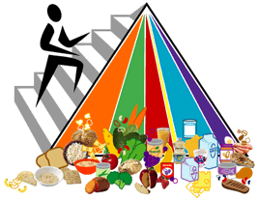

Slide 50
1. Nutrition
Choose most of your foods from the:
  grain products group (6-11 servings)
  the vegetable group (3-5 servings)
  the fruit group (2-4 servings).
Eat moderate amounts of foods from the:
  milk group (2-3 servings)
  meat and beans group (2-3 servings).
Choose sparingly foods that provide few nutrients and are high in fat and sugars.
20

Slide 51
Vitamins
Vitamins are chemicals that the body cannot make which are needed for many functions in the body. They don't provide calories but participate in reactions that release energy from foods.

Slide 52
Percentage of total energy intake
Present
Fat 42%
Protein 12%
Carbohydrate 46%
Goal
Fat 30%
Protein 10%
Carbohydrate 60%
22

Slide 53
Food Labels
Recent big change by U. S. Government.
Bring labels to class.
49

Slide 54
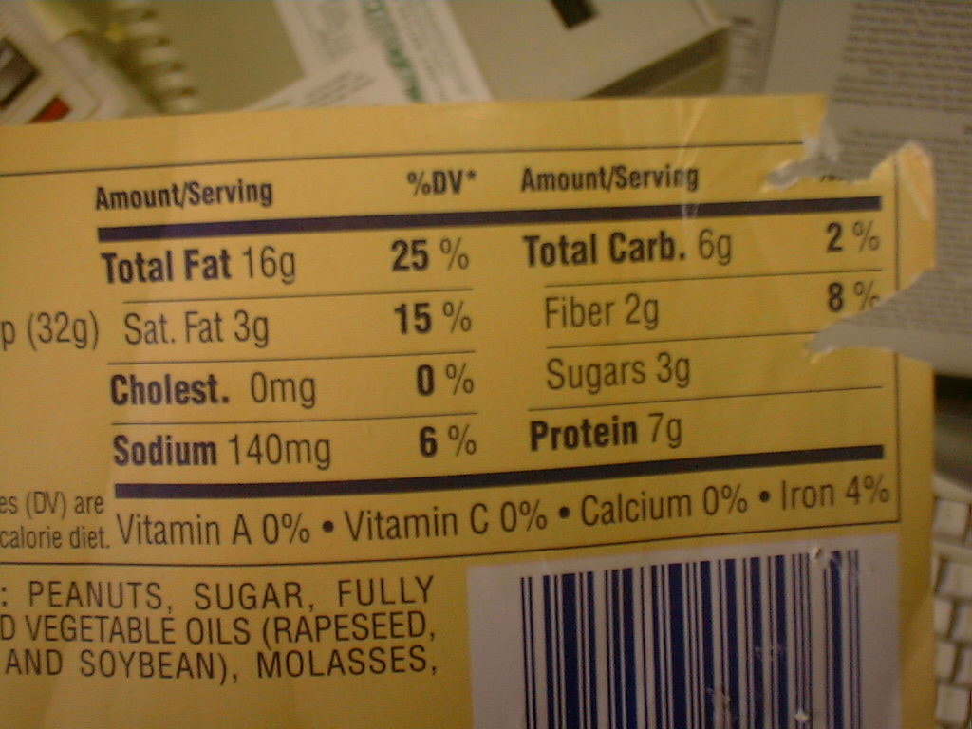

Slide 55
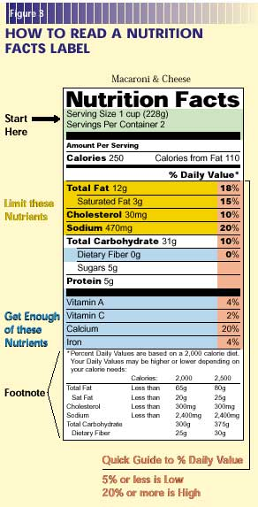
http://www.cfsan.fda.gov/~dms/foodlab.html
Notes:
https://cspinet.org/news/new-nutrition-facts-labels-feature-added-sugars-daily-value-20160520

Slide 56
Percent
Percent of calories from fat =/= Percent of daily allowance of fat

Slide 57
Percent allows us to compare foods
Potato with Bacon
fat grams 9
Santa Fe Chicken
fat grams 10

Slide 58
Percent allows us to compare foods
Potato with Bacon
182 9 81
Santa Fe Chicken
425 10 90

Slide 59
Percent allows us to compare foods
Potato with Bacon
182 9 81 45%
Santa Fe Chicken
425 10 90 21%

Slide 60
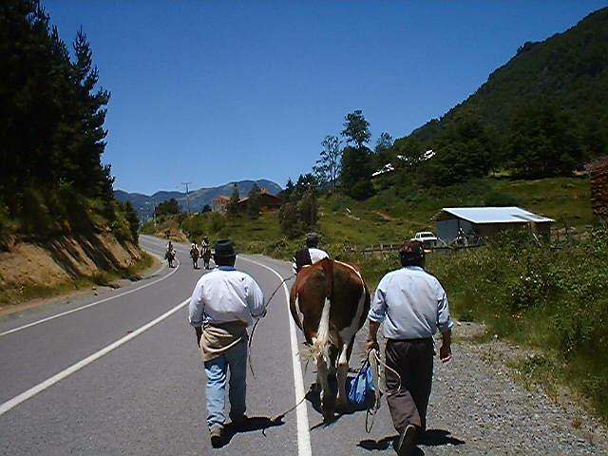
Main Street
Curarrehue, Chile
Notes:
Curarrehue

Slide 61
Choose a Diet Moderate in Sugars
The problem with sugar is that it is added to foods that offer little else from a nutritional point of view.
Cream- filled sandwich cookies are indeed delicious, but they don't provide much besides calories.

Slide 62
Choose a Diet Moderate in Sugars
Another issue is holes in your teeth if the sugar sticks to them.
Many of the other claims that sugar causes hyperactivity, criminal behavior, or obesity are simply not supported by peer-reviewed research.

Slide 63
Choose a diet low in fat
Some dietary fat is needed for good health. Fats supply energy and essential fatty acids and promote absorption of the fat-soluble vitamins A, D, E, and K.
Most people are aware that high levels of saturated fat and cholesterol in the diet are linked to increased blood cholesterol levels and a greater risk for heart disease.
24

Slide 64
To reduce fat intake
Use fats and oils sparingly.
Use the Nutrition Facts Label to help you choose foods lower in fat, saturated fat, and cholesterol.
Eat plenty of grain products, vegetables, and fruits.
25

Slide 65
To reduce fat intake
Choose low fat milk products, lean meats, fish, poultry, beans, and peas to get essential nutrients without substantially increasing calorie and saturated fat intakes.
26

Slide 66
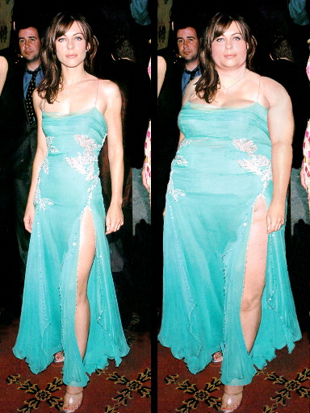
2. Dieting for Weight loss
Fundamentally, weight gain results when calories consumed are greater than calories expended.
Notes:
One useful way to think about the relation of genes with obesity was expressed by
George Bray when he said, “the genetic background loads the gun, but the
environment pulls the trigger”.

Slide 67
Energy Balance occurs when
  Energy intake=Energy output
If energy intake exceeds output we gain weight, the extra is stored as fat.
If energy intake is less than output then we gain weight as the body converts fat and other tissue for energy.
27

Slide 68
Calories
Unit of heat; The heat required to raise 1 gram of water 1 degrees centigrade
A Calorie (or kilocalorie) describes the available energy in food. It is the amount of heat required to raise the temperature of 1,000 grams (Kilogram) of water by 1 degree Celsius

Slide 69
Millie Griffin, psychology tutor
Psychology students may contact her directly via phone (843.625.9305) or email at millie.h.griffin@vanderbilt.edu.

Slide 70
Calories
3500 calories = 1 pound of fat
A deficit of 112 calories a day = 1 pound a month weight loss.

Slide 71
Calories per gram
Protein 4
Carbohydrate 4
Fat 9
29

Slide 72
Parents underestimate calories in fast food
the average meal purchased contained 733 calories, and 21% contained more than 1,000 calories,
the parents estimated an average of only 562 calories per meal, with 72% underestimating the actual content,
Notes:
However, the researchers found that only 15% of parents saw nutritional information in the restaurants and fewer still (4%) used that information when ordering. "So they may not use it even if it's more accessible,“
Jason Block, MD, of Harvard Medical School in Boston, reported at the Obesity Society meeting here.

Slide 73
Teens underestimate calories
Of those ages 11 to 20 surveyed outside of fast food chains in four U.S. cities, 80% underestimated the actual calorie content, and 30% misjudged the amount by at least 500 calories,
Notes:
Only 14% of the participants noticed any nutritional informa
Jason Block, MD, of Harvard Medical School in Boston, reported at the Obesity Society meeting here.tion in the restaurant, and fewer still -- 3% -- saw and used the information when ordering.

Slide 74
Calories needed per day
Men
Sedentary
  2510
Moderately active
  2900
Very active
  3350
Women
Most
  2150
Very active
  2500
28

Slide 75
Components of Energy Expenditure
Resting metabolism 60-70%
Physical activity 20-30%
Thermal effect of food 10%

Slide 76
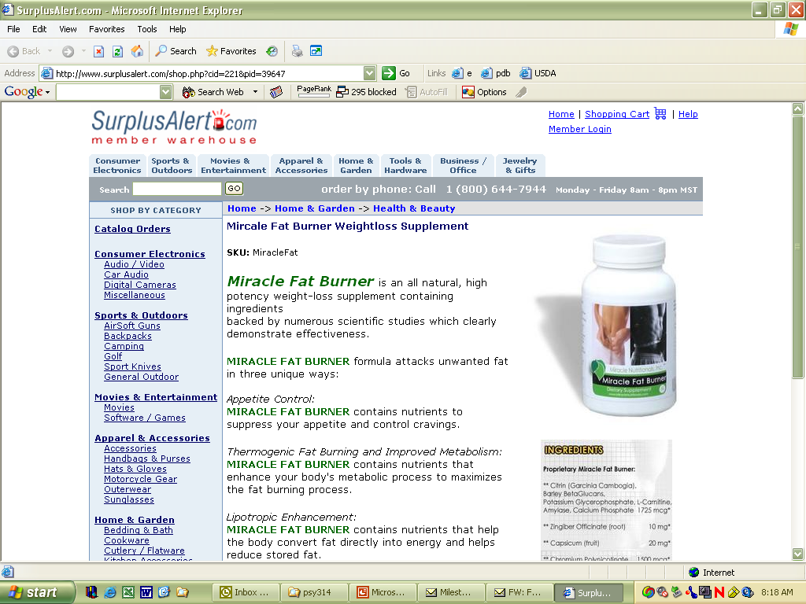

Slide 77
Caveat
Assume a man who burns 2,510 calories per day.
If he eats 2,800 calories of CHO and Protein and zero fat he will gain weight.
If he eats 2,200 calories of pure fat per day he will lose weight.
31

Slide 78
Percentage of total energy intake
Present
Fat 42%
Protein 12%
Carbohydrate 46%
Goal
Fat 30%
Protein 10%
Carbohydrate 60%
32

Slide 79
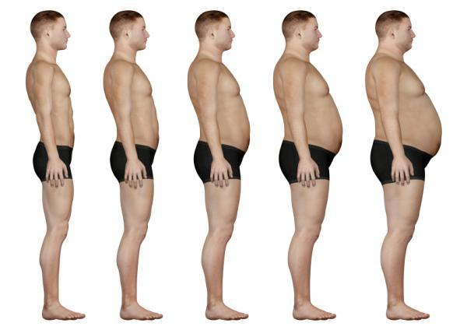
Obesity Epidemic
2/3 of Americans are overweight
1 in 3 Americans are obese

Slide 80
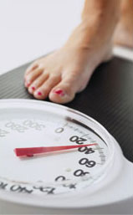
Weight loss dilemmas
Weight alone not a good measure
  Lean muscle weighs more
  Water levels fluctuate
Most interventions work short-term
  Behavior change
  Metabolic shift

Slide 81
Body Mass Index
Body weight in kilograms divided by height in meters squared.
Compute your BMI
BMI Categories:
Underweight = <18.5
Normal weight = 18.5-24.9
Overweight = 25-29.9
Obesity = BMI of 30 or greater

Slide 82
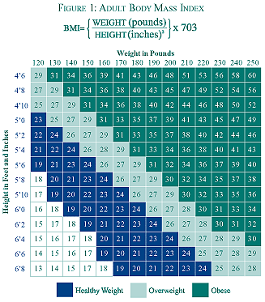

Slide 83

Percentage of Body Fat
  Measured by immersion

Slide 84
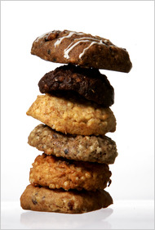
Fad Diets
Severely restricting or eliminating a food category may be nutritionally unwise.
The Cookie Diet

Slide 85
The Diet Industry
Over 26,000 weight loss diets have been published in this century.
Overweight people spend close to $40 billion dollars a year on weight control.
“Data is not the plural of anecdote.”

Slide 86
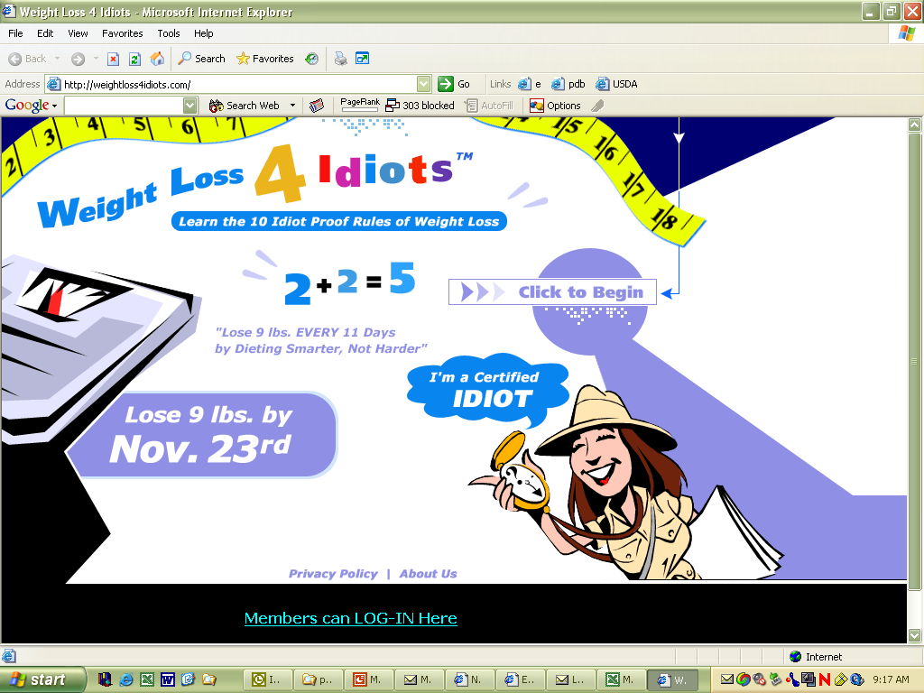

Slide 87
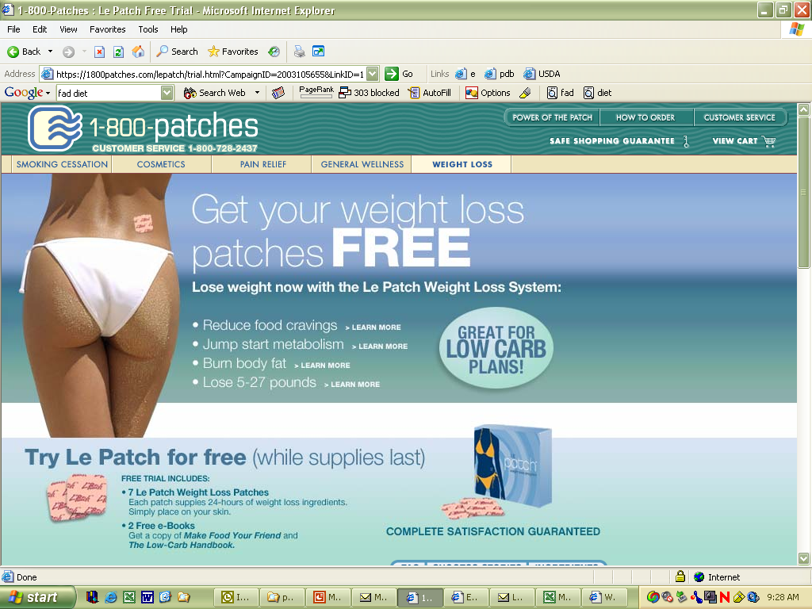

Slide 88
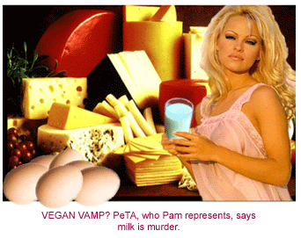
Fad diets
Fad diet page
Liquid diets
The Damage-Control Diet
The All-You-Can-Eat Soup Diet

Slide 89
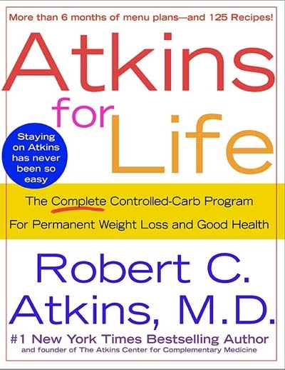
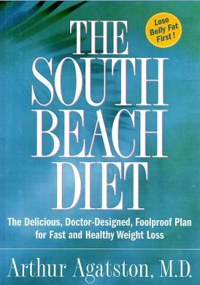
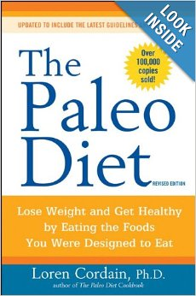
Low Carbohydrate or Protein Diet
Current fad diet.
  Low carb no consistent meaning
Technical mumbo jumbo
Profitable: $14.99 bread
ice cream and fudge sauce $73
Notes:
Atkins 258 pounds according to death certificate. British experts say the popularity of the diet was damaged by reports it may increase the risk of heart disease and cancer.
But Australian nutritionist Catherine Saxelby said the fad had probably just run its course. Atkins Nutritional company filed for Chapter 11 bankruptcy protection after the percentage of adults on the diet declined to two percent and sales of Atkins brand product fell steeply in the second half of 2004.^{[22]} The company continues to operate and the diet plan remains popular, although it has not regained its former popularity

Slide 90

Notes:
Free Shipping when you order 4 or more boxes of The Paleo Diet Bar! Enter Code: SHIP4FREE at Checkout - See more at: http://www.tpdfoods.com/product/the-paleo-diet-bar-cinnamon-raisin/#sthash.G0WzGK38.dpuf

Slide 91
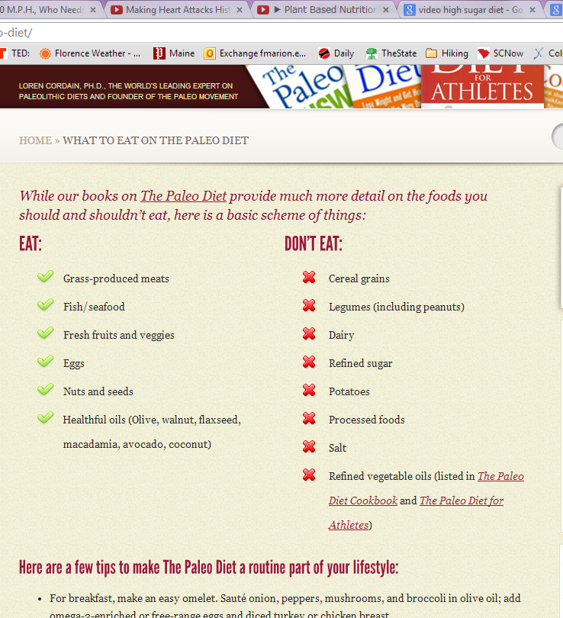

Slide 92
Testimonials and Case Studies
Dan & Karen's Story: 11 months and 136 pounds ago. Atkins Diet
Jennifer Kushnier, 29 Pounds lost: 20 in 16 weeks. South Beach Diet

Slide 93
“Low Carb” diets
Most research no controls
Weight loss attributed to calorie reduction not eating plan
Weight loss advantage lost after several months.

Slide 94
Vegetable
any of various herbaceous plants cultivated for an edible part such as the fruit or the root of the beet or the leaf of spinach or the seeds of bean plants or the flower buds of broccoli or cauliflower

Slide 95
Fruit
The part of a plant that grows where a flower used to be, after the flower was pollinated and died. The fruit contains the seeds, which can grow new plants. Fruits are often fleshy with juices and nutrients for animals to eat.

Slide 96
Effective weight loss diet
To be effective an diet must be one that a person will be able to maintain throughout life.

Slide 97
Weight Control
Calories count, no matter what you read in the press. The laws of thermodynamics have not been reversed.

Slide 98
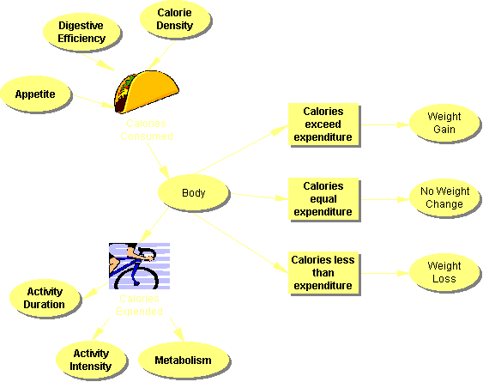

Slide 99
Weight Loss
The typical weight loss program achieves an average of ten percent reduction in weight.
A survey of almost 400 obese individuals in the September 24, 2001 issue of the Archives of Internal Medicine revealed that expectations are often unrealistic.

Slide 100
Weight Loss
The average starting weight of the subjects was 240 lbs their goals were:
  dream weight 142 lbs (41%)
  happy at 160 lbs (33%)
  disappointed at 198 lbs (18%)

Slide 101
3. Reducing heart disease
Cholesterol Waxy, fat-like substance essential for life.
Too much leads to heart disease.
Serum of blood cholesterol is the level of blood circulating in the blood stream.
Related (but not perfectly) to dietary cholesterol and saturated fat.
37

Slide 102
Cholesterol
Cholesterol raised by eating saturated fats and trans fats.
Dietary modification preferable to medication.
Lowering overall dietary fat tends to lower saturated and trans fats.
38

Slide 103
Cholesterol
High >240
Borderline high 200-239
Desirable <200
Ratio of total cholesterol to HDL may be a better predictor.
Levels of trigylcerides also critical
39

Slide 104
4. Hypertension
Diet, medication, relaxation and exercise used to treat hypertension.
Dietary interventions involve
  sodium restriction
  weight loss
40

Slide 105
Sodium
A higher intake of dietary sodium is a strong independent risk factor for CHF in overweight persons.
Arch Intern Med. 2002;162:1619-1624

Slide 106
Sodium
Not all people appear to be salt sensitive.
Some estimates suggest that 26% of normal individuals are salt-sensitive.
Most importantly it appears that the rate of salt-sensitivity is nearly twice as great (51%) in individuals who are "hypertensive".
The highest values are found in black individuals who are hypertensive (73%).

Slide 107
Dietary success
Langford et al. (1985)
500 hypertensive patients had been on medication 5 years.
Subjects able to remain in the normal range without medication:
  78% of those who restricted sodium intake
  72% of those who reduced weight (low-fat, high carbohydrate diet)
41

Slide 108
5. Diet for athletic performance
Recovery from exertion and injury
Energy
42

Slide 109
High protein intakes will not increase muscle
“There is little scientific evidence that the consumption of large amounts of protein supplements will have any beneficial effects on muscle hypertrophy, muscular strength or physical performance, quite irrespective of the claims of the manufacturers.”
Wooton, S. Nutrition for Sport
43

Slide 110
Maintaining glycogen reserves
One of the greatest problems facing the athlete is achieving adequate glycogen repletion to maintain normal energy reserves.
Following a ten-mile run followed by some interval training glycogen stores in the muscles of the legs decreased by 60-70%
44

Slide 112
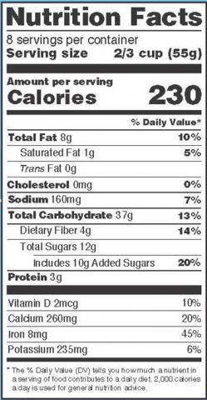
Center for science in the public interest.
The new Daily Value for added sugars on the revised labels will be 50 grams, or about 12 teaspoons—an amount representing 10 percent of the daily 2,000 calories recommended for many adults.
Notes:
Nina’s slide

Slide 113
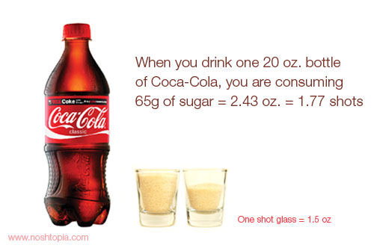
Center for science in the public interest.
Once the rules are implemented, the Nutrition Facts label on a 20-ounce bottle of Coke, for example, would likely show that it had 130 percent of the added sugars limit for a day.
Notes:
Manufacturers will have until July 26, 2018 to comply with the final requirements,

Slide 114
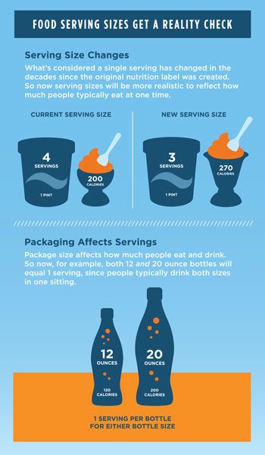
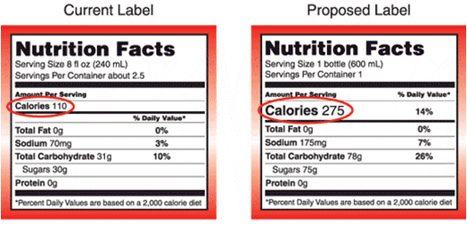
Change in serving size

Slide 115

What counts as a serving?
Grain Products Group (bread, cereal, rice, and pasta)
  1 slice of bread
  1 ounce of ready-to-eat cereal
  1/2 cup of cooked cereal, rice, or pasta
50

Slide 116
What counts as a serving?
Vegetable Group
  1 cup of raw leafy vegetables
  1/2 cup of other vegetables -- cooked or chopped raw
  3/4 cup of vegetable juice
Fruit Group
  1 medium apple, banana, orange
  1/2 cup of chopped, cooked, or canned fruit
  3/4 cup of fruit juice
51

Slide 117
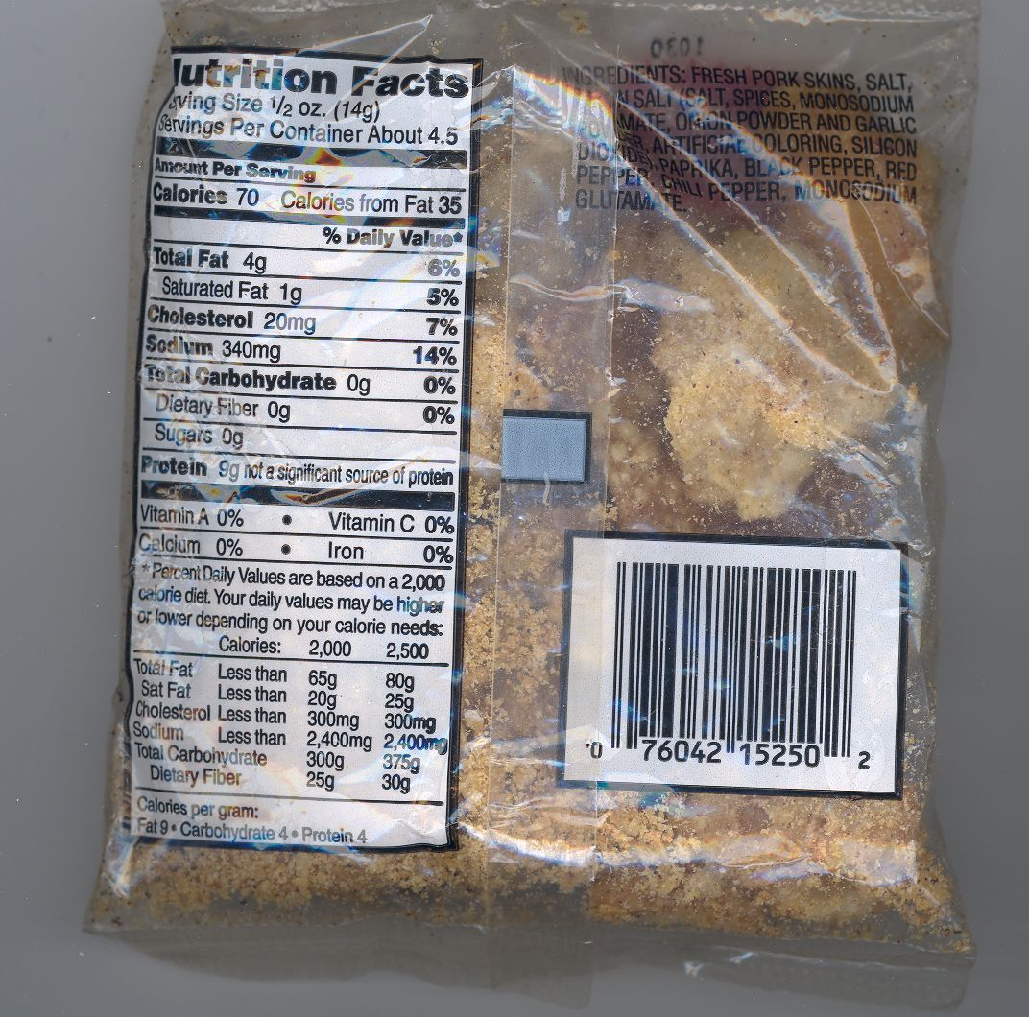

Slide 118
What counts as a serving?
Milk Group (milk, yogurt, and cheese)
  1 cup of milk or yogurt
  1-1/2 ounces of natural cheese
  2 ounces of processed cheese
52

Slide 119
What counts as a serving?
Meat and Beans Group (meat, poultry, fish, dry beans, eggs, and nuts)
  2-3 ounces of cooked lean meat, poultry, or fish
  1/2 cup of cooked dry beans or 1 egg counts as 1 ounce of lean meat.
  Two tablespoons of peanut butter or 1/3 cup of nuts count as 1 ounce of meat.
53

Slide 120
Definitions of terms used on labels
Free. Contains no amount of, or a physiologically inconsequential amount. Calorie free means less than 5 calories per serving.
Low. Foods that can be eaten frequently without exceeding dietary guidelines.
  low fat. 3 grams or less per serving
  low sodium 140 mg or less per serving
54

Slide 121
Definitions
Lean. Less that 10 grams of fat, 4.5 g of saturated fat and less than 95 mg of cholesterol
High. Contains at least 20 percent of the Daily Value
Good Source. One serving contains 10-19 % of Daily Value for a nutrient.

Slide 122
Definitions
Reduced. For a nutritionally altered product that is 25% less of a nutrient or calories than the reference product.
Light either
  1/3 the calories, 1/2 the fat of the reference food
  Sodium reduced 50%

Slide 123
Milk

Slide 124
Milk

Slide 125
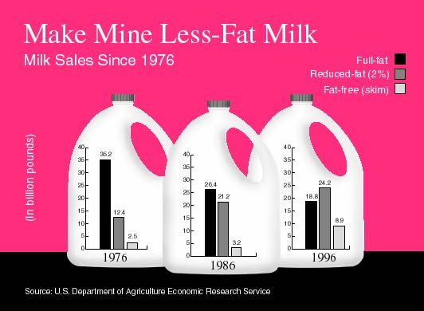

Slide 126
Milk
Fat-Reduced Milk Products Join the Food Labeling Fold
2 percent milk will become known, for example, as "reduced fat" or "less fat" instead of "low fat"
1 percent milk will remain "low fat" or become, for example, "little fat"
skim will retain its name or be called, for example, fat-free, zero-fat, or no-fat milk.

Slide 127
October 6, 1999 edition of JAMA
analysis of 570 stroke patients among study populations of over 100,000 people found that after controlling statistically for the standard cardiovascular risk factors, those eating the most fruits and vegetables had a 30% reduction in the risk of stroke.

Slide 128
5 servings a day
These people averaged more than 5 servings of fruits and vegetables daily. This is much higher than the typical person so these groups’ experiences may not be representative of the rest of the population.

Slide 129
Cruciferous vegetables
Crucifer. Any of various plants in the mustard family (Cruciferae or Brassicaceae), which includes the alyssum, candytuft, cabbage, radish, broccoli, and many weeds.

Slide 130
Legumes
1. A pod, such as that of a pea or bean, that splits into two valves with the seeds attached to one edge of the valves. b. Such a pod or seed used as food.
2. A plant of the pea family.

Slide 131
Fiber
A study of 2900 healthy adults found that dietary fiber intake was associated with lower levels of body weight, body-mass index, weight gain, fasting insulin, blood pressure, triglycerides, LDL-cholesterol, and fibrinogen (a blood clotting factor). These are all desirable

Slide 132
Correlation not causation
People who ate the most fiber (about 25 grams per day) weighed 8 pounds less than those who ate the least (about 12 grams per day). However, people eating high fiber also smoked less, were more physically active, were more likely to be women, and were twice as likely to take vitamin supplements.

Slide 133
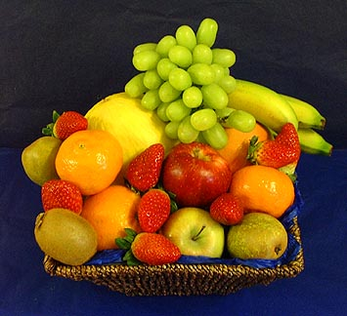
Nutrition analysis on the fly
Three times fat calories should be less than total calories.

Slide 134
Body Weight Regulation
Ghrelin-hunger-triggering hormone
  Released by the stomach
Leptin-appetite-suppressing hormone
  Increased body fat leads to release of Leptin

Slide 135
Leptin
hormone, leptin (leptos thin) (Greek)\
Leptin: appetite-suppressing hormone
  Released into the circulatory system by adipose tissue as a function of energy stores.
    Leads to decrease in food intake, increase in energy expenditure

Slide 136
Ghrelin
Ghrelin: hunger-triggering hormone
  Released by the stomach
When the stomach is empty, ghrelin is secreted. When the stomach is stretched, secretion stops.
Ghrelin levels show pre-meal increases and post-meal decreases.

Slide 137
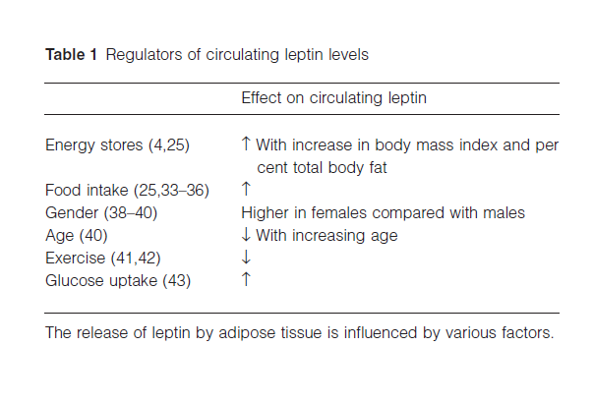

Slide 138
Leptin
As body fat increases higher levels of leptin signal the normal brain to suppress hunger.

Slide 139
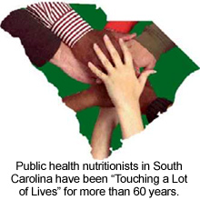
The End

Slide 140
Analyze nutrition from a chain restaurant.
Choose a restaurant not chosen by someone else. First come, first served.

