Slide 1
Exercising and Health
William P. Wattles, Ph.D.
Psychology 314

Slide 2
http://well.blogs.nytimes.com/2013/04/10/how-exercise-may-boost-the-brain/
Reinforce exercise video (Moscow) http://www.viralviralvideos.com/2013/11/11/moscow-subway-ticket-machine-accepts-30-squats-as-payment/

Slide 4
Weighing the Evidence on Exercise
http://www.nytimes.com/2010/04/18/magazine/18exercise-t.html?src=me&ref=general
Exercise important for weight loss but easily trumped by diet

Slide 5
Components of Energy Expenditure
Resting metabolism 60-70%
Physical activity 20-30%
Thermal effect of food 10%

Slide 6
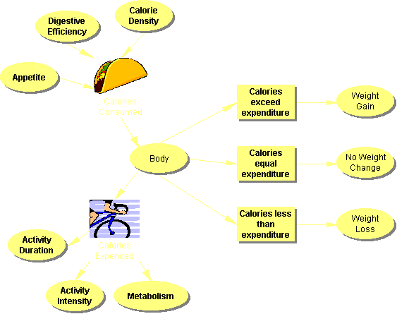

Slide 7
The American College of Sports Medicine (ACSM) and the American Heart Association (AHA) released updated physical activity guidelines in 2007
Do moderately intense cardio (i.e. walking briskly) 30 minutes a day, five days a week
Notes:
http://www.adultfitnesstest.org/resources/datacollection.pdf

Slide 8
Limiting our daily sitting/lying to just 23.5 hours: too ambitious?

Slide 9
More than 60 percent of adults do not achieve the recommended amount of regular physical activity.
Notes:
http://www.cdc.gov/nccdphp/sgr/ataglan.htm

Slide 10
When will we treat physical activity as a legitimate medical therapy…even though it does not come in a pill?

Slide 11
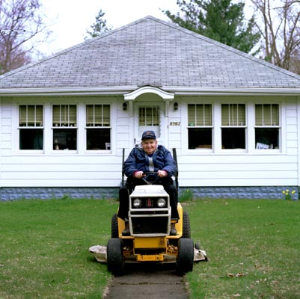

Slide 13
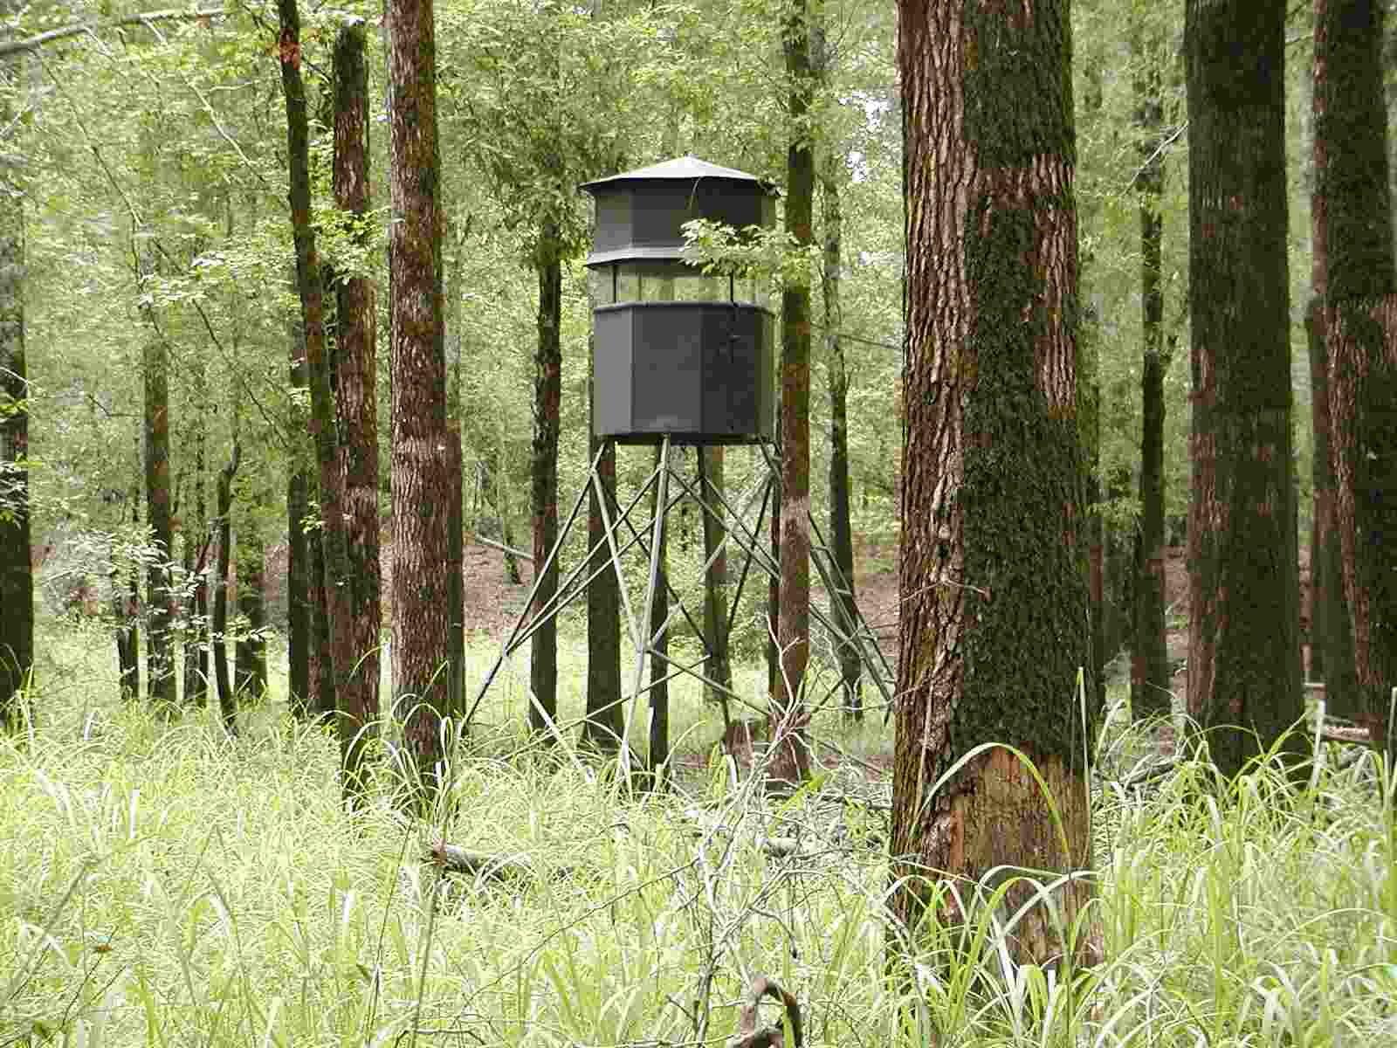

Slide 14
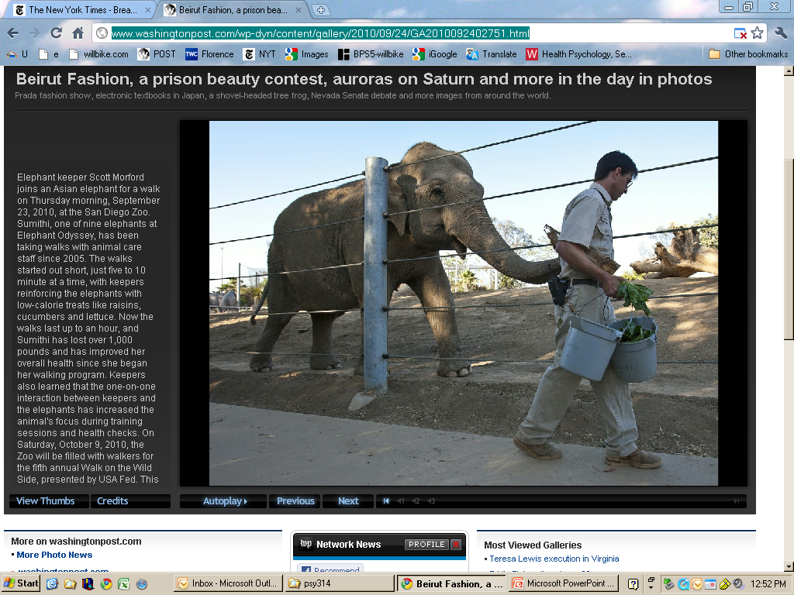

Slide 15
Notes:
2005, age 80

Slide 16
5 types physical activity
Isometric exercise-contracting muscles against an immovable object. Improves muscle strength.
Isotonic exercise-Weightlifting and many forms of calisthenics. Improve strength and endurance
Isokinetic exercise-Resistance occurs continuously. Weight-lifting machines. Superior to isometrics and isotonics.

Slide 17
Physical Activity
Anaerobic exercise-(without oxygen) exercise that burn more oxygen than the body can take in. Short bursts.
Aerobic exercise-any exercise that requires dramatically increased oxygen consumption over an extended period of time.

Slide 18
Reasons to exercise
Physical Fitness
Weight Control
Cardiovascular Health
Other Health Benefits
Psychological Benefits

Slide 19
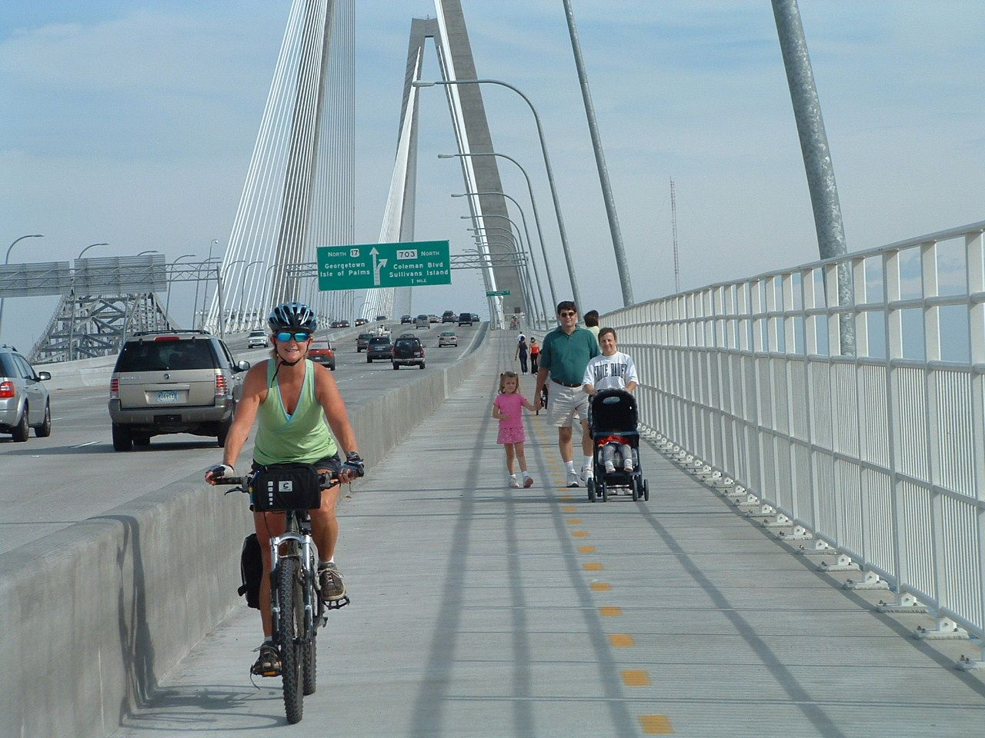
Exercise as fun!
http://www.nytimes.com/2010/03/09/health/09brod.html?scp=9&sq=exercise&st=cse
Notes:
http://www.nytimes.com/2010/03/09/health/09brod.html?scp=9&sq=exercise&st=cse

Slide 20
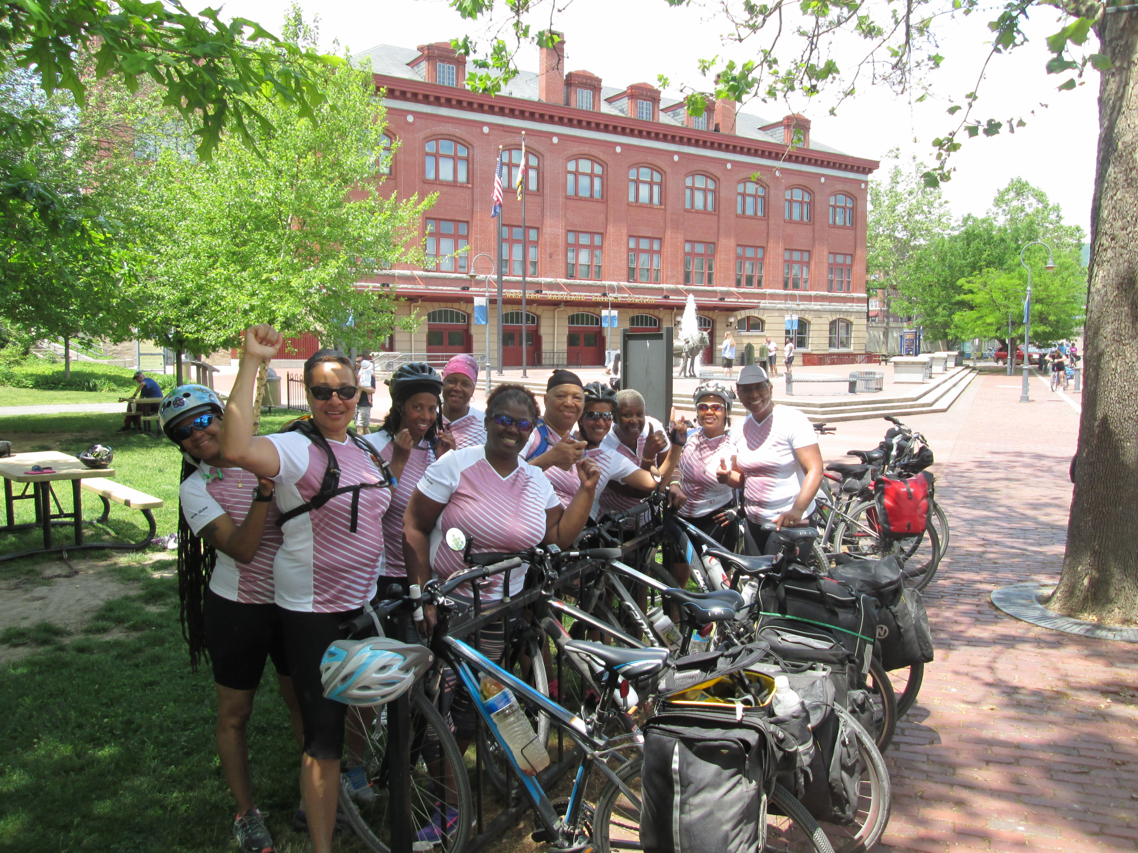

Slide 21
Physical Fitness
Four aspects of fitness
Muscle strength
Muscle endurance
Flexibility
Cardiorespiratory fitness
Quality and quantity of life

Slide 22
Physical Fitness
The effects of exercise depend on
Duration
Intensity

Slide 23
London Bus Study
In the 50’s researchers found that conductors on double-decker buses in London had less heart disease than drivers.
Correlational

Slide 24
San Francisco Longshoremen
Followed for 20 years
Controlled for self-selection
CHD death rates much higher for low activity workers

Slide 25
Harvard Alumni
Medical records dating back to 1916
Measured weekly energy expenditure

Slide 26
Harvard Alumni
60% low activity
<2,000 kcal week
40% high activity
>2,000 kcal week
High activity men had lower risk of heart attack

Slide 27
Framingham Heart Study
Limited focus on exercise
Least active men and women had three times the risk of developing heart disease.

Slide 28
Quality of life is a function of one’s ability to do what is enjoyed and required to remain independent.
In people who
have a level of fitness that compromises their daily physical
functioning, both endurance exercise and RT may contribute
to an improved health-related quality of life.

Slide 29
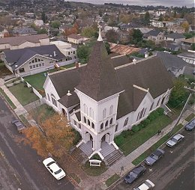
Alameda County Study
Men and women can decrease cardiovascular disease and increase life span through leisure-time physical activity

Slide 30
Women’s Health Initiative Study
This well designed study found a dose- response relationship between physical activity level and reduced risk of cardiovascular disease in post-menopausal women.

Slide 31
Women’s Health Initiative Study
The total physical-activity score at base line had a strong inverse relationship with the risk of coronary heart disease during the follow-up period.

Slide 32
Women’s Health Initiative Study
The consistency of the findings across strata of age, race and body-mass index lead further credence to a causal interpretation.
New England Journal of Medicine, 9/5/02

Slide 33
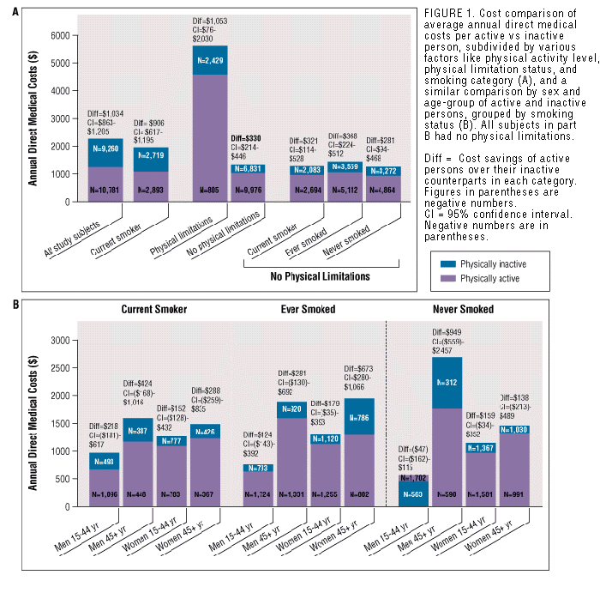
THE PHYSICIAN AND SPORTSMEDICINE - VOL 28 - NO. 10 - OCTOBER 2000
Notes:
33. Pratt M, Macera CA,Wang G. 2000. Higher
direct medical costs associated with physical
inactivity. Physician Sportsmedicine
28:63–70
34. Putnam RD.
For example, traffic congestion has grown in urban areas over
the past few decades—the average annual traffic delay per person was 7 hours
in 1982 and 26 hours in 2001

Slide 34
Behavioral Risk Factor Surveillance System (BRFSS)
For example, traffic congestion has grown in urban areas over the past few decades—the average annual traffic delay per person was 7 hours in 1982 and 26 hours in 2001
Adults drove a personal vehicle for an average of 55 min and 29 miles per day. Men and women each average four trips per day.
Notes:
U.S. households now have more automobiles than registered drivers, nd the likelihood of walking or biking is inversely related to the number of
automobiles per household. The Annual Review of Public Health is online at
http://publhealth.annualreviews.org

Slide 35
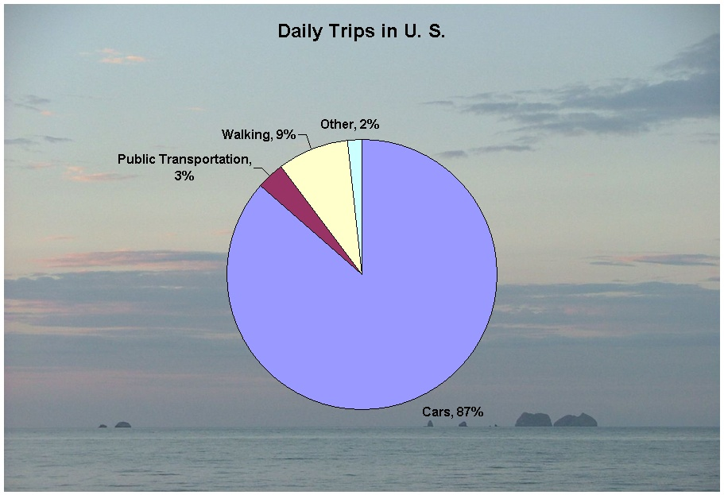

Slide 36
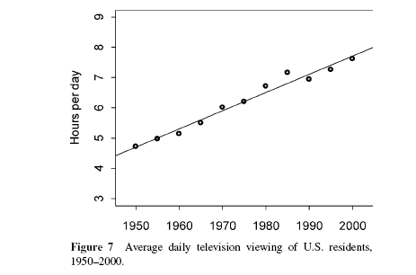

Slide 37
Reduces the risk of dying prematurely.
Reduces the risk of dying from heart disease.
Reduces the risk of developing diabetes.
Reduces the risk of developing high blood pressure.
Helps reduce blood pressure in people who already have high blood pressure.
Reduces the risk of developing colon cancer.
Reduces feelings of depression and anxiety.
Helps control weight.
Helps build and maintain healthy bones, muscles, and joints.
Helps older adults become stronger and better able to move about without falling.
Promotes psychological well-being.

Slide 38
Trends according to major type of physical activity
total physical activity: declining.
■ leisure-time physical activity: level or slightly increasing;
■ work-related activity: declining;
■ transportation activity: declining;
■ activity in the home: declining;
■ sedentary activity: increasing;

Slide 39
Rates are lowest in southern states such as Kentucky (17.7%), Louisiana (18.3%), and Mississippi (21.3%) and are highest in western states such as Hawaii (34.8%), Washington (32.4%), and Oregon (32.4%)
On the basis of BRFSS data from 2000, 26.2% of U.S. adults engaged in recommended levels of physical activity during recreational pursuits.

Slide 40
Aerobic Exercise
Jogging, walking, cross-country skiing, swimming and cycling.
Key issues are intensity and duration
Needs to be regular, of sufficient intensity and should last a minimum of 15-20 minutes.

Slide 41
Aerobic Fitness
Your resting pulse rate (RPR) is a good indicator of your cardiovascular fitness level. A normal RPR is between 72 to 86 beats per minute, while a well-conditioned athlete's is between 55 and 60, or lower

Slide 42
Aerobic Fitness
Maximum heart rate (MHR) or the highest number of times a minute your heart should beat during strenuous activity.
An accepted formula used to calculate maximum heart rate (MHR) has been to subtract your age from 220.
By measuring your pulse several times while you exercise, you can make sure your heart is staying within a desirable range for your age and fitness level.

Slide 43
Aerobic Fitness
The American Council on Exercise recommends that your pulse reach 50 to 80 percent of your maximum heart rate when you exercise.
Here's how to calculate and use your training heart rate.

Slide 44
Calculate Your Training Heart Rate Range
Subtract your age from 220. (Example for a 28-year-old: 220 - 28 = 192.)
Multiply the result by 0.50 to determine 50 percent of your estimated maximum heart rate. (For a 28-year-old: 192 x 0.5 = 96 beats per minute.)
This is the low end of your training range, or the slowest your heart should beat when you exercise.

Slide 45
Aerobic Fitness
Multiply the result from step 1 by 0.80 to calculate 80 percent of your estimated maximum heart rate.
(For a 28-year-old: 192 x 0.80 =153 beats per minute.)
This is the high end of your training range, or the fastest that your heart should beat when you exercise.

Slide 46
Aerobic Fitness
Use your answers from steps 2 and 3 to determine your training heart rate range.
(A 28-year-old's training range is 96 to 153 beats per minute.)

Slide 47
Aerobic Fitness
Accurate pulse-count assessment is crucial when monitoring exercise intensity. By using the first two fingers of one hand and locating the artery, a pulse rate can be easily determined.

Slide 48
Aerobic Fitness
Immediately after exercise, isolate your pulse and count the number of beats in a 10-second period. To determine the heart rate in beats per minute, multiply the number of beats per 10 seconds by six.
For instance, if a 10-second pulse count were 20, then the heart rate would be 120 bpm.

Slide 49
Definition of Aerobics:
Using the same large muscle group, rhythmically, for a period of 15 to 20 minutes or longer while maintaining 60-80% of your maximum heart rate.
Aerobic means with air or oxygen. You should be able to carry on a short conversation while doing aerobic exercise.

Slide 50
Aerobic Fitness
Cardiovascular fitness is an ongoing process and requires consistent reinforcement. To maintain your current level of fitness you should do aerobic exercise at least 3 times a week. To increase your level of fitness, try exercising 4 to 5 times per week.

Slide 51
Target heart rate calculator
http://www.stevenscreek.com/goodies/hr.shtml

Slide 52
American Heart Assn.
Surveys show that 24 percent of Americans age 18 or older are not active at all. 54 percent of adults get some exercise, but they don't do it regularly or intensely enough to protect their hearts. Only 22 percent of American adults get enough leisure time exercise to achieve cardiovascular fitness.

Slide 53
American Heart Assn.
Participation in regular physical activity gradually increased during the 1960s, 70s and early '80s but seems to have leveled off in recent years.

Slide 54
American Heart Assn.
Estimates are that up to 250,000 deaths per year in the United States. — about 12 percent of total deaths — are due to a lack of regular physical activity.
The relative risk of coronary heart disease associated with physical inactivity ranges from 1.5 to 2.4, an increase in risk comparable with that observed for high cholesterol, high blood pressure and cigarette smoking.

Slide 55
Other benefits of Exercise
Protection against stroke
Increased levels of HDL “good” cholesterol
Protection against cancer
Prevention of bone density loss
Ostoporosis
Control of Diabetes
Aid to Sleep

Slide 56
Exercise and cancer
There are many studies examining a possible relationship between physical activity and different types of cancer.
In general, most show the more you do, the less likely you are to get cancer.

Slide 57
Exercise and cancer
American Journal of Epidemiology
This study provides evidence that lifetime total activity reduces risk of postmenopausal breast cancer.
http://aje.oupjournals.org/cgi/content/abstract/154/4/336

Slide 58
Exercise and cancer
Exercise was inversely associated with pancreatic cancer, especially in people who weighed more. This study appeared in the August 22, 2001 edition of the Journal of the American Medical Association.

Slide 59
Psychological Benefits of Exercise
Decreased depression
Reduced anxiety
Buffer against stress
Increased self-esteem

Slide 60
In October 2008, Obama told Men's Health magazine that he works out for 45 minutes a day, six days a week

Slide 61
Excuses
Although he does his running on a treadmill, many can not afford that. As everyone knows you do not need any type of exercise equipment to run.
One does not have to have a membership in order to exercise. People make up many excuses when it comes to doing things that they do not want to do.

Slide 62
Adherence
A major problem
The majority do not stick to an exercise program
Reasons for quitting
Time
No Facility
Injury

Slide 63
Antecedent
Behavior
Consequence

Slide 64
Operant conditioning

Slide 65
Operant conditioning
Reinforce desired behavior
Consistency
Immediacy
Idiosyncratic
Reasonable goals
Weight loss
Minimize punishment
unpleasantness
injury

Slide 66
Operant conditioning
Minimize behavioral requirement
Start slowly
Use correct equipment
Moderate intensity

Slide 67
Improving Adherence
Social Support
Goal Setting
Matching person to exercise
Education and training
Emphasis on low levels of exercise

Slide 68
People who are usually inactive can improve their health and well-being by becoming even moderately active on a regular basis.
Physical activity need not be strenuous to achieve health benefits.
Greater health benefits can be achieved by increasing the amount (duration, frequency, or intensity) of physical activity.

Slide 69
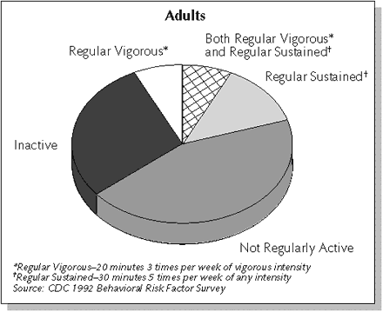
http://adbusters.org/spoofads/misc/riders/

Slide 70
THE BENEFITS OF REGULAR PHYSICAL ACTIVITY
Reduces the risk of dying prematurely.
Reduces the risk of dying from heart disease.
Reduces the risk of developing diabetes.
Reduces the risk of developing high blood pressure

Slide 71
THE BENEFITS OF REGULAR PHYSICAL ACTIVITY
Helps reduce blood pressure in people who already have high blood pressure.
Reduces the risk of developing colon cancer.
Reduces feelings of depression and anxiety.
Helps control weight.

Slide 72
THE BENEFITS OF REGULAR PHYSICAL ACTIVITY
Helps build and maintain healthy bones, muscles, and joints.
Helps older adults become stronger and better able to move about without falling.
Promotes psychological well-being.

Slide 73
Moderate Exercise
A moderate amount of physical activity is roughly equivalent to physical activity that uses approximately 150 Calories (kcal) of energy per day, or 1,000 Calories per week.

Slide 75
Table 16.1 (p. 473) Reasons for Exercising and Research Supporting These Reasons (continued on next slide)

Slide 76
Table 16.1 (cont.)

Slide 77
Citi Bike

Slide 80
After 23 million rides, no deaths in U.S. bike share programs
In fact, experts say no fatalities have been logged in any U.S. public bike share program since the first one launched in Tulsa, Oklahoma, in 2007.
There are now programs in 36 cities, including Chicago, Minneapolis and San Francisco

Slide 81
The End

