Slide 1
Health Psychology
William P. Wattles, Ph.D.
Francis Marion University
Fall 2016

Slide 2


Slide 3


Slide 4


Slide 5


Slide 6
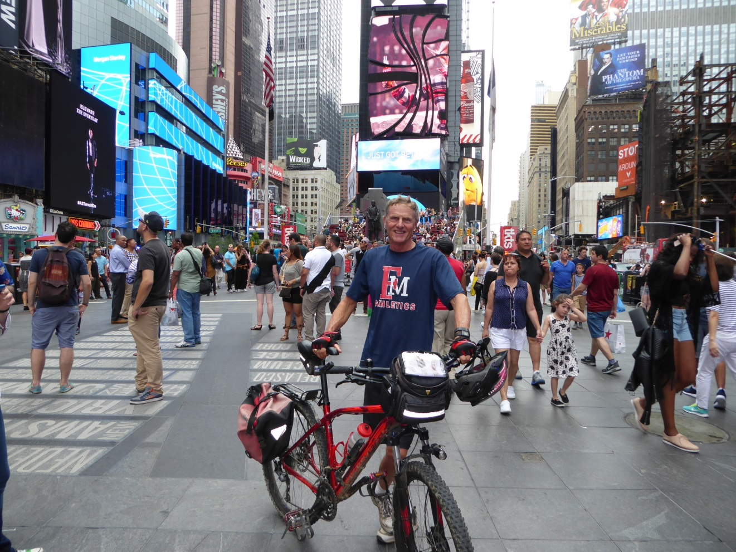

Slide 7


Slide 8


Slide 9


Slide 10
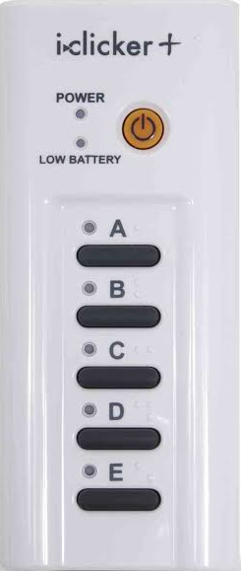
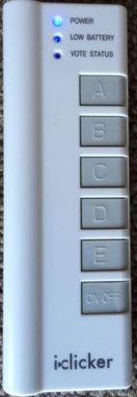
Text
Health Psychology
Richard Straub
I-Clicker-either works fine

Slide 11
Send me an e-mail
We will communicate via e-mail and web page during the term. Place PSY314 first on subject line. In text give me a 4 digit number to use if you want your grade posted.
Give me whatever e-mail address you prefer
Please send me a picture for me to use to learn your name.

Slide 12
Health Psychology
Psychology: The science that deals with mental processes and behavior.
Health:
  The overall condition of an organism at a given time.
  Soundness, especially of body or mind; freedom from disease or abnormality.

Slide 13
Texting While Driving
Bus driver
PSA video
Teen fatality
response
Why do this?
Notes:
http://www.youtube.com/watch?v=xiEFjt6ouqI&feature=related
this semseter is going to be about explaining this behavior.

Slide 14
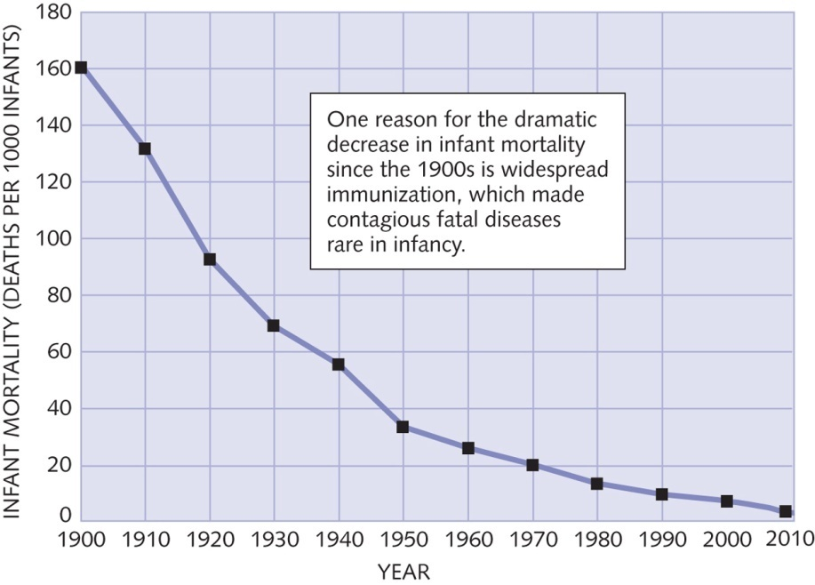
Belief Bias
Faulty reasoning
expectations lead us to rule out better explanations
Notes:
Belief bias is the tendency to judge the strength of arguments based on the plausibility of their conclusion rather than how strongly they support that conclusion. In other words, if people agree with a viewpoint, they are inclined to believe that the process used to obtain the results must also be correct.
In the 1920s there were an estimated 100,000 to 200,000 cases of diphtheria per year in the United States, causing 13,000 to 15,000 deaths per year
betwe
http://www.who.int/immunization_safety/aefi/immunization_misconceptions/en/index4.html
http://www.youtube.com/watch?v=8T_jwq9ph8k
4. "Vaccines cause many harmful side effects, illnesses, and even death - not to mention possible long-term effects we don't even know about."
Vaccines are actually very safe, despite implications to the contrary in many anti-vaccine publications. Most vaccine adverse events are minor and temporary, such as a sore arm or mild fever. These can often be controlled by taking paracetamol after vaccination. More serious adverse events occur rarely (on the order of one per thousands to one per millions of doses), and some are so rare that risk cannot be accurately assessed. As for vaccines causing death, again so few deaths can plausibly be attributed to vaccines that it is hard to assess the risk statistically. Each death reported to ministries of health is generally thoroughly examined to assess whether it is really related to administration of vaccine, and if so, what exactly is the cause. When, after careful investigation, an event is felt to be a genuine vaccine-related event, it is most frequently found to be a programmatic error, not related to vaccine manufacture.
Diphtheria-tetanus-pertussis (DTP) vaccine and Sudden Infant Death Syndrome (SIDS)
One myth that won't seem to go away is that DTP vaccine causes sudden infant death syndrome (SIDS). This belief came about because a moderate proportion of children who die of SIDS have recently been vaccinated with DTP; on the surface, this seems to point toward a causal connection. This logic is faulty however; you might as well say that eating bread causes car crashes, since most drivers who crash their cars could probably be shown to have eaten bread within the past 24 hours.
If you consider that most SIDS deaths occur during the age range when three shots of DTP are given, you would expect DTP shots to precede a fair number of SIDS deaths simply by chance. In fact, when a number of well-controlled studies were conducted during the 1980s, the investigators found, nearly unanimously, that the number of SIDS deaths temporally associated with DTP vaccination was within the range expected to occur by chance. In other words, the SIDS deaths would have occurred even if no vaccinations had been given.
In fact, in several of the studies, children who had recently received a DTP shot were less likely to get SIDS. The Institute of Medicine reported that "all controlled studies that have compared immunized versus non-immunized children have found either no association . . . or a decreased risk . . . of SIDS among immunized children" and concluded that "the evidence does not indicate a causal relation between [DTP] vaccine and SIDS."
Looking at risk alone is not enough however - you must always look at both risks and benefits. Even one serious adverse effect in a million doses of vaccine cannot be justified if there is no benefit from the vaccination. If there were no vaccines, there would be many more cases of disease, and along with them, more serious side effects and more deaths. For example, according to an analysis of the benefit and risk of DTP immunization, if there was no immunization program in the United States, pertussis cases could increase 71-fold and deaths due to pertussis could increase four-fold. Comparing the risk from disease with the risk from the vaccines can give us an idea of the benefits we get from vaccinating our children.
en 2000 and 2007 there were only three cases^{[6]} as the DPT (Diphtheria–Pertussis–Tetanus) vaccine is recommended for all school-age children. ere

Slide 15
Contributions of Psychology to Health
Change unhealthy behaviors
Relieve pain
Reduce stress
Improve compliance
  seeking health care
  adherence
Learn to live with chronic disease

Slide 16
Scientist Practitioner
The Boulder Model
All psychologists trained in methods of science

Slide 17
The Scientific Method
Fixation of Belief –Peirce
  “Doubt is an uneasy and dissatisfied state from which we struggle to free ourselves and pass into the state of belief…”

Slide 18
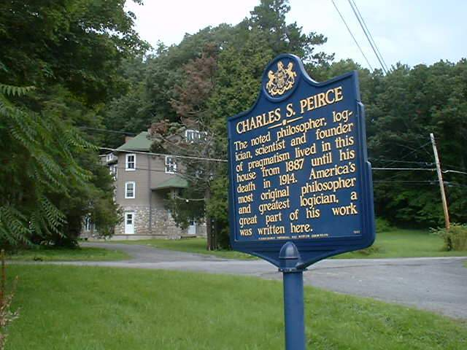

Slide 19
Fixation of Belief -Peirce
method of tenacity
Method of authority
a priori method
method of science
Notes:
Swimming after lunch
Copernicus and Galileo

Slide 20
The Scientific Method
empirical:
a. Relying on or derived from observation or experiment: empirical results that supported the hypothesis.
b. Verifiable or provable by means of observation or experiment: empirical laws
others can arrive at the same results.

Slide 21

Sierra Club Example
One page or multiple page mailer?
Opinion versus data

Slide 22
Misleading Media Messages
One must learn to be an educated consumer of health research
Reject bad science but not science itself.

Slide 23
For Example
Dr. Wattles is a good teacher.
Strongly agree 5
Agree 4
No opinion 3
Disagree 2
Strongly Disagree 1
Your Name _______________________

Slide 24
Peer Reviewed Journals
Much poor science can be prevented by reviewers suggesting improvements or rejecting faulty research.

Slide 25
Behavioral Medicine
The interdisciplinary field concerned with the development and integration of behavioral and biomedical science knowledge and techniques relevant to health and illness and the application of this knowledge and these techniques to prevention, treatment and rehabilitation.

Slide 26
Prevention
More effective than treatment in containing medical costs.
Primary prevention consists of immunizations and lifestyle changes to prevent illness in healthy people.
Secondary prevention catch disease in early and more treatable stages.
Tertiary prevention- Prevent further damage

Slide 27
Primary Prevention Examples
Increase physical activity

Slide 28
Primary Prevention Examples
Improve nutrition

Slide 29
Primary Prevention Examples
decrease tobacco use

Slide 30
Primary Prevention Examples
Decrease alcohol and drug use

Slide 31
Primary Prevention Examples
Increase dental care

Slide 32
Primary Prevention Examples
Increase immunizations

Slide 33
Put psy314 on subject line.
  Glenda got put in spam
Don’t forget to send me a picture

Slide 34
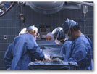
Primary Prevention Advantages
Saves money
Saves suffering and lost time from life
More effective than repairing the damage
Little potential for harm
Maintains quality of life

Slide 35
Prevention
When primary prevention is successful nothing happens and people don’t like to pay for nothing.
Must have data to show results.

Slide 36
Health Psychology
prevention and treatment of illness.
identification of risk factors.
improvement of the health care system.
shaping of public opinion with regard to health.

Slide 37
Diseases kill more than disasters
International Federation of Red Cross and Red Crescent societies (2000):
Money spent on changing people’s behavior saves more lives than money for expensive facilities like hospitals and high-tech equipment.

Slide 38
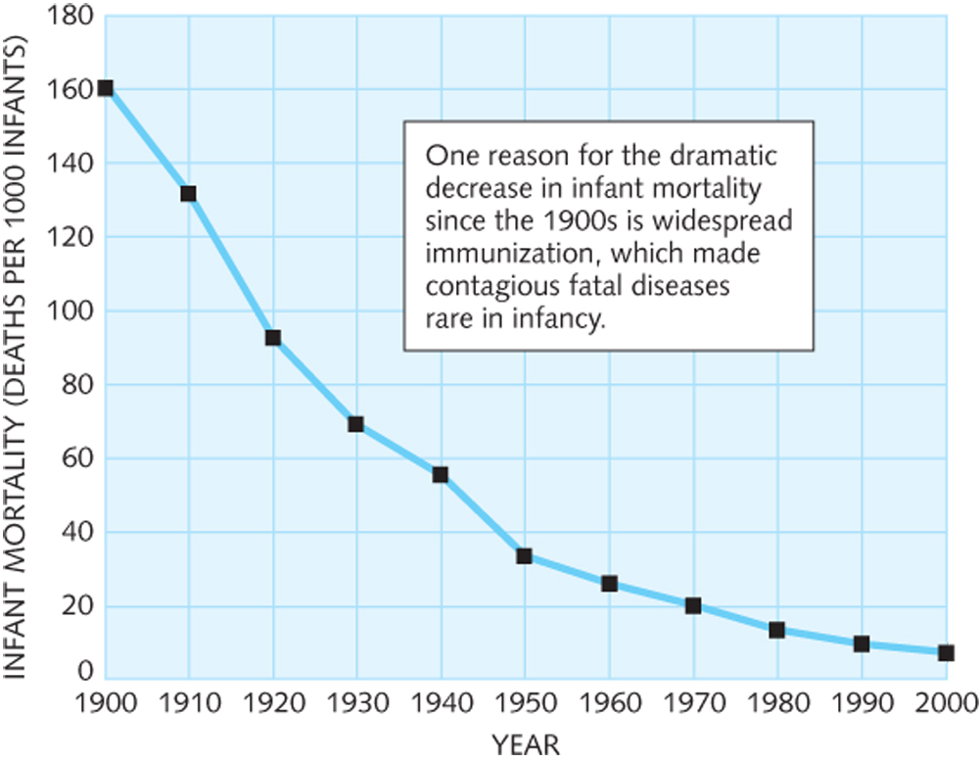
Figure 1.3 Infant mortality in the United States
Straub: Health Psychology 2E
Copyright © 2007 by Worth Publishers

Slide 39
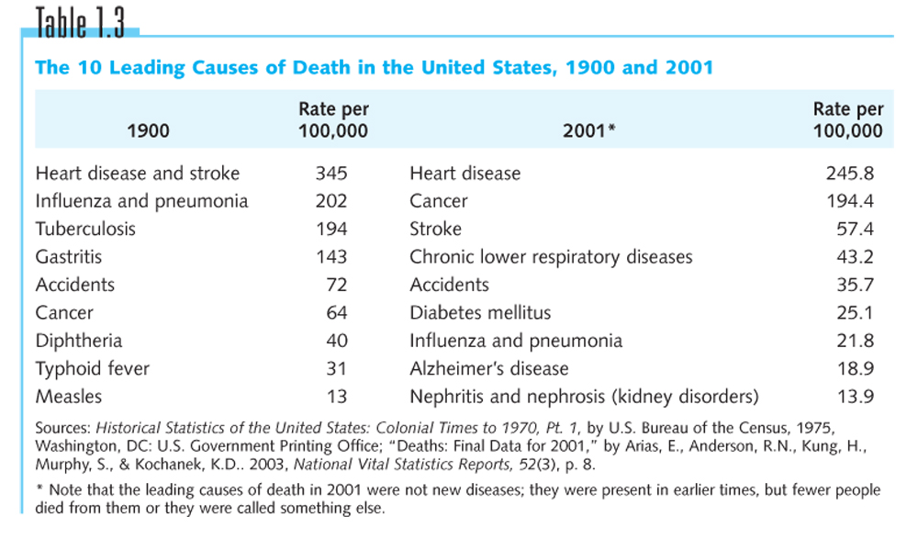
Table 1.3
Straub: Health Psychology 2E
Copyright © 2007 by Worth Publishers

Slide 40
Social Psychology and Health

Slide 41
Heart Attack Grill
http://www.youtube.com/watch?v=WfOAeZIDAnw&feature=related
http://abcnews.go.com/topics/news/heart-attack-grill.htm?mediatype=Video
death of model

Slide 42
Two ingredients of Belonging
People need some kind of regular social contact
People want the stable framework an ongoing relationship.

Slide 43
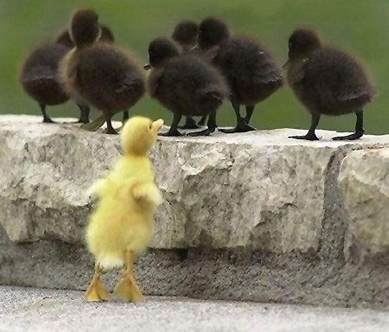
Not belonging is bad for you.
People who are alone have more physical and mental health problems.

Slide 44
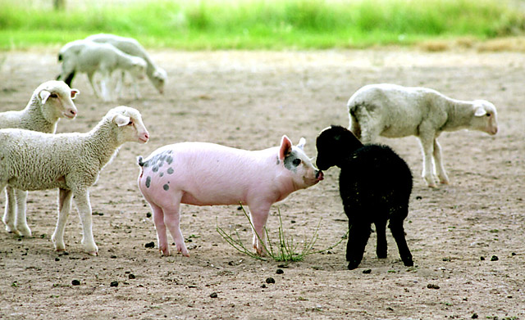
Similarity
Similarity is a common and significant cause of attraction.

Slide 45
Social Rejection
Rejected people report a variety of Problems: pain, illness, depression, eating disorders, promiscuity, low self-esteem.

Slide 46
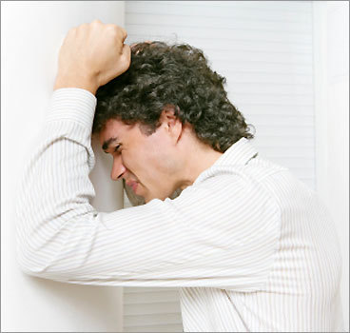
Social rejection.
rejected people eat more junk food. More impulsive, less able to reason cognitively

Slide 47

Belongingness as a Basic Need.
Most likely the need to belong is a powerful drive within the human psyche.

Slide 48
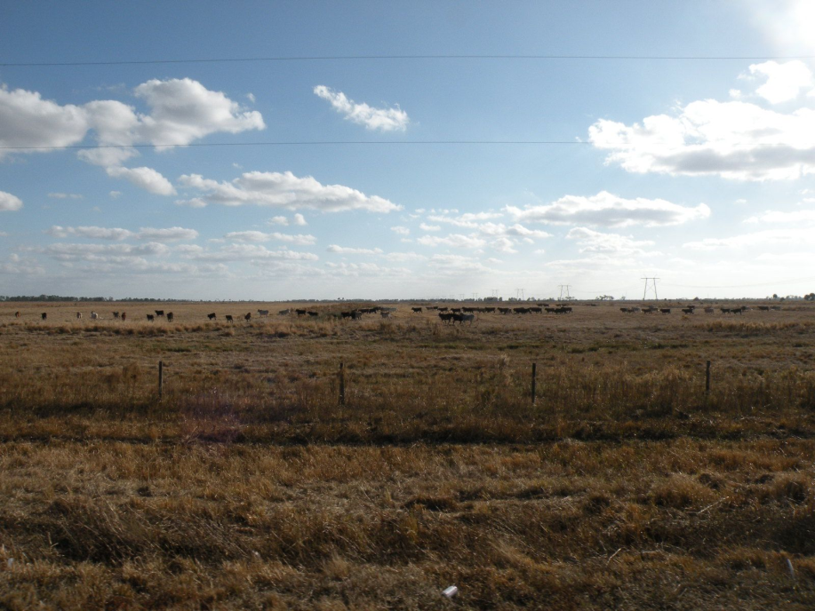
Herd instinct
A large collection of animals that all do the same thing.

Slide 49


Slide 50
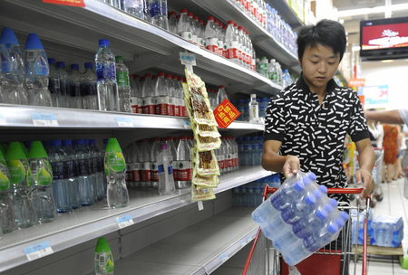

Slide 51
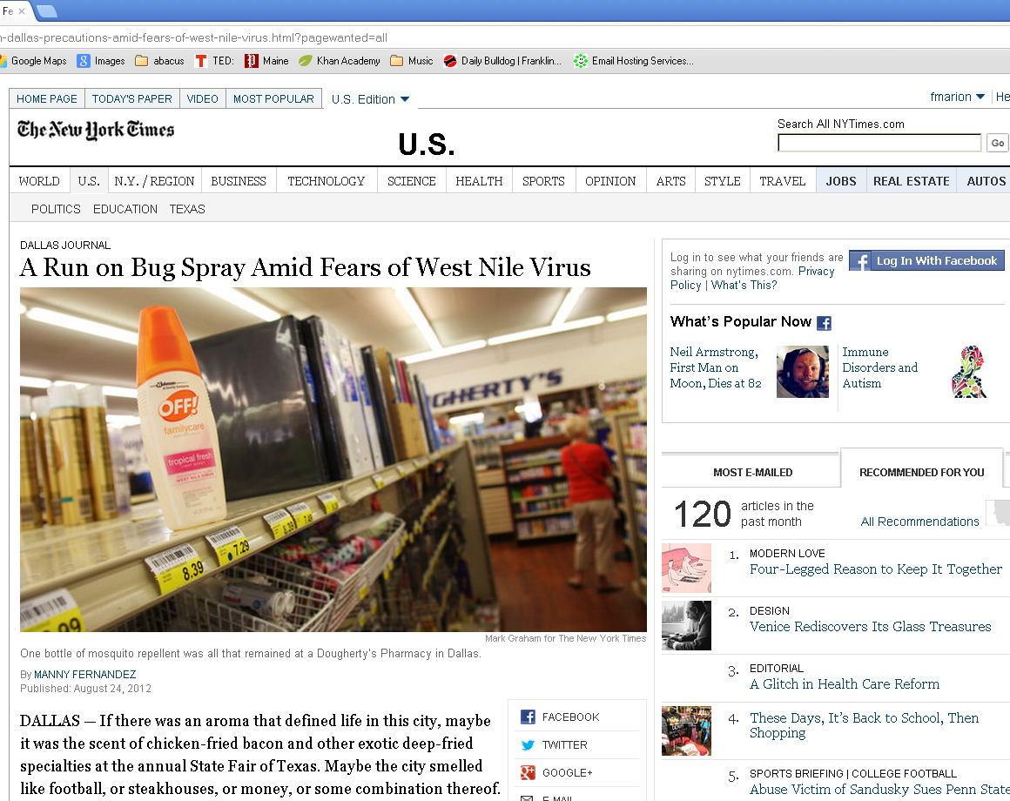

Slide 52
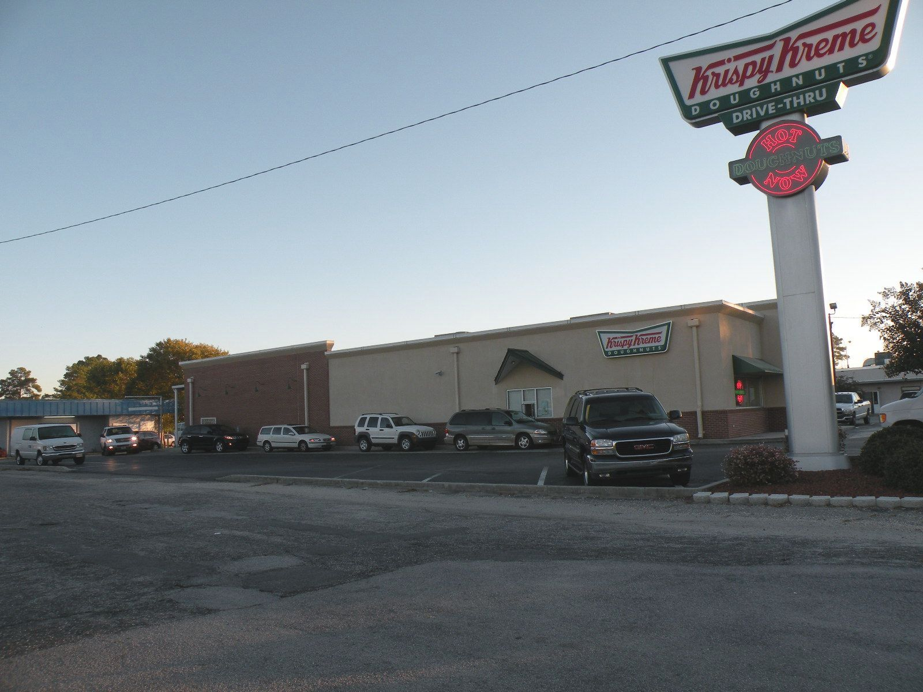

Slide 53
Among adults, the simplest and most general explanation for rejection is deviance.
Groups reject insiders more than outsiders for the same degree of deviance.

Slide 54
Social Comparison
Upward social comparison
  Can inspire
  Can discourage
Downward Social comparison
  Can make you feel good
  May lower standards

Slide 55

Aversive State
An unpleasant, temporary condition that motivates a person to act to reduce it.

Slide 56
Reactance Theory
The idea that people are distressed by loss of freedom or options and seek to reclaim or reassert them.

Slide 57
Reactance
The term reactance refers to the aversive state people have when they perceive a reduction in freedom or choice.

Slide 58
Reactance produces 3 main consequences
Makes the forbidden object more attractive
Motivates you to reclaim the lost option
May lead to feel or act aggressively toward the person who restricted your freedom.

Slide 59
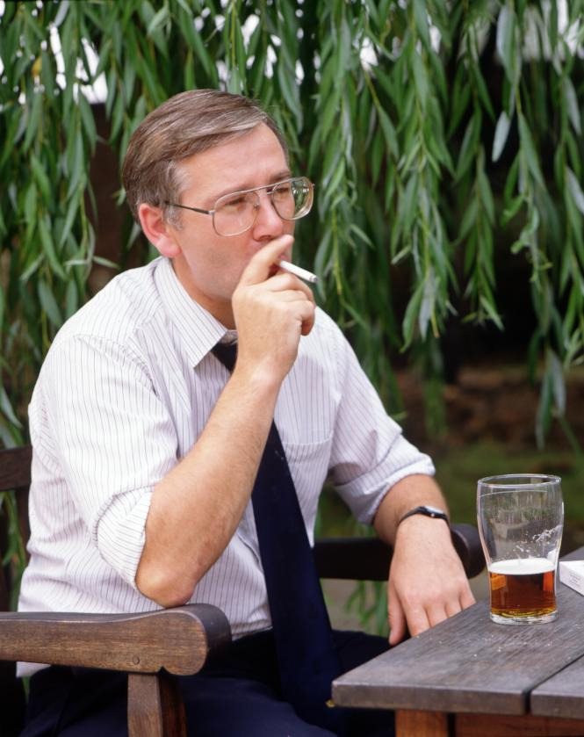
Dissonance
The term dissonance refers to the aversive state people have when they perceive discrepancies between attitudes and behavior.

Slide 60
Cognitive Dissonance
Theory that inconsistencies produce discomfort leading people to rationalize behavior or change attitudes.

Slide 61
Learning Theory
Will Wattles

Slide 62
What is learning?
How organisms come to behave in new ways.
  motivation
  knowledge
  change in behavior
…Consciousness is a small part of the human mental repertoire. –Timothy Wilson

Slide 63
Behaviorism
John B. Watson-study only what can be observed.
Empirical
a. Relying on or derived from observation or experiment: empirical results that supported the hypothesis. b. Verifiable or provable by means of observation or experiment: empirical laws.

Slide 64
Stimulus
a property of the environment that you can detect with your senses.

Slide 65
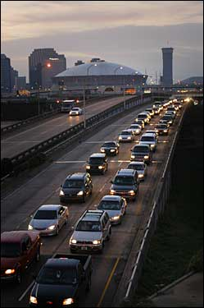
Behavior
Something you do.

Slide 66
What is this couple not doing?
Are they not reading?
Or are they not sleeping?
Not doing something is not a behavior.

Slide 67
Response
Something you do. Also called behavior
Response = Behavior
Behavior can be
  elicited
  emitted

Slide 68
Elicited Behavior
A behavior such as a reflex that results from the presentation of a stimulus and is not voluntary.
Example: Patellar reflex

Slide 69
Emitted Behavior
A voluntary behavior. The organism may or may not make this response.

Slide 70
Classical Conditioning
Pavlov’s Dog
  Meat powder
  Salivation
  Metronome
  Salivation

Slide 71
CS
conditioned stimulus
elicits
metronome
CR
conditioned response
salivation
elicits
US
UR
Unconditioned stimulus
unconditioned response
meat powder
salivation

Slide 72
Classical Conditioning
The dog learns to associate meat powder with the metronome.
The dog learns pairing
the dog learns what goes with what.

Slide 73
Operant Conditioning
Thorndike’s cat
  cage
  food
  pulling the rope
  getting the food

Slide 74
Antecedent
a stimulus that tells or reminds the organism about a relationship between a behavior and another stimulus
called the discriminative stimulus

Slide 75
Behavior
Behavior or response. Something the organism can do.

Slide 76
Consequence
A stimulus or property of the environment that is presented contingent on the behavior.

Slide 77
Antecedent
Behavior
Consequence

Slide 78
Contingent
The consequence is contingent on the behavior. No behavior no consequence.

Slide 79
Contingent
The consequence is contingent on the behavior. No behavior no consequence.

Slide 80
Operant Conditioning
The cat learns the consequences of its actions.
The cat learns what to do to get what you want.

Slide 81
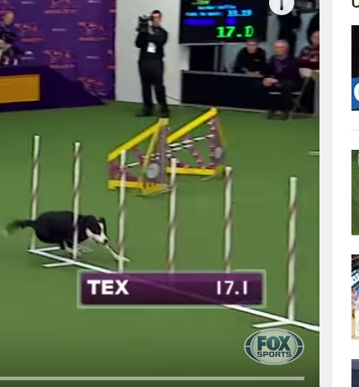
The power of operant conditioning

Slide 82
Operant conditioning

Slide 83

Positive reinforcement
Antecedent
Response
Consequence
What happens to the behavior?

Slide 84
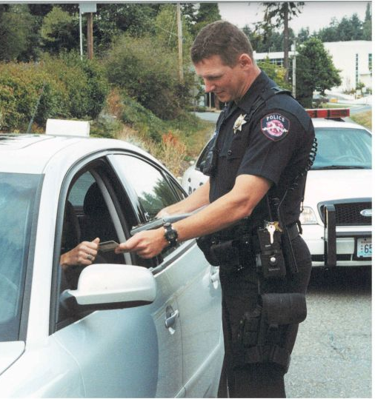
Response Cost
Antecedent
Response
Consequence
What happens to the behavior?

Slide 85
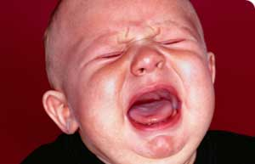
Negative reinforcement
Antecedent
Response
Consequence
What happens to the behavior?

Slide 86
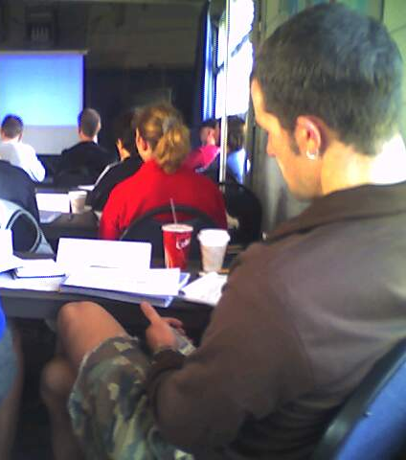
Punishment
Antecedent
Response
Consequence
What happens to the behavior?

Slide 87
Three requirements for reinforcement
The behavior must increase
The consequence must be contingent on the behavior
The contingency must cause the increase in behavior.

Slide 88
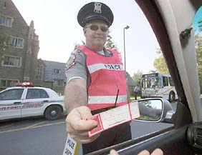
Consequences
The Cornell Police conducted "Click It or Ticket" checkpoints last week, handing out citations to people not wearing their seatbelts -- and giving out complimentary tickets to the Cornell-Yale game to those who were buckled up.

Slide 89
Operant Conditioning: Extinction
Behavior weakened when the reinforce does not follow the behavior.

Slide 90
Big Bang Theory on negative reinforcement.

Slide 91
Choice video

Slide 92
New York Times 8/31/2010
Cocaine relapse after 6 months
It happened that he had run into an old friend just outside his office with whom he had used drugs years earlier. Although he did not consciously associate the friend and the drugs, his brain had not forgotten, and the meeting touched off the urge to use again.

Slide 93
Long after someone has apparently kicked the habit, long after withdrawal symptoms subside, the individual is vulnerable to these deeply encoded unconscious associations that can set off a craving, seemingly out of the blue.
Notes:
could not rewire my patient’s brain. But at least I could try to help him reconfigure his environment by avoiding cues that might provoke cocaine craving. I had him make an inventory of all the people and places he associated with his drug use — and then had him steer clear of as many as he could. Lucky for him that he never used drugs at home.

Slide 94
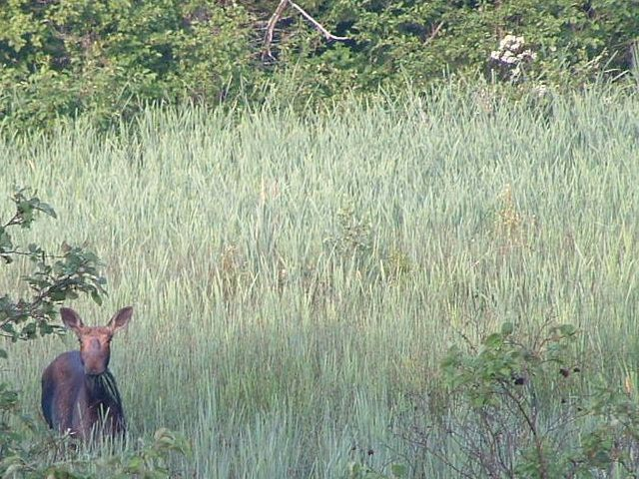
The End

Slide 95
Science Methodology
Control and manipulation
Connectivity to current knowledge
  Building upon existing base
Convergence of multiple sources
  Different methods and progress
Probabilistic reasoning
  Correlation and prediction
Multiple Causation and Interaction
The role of chance
From Stanovich, K. How to think straight about psychology

Slide 96
Science Methodology
Systematic Empiricism
Public Knowledge
Operationalism
The role of Theory
  Falsifiability
Testimonials and case study evidence
  Placebo
Correlation and Causality
From Stanovich, K. How to think straight about psychology

