Slide 1
Research Methods in Psychology
Behavioral Medicine Psy 314
William P. Wattles, Ph.D..
Francis Marion University
Notes:
1

Slide 2
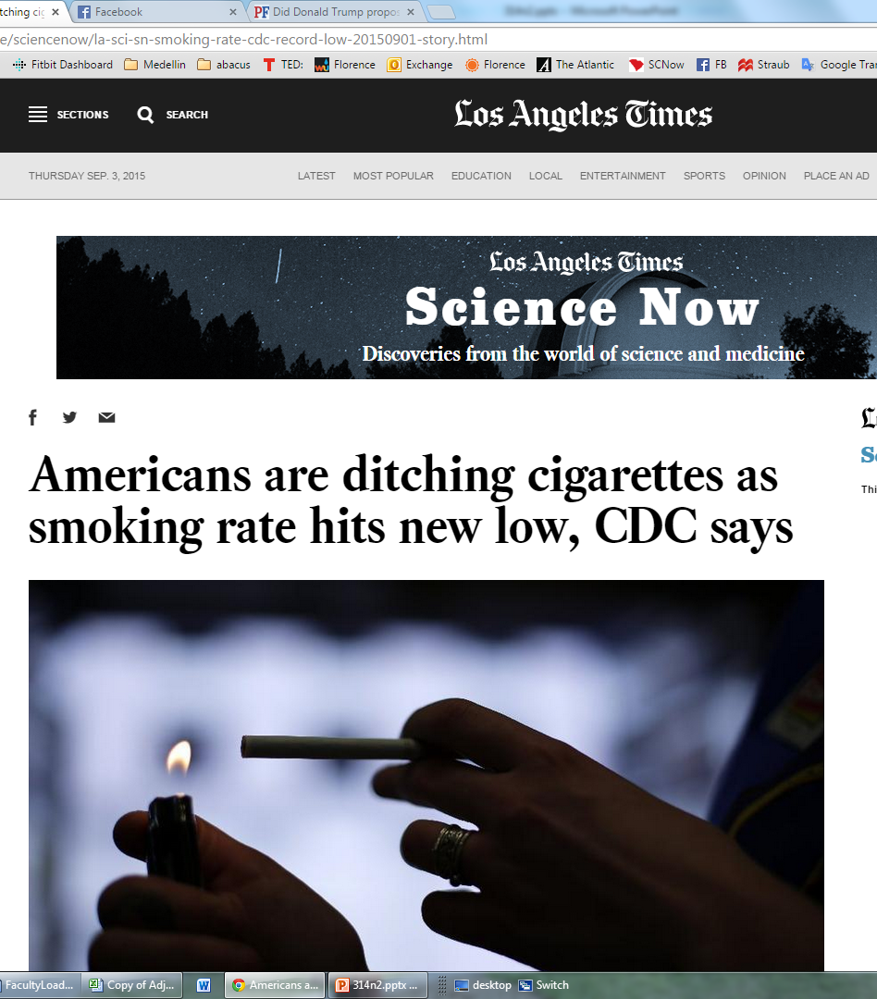
15.2%

Slide 3
Empirical
a. Relying on or derived from observation or experiment: empirical results that supported the hypothesis.
b. Verifiable or provable by means of observation or experiment: empirical laws.
Notes:
3

Slide 4
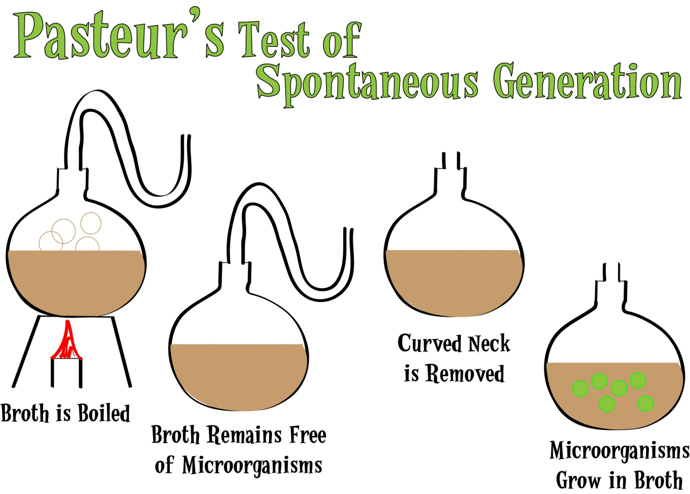

Slide 5
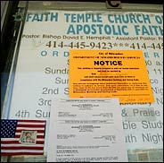
Faith Healing gone bad
NYT 8/29 8-year old died at prayer service intended to save him.

Slide 6
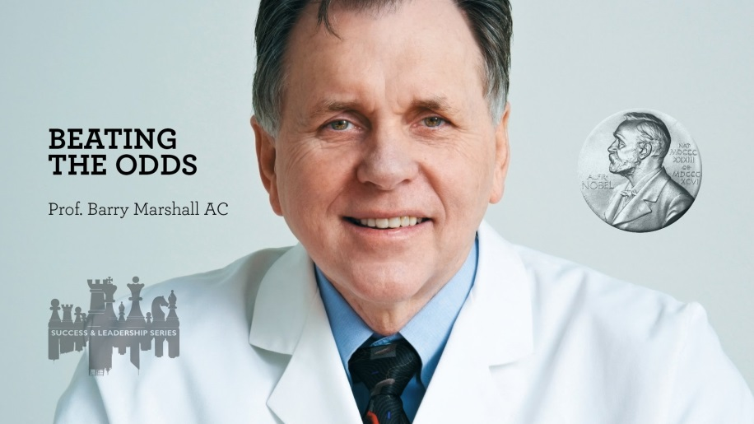
Method of Science self-correcting
Ulcers caused by

Slide 7
Method of Science self-correcting
Ulcers caused by stress

Slide 8
Method of Science self-correcting
90% of peptic ulcers are caused by a bacterium called Helicobacter pylori
Survive stomach acid
Found in patients with ulcers
90% cured with antibiotics
Even drank a solution.
Notes:
3 billion dollars a year in Tagament. "Science is not a democracy." It doesn't matter how many millions of people there are on the other side. There's one right, and it's perfectly possible for all the rest to be wrong. And ultimately all those guys were proved wrong, and they either retired or they came over the side ofHelicobacter .

Slide 9
Good science versus bad science
Alternative explanations.

Slide 10
Seven Signs of Voodoo Science
1. The discoverer pitches the claim directly to the media.
2. The discoverer says a powerful establishment is suppressing his work.
3. The effect is at the very limit of detection.
4. Evidence for the discovery is anecdotal.

Slide 11
Seven Signs of Voodoo Science
5. The discoverer says a belief is credible because it has endured for centuries.
6. The discoverer has worked in isolation.
7. New laws of nature are proposed to explain the observation.

Slide 12
The Case Study
A. Widely used, easy to implement.
B. Allows for a thorough analysis of the subject. Useful when phenomena is rare or new
C. Provides a description
D. May disconfirm uniform assumptions
E. Useful for hypothesis generation.
Notes:
4

Slide 13
Disadvantages of case study
a. Can confuse the individual and the disorder.
b. Cannot generalize from this idiographic (individual) data or to nomothetic ( general)
Notes:
5

Slide 14
Idiographic vs. Nomothetic data
Idiographic refers to the individual.
Nomothetic - Of or relating to the study or discovery of general scientific laws.
When we use nomothetic data we gain and. We lose specificity to the individual but we gain in that we can now generalize to others.
Notes:
6

Slide 15
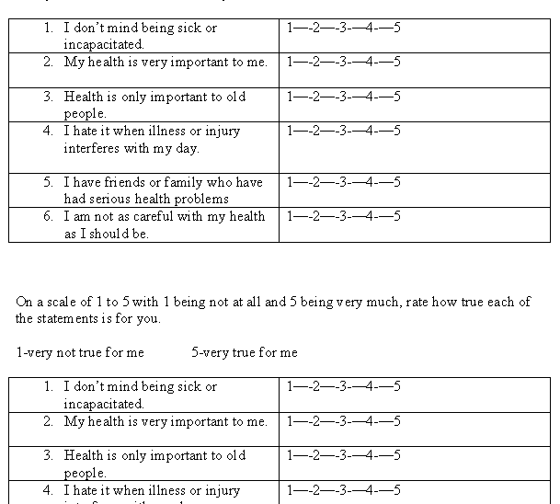
Survey
A questionnaire asking self-reported attitude or behavior.

Slide 17
Class Survey 2013

Slide 18
Class Survey 2014

Slide 19
Correlation
Observation only
Relationship one tends to follow the other
text: correlation indicates how similar the scores are.
In general when one increases the other increases and vice versa.
Notes:
7

Slide 20
Correlation
The relationship between two variables X and Y.
In general, are changes in X associated with Changes in Y?
If so we say that X and Y covary.
We can observe correlation by looking at a scatter plot.
Notes:
8
Let’s look at an example.
We have grades from PSY300 that I taught last semester
It all comes down to a lot of numbers, nice to have a machine to do the calculations.
Do you think there would be a relationship between scores on exam 2 and exam 3?
In general we’d expect those that scored well on 2 to score well on 3
Lets look for a pattern.

Slide 21
Notes:
9

Slide 22
Type of correlation
Positive correlation. The two change in a similar direction. Individuals below average on X tend to be below average on Y and vice versa.
Negative correlation the two change in the opposite direction. Individuals who are above average on X tend to be below average on Y and vice versa.
Notes:
10

Slide 23
Examples
Positive correlations: Hours spent studying and g.p.a.; height and weight, exam 1 score and exam 2 score, Obesity and type2 diabetes, hypertension, asthma
Negative correlations; temperature and heating bills; hours spent watching TV and g.p.a.; SAT median and % taking the test.
Notes:
11

Slide 24
Correlation Coefficient
One number that tells us about the strength and direction of the relationship between X and Y.
Has a value from -1.0 (perfect negative correlation) to +1.0 (perfect positive correlation)
Perfect correlations do not occur in nature
Notes:
12

Slide 25
Strength of Correlation
Weak .10, .20, .30
Moderate .40,.50, .60
Strong .70, .80, .90
No correlation 0.0
Notes:
13

Slide 26

Advantages of Correlation
Relatively simple to do.
Involves observation not manipulation

Slide 27

Disadvantages of Correlation
CORRELATION DOES NOT IMPLY CAUSATION
Notes:
14
relationship one tends to follow the other. height and weight (page 100).
1.positive-hours study, g.p.a.
2. negative-hours TV gpa,
3. how strong?
4. significant?.
5. to causation, height and inseam
A. directionality-schizo and poverty
b. third variable-alcohol, lung cancer
c. kids in classroom participate the most if they sit across the front and down the

Slide 28
Causation
Sadly, there is no sufficient way to prove that an association between a factor and a disease is a causal relationship.
http://www.med.uottawa.ca/sim/data/Causation_e.htm
Strength
Consistency
Specificity
Temporality
Dose response (biological gradiant)
Plausibility
Coherence
Notes:
Strength: A small association does not mean that there is not a causal effect, though the larger the association, the more likely that it is causal.^{[1]}
Consistency: Consistent findings observed by different persons in different places with different samples strengthens the likelihood of an effect.^{[1]}
Specificity: Causation is likely if a very specific population at a specific site and disease with no other likely explanation. The more specific an association between a factor and an effect is, the bigger the probability of a causal relationship.^{[1]}
Temporality: The effect has to occur after the cause (and if there is an expected delay between the cause and expected effect, then the effect must occur after that delay).^{[1]}
Biological gradient: Greater exposure should generally lead to greater incidence of the effect. However, in some cases, the mere presence of the factor can trigger the effect. In other cases, an inverse proportion is observed: greater exposure leads to lower incidence.^{[1]}
Plausibility: A plausible mechanism between cause and effect is helpful (but Hill noted that knowledge of the mechanism is limited by current knowledge).^{[1]}
Coherence: Coherence between epidemiological and laboratory findings increases the likelihood of an effect. However, Hill noted that "... lack of such [laboratory] evidence cannot nullify the epidemiological effect on associations".^{[1]}
Experiment: "Occasionally it is possible to appeal to experimental evidence".^{[1]}
Analogy: The effect of similar factors may be considered.^{[1]}

Slide 29
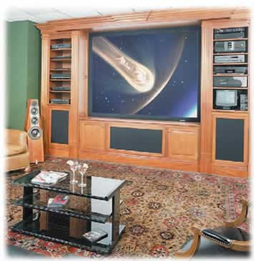
Correlation
Measures of health for nations correlate with the number of televisions.

Slide 30
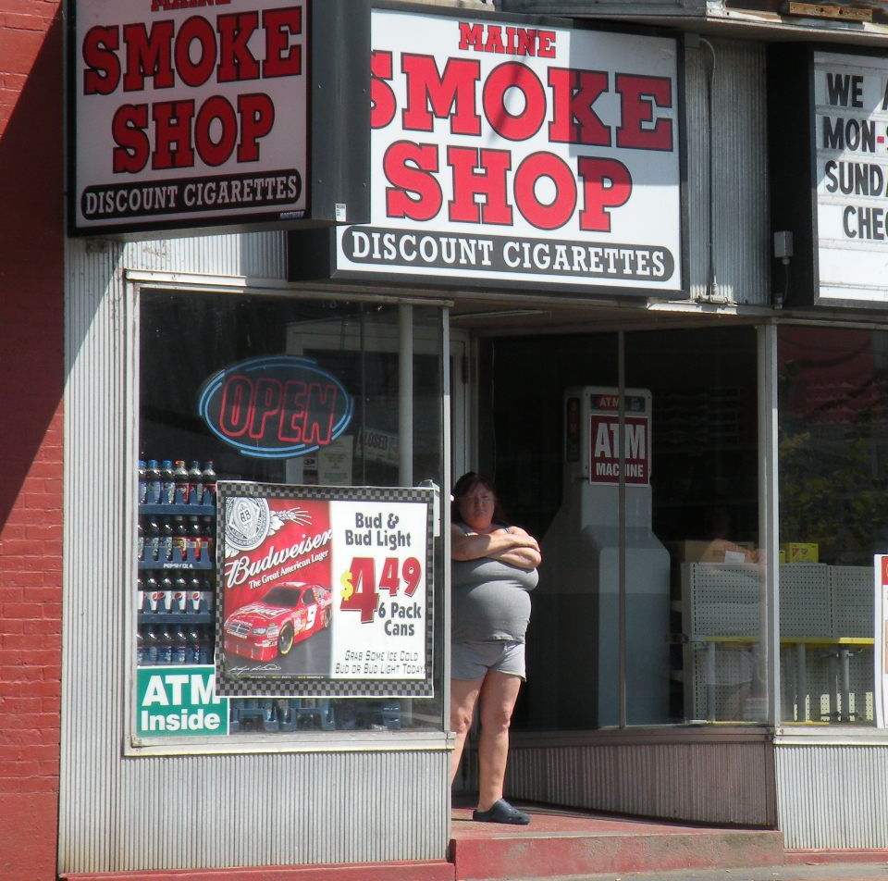
Obesity increased with popularity of low-fat diet.
  More Driving
  Less walking
  Larger portions
  More computers

Slide 31
EXPERIMENT
Experimenter Control (manipulation)
  Independent variable
  Dependent variable
Two or more groups
  experimental group
  control group
Random assignment
Notes:
15

Slide 32
Independent Variable
Under control of the experimenter
Used to explain changes in the dependent variable
Example: Type of instruction
  Should include a control group
Notes:
16

Slide 33
Dependent Variable
Not under control by the experimenter
Presumed to be caused or affected by the independent variable
Example: grade on final exam
Notes:
17

Slide 34
Random Assignment
Essential aspect of experiment
Allows us to control for all potential confounds
Each subject has an equal chance of being in each group.
Intact groups not random
Replication to deal with chance variation
Notes:
18

Slide 35
EXPERIMENT
Double-blind
  to avoid social expectations
  to avoid demand characteristics
External validity-extent to which we can generalize
Analogue-animals, cold water immersion as stress
Notes:
19

Slide 36
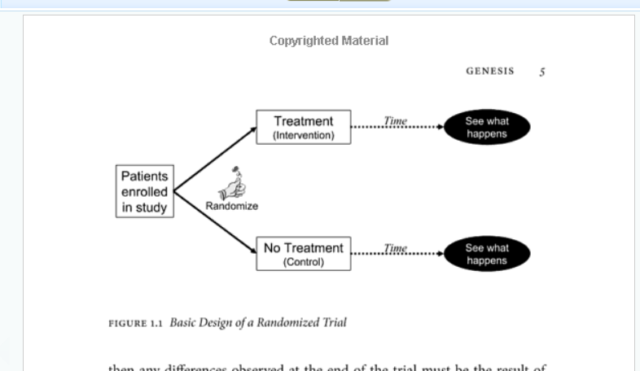
Overdiagnosed, Welch, Schwartz & Woloshin

Slide 37
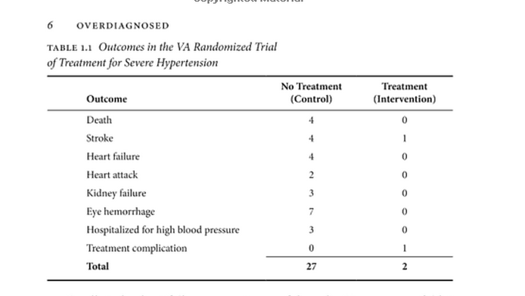
Overdiagnosed, Welch, Schwartz & Woloshin

Slide 38
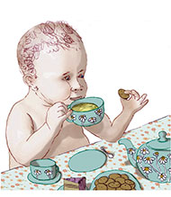
Example of Experiment
New York Times 9/1/2009
The Claim: Chamomile Can Soothe a Colicky Baby.

Slide 39
Randomized Clinical Trial
Independent Variable
  Treatment group
    Chamomile tea
  Control Group
    Other tea
Dependent Variable
  Presence of colic

Slide 40
Randomized Clinical Trial
Results
  Treatment group 57 percent better
  Control group 26 percent better

Slide 41
Advantage of Experiment
Can talk about one variable causing another.

Slide 42
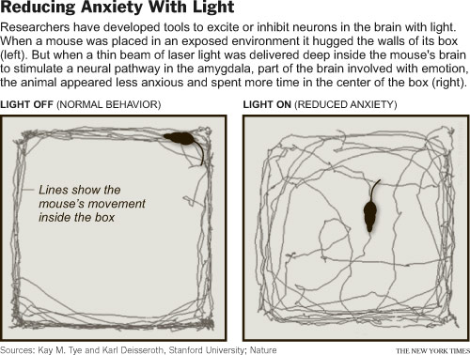
Analog Study
a type of study in psychology that attempts to replicate or simulate, under controlled conditions, a situation analogous to real life
Notes:
optogenetics
http://www.nytimes.com/2011/05/17/science/17optics.html?_r=1&sq=optogenetics&st=cse&adxnnl=1&scp=1&adxnnlx=1305723600-KfCy/Ti2Nuf0frU/bg18wQ

Slide 43
Requirements for Reaction Paper
Minimum two pages. 1 ¾ pages is not 2 pages.
Typed double-spaced standard font 10 or 12.
Free of grammar and spelling errors
Paper must be about your reactions to the story. NOT a synopsis of the article.
Due Thursday September 15 midnight

Slide 44
Research Example
Setting the Mood for Smaller Meals

Slide 45
Clinical Course of self-limiting conditions.
asymptomatic
Deterioration
Improvement
symptomatic
Intervention

Slide 46
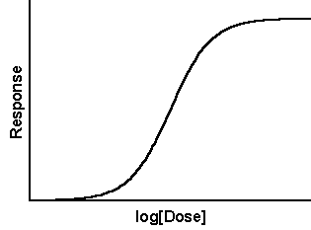
Dose Response Relationship
A direct, consistent association between an independent variable, such as a behavior, and a dependent variable, such as a disease.
Supports a causal interpretation.
Notes:
Epidemiologic Tenets of Causality
Epidemiology is the study of the causes of disease. Continually advancing for hundreds of years, it is the scientific discipline which focuses on the identification of cause and effect. Traditionally, it has been associated with the identification of the cause of disease (e.g. the identification of polluted water sources as the cause of gastrointestinal illness in London). It is also associated with the identification of an effective treatment for a disease (e.g. the role of citrus fruit ingestion in the prevention of scurvy).
Over the course of study, epidemiologists have postulated a series of tenets or conditions that must be in place in order for the causative relationship to be identified. These tenets are
Through the use of research timing and research directionality, scientists work to demonstrate these seven tenets, and thereby build a strong causative argument.
Intuitive Epidemiological Reasoning
The efforts to understand and articulate the arguments that should be used to identify or discredit a risk factor ?disease relationship have evolved over three hundred years. In 1965, Austin Bradford Hill² described the nine criteria for causality arguments in health care. These nine rules or tenets are remarkably and refreshingly devoid of complex mathematical arguments, relying instead on natural, honest intuition and common sense for the inquiry into the true nature of a risk factor ?disease relationship. The questions that Dr. Hill suggested should be asked make good sense. Are there many disease cases when the risk factor is present, and fewer disease cases when the risk factor is absent? Does a greater exposure to the risk factor produce a greater extent of disease? Other questions asked by Dr. Hill explore the “believability?of the relationship. Some of these are: Is there a discernible mechanism by which the risk factor produces the disease? Have other researches also shown this relationship? Are there other such relationships whose demonstration help us to understand the current risk factor- disease relationship? The nine precise Bradford Hill criteria are: 1) Strength of Association 2) Temporality 3)Dose-Response 4) Biologic Plausibility 5) Consistency 6) Coherency 7) Specificity 8) Experimental evidence 9) Analogy.
Strength of association
The relative risk (or odds ratio) is the cornerstone for causal inferences, measuring the strength of association. The higher the relative risk, the greater the likelihood that the relationship is causal. In the International Primary Pulmonary Hypertension Study (IPPHS), it was determined that for exposure to anorexigens, the estimated relative risk for primary pulmonary hypertension (PPH) was 6.3. With a relative risk this high, it is unlikely that any other factor could be the cause of this association. The higher the relative risk - the stronger the association ?the less likely other factors can explain the association.
¡¡
Temporal relationship
A temporal relationship must exist in order to convincingly demonstrate causation. Exposure must occur before the disease develops for it to cause that disease. Protopathic bias (drawing a conclusion about causation when the disease process precedes the risk factor in occurrence) can result without appropriate attention to the condition.
Biologic gradient (dose response).
This assumes that the more intense the exposure, the greater the risk of disease. However, a dose response relationship is not necessary to infer causation For example, the finding that the higher the diastolic blood pressure, the greater the risk of a stroke. This gradient response makes it much less likely that a factor to which the risk factor and the disease are related is an explanation of the underlying risk factor-disease relationship and therefore represents an important demonstration of the influence of the causative agent on the disease since
Biologic plausibility
There should be some basis in the scientific theory that supports the relationship between the supposed “cause?and the effect. However, observations have been made in the epidemiological studies that were not considered biologically plausible at the time but subsequently were shown to be correct. A number of biologically plausible mechanisms have been suggested in the relationship between PPH and anorexigens in both human and animal studies, the results of which have been published and analyzed in authoritative medical journals.
¡¡
Consistency with other knowledge
Consistency requires that the findings of one study be replicated in other studies. The persuasive argument for causality is much more clearly built on a collection of studies involving different patients and different protocols, each of which identify the same relationship between risk factor exposure and effect. There are numerous examples of collections of studies with different designs and patient populations but which nevertheless successfully identify the same hazardous relationship between an exposure and disease (e.g. the identification of the relationship between cigarette smoking and poor health outcomes). Research findings become more convincing when they are replicated in different populations. Different studies that examine the same exposure-disease relationship and find similar results add to the weight of causal inference.
Biologic coherence
This implies that a cause-and-effect interpretation for an association does not conflict with what is known of the natural history and biology of the disease. If we claim that a newly introduced exposure of high prevalence greatly increased the incidence of primary pulmonary hypertension (PPH), there should be an increased incidence of PPH in the population at large. If exposure to anorexigens caused the epidemic of PPH in Germany in the 1960's, we would expect a decreased incidence with withdrawal and there was. To my knowledge, there is not any contradictory evidence in the scientific literature to refute the association between anorexigens and PPH.
Specificity
If the exposure is associated with only one disease or type of disease, the specificity criteria are met. The presence of specificity is considered supportive but not necessary, and epidemiologists no longer require that the effect of exposure to an agent such as a drug be specific for a single disease. Pleural mestheliomas (the cancer which killed the actor Steve McQueen) has only one known cause -asbestos exposure), making it easier to demonstrate a causative relationship beween the two. Multifactorial diseases, e.g. atherosclerotic cardiovascular diseases, have a host of causes (e.g. elevated lipids, elevated blood pressure, cigarette smoking, diabetes, etc.). It is difficult to identify an additional cause because the new "cause" may be influenced by the established ones.
Experimental Evidence
This would include both laboratory experiments on animals as well as human experiments. Experimental evidence also includes the results of the removal of a harmful exposure. This tenet is also known as challenge - dechallenge - rechallenge.
Analogy
This would include a similarity to some other known cause-effect association.

Slide 47
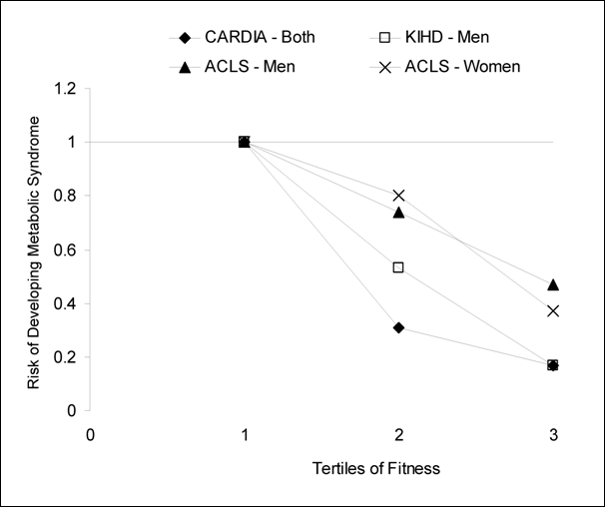
Dose response relationship
All available prospective studies that measured fitness and categorized participants based on fitness level similarly show a strong inverse dose-response between fitness and risk of developing metabolic syndrome
http://www.health.gov/paguidelines/report/g3_metabolic.aspx

Slide 48
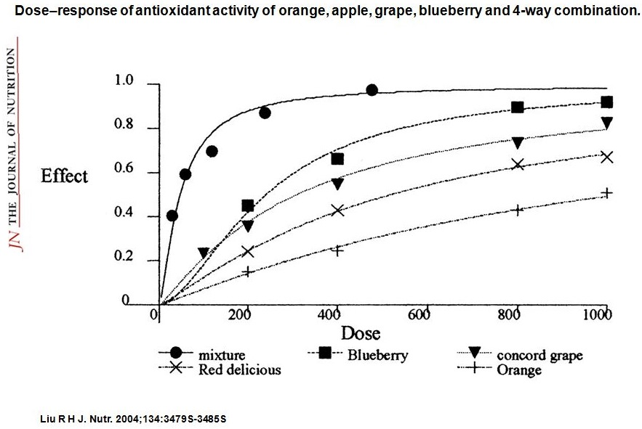
Dose response
A dose response relationship makes it much less likely that a factor to which the risk factor and the disease are related is an explanation of the underlying risk factor-disease relationship.

Slide 49
Studies over time
Cross-sectional studies-conducted during only one point in time.
Longitudinal studies follow participants over an extend time period.

Slide 50
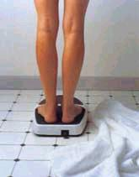
Reliability
Does the test measure consistently?
text: The degree to which test scores are free from errors of measurement
Reliability is necessary but not sufficient
Notes:
20

Slide 51
Measurement Error
Measurement error is always present
Anything affecting the test score that does not relate to the issue of interest.
  response tendency
  social desirability
text: Variation in scores not due to changes in the targeted characteristic.
Notes:
21
With simple scales:
clothes and shoes
water retention
how long since you’ve eaten
barometric pressure
where you stand on the scales
rounding
With classroom exam:
prior knowledge (for teacher effectiveness)
clues such as word definition.
health that day
cheating
distractions, heat, sound, interruptions
motivation

Slide 52

Validity
Does the test measure what it is supposed to measure?
Notes:
22

Slide 53
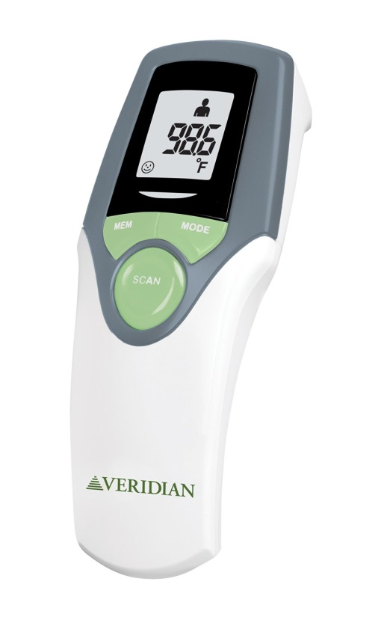
Veridian Healthcare 09-348 Infrared Thermometer
No matter how you use it, the thermometer will give a different reading every time. Typically is between 1 and 3 degrees different (97-100).
Reliability

Slide 54
Veridian Healthcare 09-348 Infrared Thermometer
We use our other thermometers to test against it and have find that this thermometer was not correct even once out of 10 times. We read the instructions, use it on the temple, find the right mode, etc, but it won't work no matter how you use it.
validity
Notes:
A limitation of the forehead thermometers is they won't be accurate if the person is sweating since sweat cools the forehead skin. Wait until the person stops sweating, or use another thermometer, companies say

Slide 55
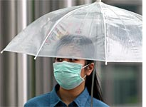
Epidemiology
Branch of medicine that investigates the frequency and distribution of disease and related factors.
Important in SARS epidemic

Slide 56
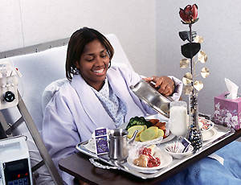
Epidemiology
Prevalence-the proportion of the population that has a particular disease at a specific time.
Incidence-measures the frequency of new cases of the disease.

Slide 57
Epidemiology
Determine the etiology or origins of a specific disease. To develop and test hypotheses.
Discovering who is more likely to have a disease is useful in determining its cause. SARS as an example
Discovering risk factors such as dirty water or smoking.

Slide 58
Epidemiology
Mortality- Death rate
Morbidity-The rate of incidence of a disease.

Slide 59

Epidemiology
A risk factor is any characteristic or condition that occurs with greater frequency in people with a disease than it does in people free from the disease.

Slide 60
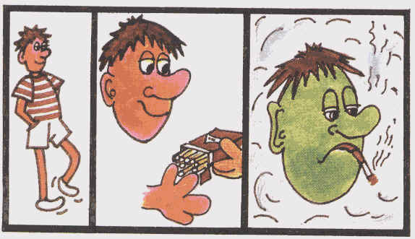
Epidemiology
Presence of a risk factor increases the likelihood of developing the illness.
Suggests primary prevention

Slide 61
Epidemiology
Relative versus absolute risk.
Relative: Considered in comparison with something else
Relative risk the ratio of incidence or prevalence in the exposed group to that of the unexposed group
Absolute risk-The persons chances of developing a disease.

Slide 62
Test A
If around 1,000 people have this test every 2 years, 1 person will be saved from dying from this cancer every 10 years.
Test B
If you have this test every 2 years, it will reduce your chance of dying from this cancer from around 3 in 1, 000 to 2 in 1,000 over the next 10 years.
Test C
If you have this test every 2 years , it will reduce your chance of dying from this cancer by around one third over the next 10 years.

Slide 63
Relative Risk
If you have this test every 2 years , it will reduce your chance of dying from this cancer by around one third over the next 10 years.

Slide 64
Absolute risk
If you have this test every 2 years, it will reduce your chance of dying from this cancer from around 3 in 1, 000 to 2 in 1,000 over the next 10 years.

Slide 65
Number needed to treat
If around 1,000 people have this test every 2 years, 1 person will be saved from dying from this cancer every 10 years.
Clinical vs. Statistical significance
Notes:
http://www.nytimes.com/2010/03/31/business/31statins.html?ref=health

Slide 66
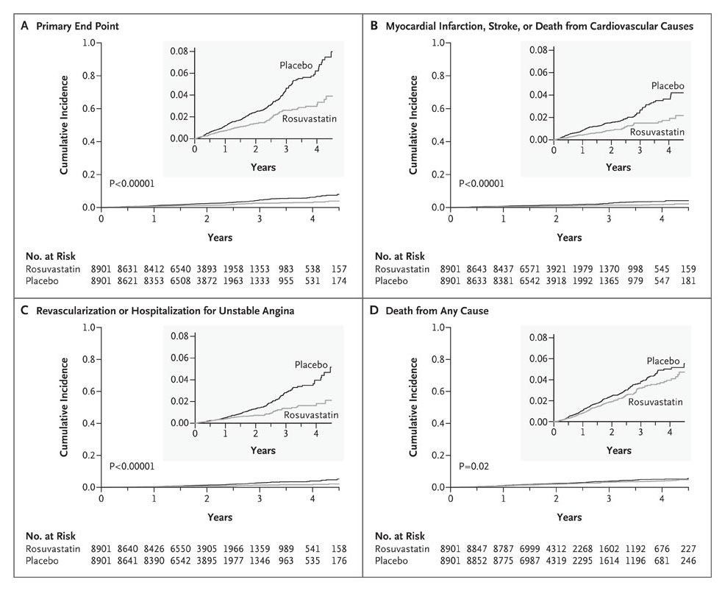
Absolute Risk vs. Relative Risk
Example New York Times Nov. 08

Slide 67
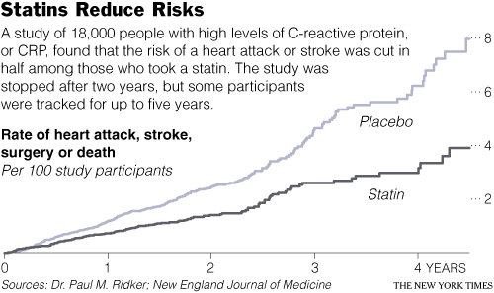
Relative Risk 4/8=50%
Absolute risk 8% reduced to 4%
A decrease of 4 % points or 4 people per hundred

Slide 68
Reaction Paper,
Upon reading the article I was a bit nervous as for what to expect
I cannot seem to make up my mind as to whether CNN’s labeling walking as a “miraculous drug” has a more positive or negative connotation.
I absolutely loved this article for so many reasons

Slide 69
Quality of care data
NYT 9/3/04
More than 98 percent of hospitals in the United States are reporting quality-of-care data for treating heart attack, heart failure and pneumonia, the Centers for Medicare and Medicaid Services said yesterday.

Slide 70

Clinton heart bypass
During Heart bypass surgery blood vessels are taken from elsewhere in the body, often the leg, and sewn in to create detours around coronary artery blockages
516,000 were performed in 2001

Slide 71
Quality of care data
Clinton hospital 3.93 deaths per hundred versus 2.18 for coronary bypass overall in NY.
Correlational data but they control for 45 risk factors.

Slide 72

The End

