Slide 1
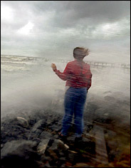
Understanding Pain
William P. Wattles, Ph.D.
Francis Marion University
Psy 314 Behavioral Medicine

Slide 2


Slide 3

Primary Prevention Advantages
Saves money
Saves suffering and lost time from life
More effective than repairing the damage
Little potential for harm
Maintains quality of life

Slide 4
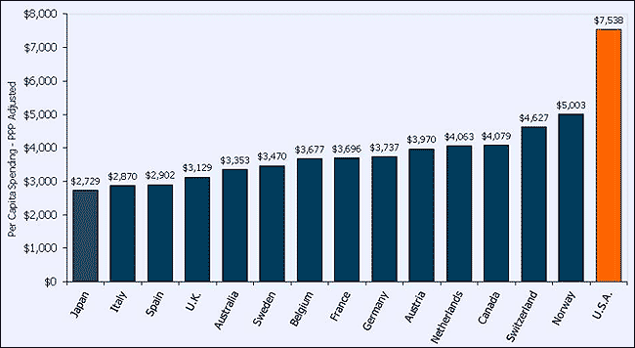
Health Care Spending
Exhibit 1
Total Health Expenditure per Capita, U.S. and Selected Countries, 2008

Slide 5

Facebook-Delaware/Lehigh Trail

Slide 6
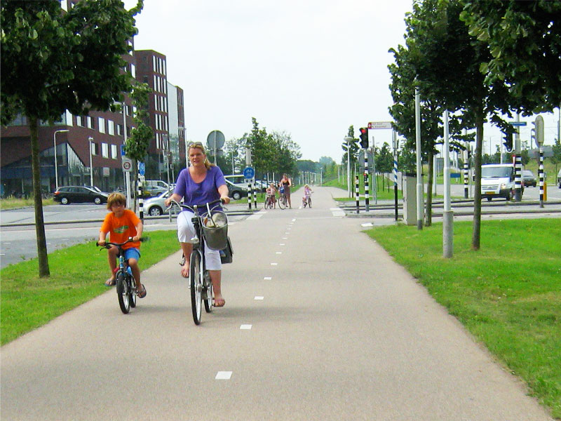
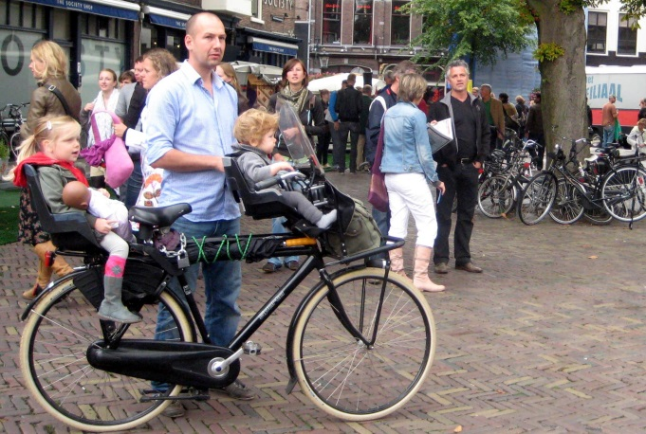
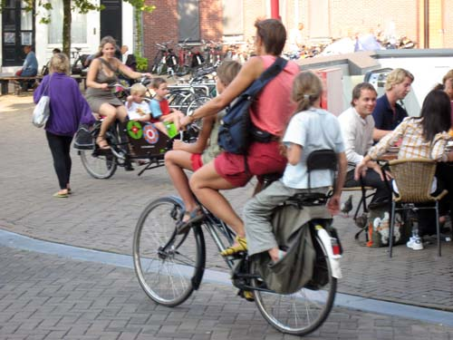
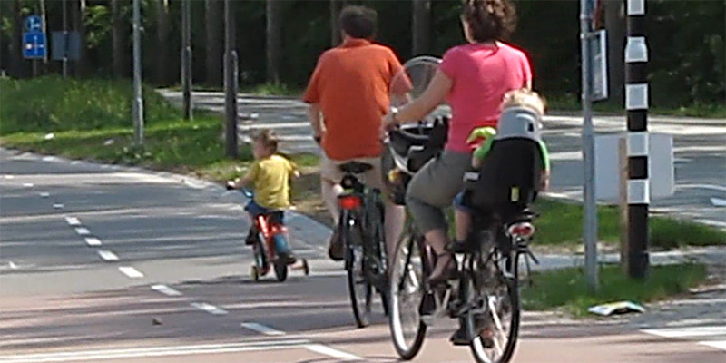
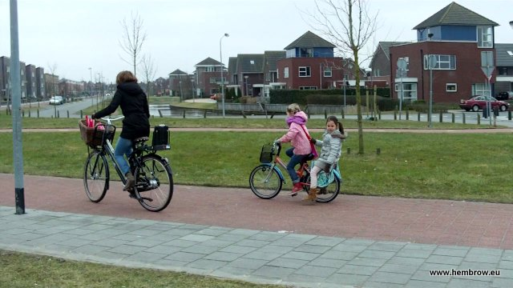

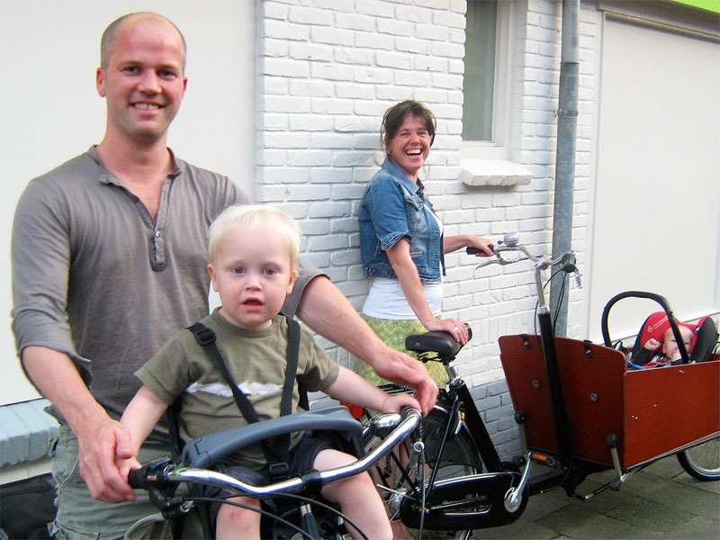


Slide 7
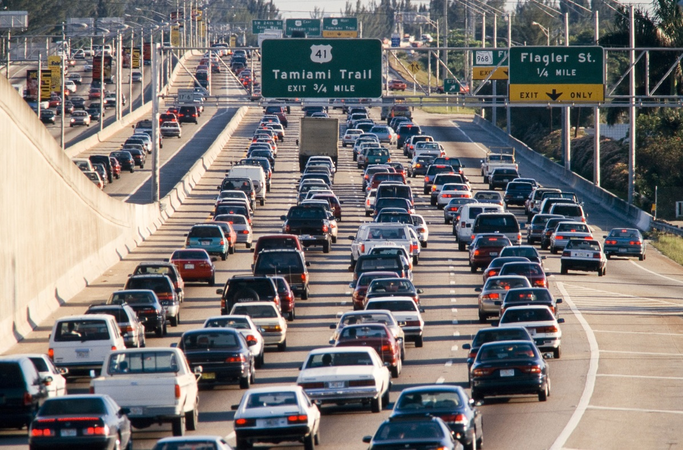



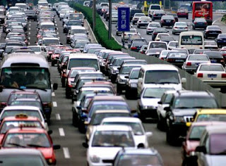
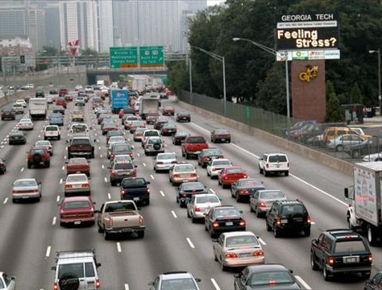
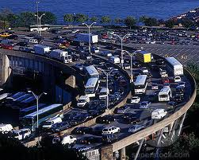


Slide 8
What is pain?
Simply put, pain is usually nature’s unpleasant way of telling you that a part of your body needs your immediate attention, or that you’re using parts of your body beyond their limits.

Slide 9
What Is Pain?
Clinical Pain
  Pain that requires some form of medical treatment
Most people experience an average of
3 to 4 different kinds of pain each year
Pain is the most common reason people seek medical treatment
Annual costs may reach $100 billion

Slide 10
Is pain good or bad?

Slide 11
Acute versus chronic pain
Acute pain is ordinarily beneficial: it warns that something is wrong.
Chronic pain never has a biological benefit.

Slide 12
40 Million Americans suffer from chronic pain such as:
Lower back problems
Arthritis
Cancer
Repetitive stress injuries
Migraine headaches

Slide 13
What percent of Americans suffer chronic pain?
5%
13%
30%
50%
80%

Slide 14
What percent of Americans suffer chronic pain?
5%
13%
30%
50%
80%

Slide 15
What is the current population of America?
58 million
118 million
158 million
318 million
1 billion

Slide 16
Subdivisions of the vertebrate nervous system
Central Nervous System
  Brain
  Spinal Cord
Peripheral Nervous System
  All neurons outside the brain and spinal cord are part of the peripheral nervous system
Notes:
4

Slide 17
Peripheral Nervous System
Somatic nervous System
  Sensory Neurons (afferent)
  Motor Neurons (efferent)
Autonomic Nervous System
    Sympathetic division
    Parasympathetic division
Notes:
4

Slide 18
The Meaning of Pain
Pain sometimes thought to be a direct consequence of physical injury.

Slide 19
Specificity Theory of Pain
Specific pain fibers and pathways exist
Pain = tissue damage

Slide 20
Nociception
is the sensation of pain in normal people

Slide 21
The perception of pain
Not a direct relationship between tissue damage and the perception of pain.
Personal perception mediates the experience of pain.

Slide 22
Suffering
An affective or emotional response triggered by a nociceptive-pain event or some other aversive stimulus.

Slide 23
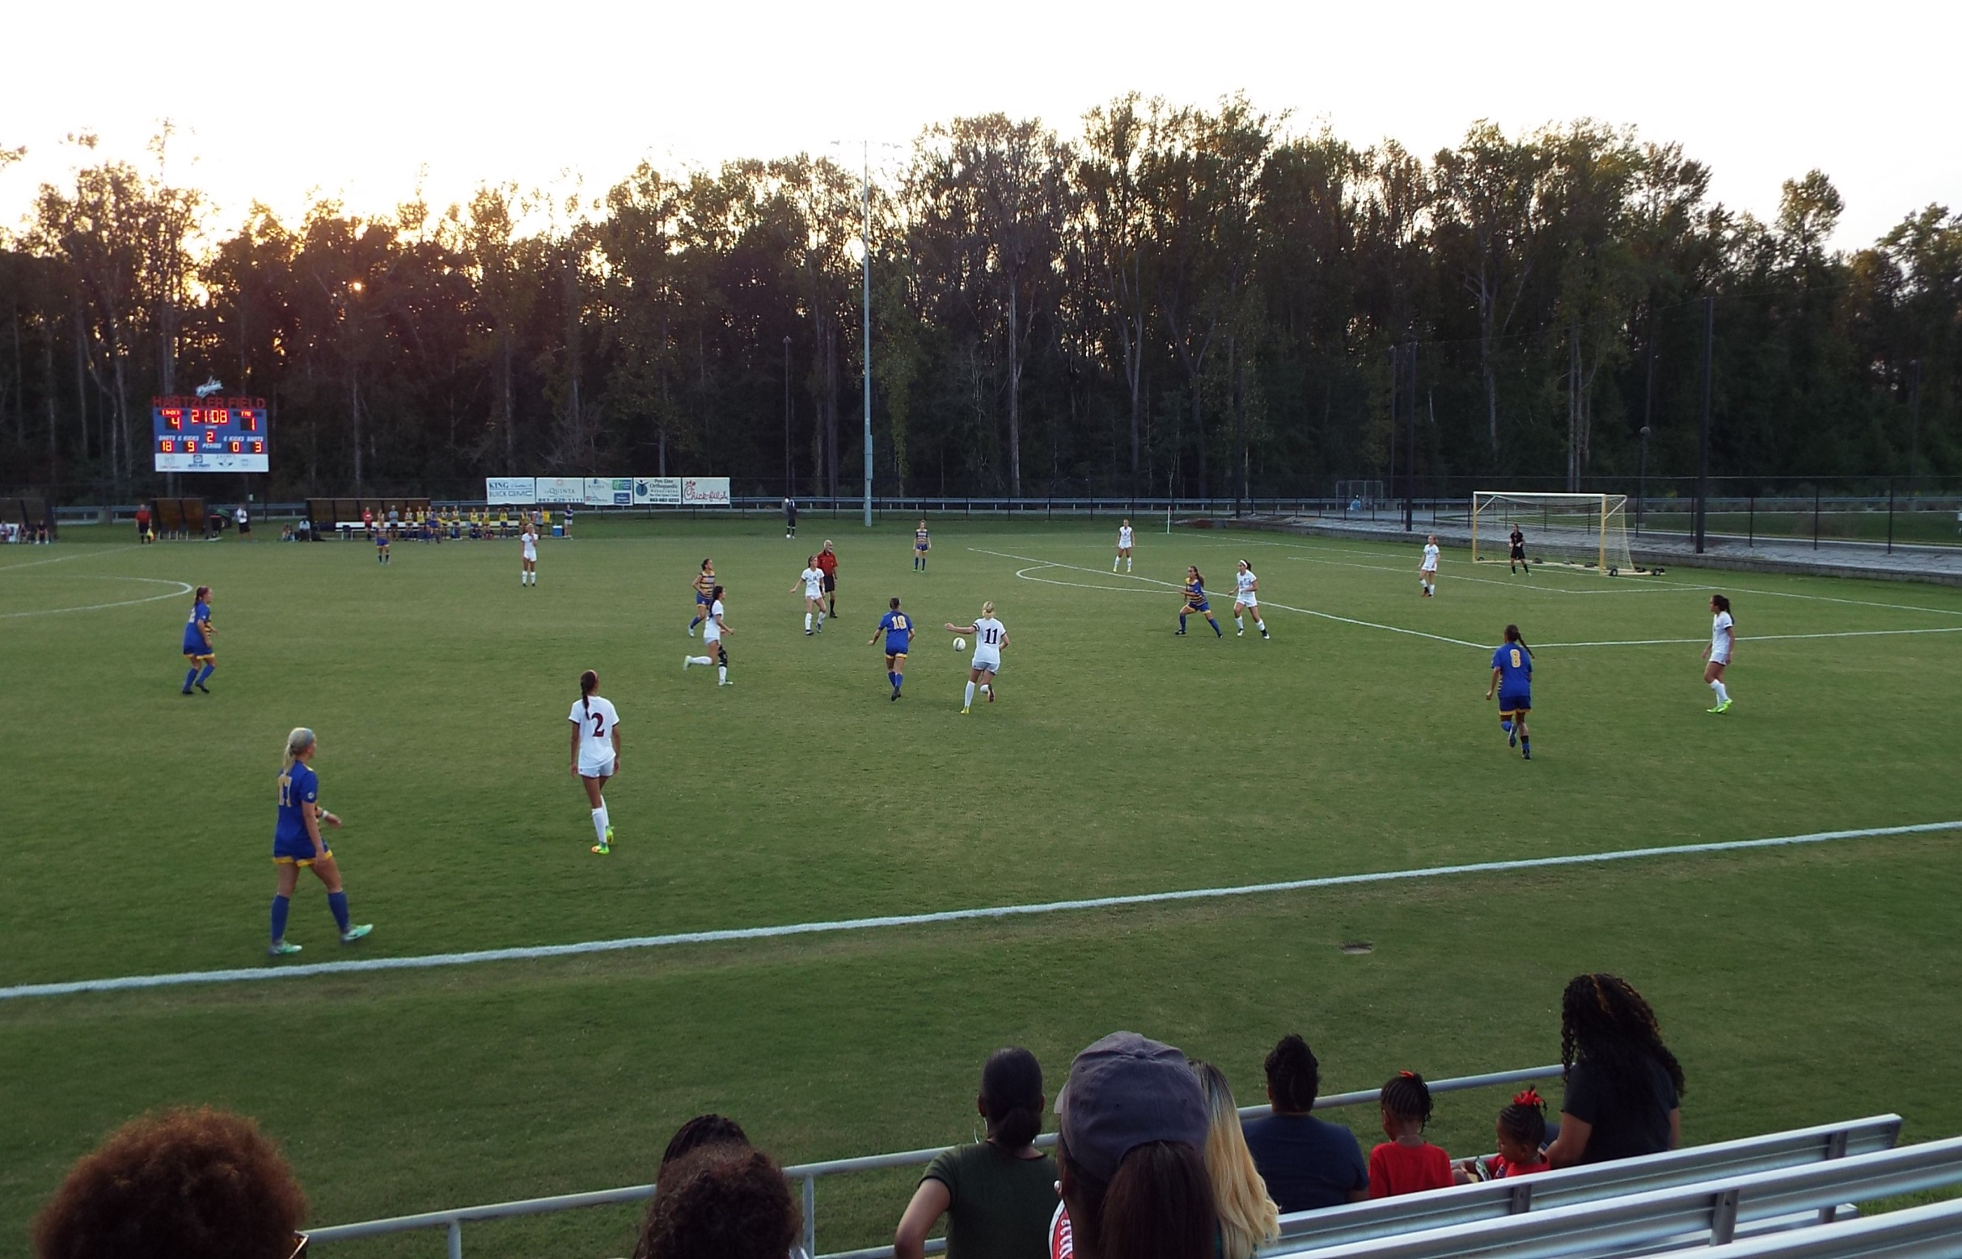

Slide 24

=/=
nociception
=/=
Pain

Slide 25
Gate Control Theory
Injury without pain.
Pain without injury (phantom limb)
Pain components
  sensory
  motivational
  emotional

Slide 26
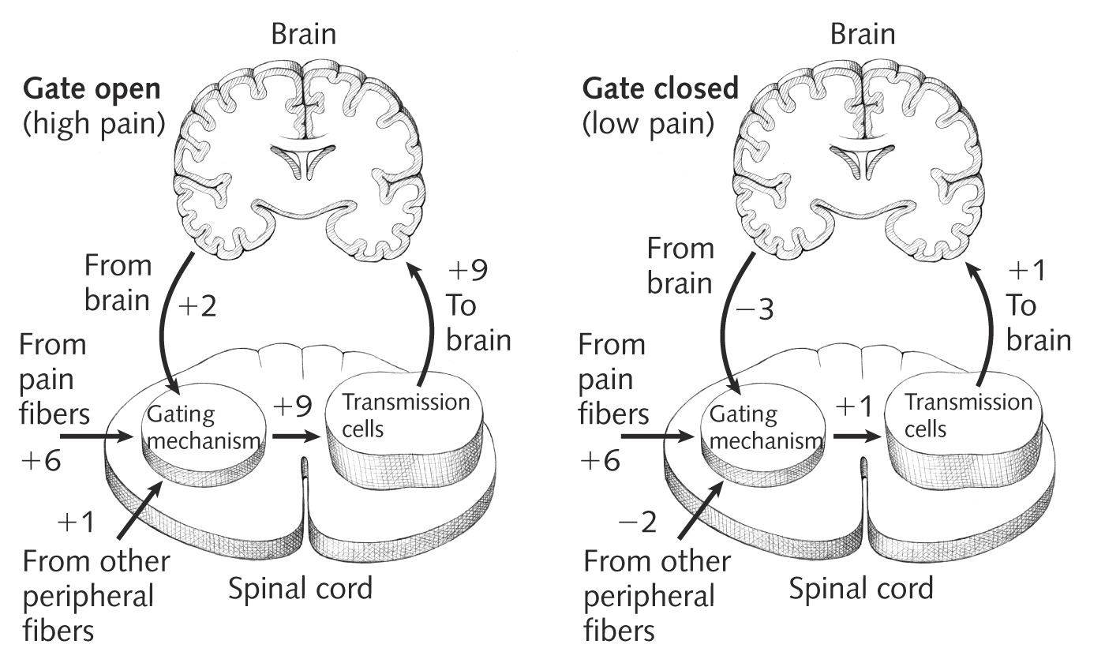
The Gate Control Theory of Pain

Slide 27
Nociception
Nociceptive
Of, causing or reacting to pain.
Definitions of pain in terms of tissue damage relay on known physiology of the body’s pain sensors (free nerve endings called nociceptors) and neural transmission of pain signals to the CNS, a process called nociception.

Slide 28
Pain chemistry
Prostaglandins, chemicals released by damaged tissue and involved in inflammation.
Pain is produced by neurons that must be energized via neurotransmitters.

Slide 29
The Physiology of Pain
Unlike other senses, pain is not triggered by only one type of stimulus, nor does it have a single type of receptor
Free Nerve Endings — sensory receptors found throughout the body that respond to temperature, pressure, and painful stimuli
Nociceptor — a specialized neuron that responds to painful stimuli

Slide 30
The Physiology of Pain
Fast Nerve Fibers
  Large, myelinated nerve fibers that transmit sharp, stinging pain
Slow Nerve Fibers
  Small, unmyelinated nerve fibers that carry dull, aching pain

Slide 31
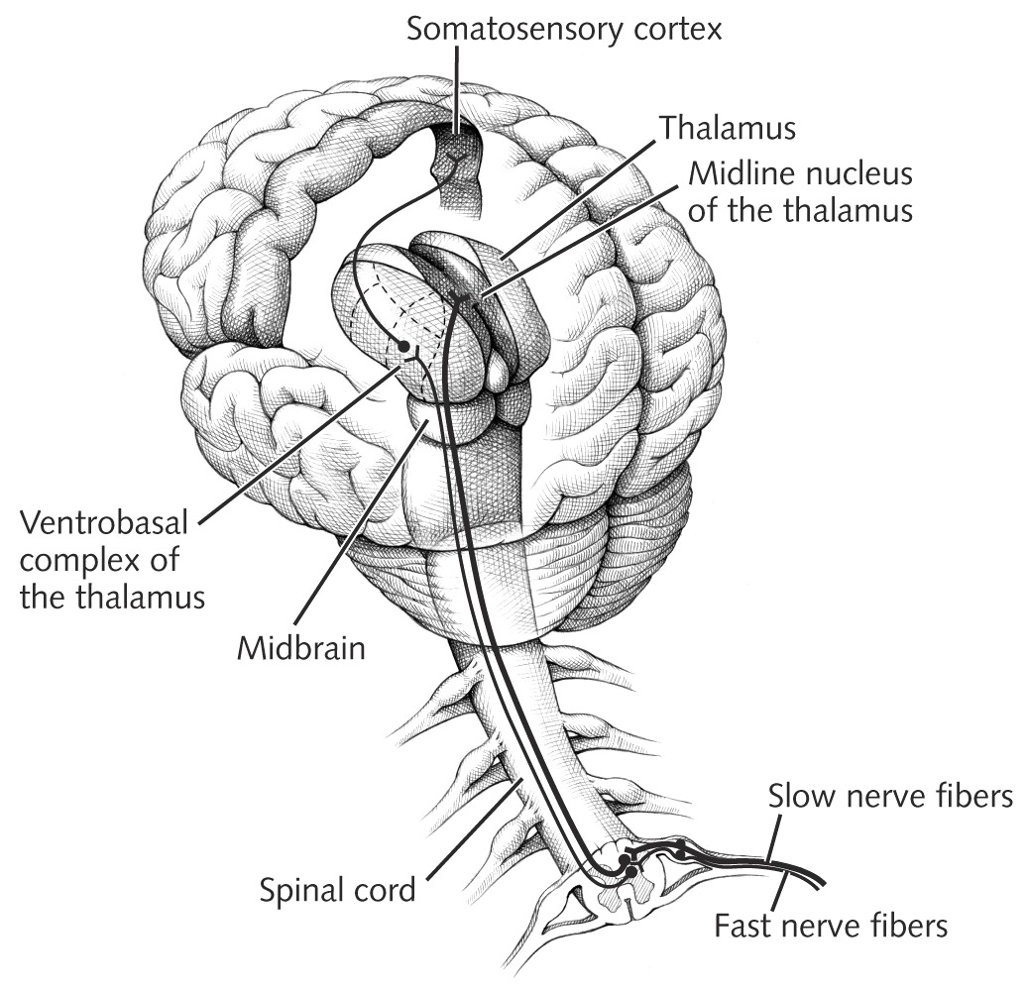
Pain Pathways

Slide 32
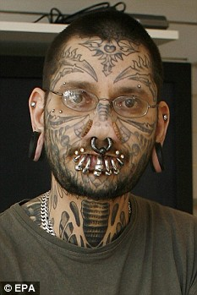
Measuring Pain
There are no objective measures of pain.

Slide 33
Measuring Pain
Psychophysiological Measures
  Psyche (mind) – physike (body)
  Electromyography (EMG) — assess the amount of muscle tension experienced
  by pain sufferers
  Indicators of autonomic arousal — using measures of heart rate, breathing rate, blood pressure, etc

Slide 34
Measuring Pain
Behavioral Measures
  Pain Behavior Scale
    Target behaviors include vocal complaints, facial grimaces, awkward postures, mobility

Slide 35
Measuring Pain
Self-Report Measures
  Structured interviews (When did the pain start? How has it progressed?)
  Pain rating scales (numerical ratings or a pain diary)
  Standardized pain inventories
    McGill Pain Questionnaire (MPQ): sensory quality, affective quality, evaluative quality of pain
    Pain Anxiety Symptoms Scale (PASS)

Slide 36
Stages of pain
Acute pain. adaptive lasts less than six months.
Prechronic pain. critical period to overcome pain.
Chronic pain endures beyond the time of healing.

Slide 37
Chronic Pain
Chronic recurrent pain- episodic
Chronic intractable benign pain-always present but not always severe.
Chronic progressive pain. Omnipresent
Chronic pain frequently associated with psychopathology.

Slide 38
Headache
29 Million Americans suffer from sever, disabling headache
18% of women and 7% of men report at least one migraine a year.
Notes:
11

Slide 39
Muscle tension headache
Causes
  stress
  posture and muscle habits
  lack of flexibility
  lack of strength
Notes:
13

Slide 40
Treating muscle-tension headache
Diaphragmatic breathing
Progressive muscle relaxation
Temperature and EMG biofeedback
Without some behavioral and cognitive coping skills training this procedure may be palliative
Notes:
14

Slide 41
Migraine headache
Causes
  Stress
  Muscle tension
  Genetics
  Diet
  Weather changes
Notes:
15

Slide 42
Treating migraine headaches
Caused by excessive vasoconstriction and vasodilatation.
Thus, controlling blood flow via biofeedback training may be able to help.
Notes:
16

Slide 43
Notes:
17

Slide 44
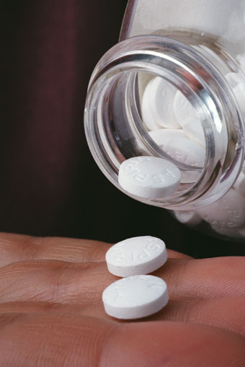
Physical Treatment of pain
Analgesic drugs relieve pain without loss of consciousness.

Slide 45

NSAIDs
Nonsteroidal anti-inflammatory drugs.
Act at the site of the injury rather than in the brain.
Have anti-inflammatory properties
Aspirin,
Ibuprofen (Advil, Motrin)

Slide 46
Tylenol (acetaminophen)
Acetaminophen has negligible anti-inflammatory activity, and is strictly speaking not an NSAID.
The medicine in Tylenol is not an NSAID. It’s a pain reliever that works differently.
  http://www.tylenol.com/

Slide 47
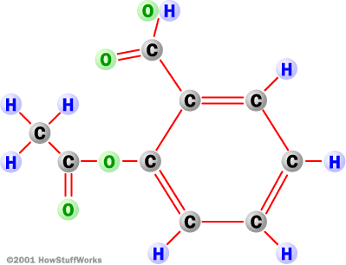
Aspirin
Known since 500 B.C.
Comes from bark of willow tree
1899 Bayer began marketing aspirin
acetylsalicylic acid

Slide 48
NSAID’s
unlike opioids, they do not produce sedation, respiratory depression, or addiction.
They work by inhibiting an enzyme that helps produce prostaglandins.

Slide 49
Aspirin
The most popular uses of aspirin are for:
  prevention of heart disease (37.6 percent),
  arthritis (23.3 percent),
  headache (13.8 percent),
  body ache (12.2 percent) and
  other pain uses (14.1 percent).

Slide 50
Pain treatment
Opiate drugs block pain by occupying the sites where the neurotransmitters would attach.
No other type of drug produces more complete pain relief.
Potential for addiction.
Oxycodone (Oxycontin)
Hydrocodone (Vicodin)
Morphine, Codeine,

Slide 51
Endorphins
Endorphins (endogenous morphine) naturally occurring neurochemical which work like opiates.

Slide 52
Chronic Pain
Pain is subjective
Secondary gains can be considerable
Pain difficult to measure
Many may be malingering
Others may be “faking” unintentionally
Notes:
18

Slide 53
Malingering
Feigning illness or other incapacity in order to avoid duty or work

Slide 54
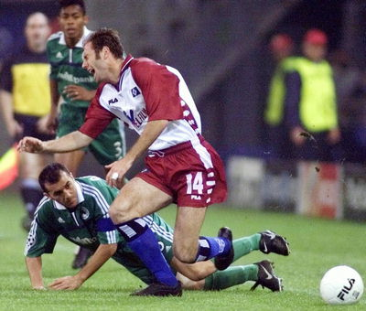
“Faking” unitentionally

Slide 55
Signal Detection Theory
Threshold is that point at which we can detect the signal. Below that we don’t detect it above that we do.
It turns out that motivation plays a roll in what we detect.
Notes:
19

Slide 56
100%
Percent
detect
0%
weak
Strength of Sensation
Strong

Slide 57
100%
Percent
detect
0%
weak
Strength of Sensation
Strong

Slide 58
Signal Detection Theory
Notes:
20

Slide 59
Sociocultural Factors
Culture and Ethnicity
  Groups differ greatly in their response to pain
  Through social learning, groups establish norms for the degree to which suffering should be openly expressed and the form
  that pain behaviors should take
Pain tolerance versus pain threshold

Slide 60
A Pain-Prone Personality?
Acute and chronic pain sufferers show elevated scores on two MMPI scales:
  Hysteria (tendency to exaggerate symptoms and use emotional behavior to solve problems)
  Hypochondriasis (tendency to be overly concerned about health and to overreport body symptoms)
Chronic pain sufferers also score high in depression

Slide 61
A Pain-Prone Personality?
Placebo responsiveness may be a situational trait rather than a dispositional trait
  No consistent personality differences in placebo responders and nonresponders

Slide 62
Types of Pain Patients (Turk & Nash)
Dysfunctional patients
  report high levels of pain, feel they have little control over their lives, and are extremely inactive
Interpersonally distressed patients
  perceive little social support and feel other people
  in their lives don’t take their pain seriously
Adaptive copers
  report lower levels of pain and distress and continue to function at a high level

Slide 63
Operant conditioning
Behavior
  Go to the doctor
Consequence
  Pain of a shot added
Behavior tends to decrease

Slide 64
Generous sick leave
Two and a half years later, she is still on government-paid sick leave, resting at her comfortable home.

Slide 65
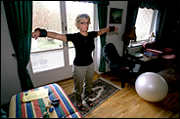
with breaks for stretching drills in her living room, restorative walks through pine woods and the occasional round of golf.

Slide 66
Malingering
62 percent of the employees interviewed said they had taken sick leave when they were not really sick and that they felt there was nothing wrong in doing so.

Slide 67
Doctor’s excuse
physicians routinely approve sick leaves solely at a patient's request.
"It takes 30 seconds to write a doctor's note, It can take an hour to convince someone that he is ready to go back to work, and meanwhile your waiting room is filling up."

Slide 68
Correlation
In 1998, the government's benefit increased from 75 percent to 80 percent of salary, and the average number of days spiked upward each year thereafter, from 11.1 in 1997 to 24.4 in 2001.

Slide 69
Employees get time off when they want it
Employers gain a way of moving underperforming workers
The government can claim one of the lowest rates of unemployment

Slide 70
Pill Mill
https://www.youtube.com/watch?v=c0Dw1ZPKFIk
https://www.youtube.com/watch?v=-sGbSN_bIKk

Slide 71
Somatoform Symptom Disorder
One or more somatic symptoms.
Excessive thoughts related to symptoms
Persistent (more than six months)
  Specify if with predominant pain

Slide 72
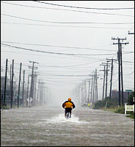
The End

Slide 73
Vioxx
Approved in 1999 for the treatment of acute pain and chronic pain from arthritis and other problems.

Slide 74
VIOXX the Science
“Merck has always believed that prospective, randomized, controlled clinical trials are the best way to evaluate the safety of medicines.”
Prospective
Randomized
Controlled

Slide 75
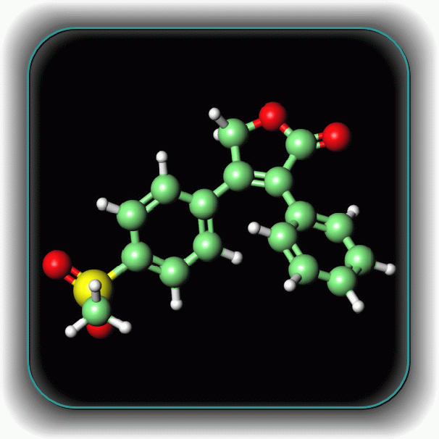
VIOXX the Science
Risk of heart attack, stroke and blood clots after 18 months.
  VIOXX 15 per thousand
  Placebo 7.5 per thousand
  “Although the absolute risk may be rather small, the relative risk is high. “

Slide 76
VIOXX the market
“Marginal efficiency, heightened risk, excessive cost.”
Vioxx provides about the same relief as aspirin though patients are less likely to develop ulcers or gastrointestinal bleeding.
Notes:
Traditional NSAIDs work by nonselectively blocking the cyclooxygenase (COX) pathway, inhibiting prostaglandin production. By not inhibiting COX-1 at therapeutic blood levels, the COX-2--specific inhibitors avoid causing GI damage.

Slide 77
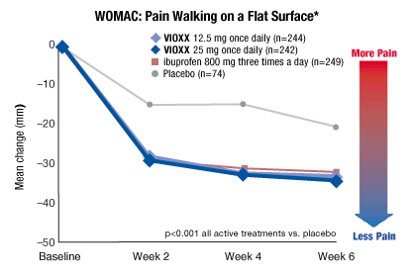
VIOXX

Slide 78
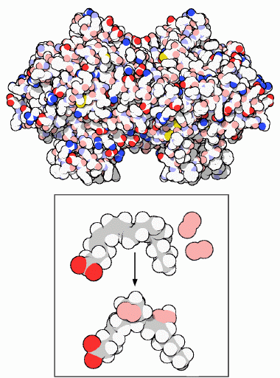
Cox-2 inhibitor
Aspirin blocks the production of prostaglandins, key hormones that are used to carry local messages.
Cyclooxygenase (cox-1, cox-2) performs the first step in the creation of prostaglandins

Slide 79
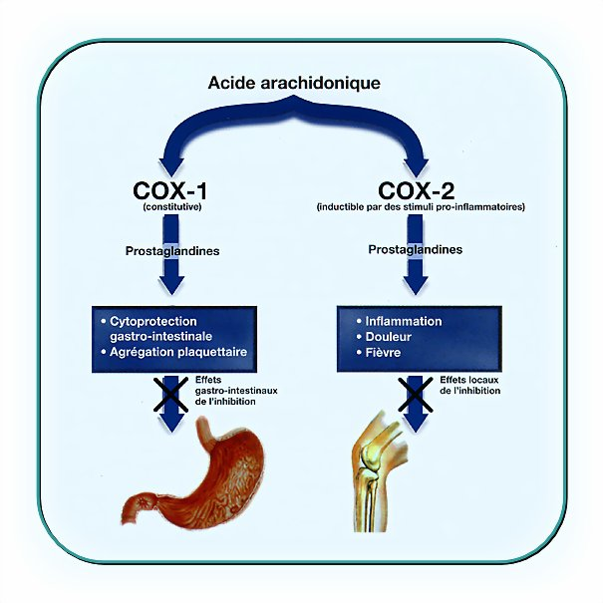
VIOXX
Private enterprise
Capitalism

Slide 80
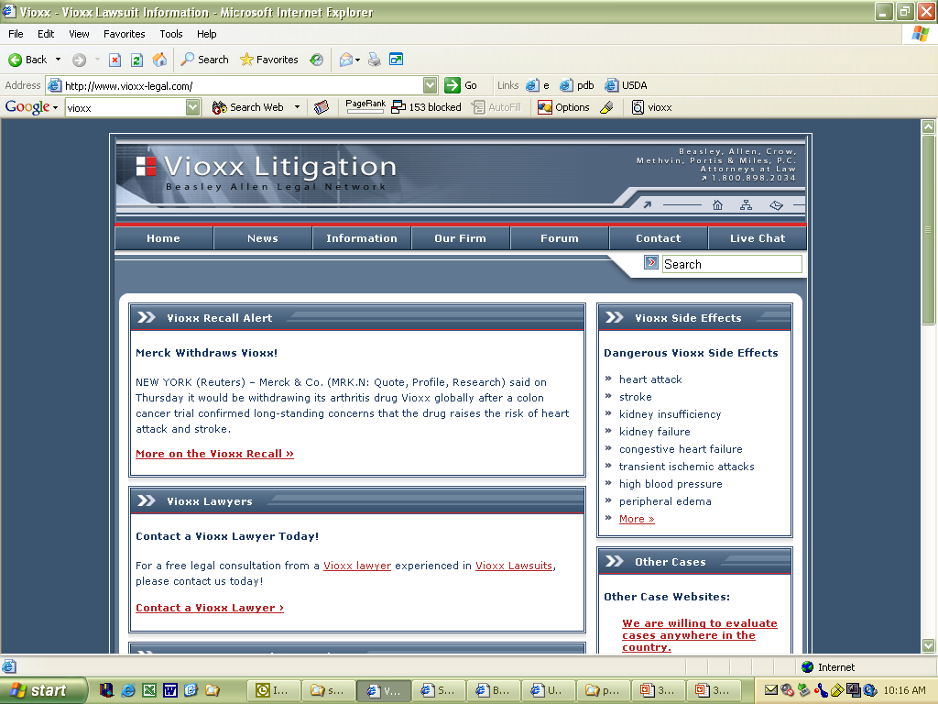
Vioxx

Slide 81
VIOXX advertising
In the first 6 months of this year alone Merck spent $45 million advertising Vioxx.
“Terrifying testimony to the power of marketing.”

