Slide 1
The Four Validities
Will Wattles
Francis Marion University

Slide 2
Evaluating Research
Construct Validity
Statistical Validity
Internal Validity
External Validity
Frequency Claims
Association Claims
Causal Claims
The Dirty Windshield
The Candle

Slide 3
Construct Validity
The quality of measures and manipulations.
Important for all three claims
How well have you measured each of the variables in the study?
convergent validity,
predictive validity,
Types of reliability

Slide 4
Statistical Validity
The degree to which statistical conclusions are appropriate.
Frequency claims:
margin of error of the estimate
Association and Causal Claims
is it significant?
what is the effect size?

Slide 5
Internal Validity
The degree to which there are not alternative explanations.
Frequency claims
generally not claiming cause so internal validity not an issue
Association Claims
Causal claims
temporal precedence?
control for alternative explanations
experiment
random assignment

Slide 6
External Validity
To whom, what or where can we generalize.
Frequency claims
random sample? Representative of the population?
Association Claims
how representative in the sample?
Causal Claims
In theory testing modes not a major issue

Slide 7
Frequency Claims
Hypertension affects almost 50 million people in the U.S.

Slide 8
Association Claims
Religious people are happier than non-religious.

Slide 9
Causal Claims
Clinical trial shows that reducing sodium lowers blood pressure.

Slide 10
The Dirty Windshield
Unsystematic variability
aka noise
What does it mean to find a difference despite a lot of unsystematic variability in our data?

Slide 11
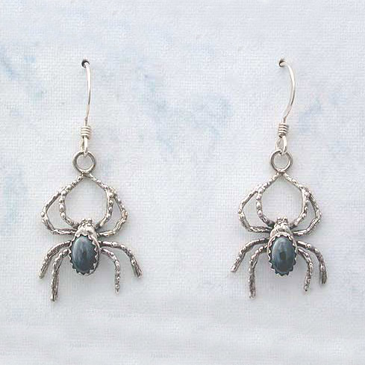
The Candle vs. the Flashlight
Do well always need a large sample?

