Slide 1
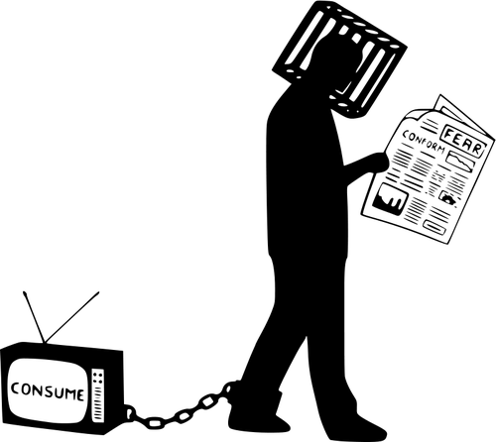
Social Media Race War
Christina Abram​
Racial Discovery​
Dr. Wattles​
PSYC 310​

Slide 2
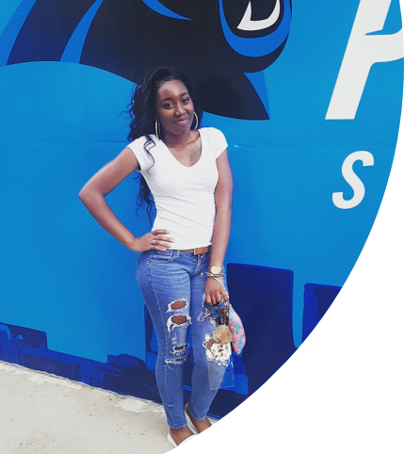
Introduction
My name is Christina Nicole Abram. I attend Francis Marion University, pursuing a Bachelors of Science in Psychology with a minor in Sociology. I am 21 year old, African-American woman raised in a middle class family by two African-American parents.
I am currently enrolled in a class called Racial Discovery that focuses on racial awareness in the United States and everyday life. Not only does this class bring introspection but also self reflection about your role in society.​

Slide 3
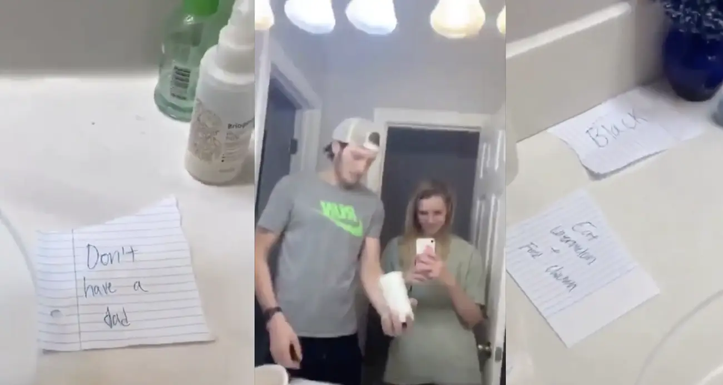
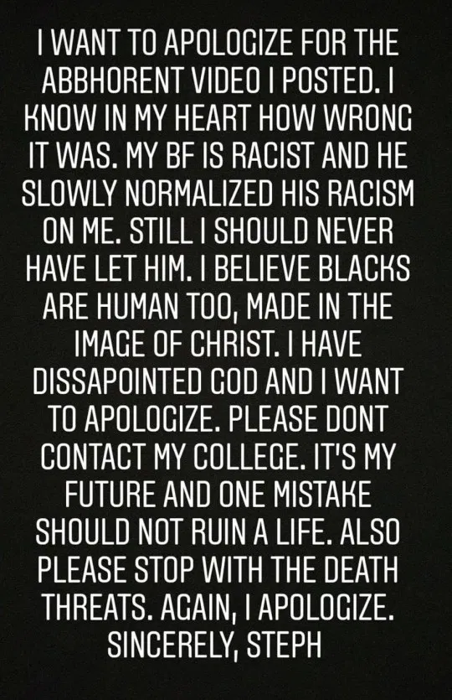
TikTok: 2 Georgia high schoolers expelled after posting racist video
A video posted was first on TikTok and then was shared and went on viral on Twitter. The video shows two teenagers using racial slurs and making derogatory comments about African-American people saying things like such as: “Don’t have a dad” “Eats watermelon” and “Go to jail.”
Included on the right is the young woman's apology for her actions in the viral video. She states “I believe blacks are human too,” and this is not ok and makes it clear that she hasn't learned the how racist her own subconscious is.
Question: Was her apology authentic or was she just afraid of repercussions?

Slide 4
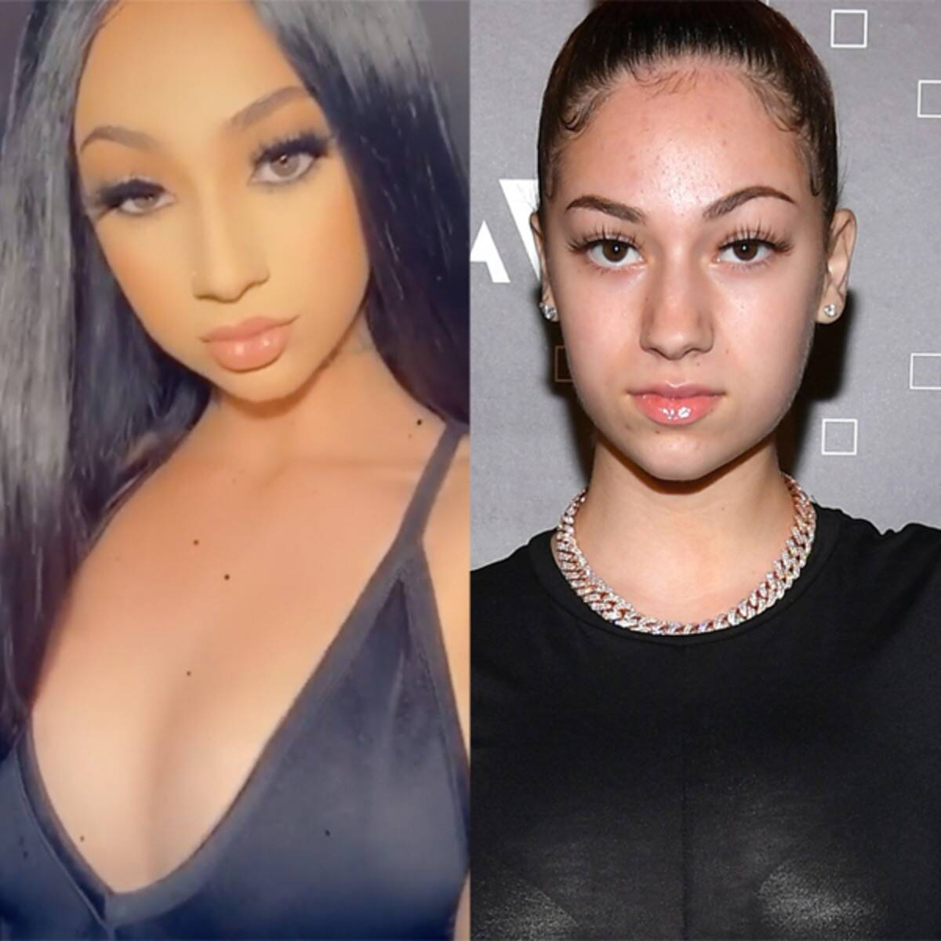
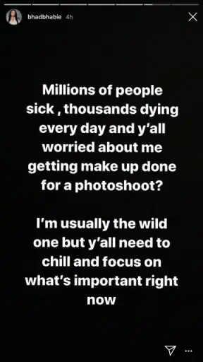
Instagram: Bhad Bhabie blackfishing - “Who wants to be black!?”
Danielle Bregoli’s transformation from a clear White woman to a racially ambiguous light skinned passing black women
She included a statement, seen on the right, to address the issues social media had with her new look. It's obvious that she doesn't understand the racial complexity of her new look.
Question: Is this ok for other cultures to change their complexion artificially to the point where they’re racially ambiguous?

Slide 5
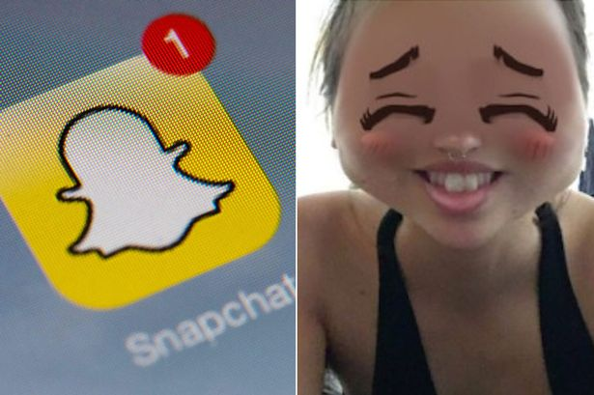
Snapchat: Yellowfishing - Racially Insensitive or Too Sensitive
Snapchat offered a filter users’ look like a traditionally seen “Asian character” , gave them a change in complexion and facial features. A number of users outraged that the filter was in effect ‘digital yellowface’
Question: Is this filter culturally insensitive and racist ?

Slide 6
Make A Change
WE, as a collective, have the power to change the narrative on social media platforms.
So what can we do? :
Vocalizing the change we wanna
Stop supporting these platforms until we see change
Email the app creators
Report these racially insensitive videos, filters, or anything else

