Slide 1
The Importance of Racial Literacy
Finn Millians

Slide 2
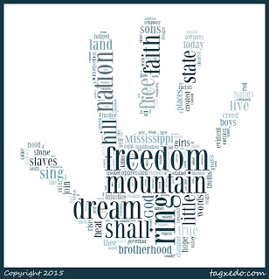
What is Racial Literacy?
The ability to read, reframe, and resolve racial tension (REC, 2020)
The original idea of racial literacy, created by France Twine, was a set of practices by adults to teach children how to recognize, respond to, and counter racism

Slide 3
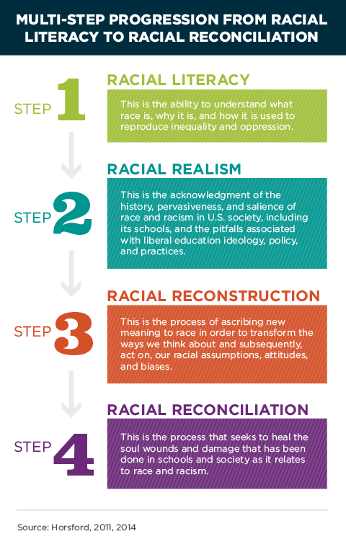

Slide 4
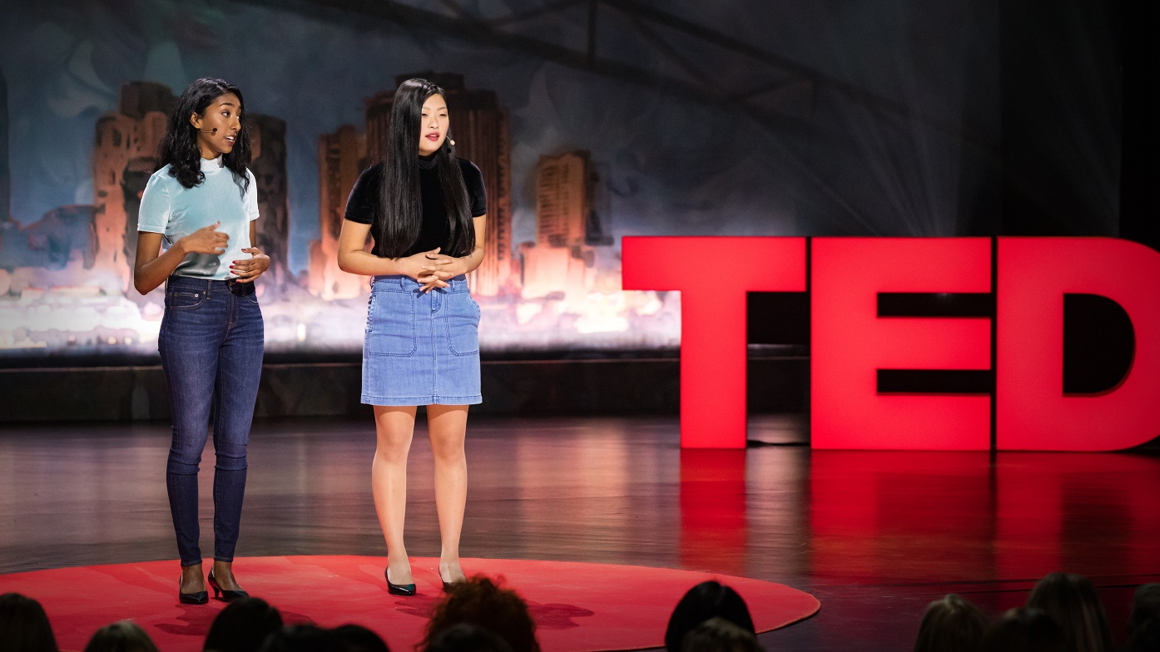
Where is the Disconnect?
TEDWomen 2017 (link in references)
Two recent high school graduates, Priya Vulchi and Winona Guo, took a gap year to travel to all 50 states and talk about race and racial literacy
They pointed out two “gaps” that prevent racial literacy in people
Mind Gap
“an inability to understand the larger, systemic ways in which racism operates” – Vulchi, 2017
Heart Gap
“Inability to understand individual experiences, to fiercely and unapologetically be compassionate beyond lip service”- Guo, 2017

Slide 5
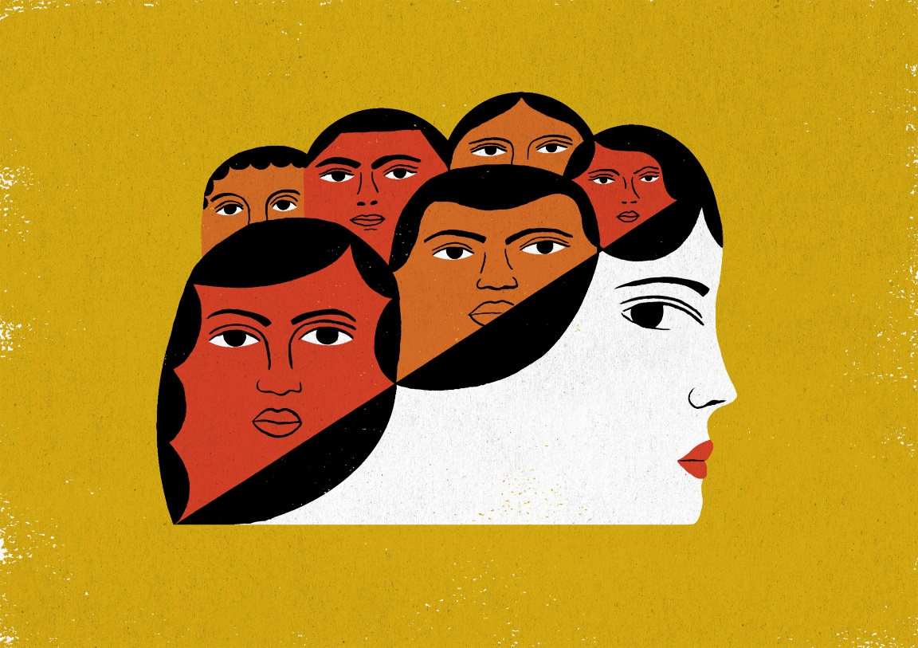
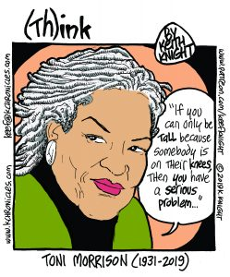
How is the Lack of Racial Literacy Perpetuated?
Misunderstanding prevalence of racial issues
Slavery, civil rights, and countless other events throughout history are taught in the past tense; it seems outdated)
Overt slavery and such might not be present in 2020, but racism is very much alive, and people need to be aware
Color blindness
The overt avoidance/lack of confrontation of race and racial issues
Unproductive
Fear/discomfort
Sometimes the topic of race and racial tension are just uncomfortable, and some may be scared to speak up

Slide 6
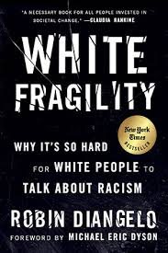
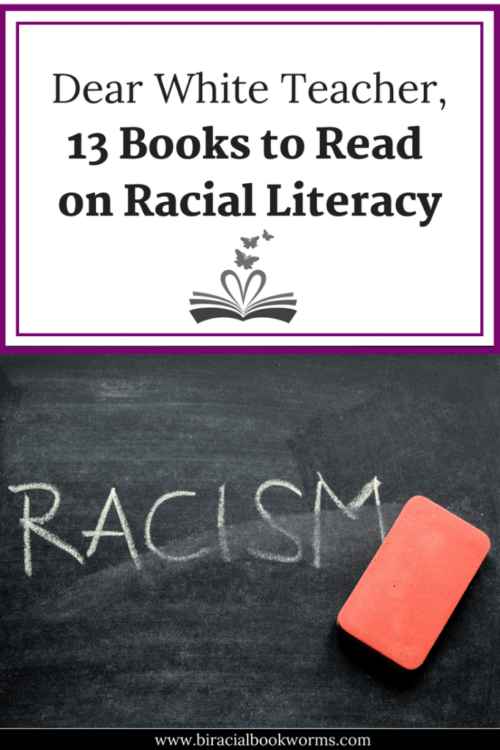
How can Racial Literacy be Cultivated?
Schools
Utilize race wars and the civil rights era—connect past issues with the prevalent present ones
Ex. Civil Rights Act of 1964 with the affirmative action clause can be connected to affirmative action in the present and the racial divide in college admissions
Color boldness
Have the courage to address color when the opportunity arises
Do not use the words “I do not see color”
Practice
Talk to people of different races and cultures
Give yourself the opportunity to understand something different

Slide 7
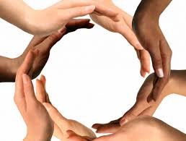
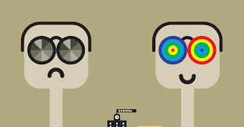
The Big Picture
Racial literacy is a tool that can be used to heal wounds and alleviate rampant hatred and misunderstandings between racial groups and within societies. It is the bridge between prejudice and peace.
It may not be the end of racism, but the ability to read, reframe, and resolve racial issues is a crucial step. The moment we, as human of all different races, develop the ability to truly understand the “why” of racism and racial tension, we will be able to come together and mend wounds that have been festering for centuries.

Slide 8
References
https://cehdvision2020.umn.edu/blog/fostering-racial-literacy-in-high-schools/
https://www.ted.com/talks/priya_vulchi_and_winona_guo_what_it_takes_to_be_racially_literate/up-next?language=en#t-1076
https://www.recastingrace.com/racial-literacy

