Slide 1
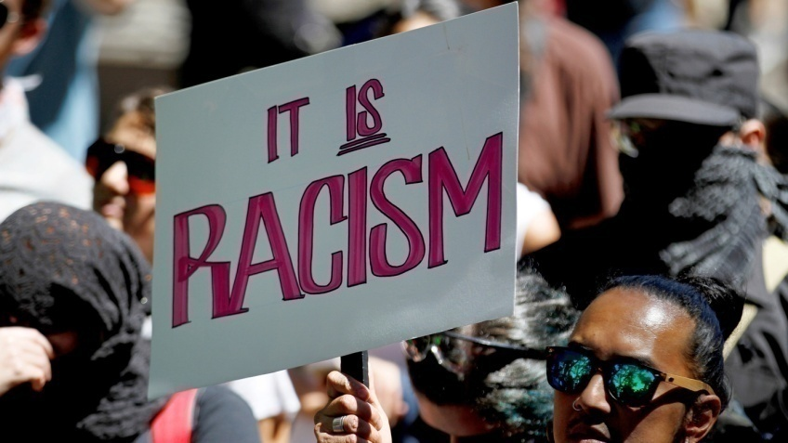
Racism ISN’T Dead
Maya Henderson

Slide 2
Introduction
My name is Maya Henderson. I am majoring in psychology, with a minor in African and African American studies. My goal is to open my own practice and become an advocate for mental health in the black community. Taking this racial discovery class has made me realize that America is more vulnerable than ever and that racism is STILL a big issue.

Slide 3
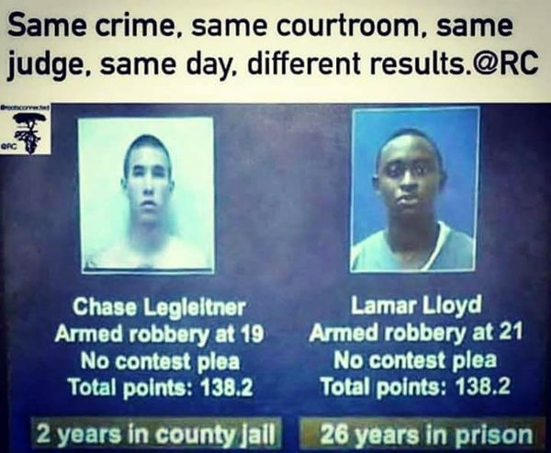
Inequality in the Criminal Justice System
Black people, specifically black men, are given longer and harsher sentences.
Black men receive prison sentences that are on average 20% longer.
The justice system was never designed for the best interest of African Americans.

Slide 4
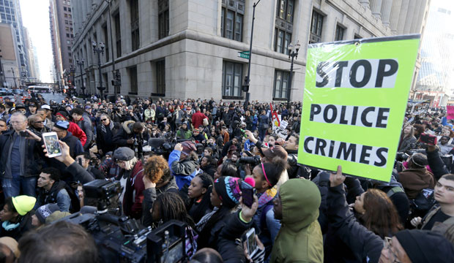
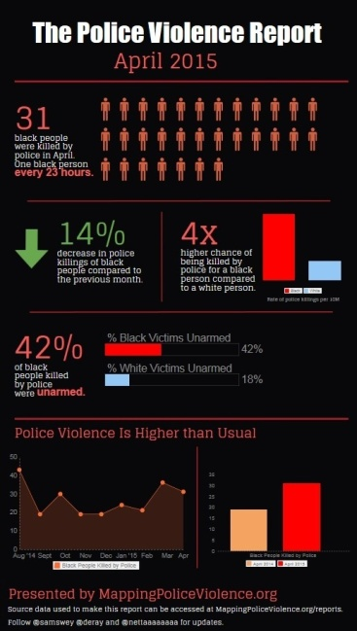
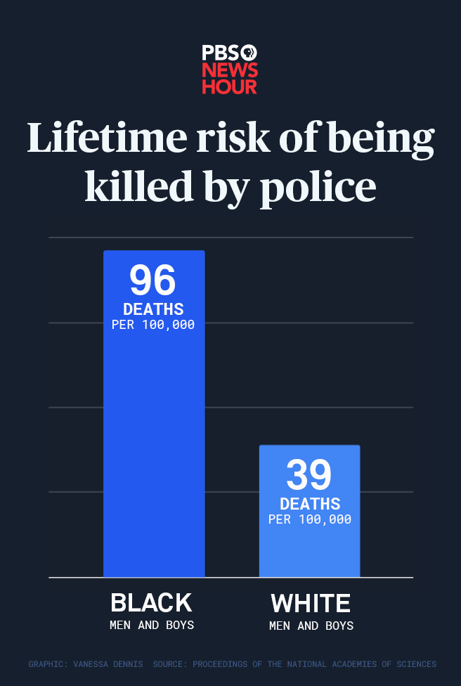
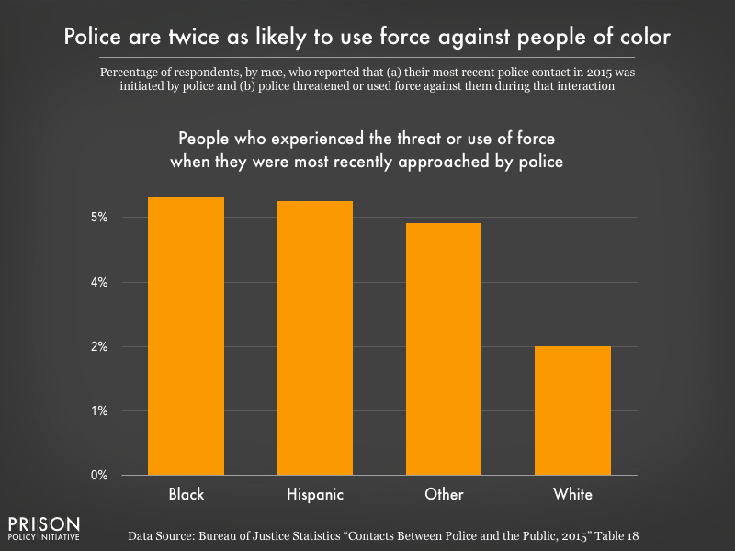
Police Brutality
Police brutality and police killings are the biggest issues within the black community.
A black person is 4X more likely to be killed by the police than a white person.
In 2015 – 42% of black victims were unarmed
Police aren’t being convicted or held responsible for their crimes.

Slide 5
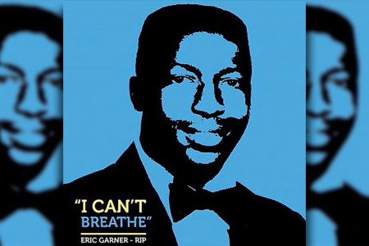
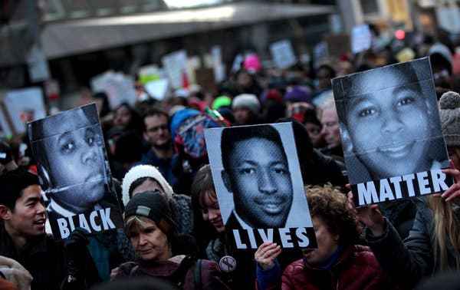
Eric Garner
Eric Garner was involved in a confrontation with police. He was wrestled to the ground and continuously cried out “I can’t breath.” He later died at the hospital.
No charges were brought against the officer(s) involved
This was the start of the fight against police brutality.
“I can’t breath” became one of the signature rally cries.
https://www.theguardian.com/us-news/video/2014/dec/04/i-cant-breathe-eric-garner-chokehold-death-video - video of the incident

Slide 6
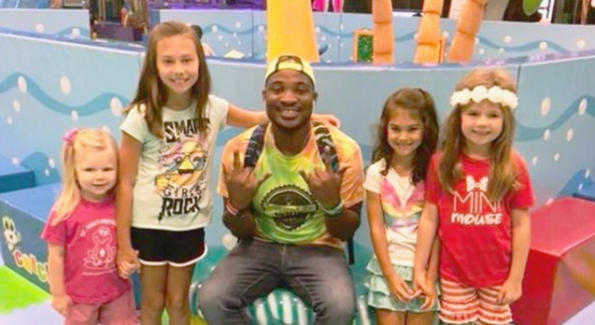
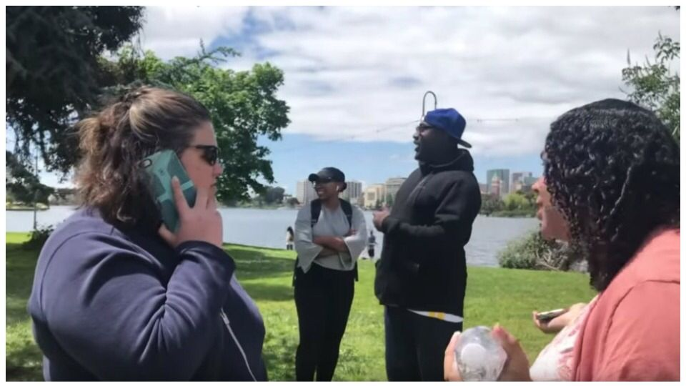
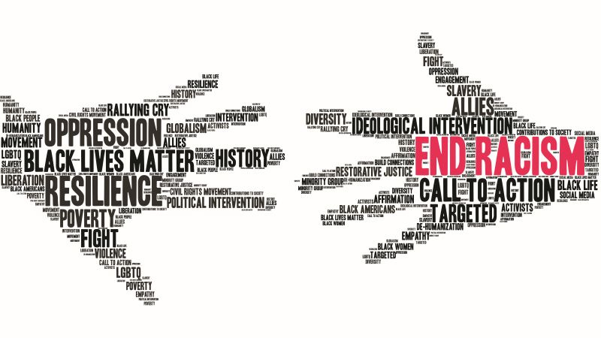
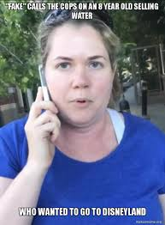
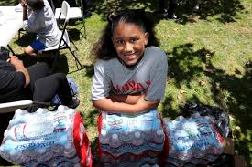
#LivingWhileBlack
Police are often called on black people for living everyday life.
"People seem to believe something is illegal about black people occupying space.“ - Rashad Robinson - president of racial justice organization Color of Change (USA TODAY interview July 2018)
Police called on black babysitter because he was babysitting white children
Police called on black family having a BBQ in a park
Police called on little girl selling water to go to Disney land.

Slide 7
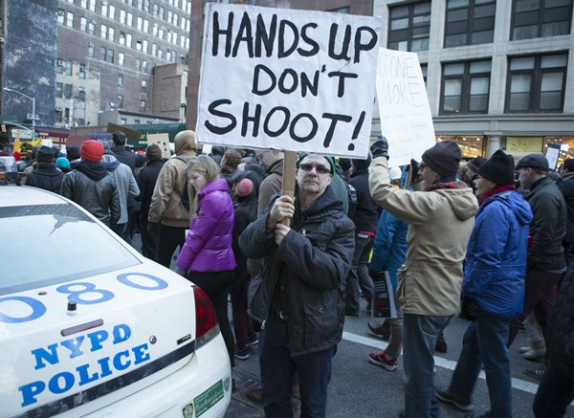
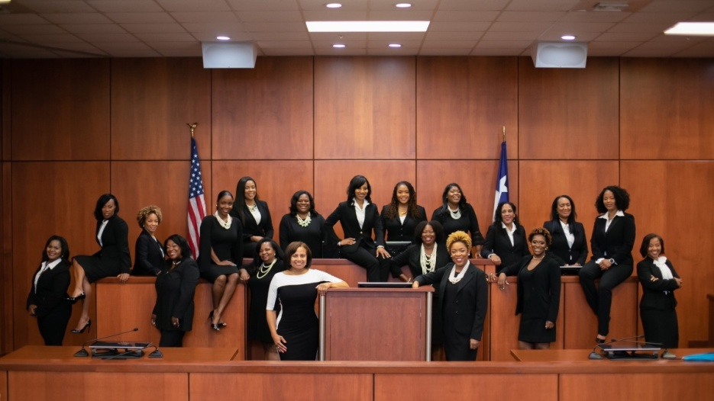
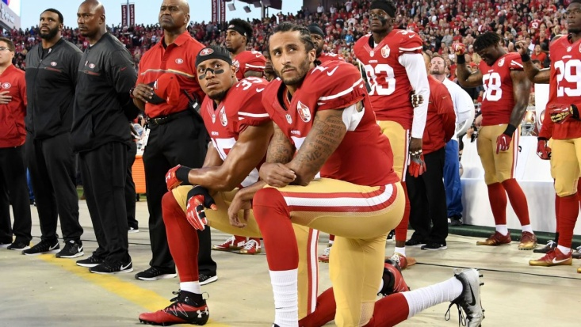
Change
People are finally taking a stand against the oppression of the black community.
The Black Lives Matter movement was created in 2013.
People of all races are participating in protest and marches.
More black men and women are becoming lawyers and judges.
Celebrities such as Colin Kaepernick are using their platform to make a change.
We MUST make a change

