Slide 1
How to add 95% confidence interval error bars to t-test output
William P. Wattles, Ph.D.
Francis Marion University

Slide 2
1. Create t-test output

Slide 3
2. Add a line for standard deviation (=sqrt(variance)

Slide 4
3. Use function to calculate Margin of error =confidence.t(.05,std dev, observations)

Slide 5
4. Calculate upper and lower limits (mean plus margin of error for upper)

Slide 6
5. Highlight labels and means Control C to copy / Insert bar chart

Slide 7
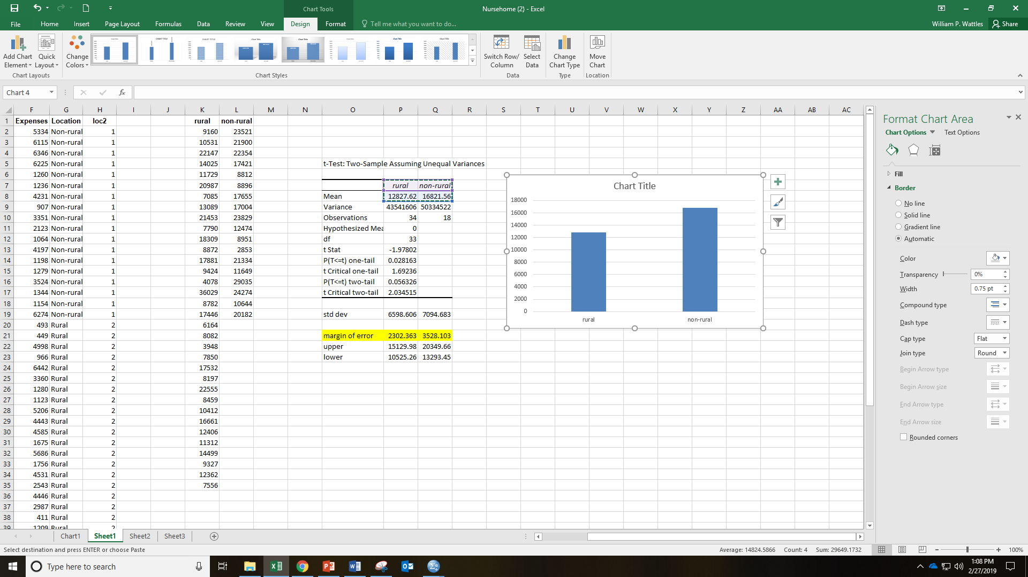
6. Highlight chart (frame with circles) Click design tab

Slide 8
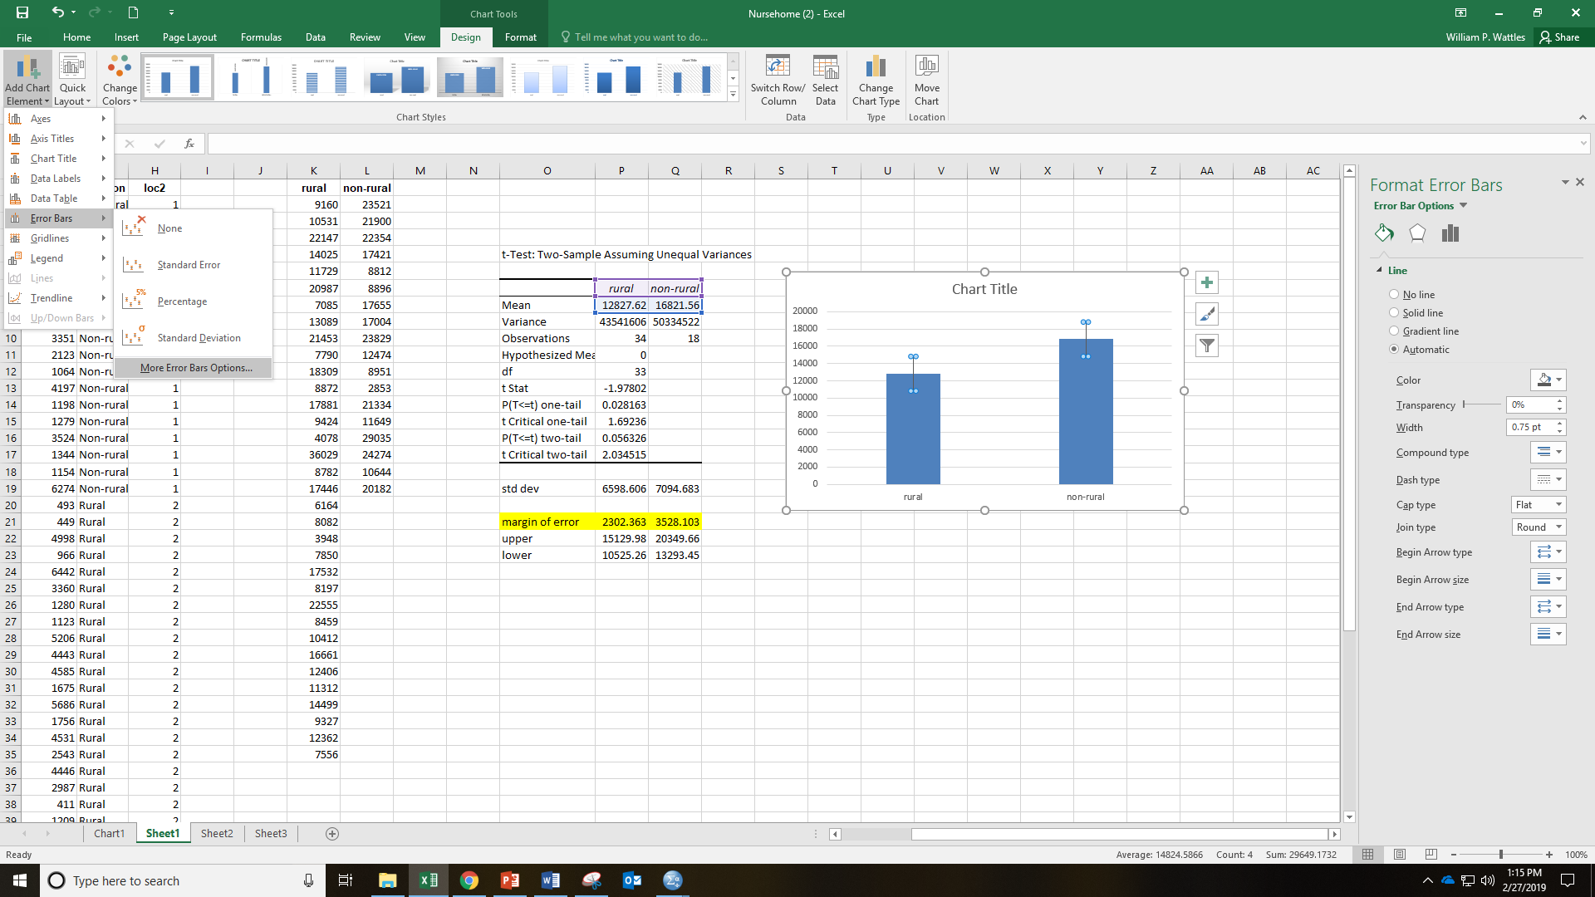
7. Add Chart Elements/Error bars/more error bar options.

Slide 9
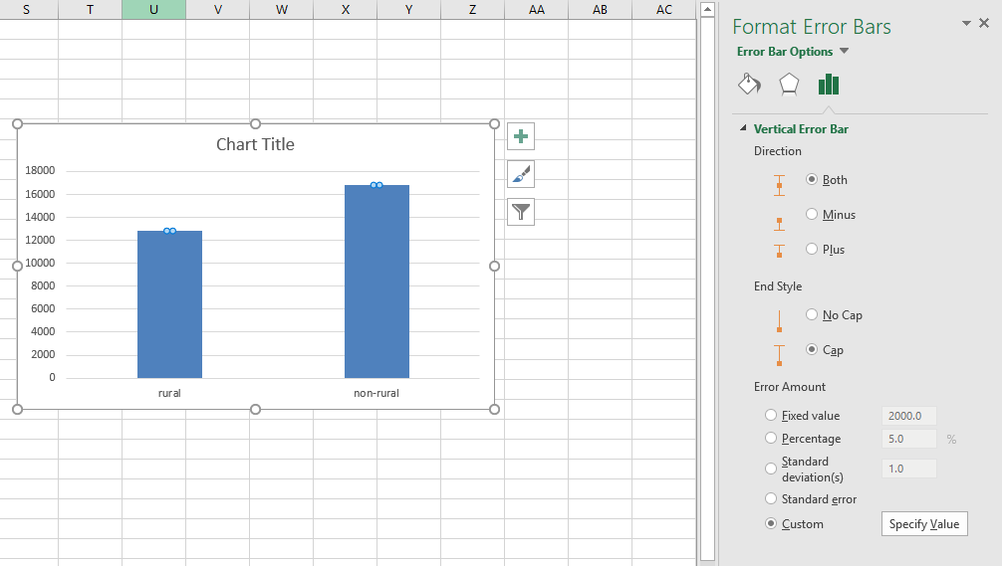
8. Select custom Click on box that says specify values.

Slide 10
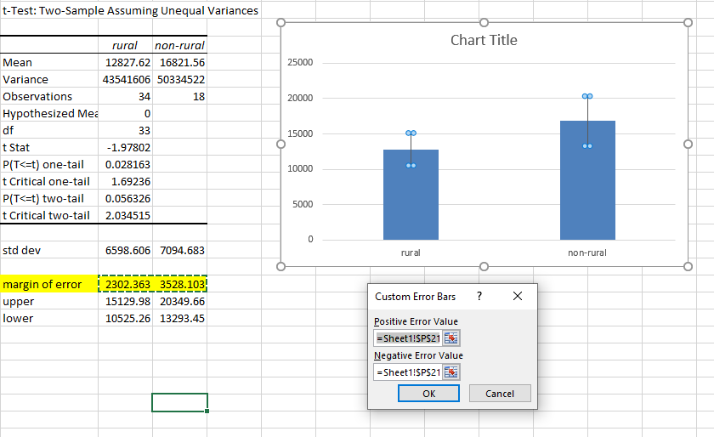
9. Highlight margin of error for both bars.

Slide 11
10. Always label chart and error bars.

