Slide 1
Hypothesis Testing
William P. Wattles, Ph.D.
Psychology 302
Notes:
http://www.slate.com/articles/health_and_science/science/2016/01/amy_cuddy_s_power_pose_research_is_the_latest_example_of_scientific_overreach.html
Clilnical significance

Slide 2
Statistical Inference
Provides methods for drawing conclusions about a population from sample data.
Population (parameter)
Sample (statistic)

Slide 3
The problem
Sampling Error

Slide 4
Dealing with sampling error
Confidence intervals
Hypothesis testing

Slide 5
Hypothesis testing
We use confidence intervals when our goal is to estimate a population parameter.

Slide 6
Hypothesis testing
A more common need is to assess the evidence for some claim about the population.

Slide 7
Tests of significance
Does a change in the independent variable produce a change in the dependent variable. Examples.
Or is the observed difference merely the result of sampling error?
Is the observed difference meaningful (significant).

Slide 8
Hypothesis Testing
Dr. Diligent has found a better treatment for procrastination. She reports that students trained in her method have a higher g.pa. than the average.
FMU

Slide 9
Null, says: “It’s nothing but sampling error.

Slide 10
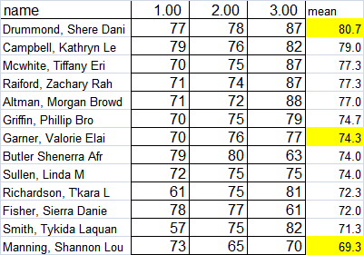

Slide 11
Dr . Diligent offers an alternative hypothesis that the difference probably did not come about by chance.
If she is correct the observed effect would be unlikely to occur by chance.

Slide 12
Dr. Diligent says that the sample comes from a different population with a different mean.
pop mean 72.55
pop std dev 12.62
sample mean 79.53
n=25
FMU

Slide 13
Who is correct?
Ha
Ho
FMU

Slide 14
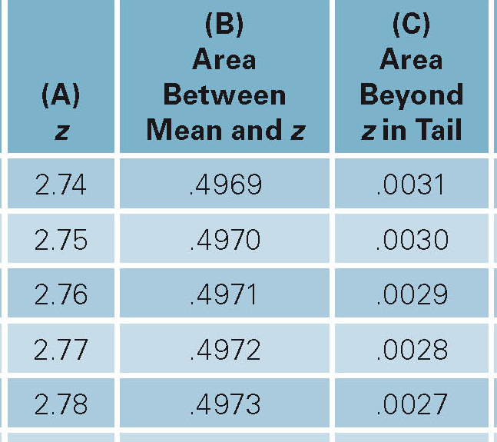
Hypothesis test
μ=72.55, σ =12.62
n=25, M=79.53
std err=std dev/sqrt N
Std err=12/5=2.52
Z=M-μ/ σ_{M}
Z=79.53-72.55/2.52=+2.77
Area beyond +2.77 .0028

Slide 15
μ population mean
σ population std dev
M sample mean
n sample size
σ_{M} Standard error of the mean.
Z _{obt} Z score of the sample mean
Z _{obt =}M-μ/σ_{M}

Slide 17
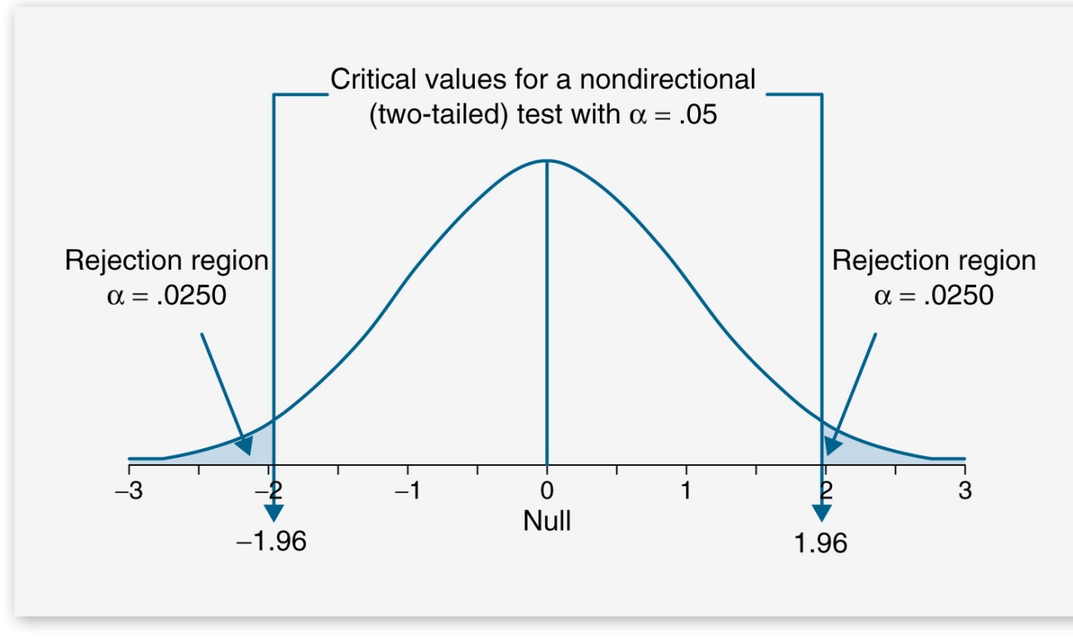
Statistical Significance
2.77 > 1.96
p < .05

Slide 18
Reject the null hypothesis
The results probably did not occur by chance.
There must be something to her procrastination training program.

Slide 19
Null hypothesis
null hypothesis (Ho) states that there is no difference between the population means. Any observed difference is random sampling error.
alternative hypothesis states that the means are different.

Slide 20
Statistical significance
Means we have concluded that the data are too unlikely to have occurred by chance alone. Thus, there is a relationship between the independent and dependent variable.
Means we have rejected the null hypothesis Ho.

Slide 21
Statistical significance
Failure to reject Ho suggests that the difference could have occurred by chance and we conclude that the means are the same.

Slide 22
P-Value
The probability of obtaining a value as extreme or more extreme than the observed statistic.
The probability that the test would produce a result at least as extreme as the observed result if the null hypothesis were true.

Slide 23
Alpha or Significance level
Statistical significance simply means rareness.
Another term for significance level is alpha level.
.05 is generally considered the minimum necessary for significance.

Slide 24
Statistically significant
We can calculate a P-value using the area under the curve. It tells us how likely the obtained statistic would be if the null hypothesis were true.
Level of significance alpha α says how much evidence we require.
Usually .05, .01 or .001

Slide 25
Statistically significant
If the P-value is as small or smaller than alpha, we say that the data are statistically significant at level alpha.

Slide 26
Critical Z
The Z score that cuts off the most extreme 5% of the scores.
One tail versus two tail.
Two tail
  1.96 5%
  2.576 1%
One Tail
  1.645 5%
  2.326 1%

Slide 27
Two-tail test
Divides the critical region into two areas, each cutting off half the alpha level.

Slide 28
One-tail test
A one-tailed significance test has only one critical regions and one critical value. Not frequently used.
Notes:
Cohen gives the following example of a one-tailed test. An assembly line is currently using a particular process (A). We are planning to evaluate an alternate process (B) which would be expensive to implement but could yield substantial savings if it works as expected. The test has three possible outcomes: (1) Process A is better; (2) There is no difference between the two; (3) Process (B) is better. However, for our purposes, outcomes (1) and (2) are functionally equivalent since either would lead us to maintain the status quo. Put another way, we have no need to distinguish between outcomes (1) and (2).

Slide 29
One-tail vs.. two-tail
One tail used if problem specifies a direction. (I.e., is greater than, taller than)
Two tail used when the alternative hypothesis is that the two means are different.
A one-tail test is more powerful

Slide 30
Power
the probability of rejecting a false null hypothesis.

Slide 31

Hypothesis test example
Job satisfaction scores at a factory have a standard deviation of 60.
Example 14.8 page 375
X = self-paced-machine paced

Slide 32
Hypothesis test
μ=0, σ=60, M=17,n=18
Z=M-μ/σ_{M}
  std err=std dev/sqrt N
    Std err=60/sqrt18=14.14
Z=17-0/14.14 = 1.20
P-Value 1.20 = .1151 * 2= .2302

Slide 33
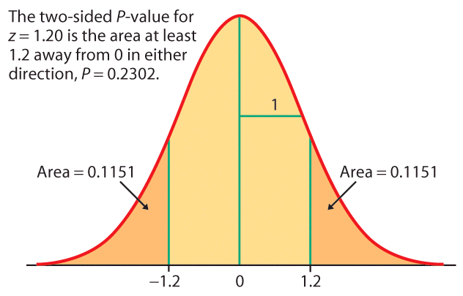

Slide 34
P value= .23 which is greater than .05
Fail to reject the null hypothesis

Slide 35
P-values
The probability of a score as extreme as the observed score.
The decisive value of P is called the significance level.
Signified by the Greek letter alpha
Most commonly alpha is .05

Slide 36
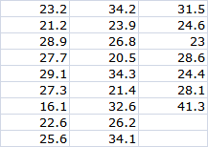
14.20 Reading a computer screen
Do these data give evidence that it takes longer to read with Gigi font?

Slide 37

14.20 Reading a computer screen
25 adults
Pop std dev = 6 seconds
Mean time for Times New Roman is 22 seconds

Slide 38
14.20 Reading a computer screen
Do these data give evidence that it takes longer to read with Gigi font?

Slide 39
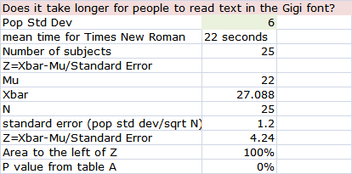
14.20 Reading a computer screen

Slide 40
Inference as a decision
We make a decision to accept Ho or Ha.
Sometimes we are correct
Sometimes we are wrong.

Slide 41
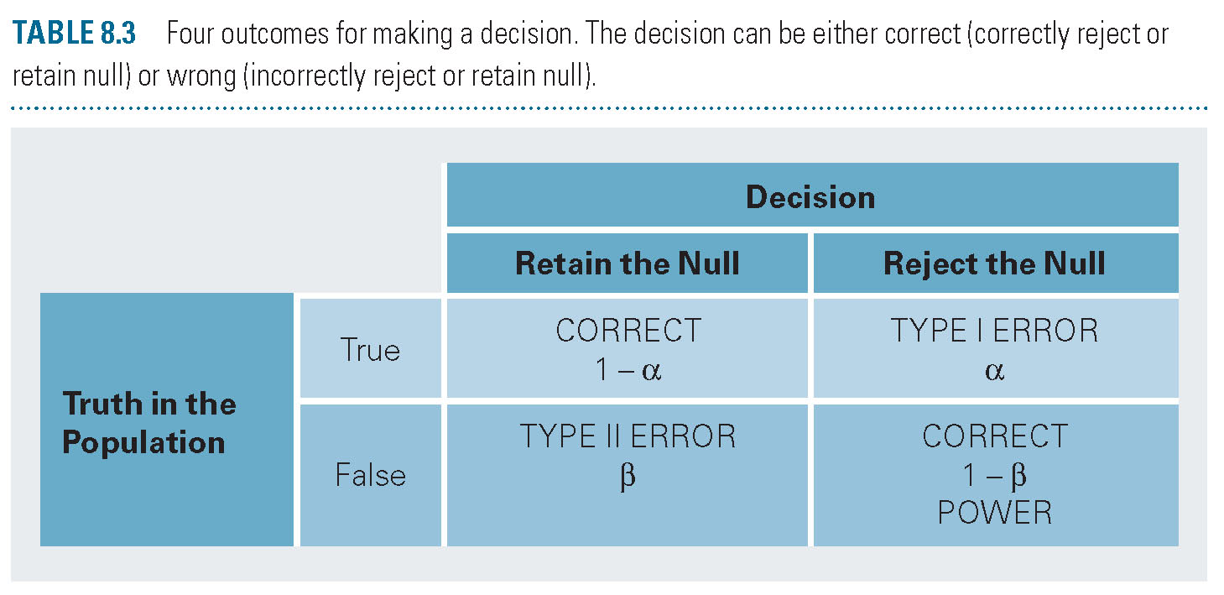
Type I and Type II errors

Slide 42
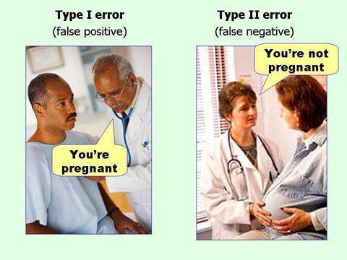

Slide 43
Type I error
If we reject Ho when in fact Ho is true
If we decide it was not chance when in fact it was chance.

Slide 44
Type II error
If we accept Ho when Ho is false.
If we attribute a result to chance when it is not chance.

Slide 45
Effect Size
Hypothesis testing looks at the statistical significance of the effect
Effect size looks at the size of the effect.
Different procedures use different measures of effect size.

Slide 46
Cohen’s d
The number of standard deviations an effect shifted above or below the mean stated in the null hypothesis.

Slide 47
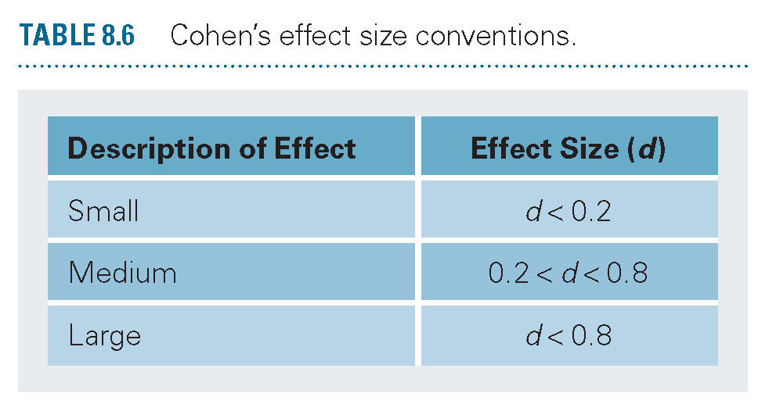
Cohen’s d
Cohen’s d equals zero when the means are the same and rises as they differ.

Slide 48
Effect Size and NHST: one sample example
Frito Lay claims a bag of Doritos has 269.3 grams
Is this true?
Do science: get a sample
Mean of 8 bags is 270.675

Slide 49
Effect Size
Population Mean
  269.3
Sample Mean
  270.675
Pop Standard deviation estimate
  .523

Slide 50
Effect Size
Effect Size = 2.63
This is a very large effect size.

Slide 51
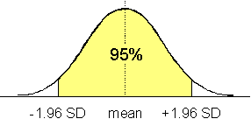
Null Hypothesis Significance Test NHST
I the population mean really was 269.3 how often would you get a mean of 270.675 by chance?

Slide 52
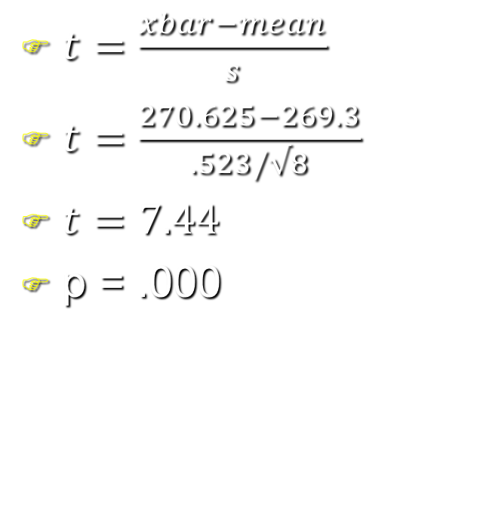
NHST
The null hypothesis states that the mean =269.3
The alternative hypothesis that the mean =/= 269.3
$t=\frac{xbar−mean}{s}$
$t=\frac{270.625−269.3}{.523/√8}$
$t=7.44$
p = .000

Slide 53

The End

Slide 54
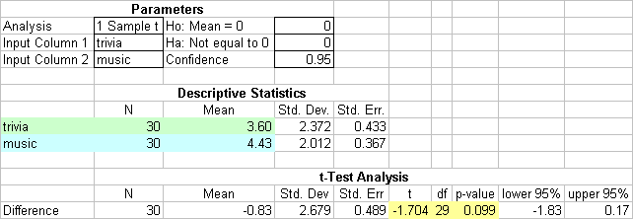
Hypothesis test for music trivia data

Slide 55

14.55 page 390
Does eye grease increase sensitivity?
Ho= μ = 0
Ha μ > 0

Slide 56
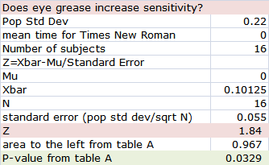
14.55 page 390
P is less than .05
Reject null hypothesis
Accept alternative hypothesis
Data suggest that grease increases sensitivity

