Slide 1
Inference for Categorical Data
William P. Wattles, Ph. D.
Francis Marion University
Notes:
http://www.quantpsy.org/chisq/chisq.htm

Slide 2
Continuous vs. Categorical
Continuous (measurement) variables have many values
Categorical variables have only certain values representing different categories
Ordinal-a type of categorical with a natural order (e.g., year of college)
Nominal-a type of categorical with no order (e.g., brand of cola)

Slide 3
Categorical Data
Tells which category an individual is in rather than telling how much.
Sex, race, occupation naturally categorical
A quantitative variable can be grouped to form a categorical variable.
Analyze with counts or percents.

Slide 4
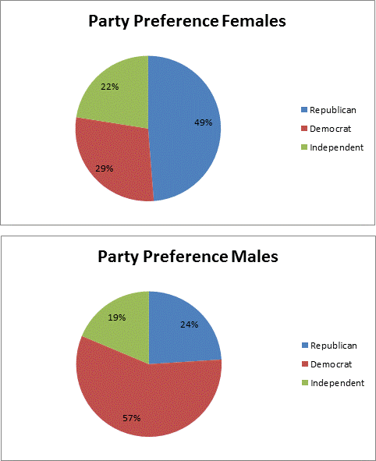
Describing relationships in categorical data
No single graph portrays the relationship
Also no similar number summarizes the relationship
Convert counts to proportions or percents

Slide 5
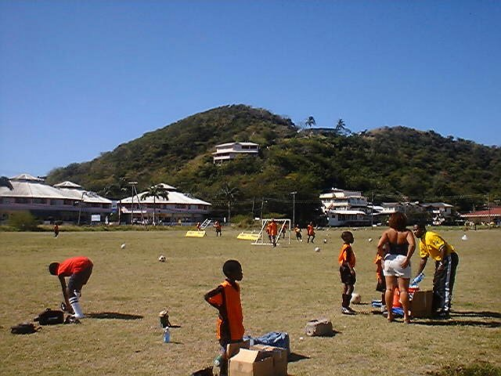
Relationships between categorical variables

Slide 6
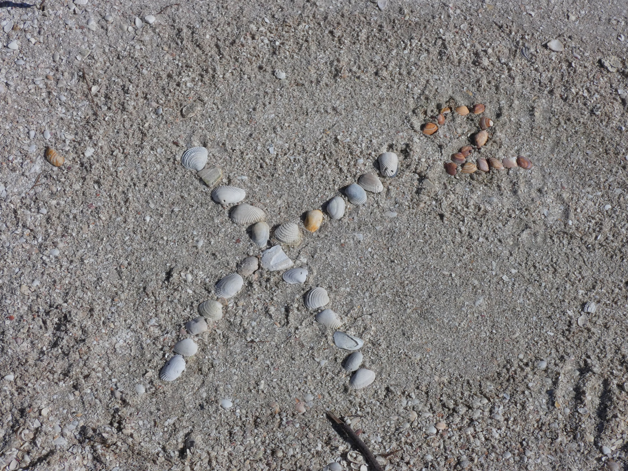

Slide 7


Slide 8
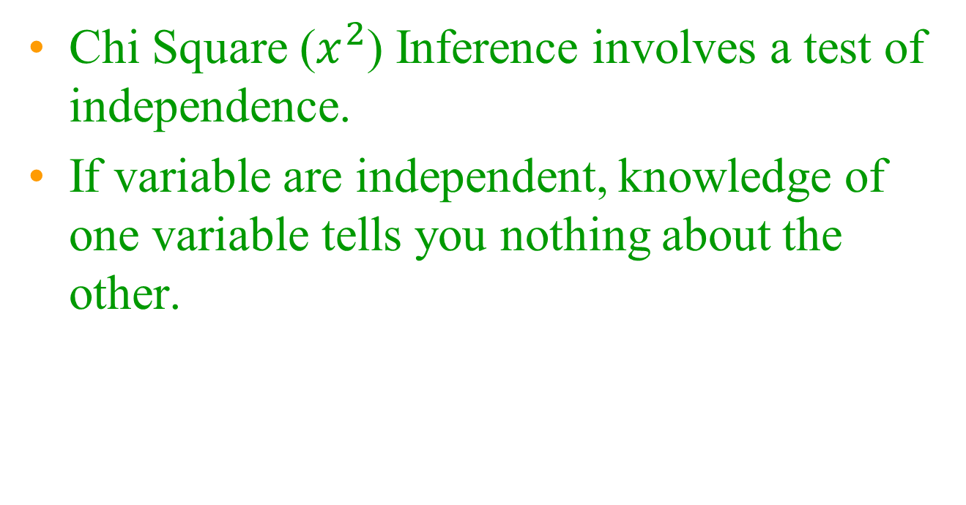
Moving from descriptive to Inferential
Chi Square ($x^{2}$) Inference involves a test of independence.
If variable are independent, knowledge of one variable tells you nothing about the other.
Notes:
63%

Slide 9
Moving from descriptive to Inferential
Inference involves expected counts.
  Expected count=The count that would occur if the variables are independent
Notes:
63%

Slide 10
Inference for two-way tables
Chi Square test of independence.
For more than two groups
Cannot compare multiple groups one at a time.

Slide 11
To Analyze Categorical Data
First obtain counts
In Excel can do this with a pivot table
Put data in a Matrix or two-way table

Slide 12
Matrix or two-way table

Slide 13
Inference for two-way tables
Expected count
The count that would occur if the variables are independent

Slide 14
Matrix or two-way table
Rows
Columns
Distribution: how often each outcome occurred
Marginal distribution: Count for all entries in a row or column

Slide 15
Row and column totals

Slide 17
Expected counts
37% of all subjects are Republicans
If independent 37% of females should be Republican (expected value)
37% of 80= 29
37% of 75 = 28

Slide 18
Expected counts rounded

Slide 19
Observed vs. Expected

Slide 20
Chi-Square
Chi-square A measure of how far the observed counts are from the expected counts

Slide 21
Chi-square test of independence

Slide 22
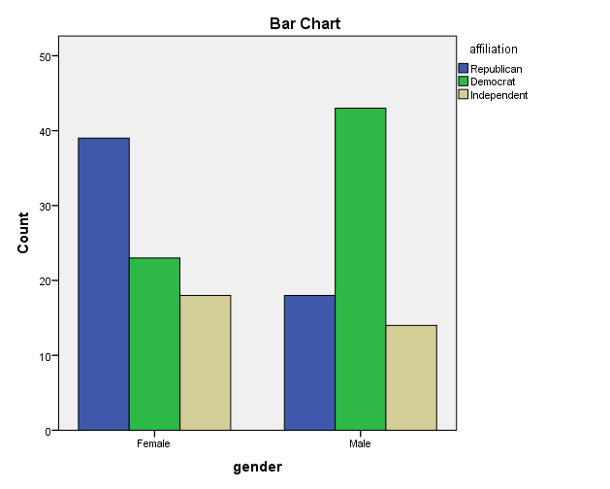
Chi Square test of independence with SPSS

Slide 23
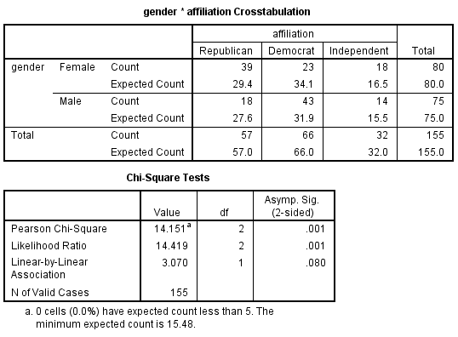
Chi Square test of independence with SPSS

Slide 24
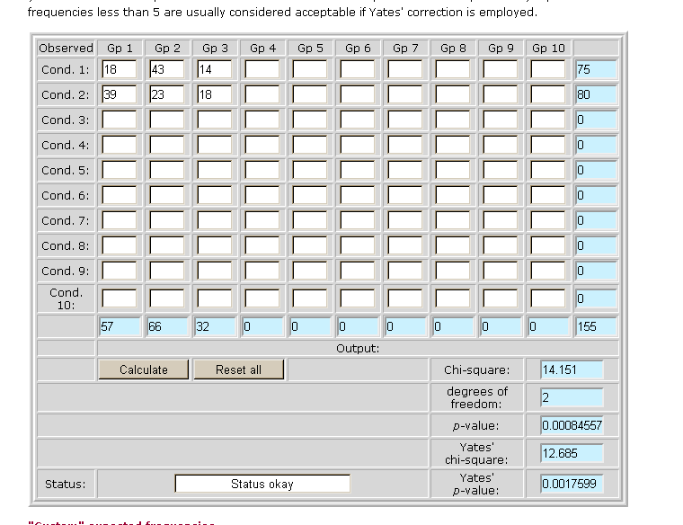
Chi Square
Notes:
http://www.quantpsy.org/chisq/chisq.htm

Slide 25
Chi-square test of independence
Degrees of Freedom
df=number of rows-1 times number of columns -1
compare the observed and expected counts.
P-value comes from comparing the Chi-square statistic with critical values for a chi-square distribution

Slide 26
Example
Have the percent of majors changed by school?

Slide 27
Data collection
http://www.fmarion.edu/about/FactBook
2004/2005 Fall 2004 Graduates by Major

Slide 28



Slide 29
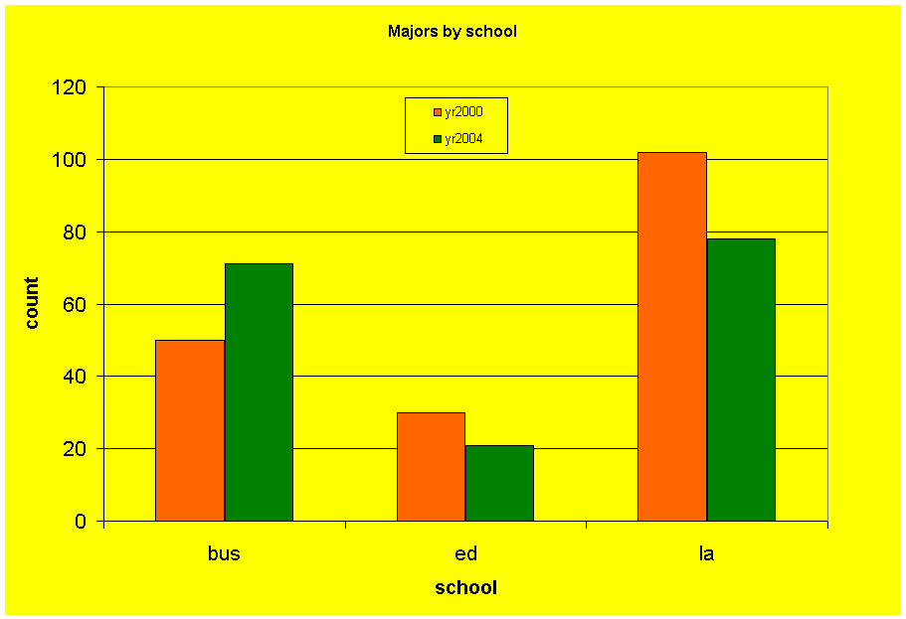

Slide 30
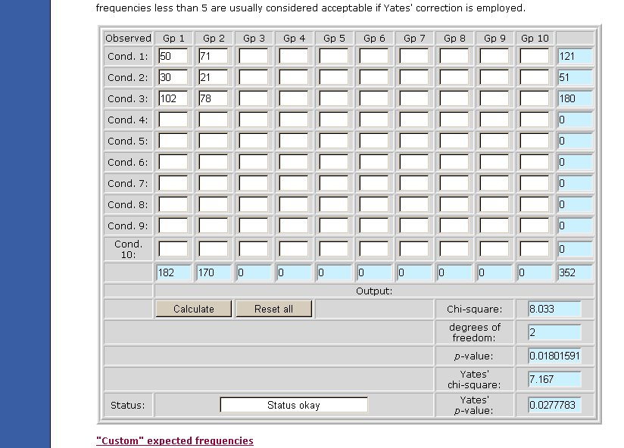
Chi Square
Notes:
http://www.quantpsy.org/chisq/chisq.htm

Slide 31
Marital Status, page 543

Slide 32
Marital Status, page 543

Slide 33
Olive Oil, page 578

Slide 34
Olive Oil, page 578

Slide 35
Business Majors, page 563

Slide 36
Business Majors, page 563

Slide 37
Chi Square Warning
Use of the chi-square tests is inappropriate if any expected frequency is:
  below 1 or
  if the expected frequency is less than 5 in more than 20% of your cells.

Slide 38
Effect Size for Chi Square
Cramer's V is a way of calculating correlation in tables which have more than 2x2 rows and columns.
It is used as post-test to determine strengths of association after chi-square has determined significance.

Slide 39
Interpreting Effect Size
Notes:
http://groups.chass.utoronto.ca/pol242/Labs/LM-3A/LM-3A_content.htm for more detail. Above .5 may be redundant (measuring same thing)

Slide 40
Exam Three
37 multiple choice questions, 4 short answer
T-tests, chi square, and Regression.
General questions about analyzing categorical data and t-tests
Review from earlier this term

Slide 41
Inference as a decision
We must decide if the null hypothesis is true.
We cannot know for sure.
We choose an arbitrary standard that is conservative and set alpha at .05
Our decision will be either correct or incorrect.

Slide 42
Type I and Type II errors

Slide 43
Type I error
If we reject H_{o} when in fact H_{o} is true, this is a Type I error
Statistical procedures are designed to minimize the probability of a Type I error, because they are more serious for science.
With a Type I error we erroneously conclude that an independent variable works.

Slide 44
Type II error
If we accept H_{o} when in fact H_{o} is false this is a Type II error.
A type two error is serious to the researcher.
The Power of a test is the probability that H_{o} will be rejected when it is, in fact, false.

Slide 45
Probability

Slide 46
Power
The goal of any scientific research is to reject H_{o} when H_{o} is false.
To increase power:
  a. increase sample size
  b. increase alpha
  c. decrease sample variability
  d. increase the difference between the means

Slide 47
Categorical data example
African-American students more likely to register via the web.

Slide 48
Table

Slide 49
Web Registration by Race
60%
50%
40%
44%
30%
34%
White
29%
African-American
20%
25%
10%
0%
2000
2001
Year

Slide 50
Categorical Data Example
African-American students university-wide (44%) were more likely that white students (34%) to use web registration, X²(1, N = 1963) = 20.7 , p < .001.

Slide 51


Slide 52
Smoking among French Men
Do these data show a relationship between education and smoking in French men?

Slide 53
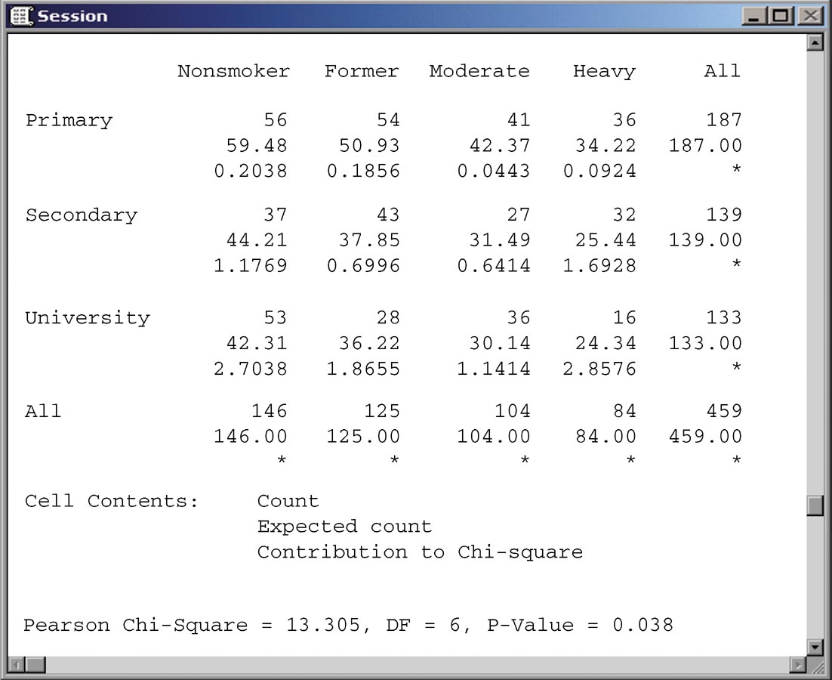

Slide 54
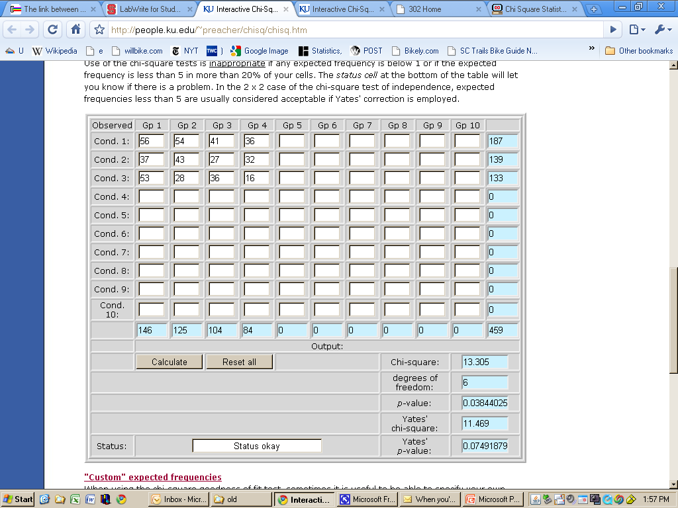
Notes:
http://www.quantpsy.org/chisq/chisq.htm

Slide 55
Effect Size
Cramer's V is used as a post-test to determine strengths of association after chi-square has determined significance.
.1 weak
.3 moderate
.5 Strong

Slide 56
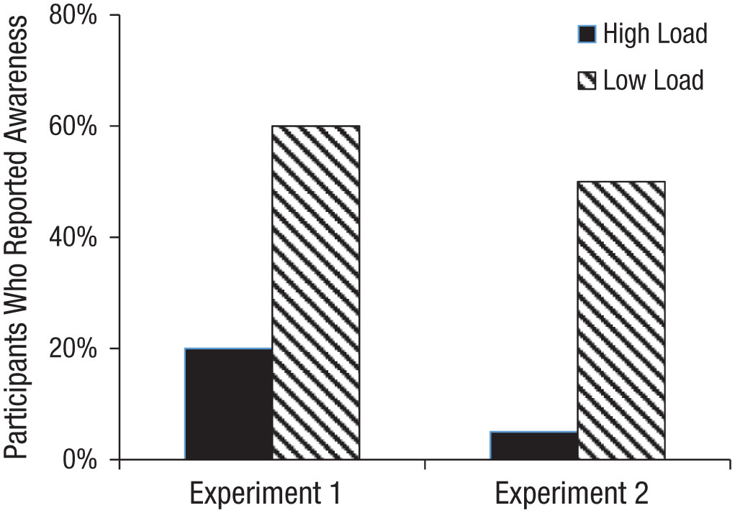
Fig. 1. Percentage of participants who indicated awareness of the olfactory stimulus in the high- and low-load conditions of Experiments 1 and 2 (N = 40 in each).
https://journals.sagepub.com/doi/10.1177/0956797618781325
Published in: Sophie Forster; Charles Spence; Psychol Sci 29, 1642-1652.
DOI: 10.1177/0956797618781325
Copyright © 2018 Association for Psychological Science

Slide 57
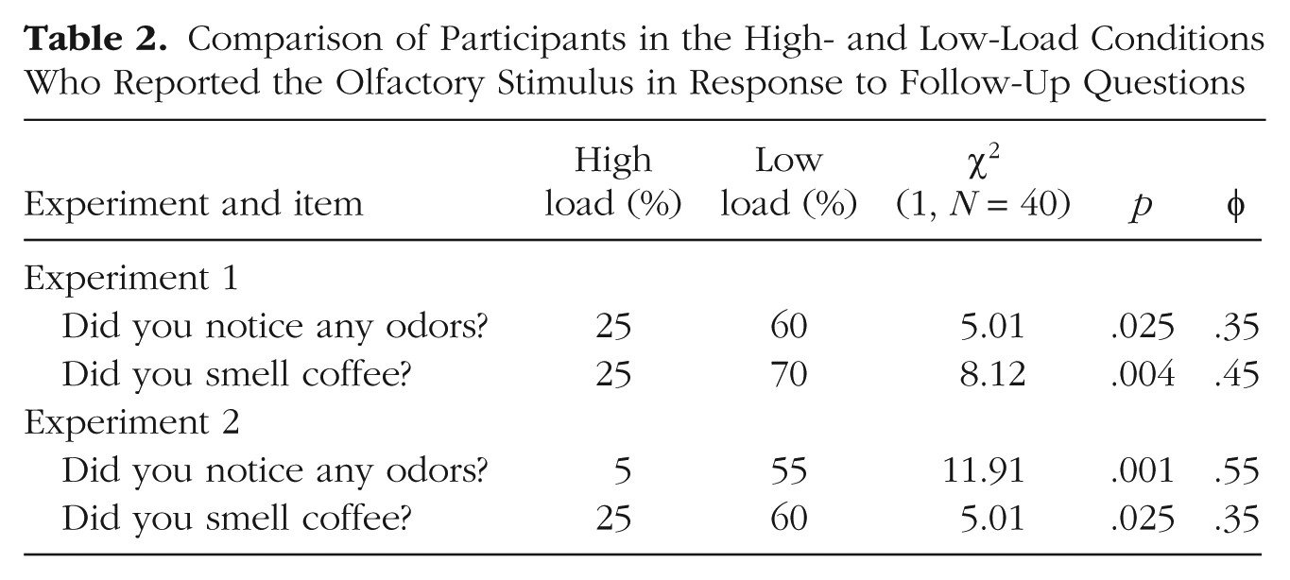
Table 2. Comparison of Participants in the High- and Low-Load Conditions Who Reported the Olfactory Stimulus in Response to Follow-Up Questions
 | High Load | Low Load
Yes | 5 | 12
No | 15 | 8
Published in: Sophie Forster; Charles Spence; Psychol Sci 29, 1642-1652.
DOI: 10.1177/0956797618781325
Copyright © 2018 Association for Psychological Science

Slide 58
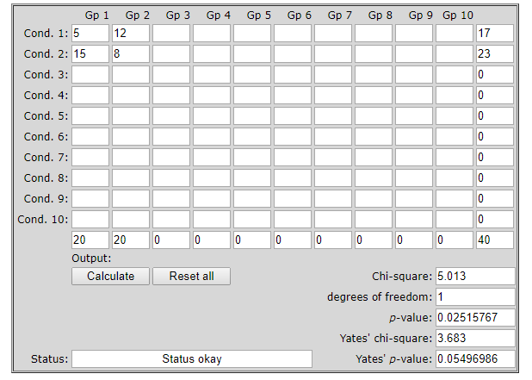

Slide 59
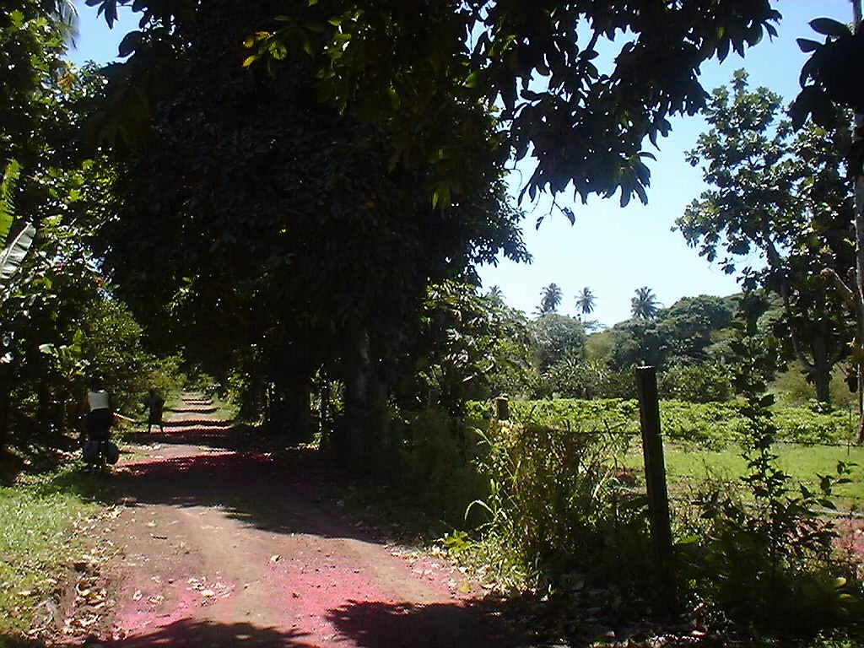
The End
The End

Slide 60
Benford’s Law page 550
Faking data?

Slide 61
Problem 20.14

Slide 64
Significance test

Slide 65
Example
Survey2 Berk & Carey page 261

