Slide 1
Describing distributions with numbers
William P. Wattles
Psychology 302
1
Notes:
1
1
1
1
1

Slide 2
Measuring the Center of a distribution
Mean
The arithmetic average
Requires measurement data
Median
The middle value
Mode
The most common value
2
Notes:
2
2
2
2
2

Slide 3
Measuring the center with the Mean
3
Notes:
3
3
3
3
3

Slide 4
Our first formula
4
Notes:
4
4
4
4
4

Slide 5
The Mean
One number that tells us about the middle using all the data.
The group not the individual has a mean.
5
Notes:
5
5
5

Slide 6
Population
Sample

Slide 7
Sample mean
6
Notes:
6

Slide 8
Mu, the population mean
7
Notes:
7

Slide 9
Population
Sample

Slide 10
Calculate the mean with Excel
Save the file psy302 to your hard drive
right click on the file
save to desktop or temp
Open file psy302
Move flower trivia score to new sheet
8
Notes:
8
6

Slide 11
Calculate the mean with Excel
Rename Sheet
double click sheet tab, type flower
Calculate the sum
type label: total
Calculate the mean
type label: mean
Check with average function
9
Notes:
9
7

Slide 12
Measuring the center with the Median
Rank order the values
If the number of observations is odd the median is the center observation
If the number of observations is even the median is the mean of the middle two observations. (half way between them)
10
Notes:
10
8
8
6
5

Slide 13
Measuring the center with the Median
11
Notes:
11
9
9
7
6

Slide 14
The mean versus the median
The Mean
uses all the data
has arithmetic properties
The Median
less influenced by Outliers and extreme values
12
Notes:
12
10
10
8
7

Slide 15
Mean vs. Median

Slide 16
The Mean
The mean uses all the data.
The group not the individual has a mean.
We calculate the mean on Quantitative Data
Three things to remember
5
Notes:
5
5
5

Slide 17
The mean tells us where the middle of the data lies.
Essential but not enough

Slide 18
Variability
High Variability
Low Variability

Slide 19
Please notice a slight change to the schedule. We will have Exam One on Friday February 2.
We will have Exam Two on Friday February 23

Slide 20
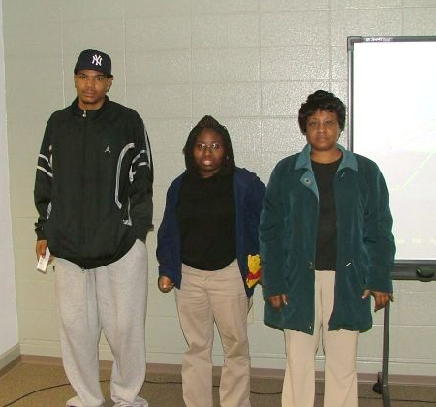
Mean = 68 inches
Mean = 68 inches
Std Dev= 8.54 inches
Std Dev= .57 inches
Notes:
7760 67
68 6768
68 68 mean
0.57735 8.544004 standard deviation

Slide 21
Measuring Spread
Knowing about the middle only tells us part of the story of the data.
We need to know how spread out the data are.
Notes:
13

Slide 22
Why is the mean alone not enough to describe a distribution?
Outliers is NOT the answer!!!!

Slide 23
The mean tells us the middle but not how spread out the scores are.

Slide 24
Example of Spread
New York
mean annual high temperature 62
14
Notes:
14

Slide 25
Example of Spread
San Francisco
mean annual high temperature 65
14
Notes:
14

Slide 26
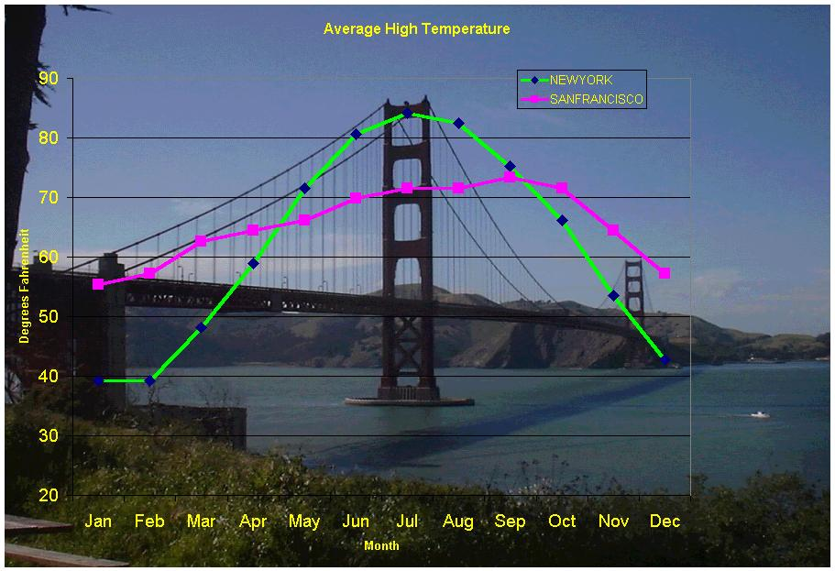

Slide 27
Example of Spread
New York
mean max min range sd
62 84 39 45 17.1
San Francisco
65 73 55 18 6.4
16
Notes:
16

Slide 28
Example of Variability
Notes:
Standard deviation 7% for the final 26% for the quiz

Slide 29
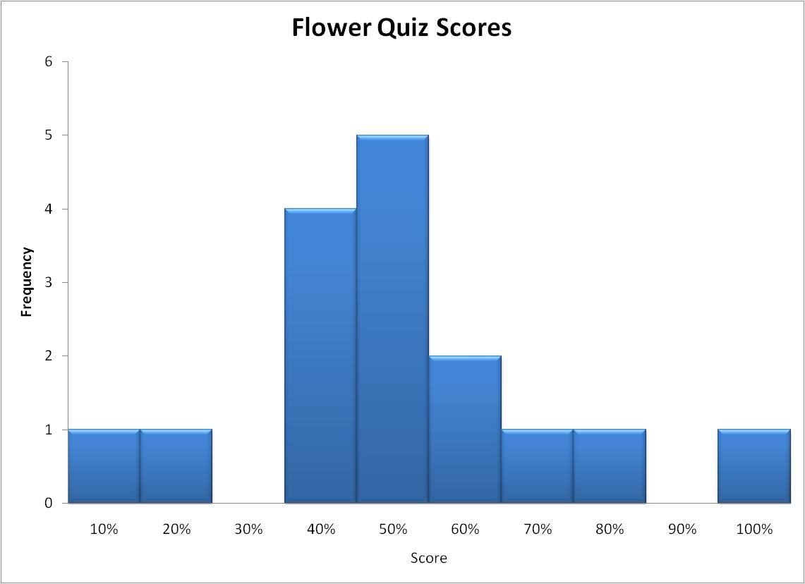
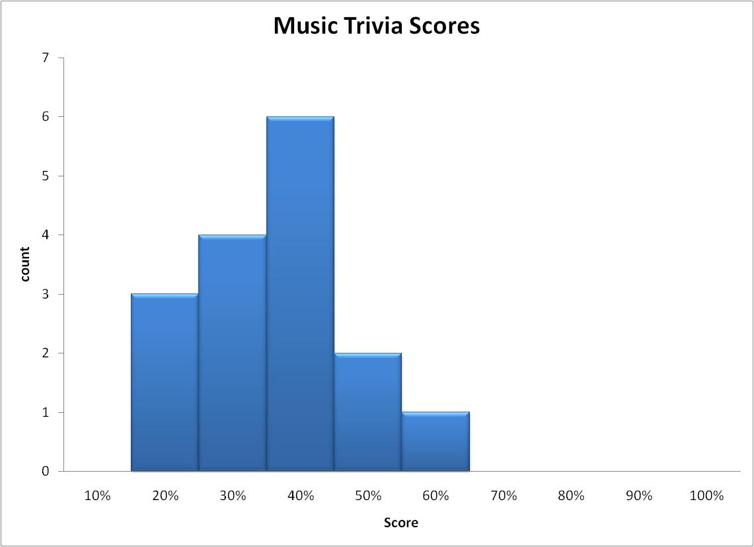
Mean 50.63%
Std Dev 21.4%
Mean 33.19%
Std Dev 13.2%

Slide 30
Deviation score
Each individual has a deviation score. It measures how far that individual deviates from the mean.
Deviation scores always sum to zero.
Deviation scores contain information.
How far and in which direction the individual lies from the mean
19
Notes:
19
17
13

Slide 31
Measuring spread with the standard deviation
Measures spread by looking at how far the observations are from their mean.
The standard deviation is the square root of the variance.
The variance is also a measure of spread
18
Notes:
18
16
12
10
9

Slide 33
Individual deviation scores

Slide 34
Standard deviation
One number that tells us about the spread using all the data.
The group not the individual has a standard deviation.
Note!!
Notes:
21
19
15

Slide 35
Standard Deviation
23
Notes:
23
21
17
14
11

Slide 36
Variance
22
Notes:
22
20
16
13
10

Slide 37
Properties of the standard deviation
s measures the spread about the mean
s=0 only when there is no spread. This happens when all the observations have the same value.
s is strongly influenced by extreme values
24
Notes:
24
22
18
15
12

Slide 38
New Column headed deviation
Deviation score = X – the mean

Slide 39
Calculate Standard Deviation with Excel
In new column type heading: dev2
Enter formula to square deviation
Total squared deviations
type label: sum of squares
Divide sum of squares by n-1
type label: variance
25
Notes:
25
23

Slide 40
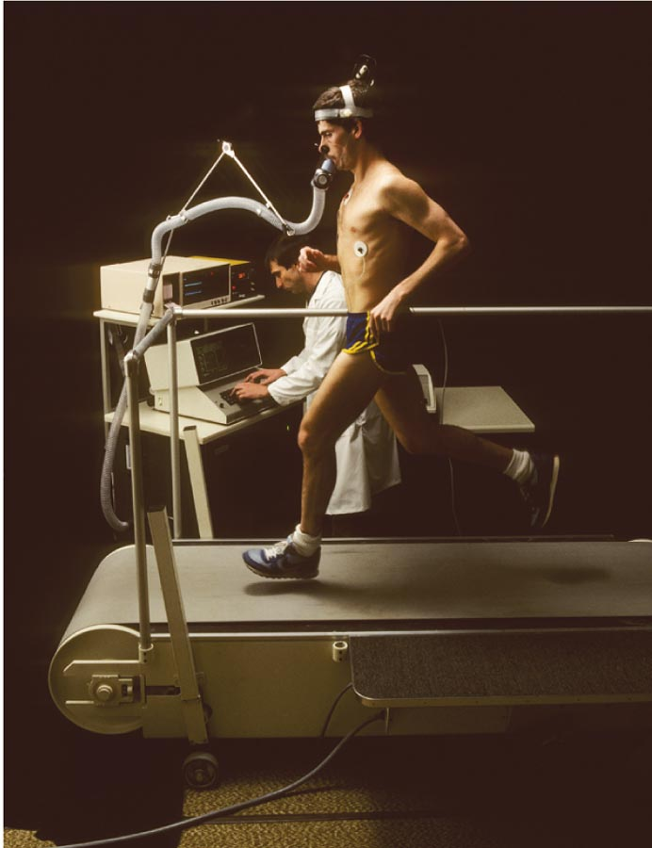
Moore page 50

Slide 42
To Calculate Standard Deviation:
Total raw scores
divide by n to get mean
calculate deviation score for each subject (X minus the mean)
Square each deviation score
Sum the deviation scores to obtain sum of squares
Divide by n-1 to obtain variance
Take square root of variance to get standard deviation.

Slide 43
Population
Sample

Slide 44
Sample variance
26
Notes:
26

Slide 45
Population variance
27
Notes:
27

Slide 46
Population Variance
Sample Variance

Slide 47
Little sigma, the Population standard deviation
28
Notes:
28

Slide 48
Sample standard deviation
29
Notes:
29

Slide 49
Population Standard Deviation
Sample Standard Deviation

Slide 50
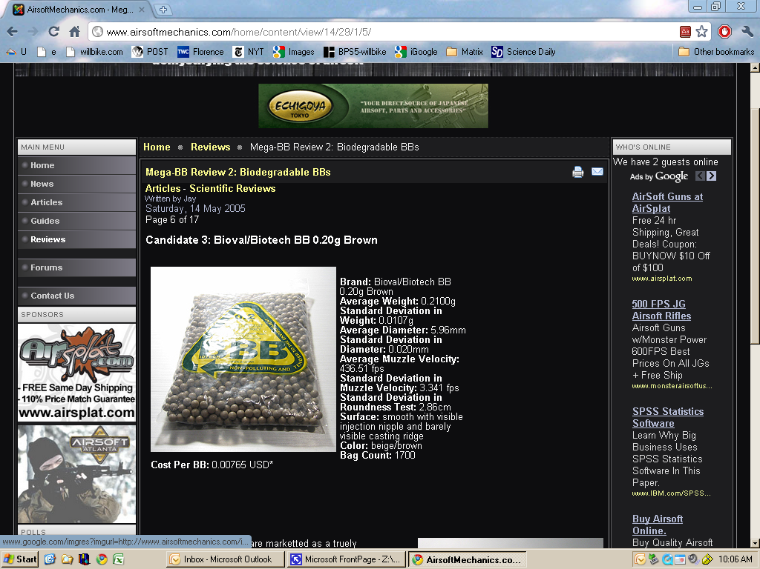

Slide 51
To analyze data
1. Make a frequency distribution and plot the data
Look for overall pattern and outliers or skewness
Create a numerical summary: mean and standard deviation.

Slide 52
Start with a list of scores
41

Slide 53
Make a frequency distribution
42

Slide 54
Frequency distribution
43

Slide 55
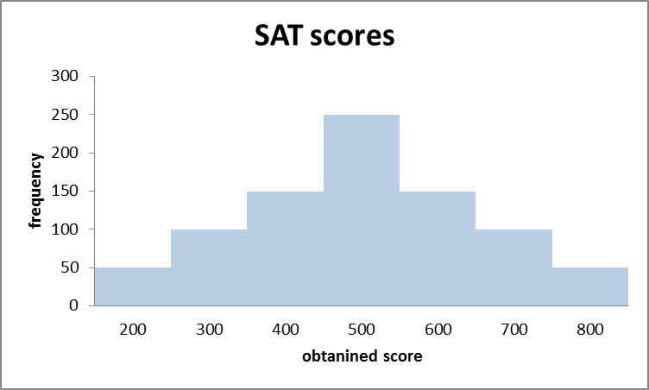
Represent with a chart (histogram)
44

Slide 56
Represent with line chart
45

Slide 57
Density Curve
Replaces the histogram when we have many observations.

Slide 58
Transform a score
Hotel Atlantico
200 pesos
Peso a unit of measure

Slide 59
Transform a score
1 dollar = 28.38 pesos
200/28.38=$7.05
Dollar a unit of measure

Slide 60
standardized observations or values.
To standardize is to transform a score into standard deviation units.
Frequently referred to as z-scores
A z-score tells how many standard deviations the score or observation falls from the mean and in which direction
31
Notes:
31
25
21
16
13

Slide 61
Standard Scores (Z-scores)
individual scores expressed in terms of the mean and standard deviation of the sample or population.
Z = X minus the mean/standard deviation
32
Notes:
32
26
22
34
31
29
28
27
27

Slide 62
Z-score
33
Notes:
33
27
23
17
14

Slide 63
new symbols
34
Notes:
34
28
24
18
15

Slide 64
Calculate Z-scores for trivia data
Label column E as Z-score
Type formula deviation score/std dev
Make std dev reference absolute (use F4 to insert dollar signs)
Copy formula down.
Check: should sum to zero
35

Slide 65
Z Scores
Height of young women
Mean = 64
Standard deviation = 2.7
What is the deviation score for a woman who is 70 inches?
What is the deviation score for a woman 5 feet tall (60 inches).
37
Notes:
37
29
25
19
16

Slide 66
Z Scores
Height of young women
Mean = 64
Standard deviation = 2.7
What is the deviation score for a woman who is 70 inches? 70-64= 6 inches
What is the deviation score for a woman 5 feet tall (60 inches). 60-64 = -4 inches
37
Notes:
37
29
25
19
16

Slide 67
Z Scores
Height of young women
Mean = 64
Standard deviation = 2.7
How tall in deviations is a woman 70 inches?
A woman 5 feet tall (60 inches) is how tall in standard deviations?
37
Notes:
37
29
25
19
16

Slide 68
Z scores
Height of young women
Mean = 64
Standard deviation = 2.7
How tall in deviations is a woman 70 inches? z = 2.22
A woman 5 feet tall (60 inches) is how tall in standard deviations? z = -1.48
38
Notes:
38
30
26
20
17

Slide 69
Calculating Z scores
39
Notes:
39
31
27
21
18

Slide 70
Calculating X from Z scores

Slide 71
Types of data
Categorical or Qualitative data
Nominal: Assign individuals to mutually exclusive categories.
exhaustive: everyone is in one category
Ordinal: Involves putting individuals in rank order. Categories are still mutually exclusive and exhaustive, but the order cannot be changed.

Slide 72
Types of data
Measurement or Quantitative Data
Interval data: There is a consistent interval or difference between the numbers. Zero point is arbitrary
Ratio data: Interval scale plus a meaningful zero. Zero means none. Weight, money and Celsius scales exemplify ratio data
Measurement data allows for arithmetic operations.

Slide 73
Review
Video2

Slide 74
The End
60
Notes:
60
47
43
33
30

Slide 75
To view File extensions
Open Windows Explorer
Choose Tools/Folder Options/View
uncheck “hide extensions for known file types.

Slide 76
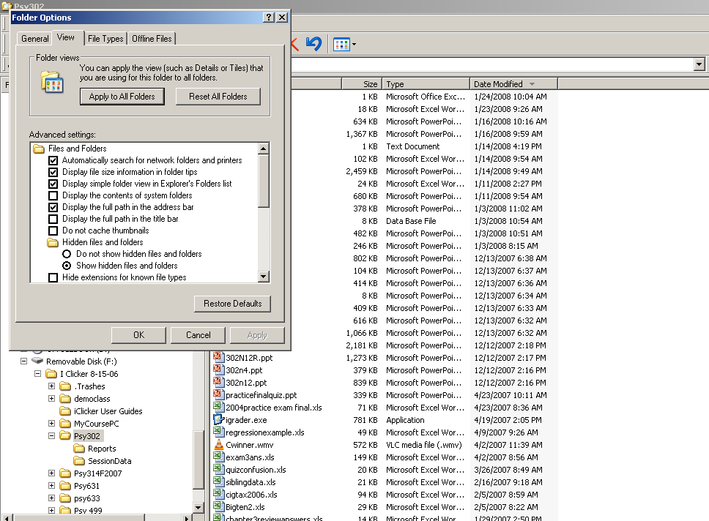

Slide 77
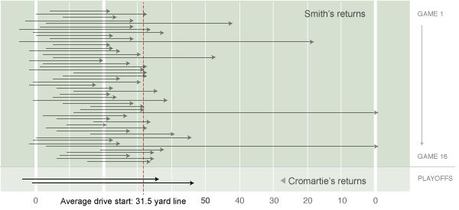
Mean vs. Median

