Slide 1
The Normal Distribution
William P. Wattles
Psychology 302
1
Notes:
1
1
1
1
1

Slide 2
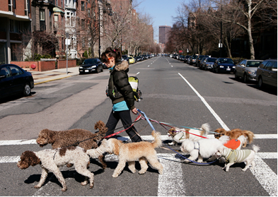
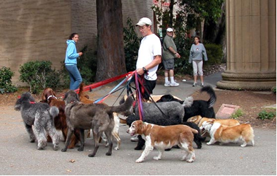
Which group has a larger standard deviation for height?

Slide 3
Frequency distribution
A table or graph that indicates all the values a variable can take and how often each occurs.

Slide 4
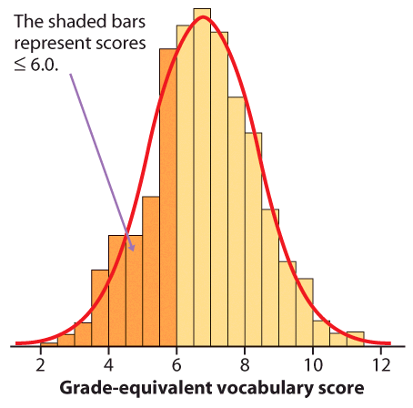
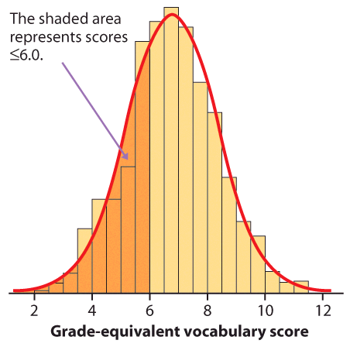
Density curves
A density curve is a mathematical model of a distribution.
It is always on or above the horizontal axis.
The total area under the curve, by definition, is equal to 1, or 100%.
The area under the curve for a range of values is the proportion of all observations for that range.
Histogram of a sample with the smoothed density curve theoretically describing the population
Notes:
Here is our histogram. One woman in the first group, 2 in the second, etc.
This is a normal distribution - it has a single peak, is symmetric, does not have outliers, and when a curve is drawn to describe it, the curve takes on a particular shape.

Slide 6
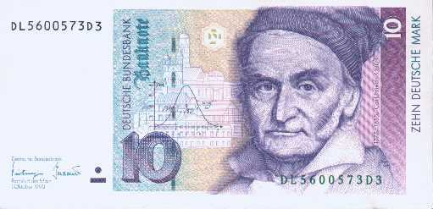
Normal Distribution
Gaussian Distribution
Mean=Median=Mode
Notes:
"the Prince of Mathematicians" Johan Gauss child prodigy

Slide 7
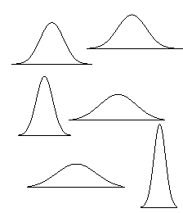
Normal Distribution
Normal distributions have the same general shape. They are symmetric with scores more concentrated in the middle than in the tails.

Slide 8
A family of density curves
Here the means are the same (μ = 15) while the standard deviations are different (σ = 2, 4, and 6).
Here the means are different
(μ = 10, 15, and 20) while the standard deviations are the same (σ = 3).

Slide 9
Z scores and the normal curve
The 68-95-99.7 rule
68% fall within one standard deviation of the mean
95% fall within two standard deviations of the mean
99.7% of the observations fall with three standard deviations of the mean
40
Notes:
40
32
28
22
19

Slide 10
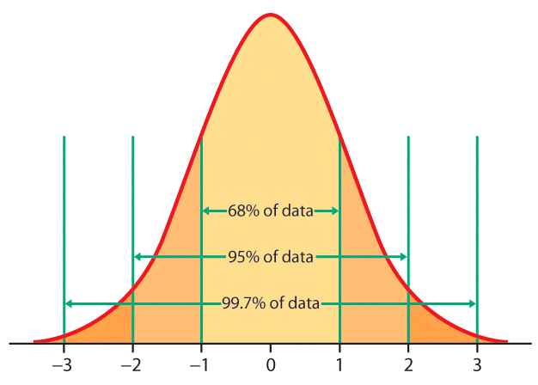

Slide 11
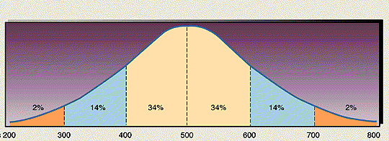
Normal Curve

Slide 12
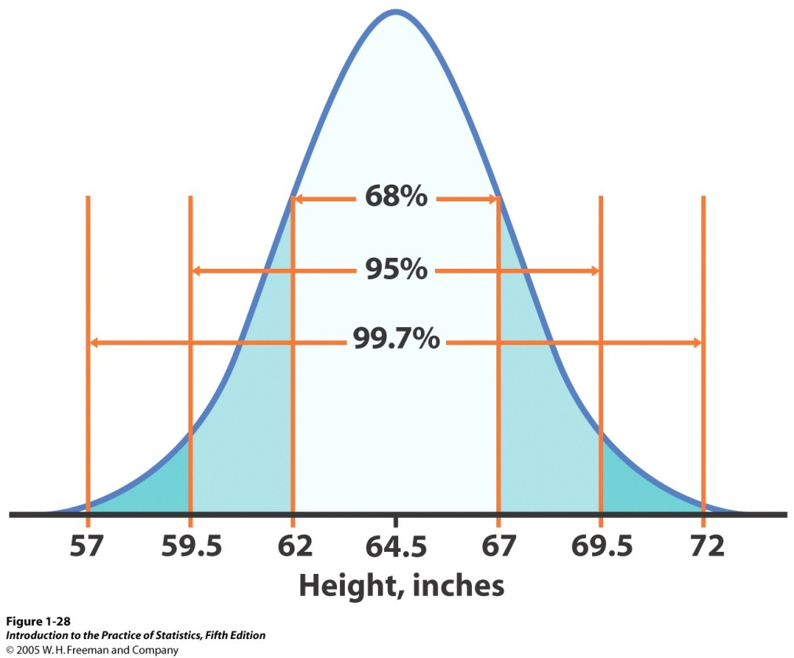
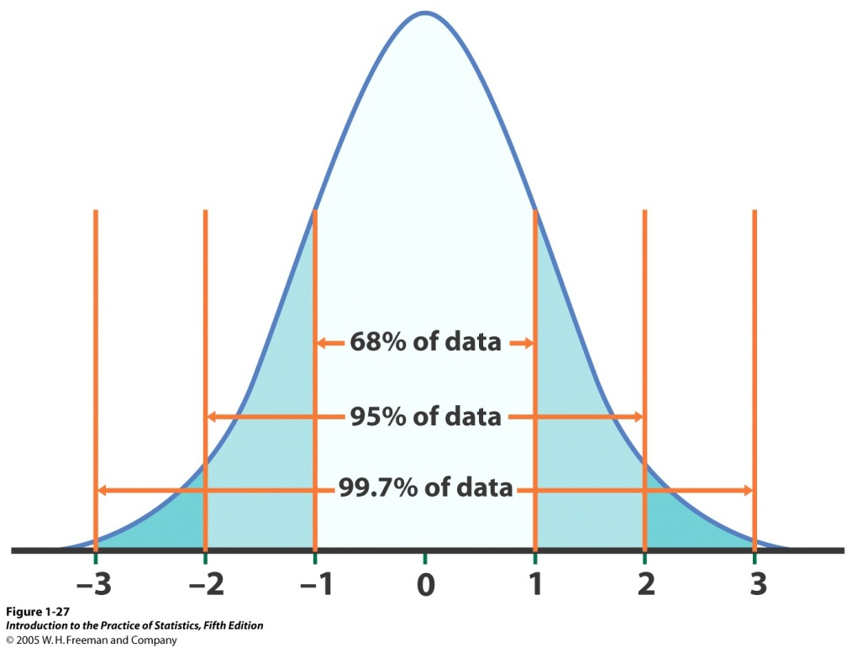
The standard Normal distribution
Because all Normal distributions share the same properties, we can standardize our data to transform any Normal curve N (μ, σ) into the standard Normal curve N (0,1).
N(64.5, 2.5)
N(0,1)
=>
Standardized height (no units)
For each x we calculate a new value, z (called a z-score).

Slide 13
Percentile scores
The percentile rank of a score is the percentage of scores in its frequency distribution that are equal to or lower than it.

Slide 14
Standard Scores (Z-scores)
Can use Table A handed out in class to determine the area under the curve cut off by any Z-score.
36
Notes:
36
26
22
34
31
29
28
27
27

Slide 15
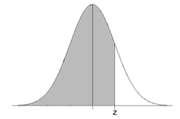
Using Table A, What portion of the distribution lies below a Z score of 1.28?
Z score of 1.28=.8997

Slide 16
Using Table A, What Z score cuts off the bottom 70%
Z score of 0.53=.7019

Slide 17
Area under the curve
Height of young women
  Mean = 64
  Standard deviation = 2.7
What proportion of women are less than 70 inches tall?
47
Notes:
47
34
30
24
21

Slide 18
Area under the curve
Height of young women
  Mean = 64
  Standard deviation = 2.7
Z score for 5’10” +2.22
Area to the left = .9868
A woman 70 inches tall is taller than 99% of her peers.
47
Notes:
47
34
30
24
21

Slide 19
WAIS mean=100, SD=15
What percent are retarded, I.e. less than 70?
What percent are MENSA eligible, I.e. greater than 130?

Slide 20
Area under the curve
WAIS mean=100, SD=15
Z=X-mean/standard deviation
What percent are retarded, I.e. less than 70?
Z=70-100/15, Z=-2.00, 2.28%
What percent are MENSA eligible, I.e. greater than 130?
Z=130-100/15 Z=+2.00, 2.28%

Slide 21

Percentile scores
The percent of all scores at or below a certain point.
The same procedure as with proportions
More commonly used than proportions
58
Notes:
58
45
41
38
35
33
32
31
31

Slide 22
Percentile scores
A recent applicant received GRE scores of V 147 and Q 148. Are those good scores?
Mean 150.54 V
SD 8.44 V
Mean 152.14 Q
SD 8.83 Q
58
Notes:
58
45
41
38
35
33
32
31
31

Slide 23
Percentile scores
A recent applicant to our master’s program received GRE scores of V 147 and Q 148. Are those good scores?
58
Notes:
58
45
41
38
35
33
32
31
31

Slide 24
Sample Problem
SAT mean=1020, SD=207
Division 1 athletes must have 820 to compete? Is this fair?
What percent score less than 820?

Slide 25
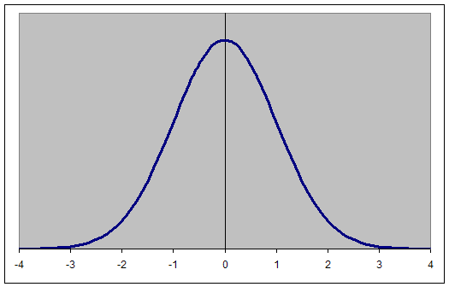
Normal Curve

Slide 26
SAT mean=1020, SD=207
What percent score less than 820?
.1660

Slide 27
SAT mean=1020, SD=207
Division 1 athletes must have 720 to practice? Is this fair?
What percent score less than 720?

Slide 28
Normal Curve

Slide 29
SAT mean=1020, SD=207
What percent score less than 720?
.0735

Slide 30

What is a Z score?

Slide 31

A z-score tells how many standard deviations the score or observation falls from the mean and in which direction

Slide 32
Z-Score
A Z-score tells how many standard deviations an individual’s score lies above or below the mean.

Slide 33
Psy 302 Paper
Pick a subject that interests you.
Do some library research.
Collect data
  two groups (minimum 15 per group)
  measurement data
Analyze data with t-test
  SPSS
  Excel
Make a histogram of your results.
Write paper APA style per sample paper.

Slide 34

Growth Mindset
You don’t have to be good at something to work hard and get better.

Slide 35
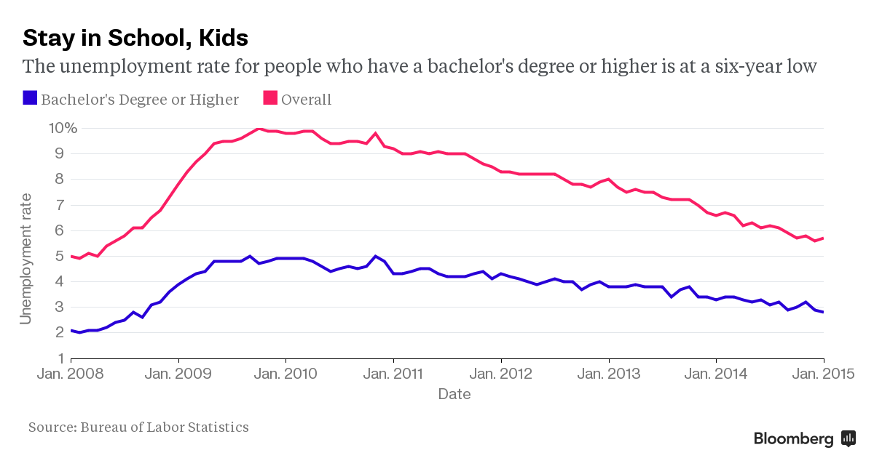

Slide 36
The End
60
Notes:
60
47
43
33
30

