Slide 1
Psychometrics
William P. Wattles, Ph.D.
Francis Marion University

Slide 3
Psychometrics
The quantitative and technical aspects of measurement.

Slide 4
Quantitative
Quantitative: of or pertaining to the describing or measuring of quantity.

Slide 5
Evaluating Psychological Tests
How accurate is the test?
  Reliability
  Validity
  Standardization
    adequate norms
    administration

Slide 6
Reliability
Measurement error is always present.
Goal of test instruction is to minimize measurement error.
Reliability is the extent to which the test measures consistently
If the test is not reliable it cannot be valid or useful.

Slide 7
Reliability
A reliable test is one we can trust to measure each person approximately the same way each time.

Slide 8
Measuring reliability
Measure it twice and compare the results

Slide 9
Methods of testing reliability
Test-retest
Alternate form
Split-half
Interscorer reliability

Slide 10
Test-retest
Give the same test to the same group on two different occasions.
This methods examines performance of the test over time and evaluates its stability.
Susceptible to practice effects.
May
June

Slide 11
Alternate Form
Two versions of the same test with similar content.
Order Effects-Half get A first and B second and vice versa
Forms must be equal
A
B

Slide 12
Split-half
Measure internal consistency.
Correlate two halves such as odd versus even.
Works only for tests with homogeneous content
Odd
Even

Slide 13
Interscorer Reliability
Measures scorer or inter-rater reliability
Do different judges agree?
8

Slide 14
Speed Versus Power Tests
Power test-person has adequate time to answer all questions
Speed test-score involves number of correct answers in a short amount of time
Must alter split-half method for speed tests

Slide 15
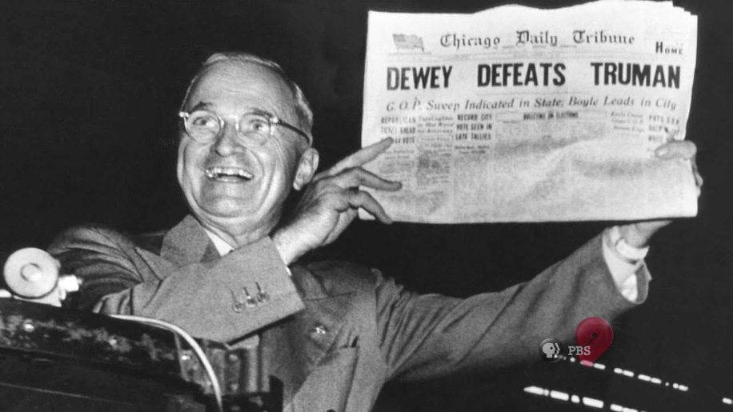
Systematic versus Random Error
Systematic error-a single source of error that is constant across measurements
Random error-error from unknown causes

Slide 16
The Reliability Coefficient
A correlation coefficient tells us the strength and direction of the relationship between two variables.

Slide 17
Standard Error of Measurement
An index of the amount of inconsistency or error expected in an individual’s test score

Slide 18
Standard Error of Measurement
Standard Error of Measurement=

Slide 19
The standard error of measurement (SEM) is an estimate of error to use in interpreting an individual’s test score.
A test score is an estimate of a person’s “true” test performance

Slide 20
Confidence Intervals
Use the SEM to calculate a confidence interval.
Can determine when scores that appear different are likely to be the same.

Slide 21
The standard error of measurement is an estimate of the standard deviation of a normal distribution of test scores that would occur by a person who took a test an infinite number of times.

Slide 22
A Wechsler test with a split-half reliability coefficient of .96 and a standard deviation of 15 yields a SEM of 3
SEM = s √( 1 – r ) = 15 √ ( 1-.96) = 15 √.04 = 15 x .2 = 3

Slide 23
For a 68% interval, use the following formula:
Test score ± 1(SEM)
Someone who scored 97 likely has a true score between 94 and 100.

Slide 24
A 95 percent confidence interval is approximately equal to with area within 2 standard deviations on either side of the mean.
Test score ± 2(SEM) 91-103

Slide 25

ASVAB
The ASVAB is not an IQ test. It does not measure intelligence. The battery of tests were designed specifically to measure an individual's aptitude to be trained in specific jobs.

Slide 26
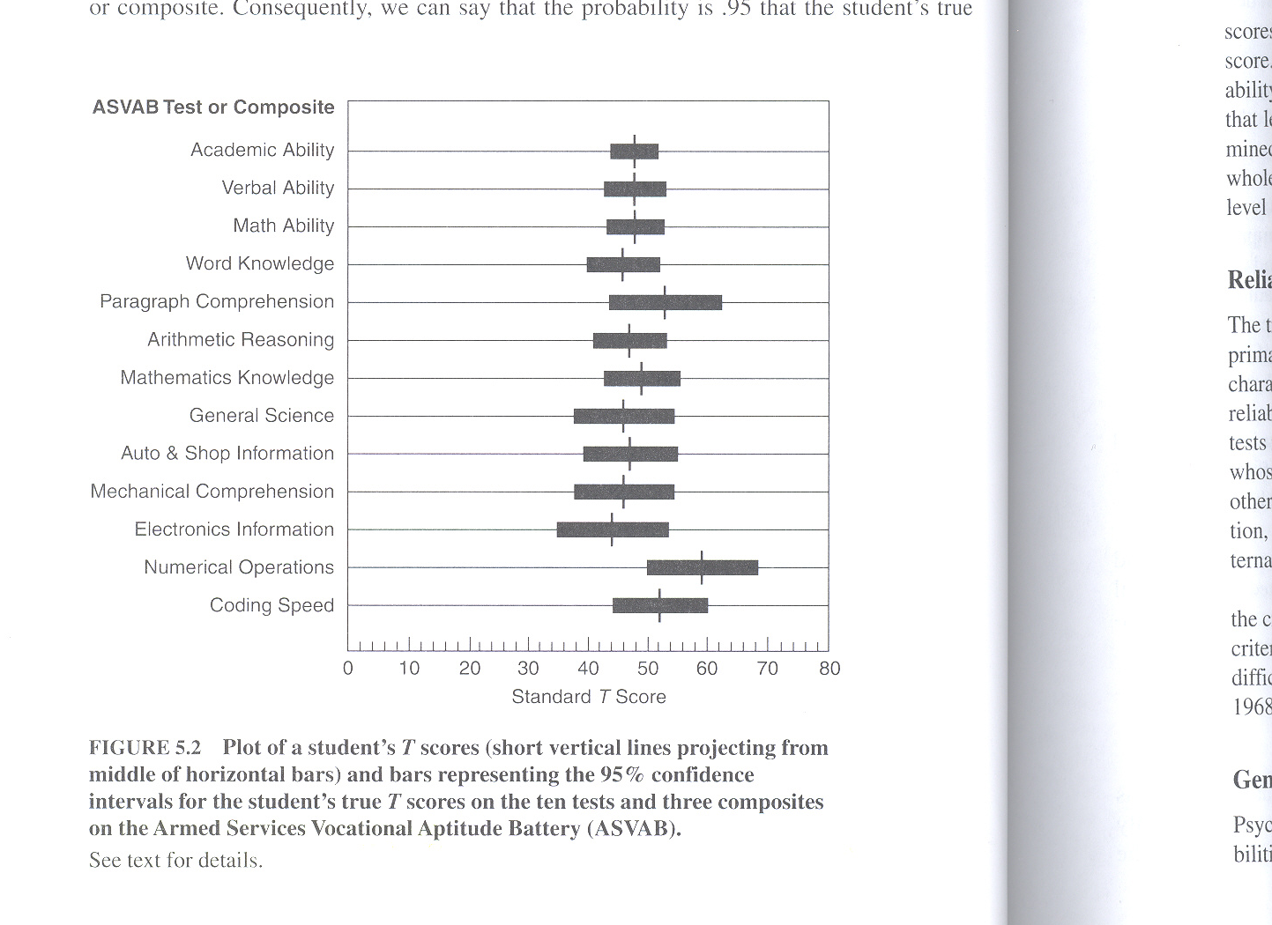

Slide 27
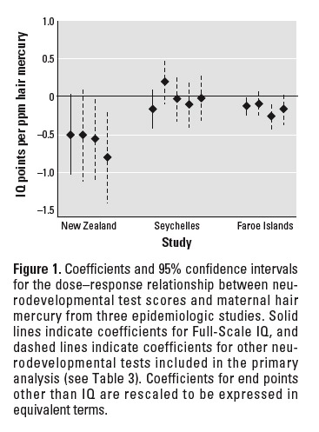

Slide 28

Would flower trivia be a reliable estimate of your ability in statistics?

Slide 29
Validity
Does the test measure what it purports to measure?
More difficult to determine than reliability
Generally involves inference
Notes:
The act of reasoning from factual knowledge or evidence.
The American Heritage Dictionary of the English Language, Third Edition is licensed from Houghton Mifflin Company. Copyright © 1992 by Houghton Mifflin Company. All rights reserved.
Selected Illustrations from the Concise Columbia Encyclopedia. Copyright © 1991 by Columbia University Press.

Slide 30
Validity
Content validity
Face validity
Criterion-related validity
Construct Validity

Slide 31
Face Validity
Does the test appear to measure what it purports to measure.
  Not essential
  May increase rapport

Slide 32
Despite the appeal it seems at face-validity levels to possess, my review at the Buros Institute of Mental Measurements website suggested the psychometrics are poor, and I decided it was not something upon which I could reasonably rely.

Slide 33
Content Validity
Does the test cover the entire range of material?
  If half the class is on correlation then half the test should be on correlation.
  Not a statistical process.
  Often involves experts
  May use a specification table

Slide 34
Specification Table

Slide 35
Criterion-related Validity
Does the test correlate with other tests, behaviors that it should correlate with?
  Concurrent
    Test administration and criterion measurement occur at the same time.
  Predictive
    The relationship between the test and some future behavior.

Slide 36
Construct Validity
Does the test’s relationship with other information conform to some theory?
The extent to which the test measures a theoretical construct.

Slide 37
Construct
An attribute that exists in theory, but is not directly observable or measurable.
  Intelligence
  Self-efficacy
  Self-esteem
  Leadership ability

Slide 38
Self-efficacy
A person’s expectations and beliefs about his or her own competence and ability to accomplish an activity or task.

Slide 39
Identify related behaviors
Identify related constructs
Behaviors related to other constructs
Construct explication

Slide 40
Test Interpretation
Criterion-referenced tests
  Tests that involve comparing an individual’s test scores to an objectively stated standard of achievement such as being able to multiply numbers.
Norm-referenced tests
  Interpretation based on norms
    Norms: a group of scores that indicate average performance of a group and the distribution of these scores

Slide 41

The End

Slide 42
Inference: The act of reasoning from factual knowledge or evidence.

